Slide 1
MOMI

Slide 2
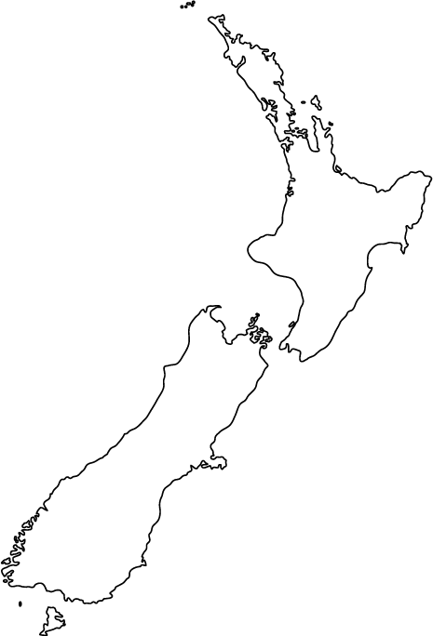



Alice
69 Years Old
Lives in Dunedin
John
43 Years Old
Lives in Auckland

Slide 3
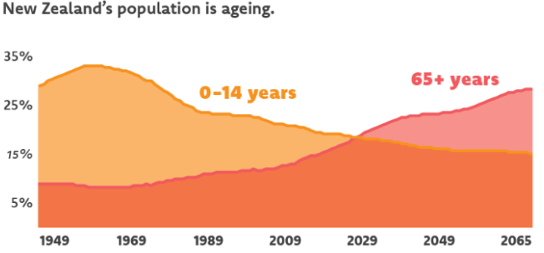
Expected population for the Elderly
Retrieved from http://www.superseniors.msd.govt.nz/about-supersenis/ageing-population/index.html

Slide 4


Testimonials
“ We could greatly benefit from getting information about how they are at all times so that we can be less stressful should something happen to them.”
“ I am very very stressed all the time now as I know that my parents are very weak and cannot look after themselves.”

Slide 5

MOMI
Looking After Your Loved Ones

Slide 6
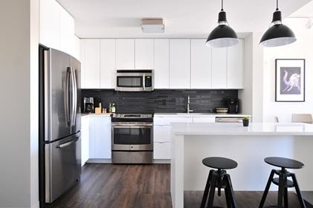



Levels of Security
Level - 1
Level - 2
Level – 3
Notes:
(BACK UP PITCH)
Level -1: Motion sensors - detect unusual activity and notify John, gives John a piece of mind.
Level -2 Audio and Thermo sensors - detect
Level -3 Visual - increases security

Slide 7
Demo

Slide 8
Existing solution/competitors
Product | Motion Sensor | Visual Picture | Relatives Notification | Thermal Sensor
AbiBird | ✓ | Χ | ✓ | Χ
CCTV | ✓ | ✓ | Χ | Χ
MOMI | ✓ | ✓ | ✓ | ✓
Notes:
Abibird: What they do and why our products are better than theirs.

Slide 9
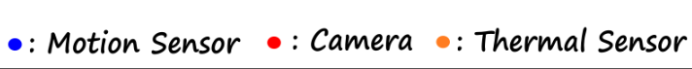
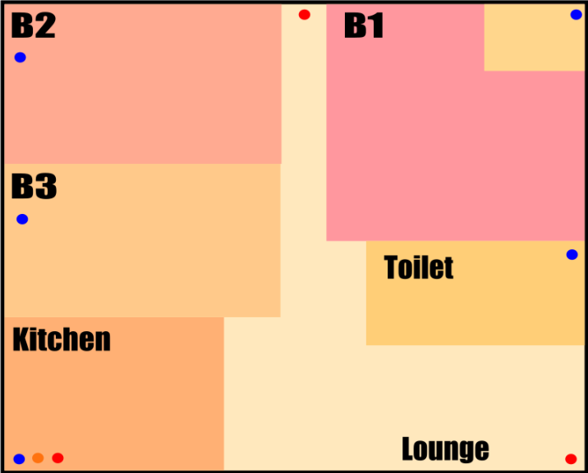
3 Bedroom House

Slide 10
Business Model
Level of Service | Equipment Cost for a 3 bedroom house (NZ$) | Price to customer (NZ$ per month) | Estimated customers(%) | Estimate customer in first year after launch (people)
Level 1 | 60 | 20 | 60 | 12,000
Level 2 | 75 | 30 | 30 | 6,000
Level 3 | 620 | 65 | 10 | 2,000
Revenue : NZD$ 550,000 per month
Equipment Costs: NZD$ 2,410,000 (One-Time)
Break Even - 5 months

Slide 11
Timeline

Slide 12
Past 48 Hours
3 months from now
48 Hours
Users Validation
App testing
Sensor testing
Business Model
First sale
Market Validation
First group of testing use

Slide 13
The next 6 months
Billions of Dollars
Potential Upgrades
Testimonials and Feedback
Partnerships with retirement homes

Slide 14
Any Questions?

Slide 15
MOMI
A 21st Century Mother

Slide 16
<Technology/>
API Gateway
User Service
User Database
Mobile Client
REST API
REST API
Notification Service
Payment
Service
Sensor Hub
REST API
Sensor
Service
Sensor Database
Notes:
EC2
Stacks:
Frontends
React, React Native, Styled-components,
Backends
Node.js, Express.js, MySQL, Strip

Slide 17
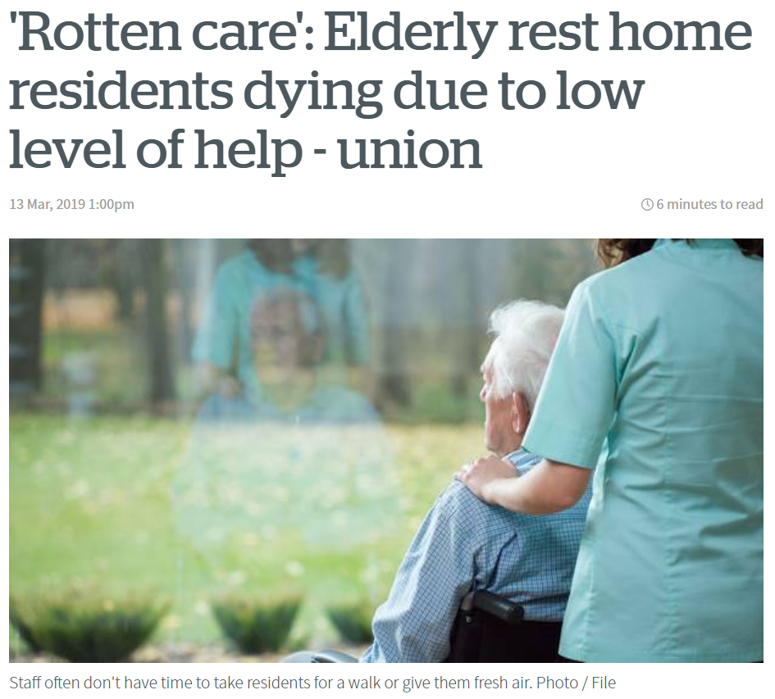
Market Validation: News Article
Notes:
Shortage of caregivers. Currently an issue.
Injuries increases.
“... Elderly living in rest homes are getting around six minutes of care an hour and unions are warning some residents are dying as a result. ” @ New Zealand Herald
Their child of the elderly…. Wants…. Parents ….. Environment to be comfortable
That quality of care (As a result)… can discourage their children (like John Smith) to NOT send their parents to rest homes.

Slide 18
2013 census for the elderly: In detail.
Population of the elderly in the 2013 census: close to 15% (607,032 people)
Elderly that are in residential homes: Around 5% (31,899 people)
Elderly that are independent in their homes: close to 95% (575133 people)
Elderly that are independently living in their own home: close to 30% (156200 people)
Notes:
The population of the elderly in NZ in the 2013 census was 607,032. From those 607,032 elderly people, 5.3% are in residential homes. This means out of 94.7% that lives in a home, close to 30% of them, who were aged 65 and over of them are living alone. Which can be potential customers because it’s increasing.
Shorten version:
The population of the elderly in NZ in the 2013 census was 607,032. Close to 30% of them, who were aged 65 and over of them are living alone. Which can be potential customers because it’s increasing.
By 2038, it is estimated to grow by double the population it currently had. This means it’s likely the product can be released into the market.

Slide 19
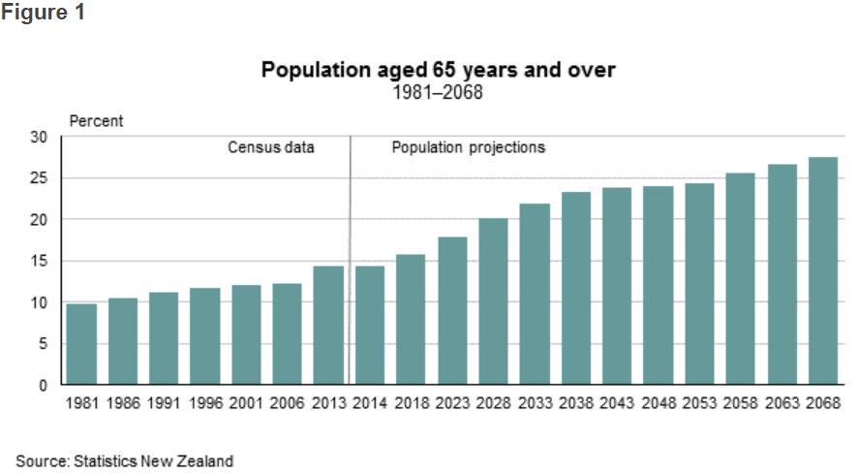
Market validation: 2013 census

Slide 20
Testimonials continued.
“They do not want to go to a retirement home as they are extremely familiar of their surroundings.”
“It has been extremely stressful for our family who are all not in the geographical vicinity of my mom and dad.”
“Recently their long-term neighbours who kept a close eye on them have also migrated to Australia and my parents feel very exposed, unsecure and extremely unsafe. As a result my stress levels have gone up exponentially.”

Slide 21
References
http://archive.stats.govt.nz/browse_for_stats/population/census_counts/2013CensusUsuallyResidentPopulationCounts_HOTP2013Census.aspx
http://archive.stats.govt.nz/Census/2013-census/profile-and-summary-reports/outside-norm/residential-old.aspx
http://archive.stats.govt.nz/Census/2013-census/profile-and-summary-reports/quickstats-65-plus/population-overview.aspx

