Slide 1
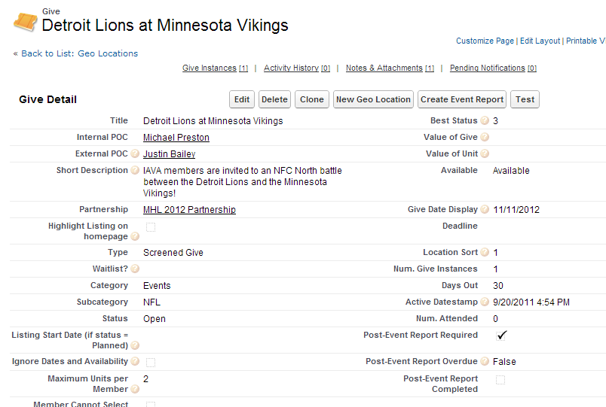
Salesforce Post-Event Report
Some Details:
Button exists on Gives, Campaigns, and Activities
Report Required – On by default for gives, off by default on Campaigns
Report Overdue – Calculated by Start Date, Required, and Completed checkboxes – to feed reports on all overdue reports
“Create Event Report” Button launches Event Report

Slide 2
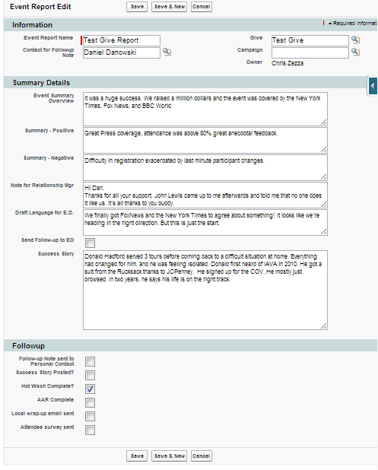
Report Name automatically generated
External POC pulled from parent record
When “Send Follow-up to EO” is checked, an email is sent to the EO containing the “Draft Language for E.D.”

Slide 3
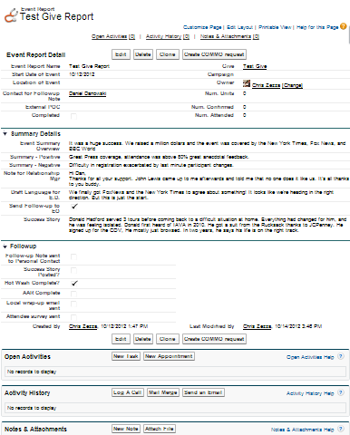
Once saved:
Num. Units, Num. Confirmed, and Num. Attended pulled from Parent record
Attachments can be added
Activities can be associated
“Create COMMO Request” button for any mass email, facebook or twitter post that is needed.
Completed checkbox automatically checks “Post-Event Report Completed” checkbox on associated Campaign or Give

Slide 4
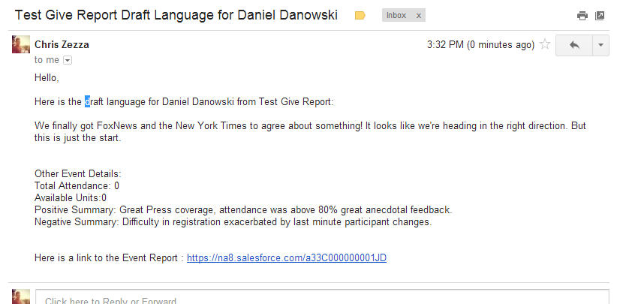
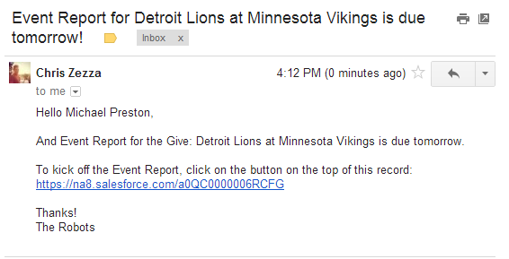
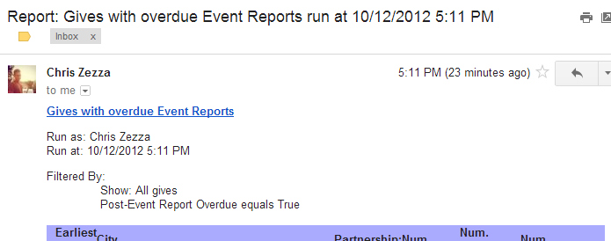
Notifications and Tracking
Draft Language is sent to ED when selected
COMMO is notified when COMMO case is created
Event Manager emailed when Report Due Date is near
Event Manager and whoever else is emailed when Report becomes overdue
Weekly report on Event Reports completed, overdue give reports, and overdue Campaign reports are sent to EO
List Views available at any time to see recently completed reports or overdue

