Slide 1
Etch-a-Sketch on SH1106 OLED
Microcontroller-based graphics system
Samuel Dinerman
ECE 3411 – Microprocessor Applications Laboratory
04/04/26
Notes:
This project implements an interactive Etch A Sketch using an SH1106 OLED display and analog inputs, focusing on low-level display control and embedded graphics.

Slide 2
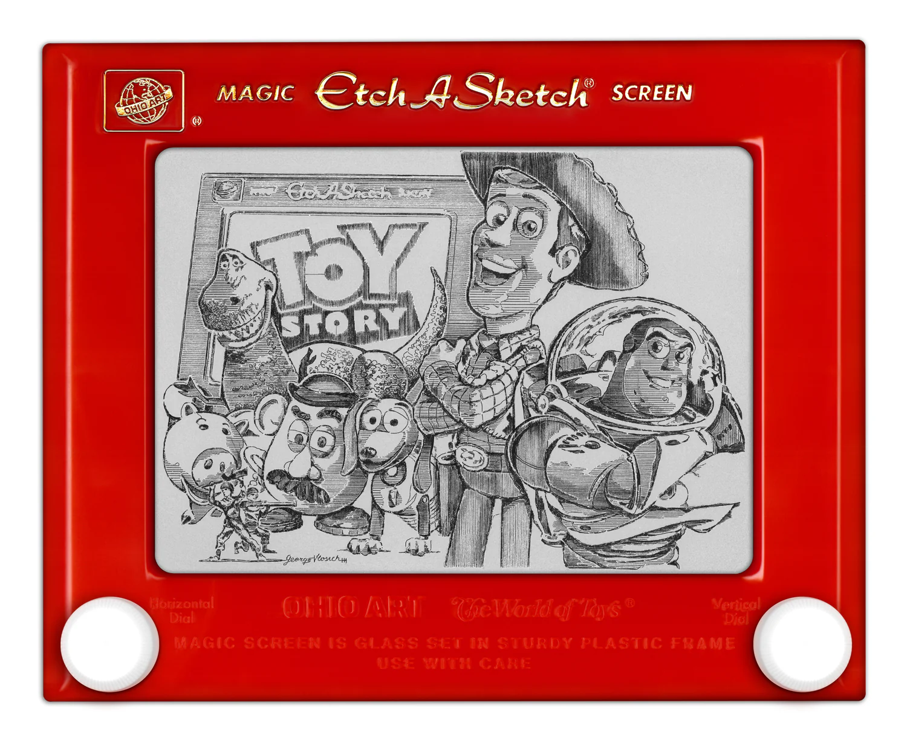
What is it?
An Etch A Sketch has a thick, flat gray screen in a red plastic frame. There are two white knobs on the front of the frame in the lower corners. Twisting the knobs moves a stylus that displaces aluminum powder on the back of the screen, leaving a solid line. The knobs create lineographic images. The left control moves the stylus horizontally, and the right one moves it vertically.
https://en.wikipedia.org/wiki/Etch_A_Sketch
Credit: https://gvartwork.com/pages/etch-a-sketch

Slide 3
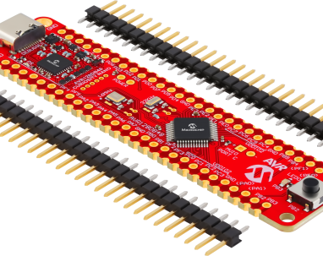
Will it run on AVR?
Over the course of the Spring 2026 semester we have become familiarized with the capabilities of the AVR128DB microcontroller
Can we recreate a classic mechanical drawing toy using a microcontroller and hardware control?
We can imagine that potentiometers could replace the knobs and an OLED display could replace the mechanical drawing space

Slide 4
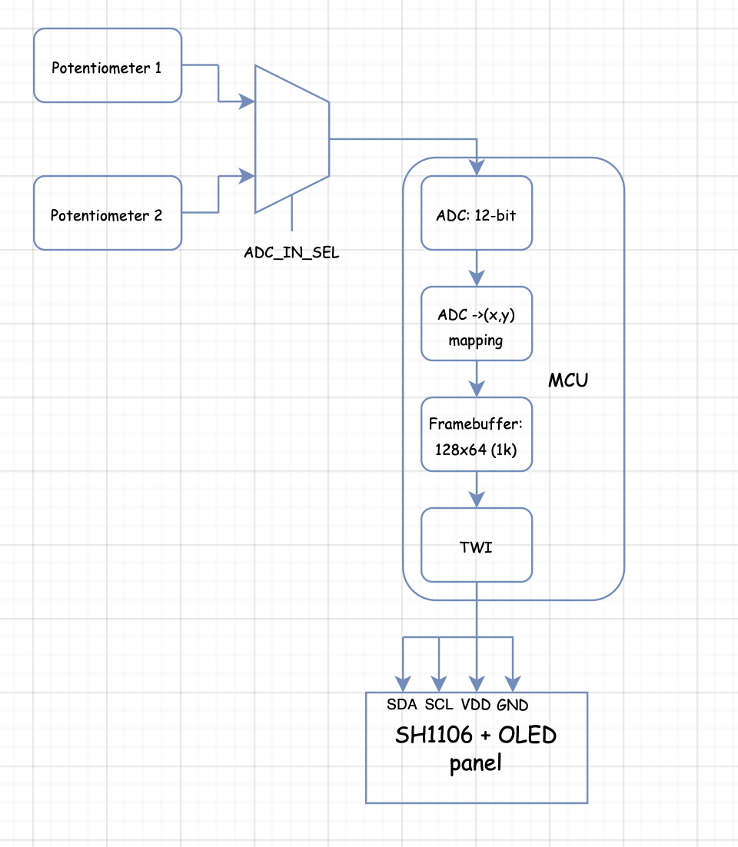
System Overview
Two potentiometers must share a single ADC, so inputs are multiplexed and sampled sequentially.
The digital values are mapped to screen coordinates, stored in a frame buffer, and transmitted over TWI to the SH1106 controller.

Slide 5
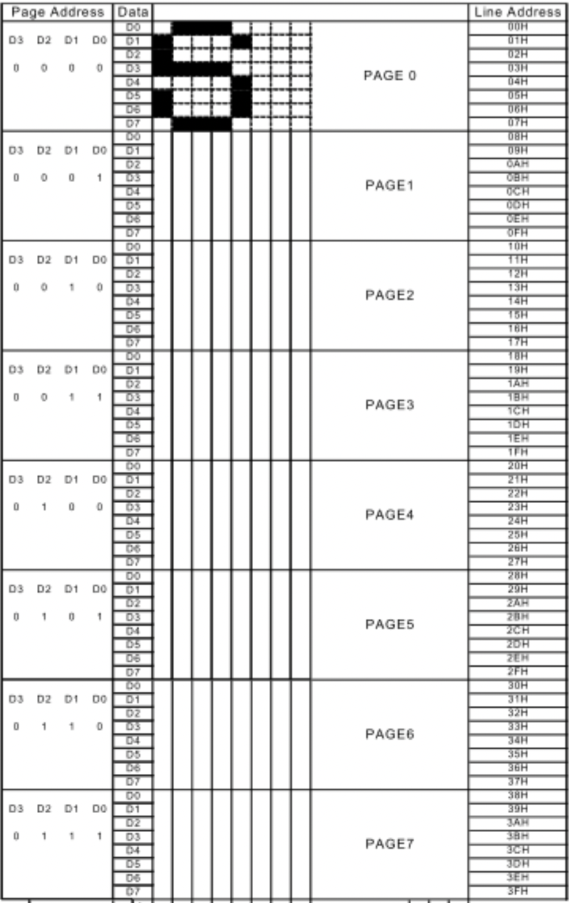
Display Addressing
The display is divided into 8 pages, each 8 pixels tall
Each column stores 1 byte representing 8 vertical pixels
Writing a byte fills a vertical column within the selected page
The column address auto-increments after each write

Slide 6
Drawing software ideas
Since we are writing 8 pixels at a time, and columns auto increment, a display buffer is an appropriate way to store pixel data.
We keep a software copy of the display, modify this buffer then scan the display to update it, page-by-page, column-by-column.

Slide 7
Drawing Software implementation
***Will fill in with the appropriate functions***

Slide 8
“Hello World”
The technique works, but there is a problem… the ADC’s change quicker than the display updates, yielding choppy lines where we want solid lines

Slide 9
Bresenham’s Line Algorithm
I discussed my problem with a mystic (ChatGPT), and it was revealed that my problems could be solved with earler computer graphics algorithms
Basically, *** fill in high level description of the algorithm***
***Paste implementation to the right***
https://www.geeksforgeeks.org/dsa/bresenhams-line-generation-algorithm/

Slide 10
Stay in line
At this point all basic plotting apis have been implemented and we have a working canvas
We do need to be able to clear our canvas

Slide 11
A clean slate
A button was added to clear the display buffer
Perhaps in the future a gyroscope will be added for a more tried and true, fun way to shake-to-clear

Slide 12
Continuous Improvement
Drawing on this toy is fun for about 5 minutes, but it is setup as a basic sandbox for a multitude of classic games and toys
Going forward, classic games like snake and pong, or mesmerizing widgets like a space screen saver or Conway’s Game of Life can be added to a library of applications

