Slide 1

Student Mental Health Analysis Research Project
School of Computer Science and Engineering
Department of Computer Science and Engineering
Submitted By:
Samarth Varshney
2427030064
Supervised By:
Dr. Onkar Singh

Slide 2
Outline
Introduction
Literature Review
Problem Statement
Proposed Solution
Objectives
Results

Slide 3
Introduction
Mental health is a critical factor affecting students’ academic performance and overall well-being.
College students often face academic pressure, workload, and lifestyle challenges.
These factors can lead to mental health issues such as stress, anxiety, and depression.
Data analysis helps identify patterns and relationships in student mental health data.

Slide 4
Introduction Contd…
Understanding mental health trends helps institutions provide better support.
Data analytics enables visualization and statistical understanding of mental health factors.
This project analyzes student mental health using survey-based data.
The goal is to identify key factors affecting student mental well-being.

Slide 5
Literature Review
Many studies show academic stress is a major cause of mental health issues.
Research indicates sleep deprivation negatively affects mental health.
Students with high workload show higher anxiety levels.
Mental health awareness is increasing in educational institutions.

Slide 6
Literature Review Contd…
Survey-based analysis is widely used in mental health research.
Data analytics tools help identify patterns and correlations.
Visualization techniques improve understanding of mental health trends.
Early identification can help prevent severe mental health problems.

Slide 7
Problem Statement
College students experience mental health issues due to academic and lifestyle factors. This project analyzes student mental health data to identify patterns and contributing factors.

Slide 8
Objectives
To analyze student mental health using data analytics techniques
To identify patterns in depression and anxiety among students
To study the relationship between academic performance and mental health
To visualize mental health data for better understanding

Slide 9
Proposed Methodology (Data Collection)
Step 1: Data Collection
Dataset obtained from Kaggle
Dataset contains student mental health survey responses
Includes gender, CGPA, depression, anxiety, and treatment data

Slide 10
Proposed Methodology (Data Preprocessing)
Step 2: Data Preprocessing
Load dataset using Python
Check for missing values
Clean and prepare data
Select relevant columns

Slide 11
Proposed Methodology (Data Analysis)
Step 3: Data Analysis
Perform statistical analysis
Analyze distribution of mental health conditions
Identify patterns and relationships

Slide 12
Proposed Methodology (Visualization)
Step 4: Data Visualization
Create graphs using Matplotlib and Seaborn
Gender distribution analysis
Depression and anxiety analysis
Correlation analysis

Slide 13
Methodology Chart
Data Collection
↓
Data Cleaning
↓
Data Analysis
↓
Data Visualization
↓
Result Interpretation
↓
Conclusion

Slide 14
Result (Table)
Mental Health Condition | Number of Students
Depression (Yes) | 35
Depression (No) | 65
Anxiety (Yes) | 40
Anxiety (No) | 60

Slide 15
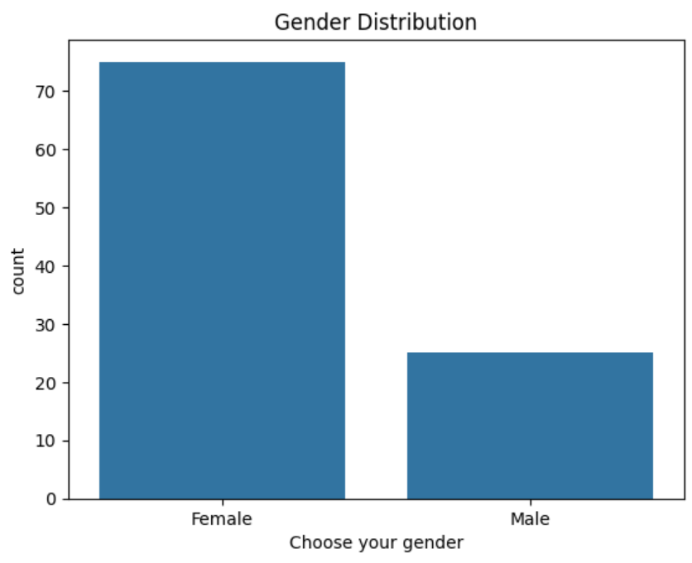
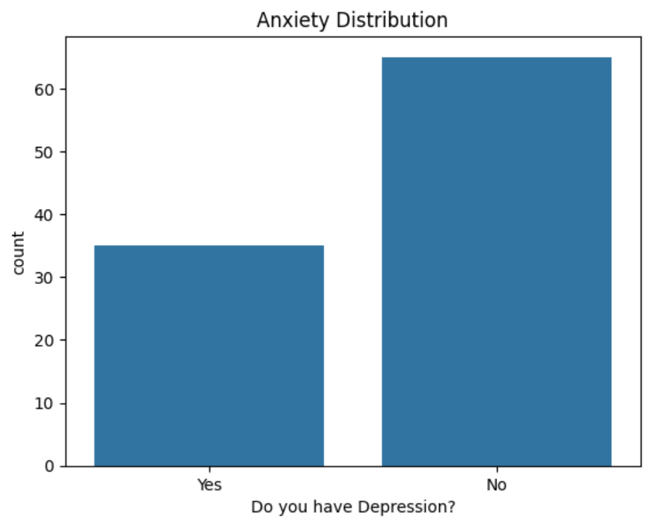
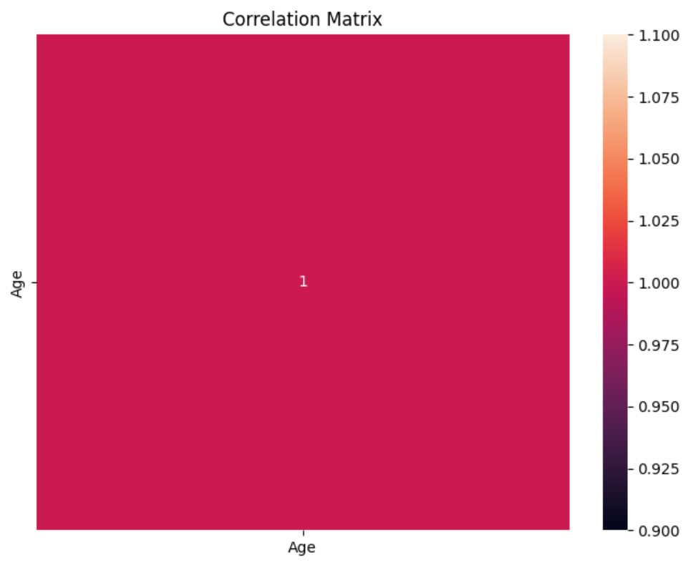
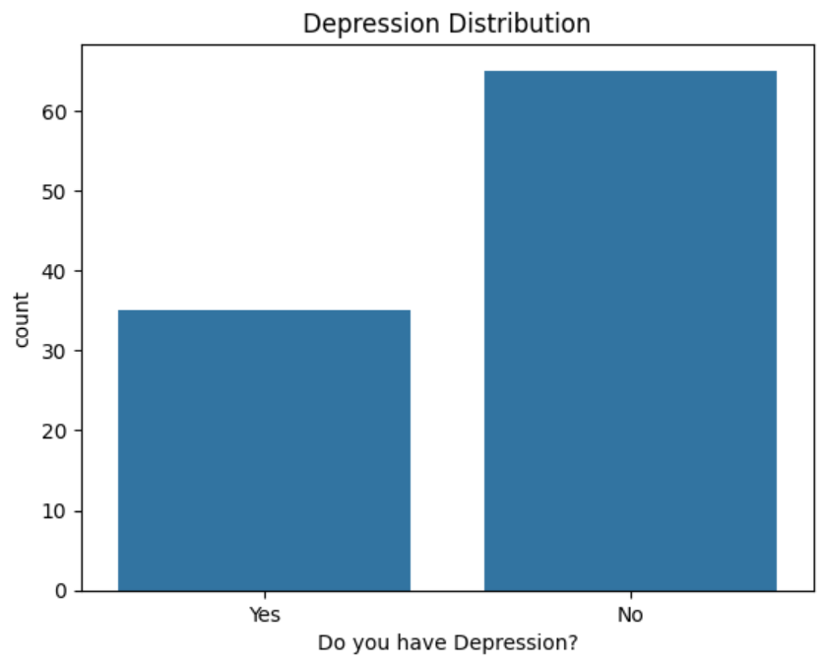

Result (Graphs)

Slide 16
Outcome
Successfully analyzed student mental health dataset
Identified patterns in depression and anxiety
Visualized mental health trends using graphs
Gained insights into factors affecting student mental health
Demonstrated use of data analytics in real-world problems

Slide 17
References
Kaggle – Student Mental Health Dataset
Python Documentation
Pandas Documentation
Seaborn Documentation
Matplotlib Documentation

Slide 18
Thank You

