Slide 1
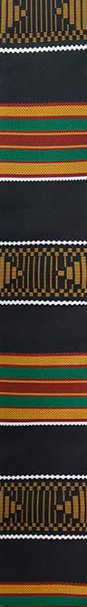
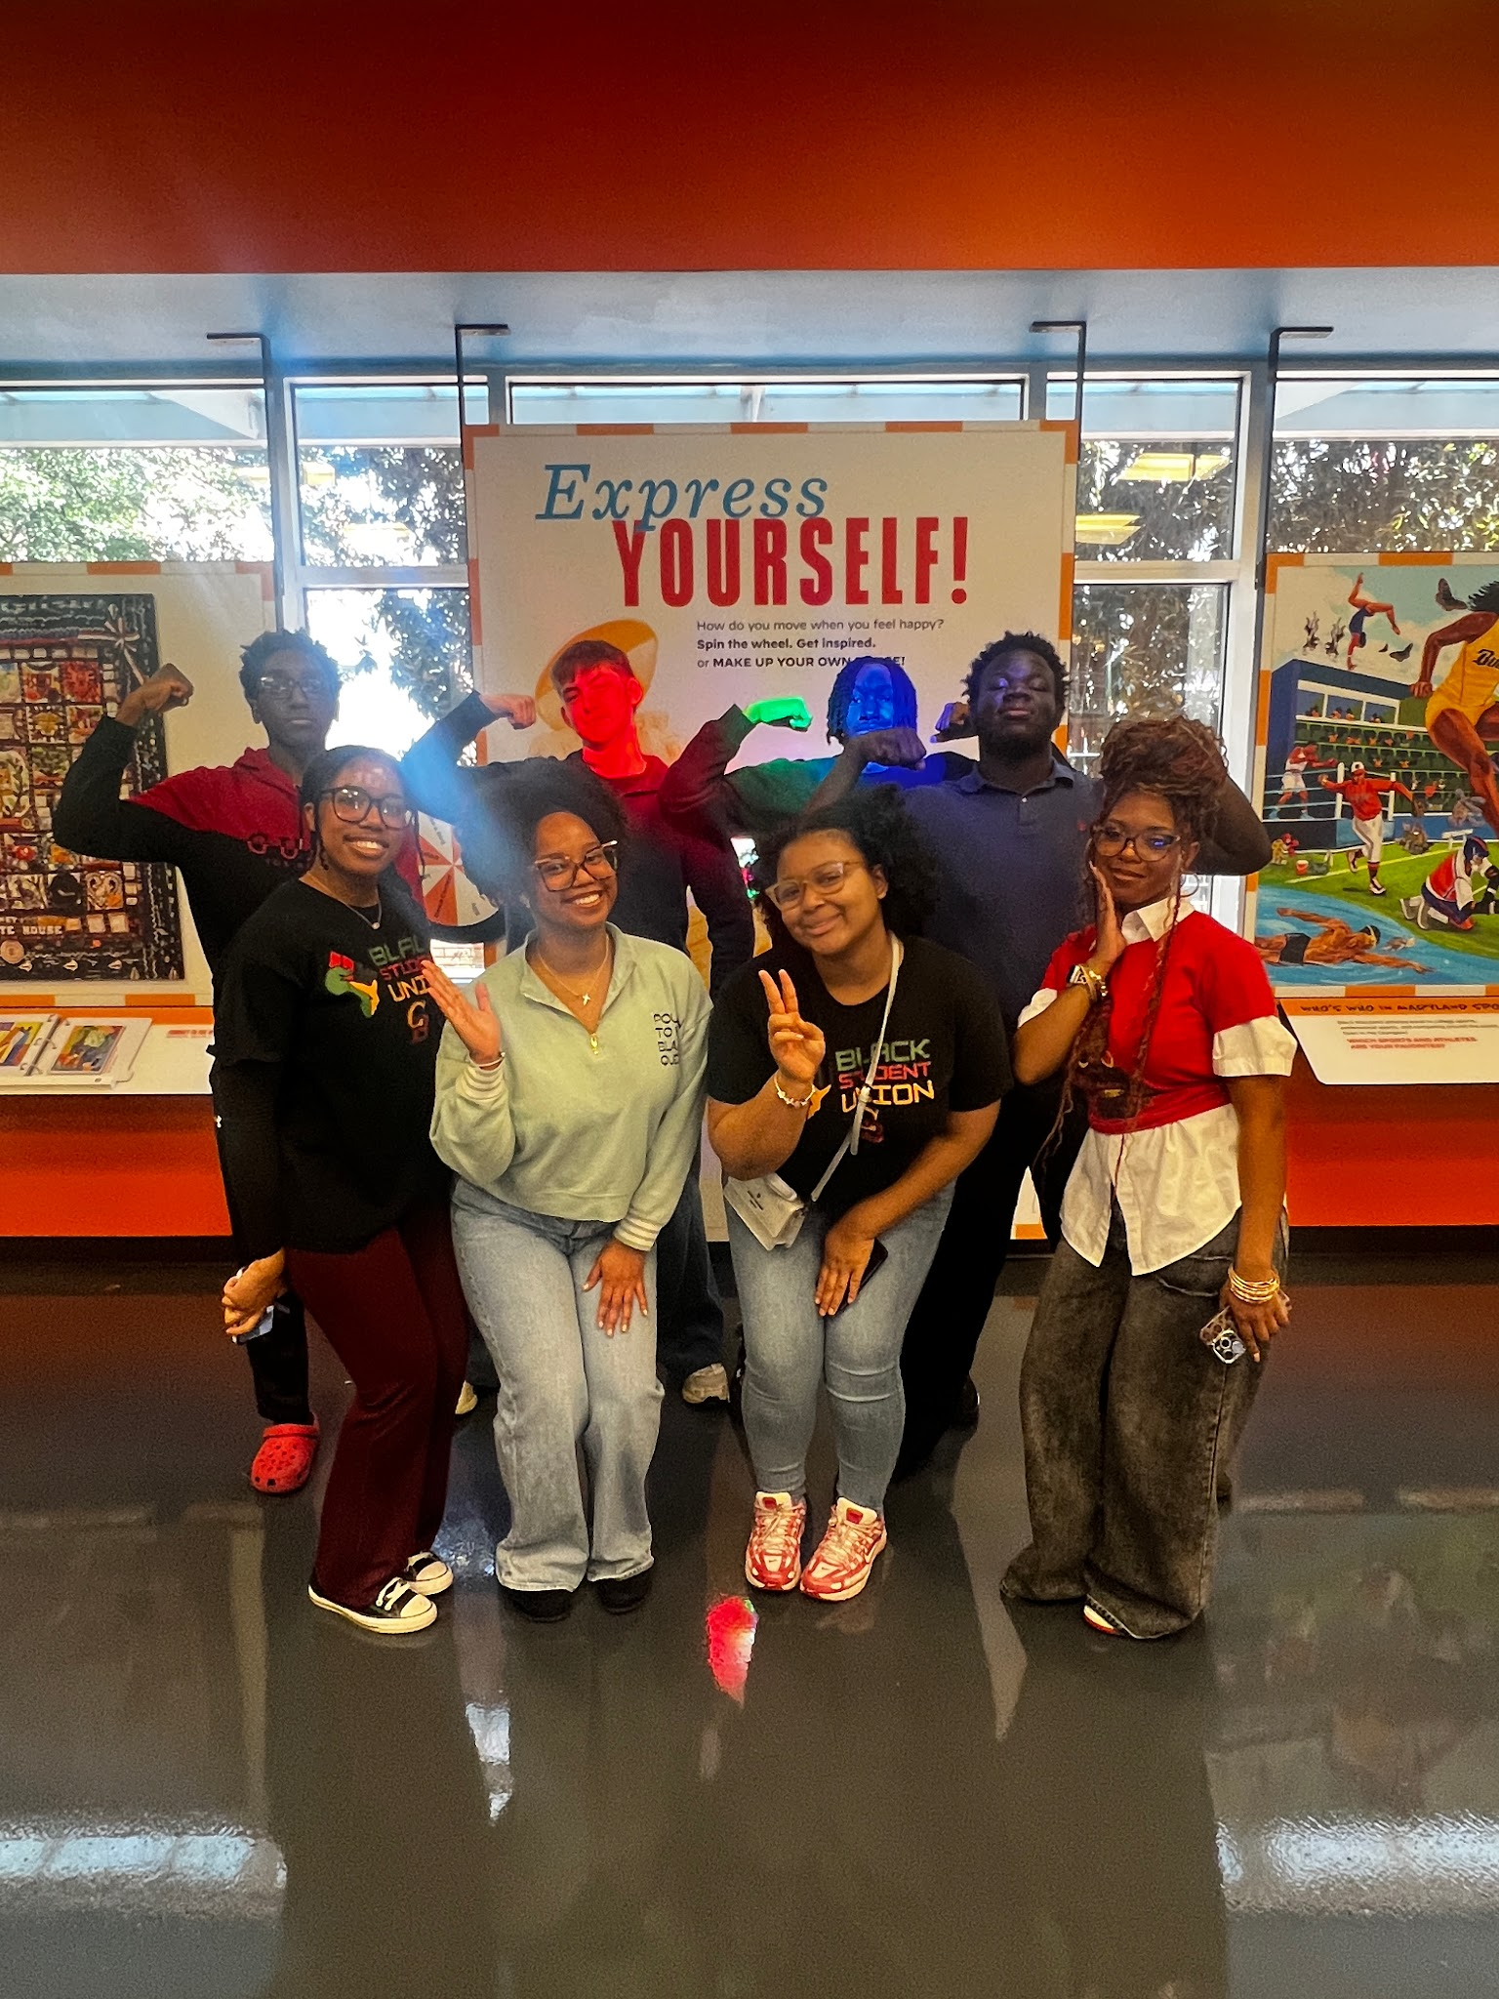

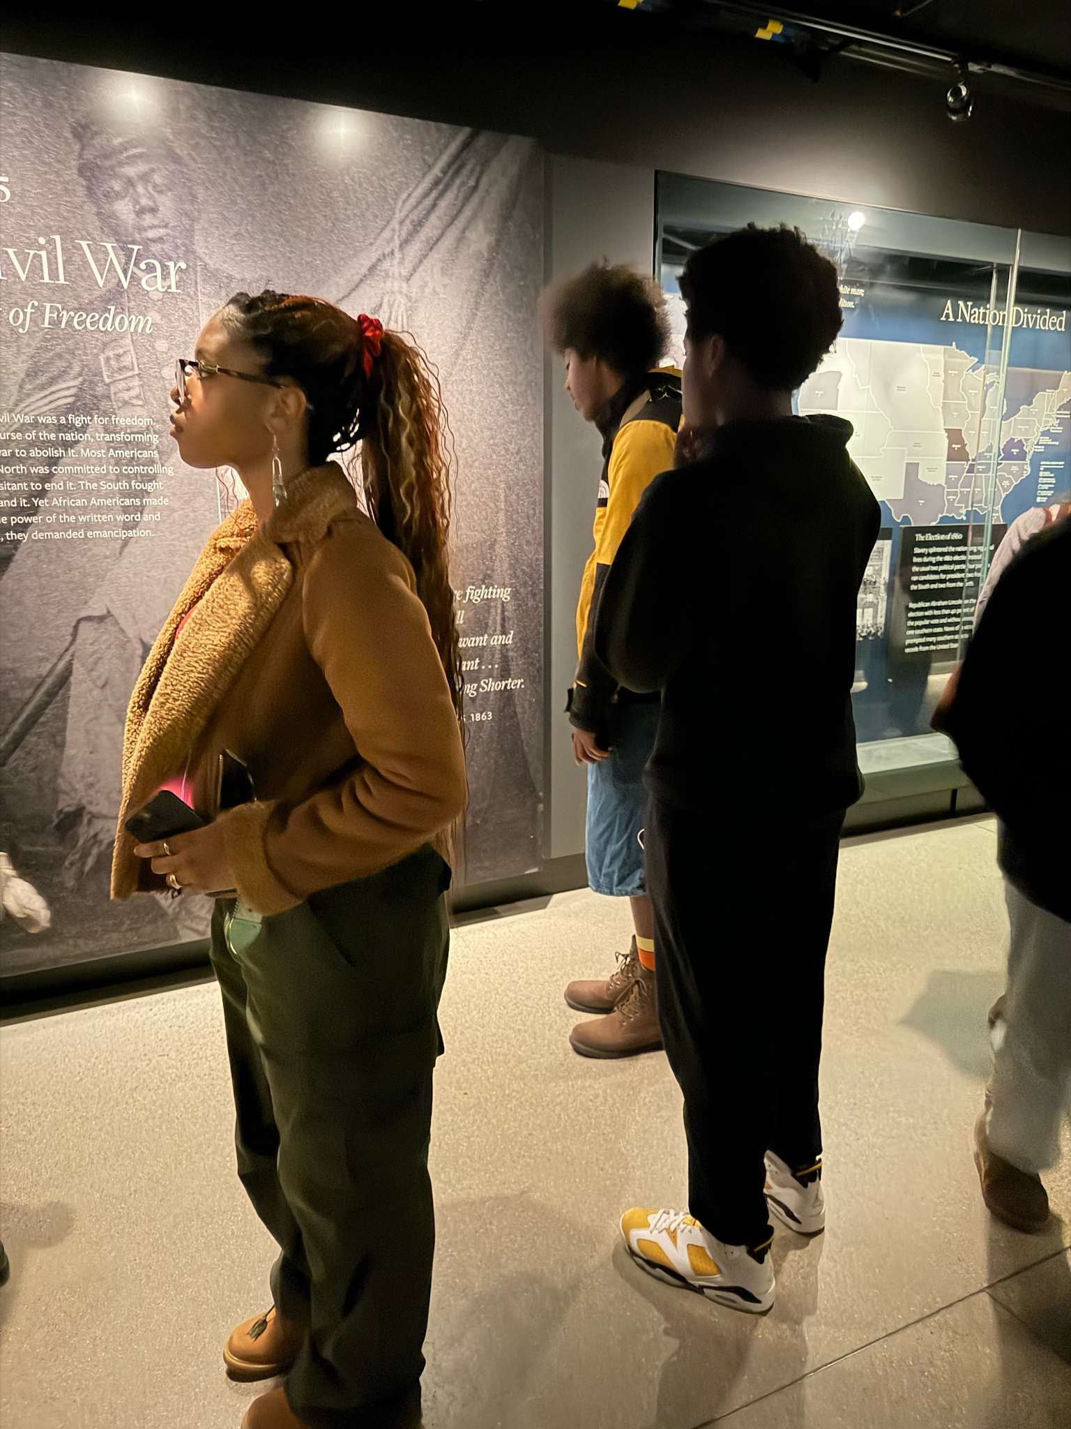
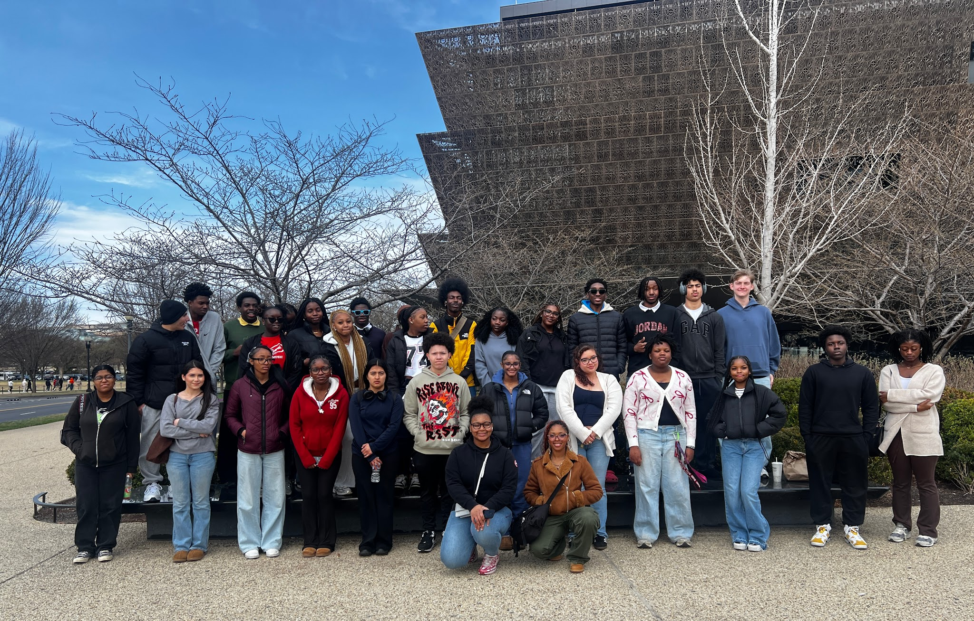
Black
Student Union

Slide 2
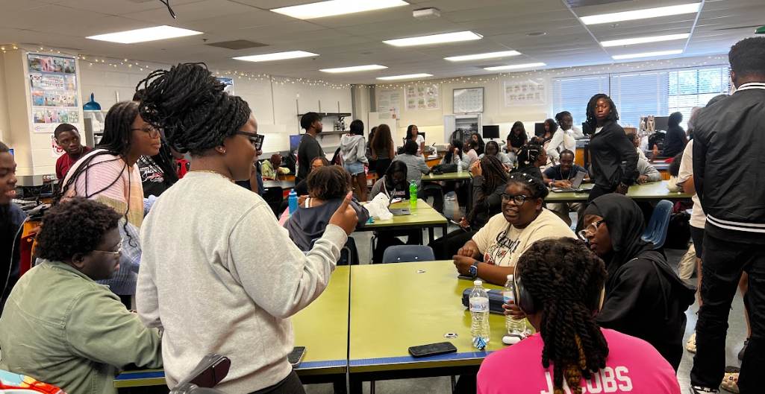
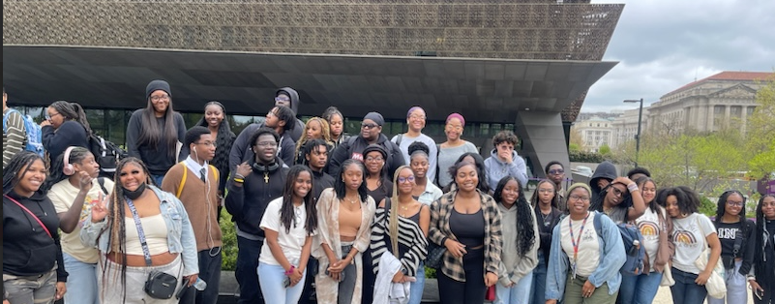
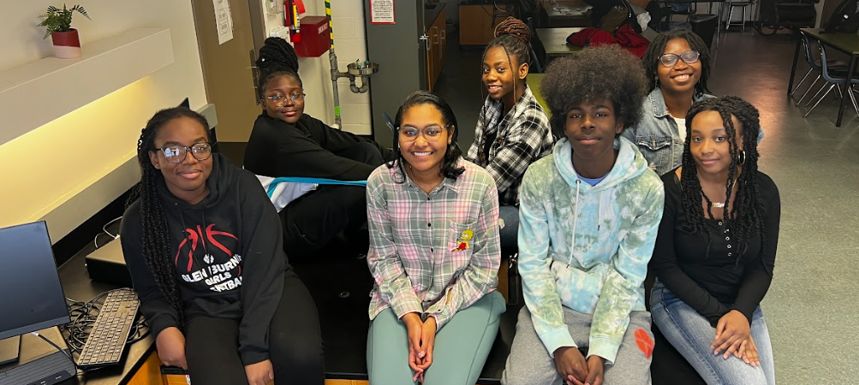
Welcome to GB’s Black Student Union
Advisors:
Ms. Azike, Mr. Gibson & Dr. Prince-Torain
Senior President:
Henry Nwobodo
Senior Vice President:
Sam Ogunnubi

Slide 3

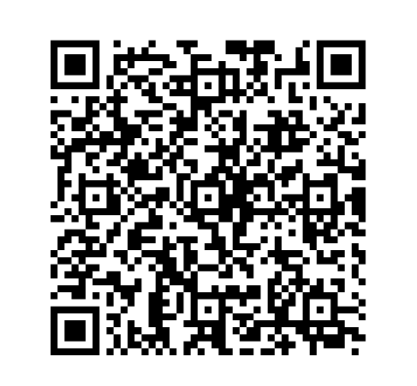
The Black Student Union
Attendance
Welcome!
Please find a seat, take a moment to complete the attendance for today’s meeting.

Slide 4
What is BSU & What Do We Do?
WHAT IS BSU?
Highlighting Black Excellence & Culture
BSU is where we come together to highlight Black excellence. At the end of the day, we wanted this space to grow as a community and support each other in Black culture.
Whether you are a freshman or a senior, this is your family and your support network at Glen Burnie.
WHAT WE DO
Real Experiences, Tours & Leadership
• College Field Trips: Touring HBCUs & Black historical museums • Annual HBCU College Fair: Connecting our upcoming juniors with colleges • Black History Spirit Week & Cultural Potluck • Study Jams, finals cocoa prep, and giving back to our community

Slide 5
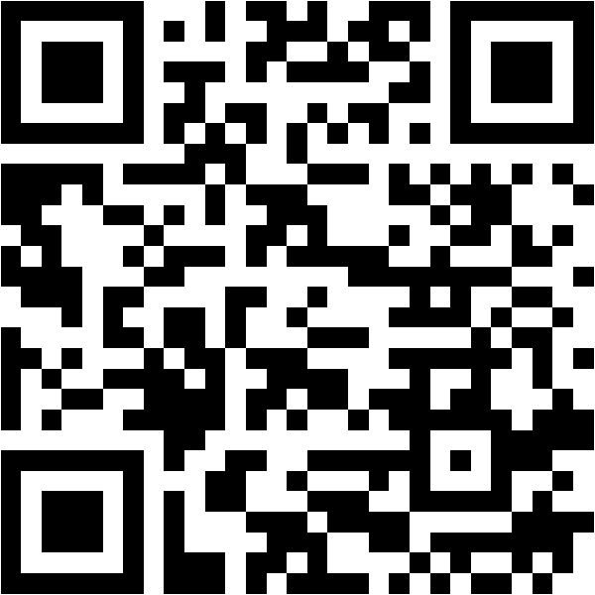
Field Trips: Putting Your Ideas Into Reality!
Where Do YOU Want to Go?
The main things we’ve done have been our field trips! We’ve visited HBCUs and Black historical museums. Every year, we host an HBCU College Fair highlighting historical colleges for our upcoming juniors.
We want YOUR help deciding where we go this year. If there are any campuses, museums, or places you want to visit, scan the QR code so we can put your ideas into reality!
FIELD TRIP SURVEY
Scan to submit your trip ideas!

Slide 6
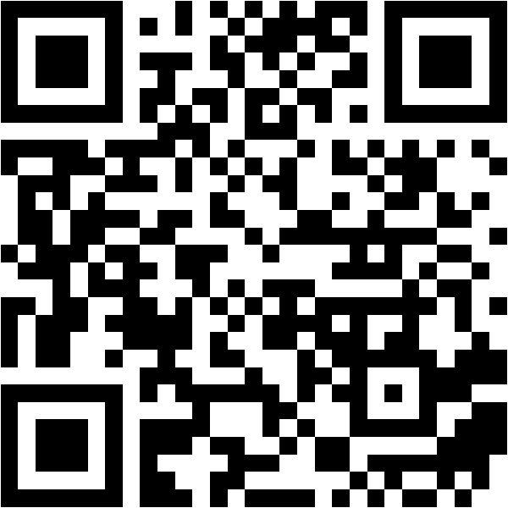
Join the Executive Board (No Campaigning!)
A New Year = A New Executive Board
It’s a brand new year, meaning a new Executive Board! This year, we are NOT doing stressful campaigning or public speeches—we’re doing a simple Google Form.
If anyone is interested in getting a leadership role or joining a committee (Social Media, Events, Service), scan the QR code and fill out the form.
⚡ Our advisors will review all submissions and announce decisions by NEXT MEETING!
APPLY FOR E-BOARD
Scan to apply for board & roles!

Slide 7

Keeping up with BSU
Join the groupme!
All Updates will be sent in here so make sure you have joined.

Slide 8
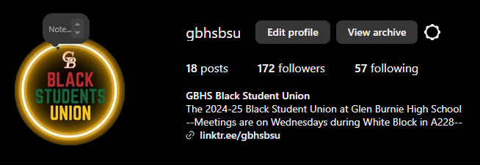
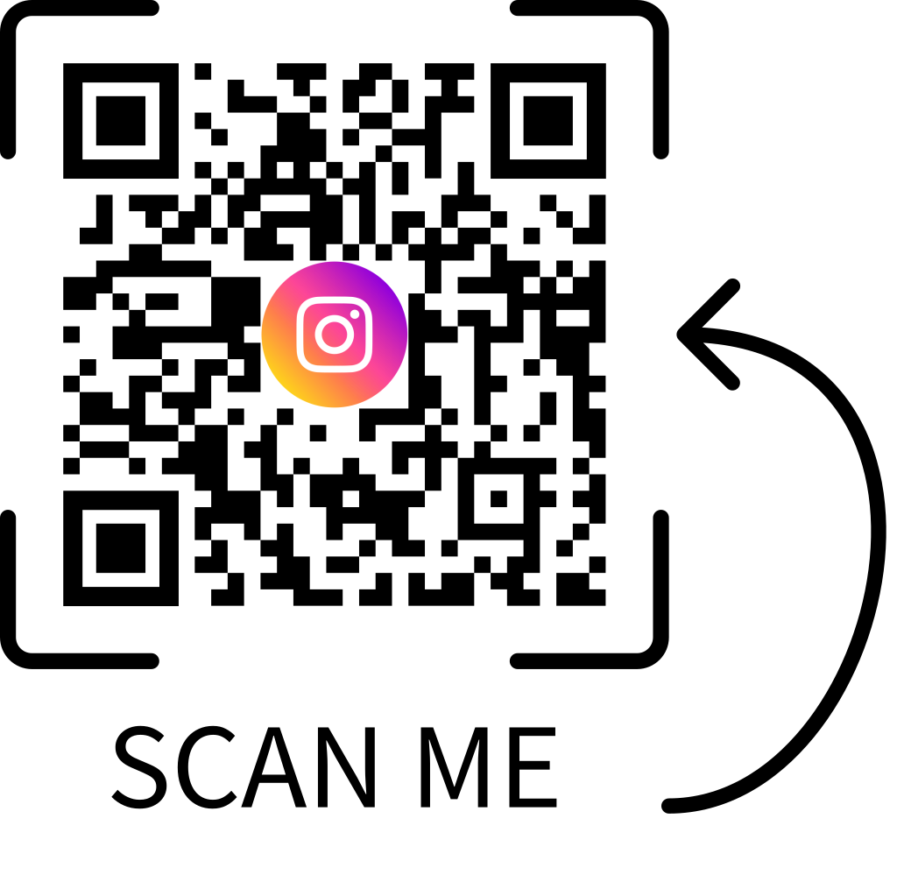
✨Follow our instagram to stay updated on upcoming meeting, & events
ALSO follow us on instagram @gbhsbsu

Slide 9
The Real Vibe: Chill, Fun & Games!
Apologies for the 'Information Bomb' Today!
We know meeting #1 is packed with slides, links, forms, and announcements. We had to get all the important logistics out of the way!
BUT PLEASE REMEMBER: BSU is a CHILL space.
• We play trivia, board games, cards, and video games • We eat great snacks and music is always playing • We unwind, talk about real topics, laugh, and celebrate each other • No homework stress, no stiff lectures—just good energy and genuine community!

Slide 10
THANK YOU FOR COMING!

