Slide 1
Blockchain attack events

Slide 2
Part 1:Ethereum Solidity

Slide 3
常见solidity 漏洞类型：
Reentrancy - 重入
Access Control - 访问控制
Arithmetic Issues - 算术问题（整数上下溢出）
Unchecked Return Values For Low Level Calls - 未严格判断不安全函数调用返回值
Denial of Service - 拒绝服务
Bad Randomness - 可预测的随机处理
Front Running
Time manipulation
Short Address Attack - 短地址攻击
Unknown Unknowns - 其他未知
http://rickgray.me/2018/05/17/ethereum-smart-contracts-vulnerabilites-review/
https://www.dasp.co/

Slide 4
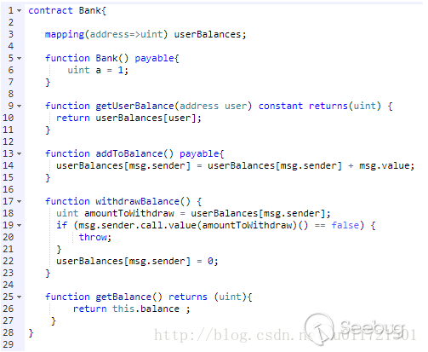
1.Reentrancy
DAO attack on ETH
TWO ways to send ETH
1. use send : msg.sender.send(100)
2. use message call: msg.sender.call.value(100)()
It's recommended to use send instead of call. You only have 2300 gas for send. It will throw out exception after
it's used out. But for call, you will have enough gas.
Attack process:
1.Attacker send 10 wei to account using addTobalance
2.Attacker call withdrawBalance
3.The fallback function will get called in the attacker
4. The attacker call withdraw function in the fallback
again and again
5. The attacker get the money
https://paper.seebug.org/544/

Slide 5
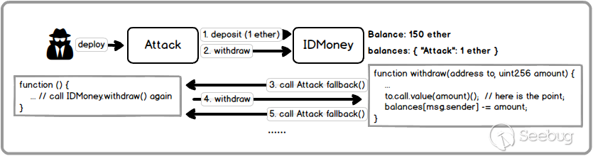

Slide 6
2.Acess Control
contract Delegation {
address public owner;
Delegate delegate;
function Delegation(address _delegateAddress) {
delegate = Delegate(_delegateAddress);
owner = msg.sender;
}
function () {
if (delegate.delegatecall(msg.data)) {
this;
}
}
}
OpenZeppelin CTF
pragma solidity ^0.4.10;
contract Delegate {
address public owner;
function Delegate(address _owner) {
owner = _owner;
}
function pwn() {
owner = msg.sender;
}
}
The address of pwn()
bytes4(keccak256("pwn()"))

Slide 7
2.Acess Control
1.public 标记函数或变量可以被任何账户调用或获取，可以是合约里的函数、外部用户
或继承该合约里的函数
2.external 标记的函数只能从外部访问，不能被合约里的函数直接调用，但可以使用 this.func()
外部调用的方式调用该函数
3.private 标记的函数或变量只能在本合约中使用（注：这里的限制只是在代码层面，以太坊是公
链，任何人都能直接从链上获取合约的状态信息）
4.internal 一般用在合约继承中，父合约中被标记成 internal 状态变量或函数可供子合约进行直
接访问和调用（外部无法直接获取和调用）

Slide 8
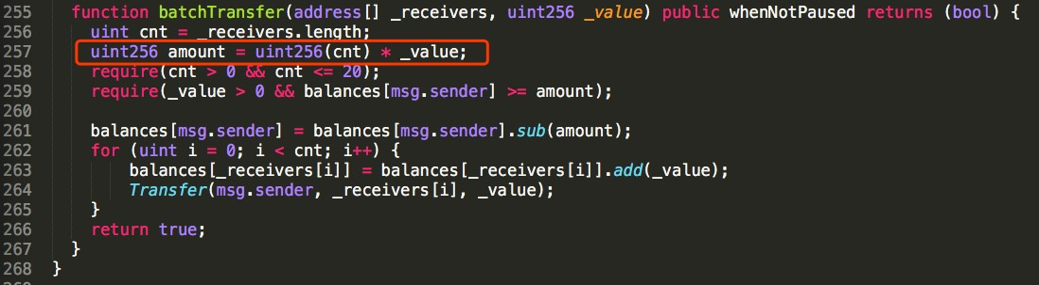
3.Arithmetic Issues
batchoverflow
ERC20
https://blog.peckshield.com/2018/04/22/batchOverflow/

Slide 9
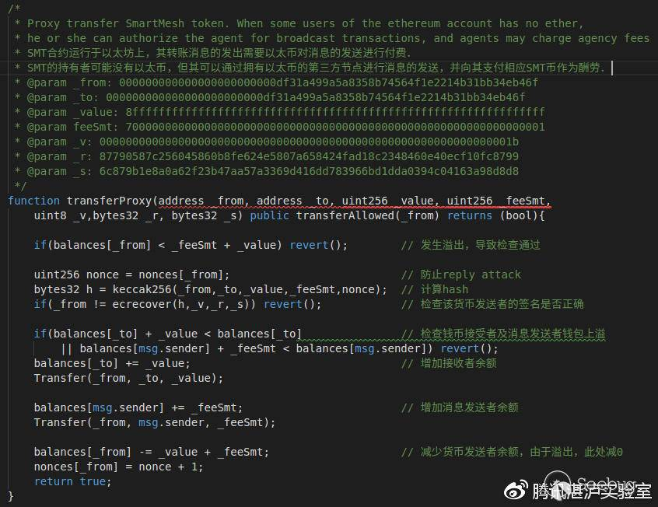
SMT Interger overflow

Slide 10
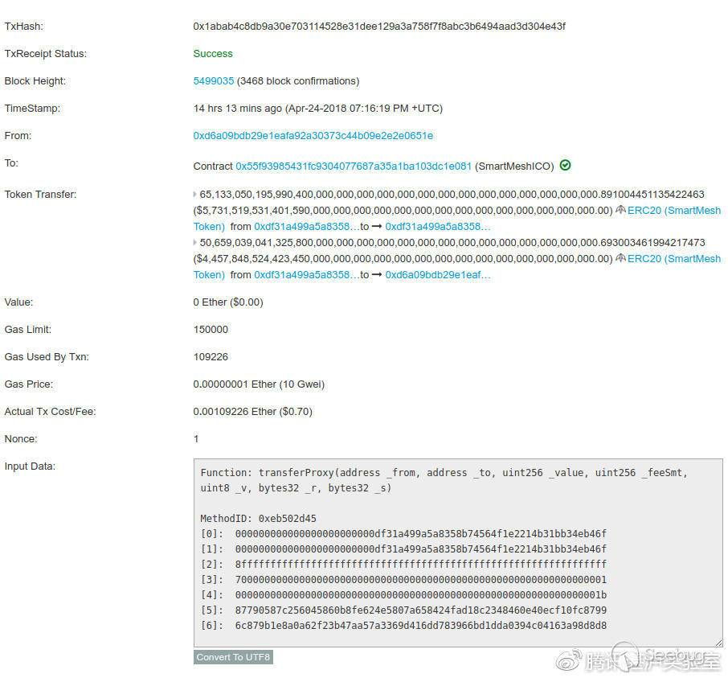
SMT Interger overflow
if (balances[_from] < _feeSmt + _value) revert()
_feeSmt _value皆为uint256，会发生无符号整型数据上溢。
漏洞复现：
https://paper.seebug.org/592/
Use safemath library
https://ethereumdev.io/safemath-protect-overflows/

Slide 11
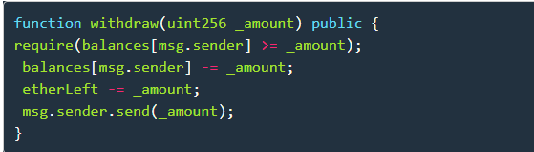
4.Unchecked Return Values For Low Level Calls
未检查到这种低级别调⽤的返回值，则可能导致失败打开和其他不想要的结果。
The King of the Ether Throne contract ("KotET contract" for short)
Suppose the current claim price for the throne is 10 ether.
You want to be King/Queen, so you send 10 ether to the contract.
The contract sends your 10 ether (less a 1% commission) to the previous King/Queen, as a "compensation payment".
The contract makes you the new King/Queen of the Ether Throne.
The new claim price for the throne goes up by 50%, to 15 ether in this case.
If an usurper comes along who is willing to pay 15 ether, they depose you and become King/Queen, and you receive
their payment of 15 ether as your "compensation payment".
https://www.kingoftheether.com/postmortem.html

Slide 12
5.Denial of Service
GovernMental's 1100 ETH jackpot
the contract clears internal storage with these instructions:
creditorAddresses = new address[](0);
creditorAmounts = new uint[](0);
require a gas amount of 5057945, but the current maximum gas amount for a transaction is only 4712388.
https://www.reddit.com/r/ethereum/comments/4ghzhv/governmentals_1100_eth_jackpot_payout_is_stuck/

Slide 13
6.Bad Randomness
The SmartBillion lottery
https://www.reddit.com/r/ethereum/comments/74d3dc/smartbillions_lottery_contract_just_got_hacked/
Introduction paper and how to create a random number
https://blog.positive.com/predicting-random-numbers-in-ethereum-smart-contracts-e5358c6b8620

Slide 14
7.Front Running
if a given user is revealing the solution to a puzzle or other valuable secret, a malicious user can steal
the solution and copy their transaction with higher fees to preempt the original solution.
Example:
A smart contract publishes an RSA number (N = prime1 x prime2).
A call to its submitSolution() public function with the right prime1 and prime2 rewards the caller.
Alice successfuly factors the RSA number and submits a solution.
Someone on the network sees Alice's transaction (containing the solution) waiting to be mined and
submits it with a higher gas price.
The second transaction gets picked up first by miners due to the higher paid fee. The attacker wins the prize.

Slide 15
8.Time manipulation
A game pays out the very first player at midnight today.
A malicious miner includes his or her attempt to win the game and sets the timestamp to midnight.
A bit before midnight the miner ends up mining the block. The real current time is "close enough" to
midnight (the currently set timestamp for the block), other nodes on the network decide to accept the block.
function play() public {
require(now > 1521763200 && neverPlayed == true);
neverPlayed = false;
msg.sender.transfer(1500 ether);
}

Slide 16
9.Short address
When you want to send coin using transfer method you will need these parameters in the transaction
0x90b98a11 -->method hash
00000000000000000000000062bec9abe373123b9b635b75608f94eb8644163e ---> target addr
0000000000000000000000000000000000000000000000000000000000000002 -->number
Get an address with 00 at the end then decrease 2 00 in the target addr
0x90b98a11
00000000000000000000000062bec9abe373123b9b635b75608f94eb86441600
00000000000000000000000000000000000000000000000000000000000002
So the number changes from 2 to 200 !!!
https://ericrafaloff.com/analyzing-the-erc20-short-address-attack/

Slide 17
10.Unknow attacks

Slide 18
Part 2:Other interestring attacks

Slide 19
Equihash 算力伪造
Equihash 为一种POW算法，有加密货币使用equihashverify依赖库来进行共识。
验证过程：
在函数bool verifyEH(const char hdr, const char soln)中，hdr是区块头信息，参数soln是矿工求解出
来的{Xij}序列。verifyEH函数的作用，就是用来判断{Xij}是否是由区块头信息hdr产生的广义生日悖论
问题的正确解。
简单理解：
Vhash=hash(hdr,x1)^ hash(hdr,x2) ^…^. hash(hdr,x512)；
Vhash的结果为0，则为true。
在广义生日悖论问题中，所有的xij必须是不相同的。而这里并没有检查是否由重复。对于任意区块头
hdr，攻击者只要让所有的 xi全部相等，则得到结果相同，偶数个异或后变为0

Slide 20
51% attack
Monacoin
Selfish mining:
当恶意矿工挖到了一个新的块 B1，不立即广播，而是接着这个块挖下一个块 B2。在这期间如果别人
挖出来了，就马上广播 B1 到全网，如果挖出了第二个，那就直接广播出去，这样恶意矿工的收益就
是连续两个块，而别人颗粒无收，由于这种攻击需要攻击者拥有25%以上的算力才能将数学期望拉高
到与正常挖矿相同或者更高，所以这次攻击同时也采用了这种行为。
双花攻击 (double spend attack):
攻击者在公链中签名并广播一笔交易发送 Monacoin 到交易所，并同时在自己的私有链上广播一个将
Monacoin 发送到自己钱包的交易，然后使用大量算力挖掘私有链，当交易所确认存款后，立即广播
私有链。由于攻击者拥有大量算力，私有链长度总是比共有链长，所以最后那些发往交易所的
Monacoin 被回滚了。

Slide 21
51% attack
Bitcoin Gold
资金钱包 GTNjvCGssb2rbLnDV1xxsHmunQdvXnY2Ft
挖矿钱包 GXXjRkdquAkyHeJ6ReW3v4FY3QbgPfugTx
与 Monacoin 类似的，Bitcoin Gold 中攻击者也将这笔交易同时发给交易所和自己，
并成功将自己的私链变成最长链，从而使得这条链重新变为公链。

