Slide 1

Market Fraud Detection System Analysis
A simple, kid?friendly look at how we spot risky transactions
By Manohar Samoji

Slide 2
What we will see
Today?s map
1. What is fraud?
2. How our system works
3. Data in ? scores out
4. Visuals and alerts
5. Admin controls
6. Safety and reset
7. Demo flow

Slide 3
What is fraud?
It?s when someone tries to trick the system.
Normal
Fraud
Real customer, real purchase, safe behavior.
Strange patterns, fake identity, risky behavior.

Slide 4
A simple story
Imagine a toy store. One kid buys 1 toy. That?s normal.
Another kid buys 100 toys in 1 minute using a new card. That looks suspicious.
Our system says: ?Check this!?

Slide 5
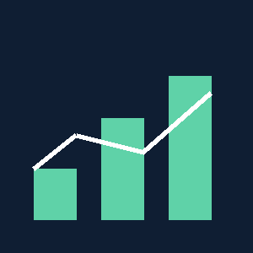
Big picture
Input
Model
Output
CSV / PDF data
Rules + ML
Fraud / Review / Normal

Slide 6
What data goes in?
We read transaction details like:
Amount
Country
Device risk
Velocity
Merchant risk
Time of day

Slide 7
Upload ? Score
Upload
Analyze
Result
CSV or PDF
Model scores each row
Normal / Review / Fraud

Slide 8
Traffic?light risk scale
Green
Yellow
Red
Normal
Review
Fraud

Slide 9
How the model decides
We look for risky patterns:
? Very high amount
? Too many transactions quickly
? High?risk country
? Blacklist match

Slide 10
Visuals help us understand
Line chart
Bars
Shows risk trend
Scored vs Errors vs Alerts

Slide 11
Visuals page
A focused page for charts, summary and insights.

Slide 12
Insight summary
Scored rate, error rate, and fraud rate shown in one box.

Slide 13
Admin vs user
User
Admin
Uploads, views results
Manages users and roles

Slide 14
Admin tools
Search users, change roles, deactivate, reset passwords.

Slide 15
Password reset flow
Request
Email
Update
User asks for reset
Reset link sent
New password set

Slide 16

Safety checks
? CSRF protection
? Email verification
? Admin?only access

Slide 17
Demo in 5 steps
1. Login
2. Upload CSV
3. View charts
4. Open visuals page
5. Download snapshot

Slide 18
What we get
Fast scoring, clear visuals, and easy investigation.

Slide 19
Future ideas
? Smarter PDF parsing
? More charts
? Automatic alerts

Slide 20
Thank you!
Questions?
Market Fraud Detection System

