Slide 1
PC Build Recommendation engine
Scraping PCPartPicker.com

Slide 2
Outline
Introduction to PC Building
Webscraping with PhantomJS
Visualizing and Understanding the Data with Python/Pandas
Final Product: PC Build Recommendation Engine with SQL and Shiny-R
Scraping
PCPartPicker
Product landing page
URLs for products
Data from each product
Python Processing
Shiny App

Slide 3
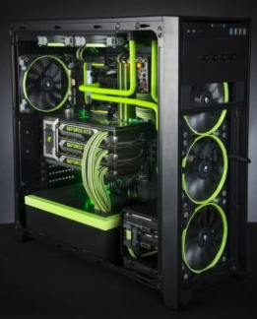
Introduction to PC building
8 core components
Motherboard
Central Processing Unit (CPU)
Graphics Processing Unit (GPU)
Power Supply Unit (PSU)
Memory (random access memory – RAM)
Storage (for persistent data)
CPU cooler
Case
Many optional and peripheral components (not included in this project)
image source

Slide 4
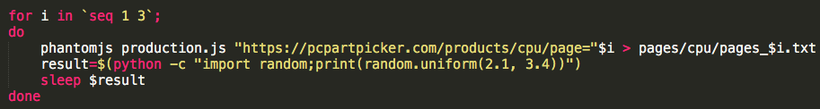
Webscraping Pcpartpicker.com
Example bash script to call PhantomJS for each page in CPU category
Scraping
PCPARTPICKER
Product landing page
URLs for products
Data from each product
Python Processing
Shiny App

Slide 5
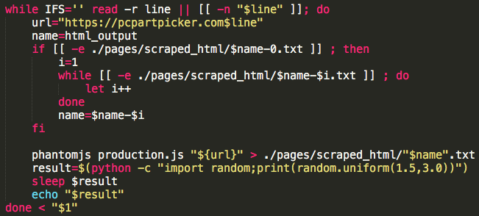
Webscraping Pcpartpicker.com
Example bash script to call PhantomJS for each product via scraped URL
Scraping
PCPARTPICKER
Product landing page
URLs for products
Data from each product
Python Processing
Shiny App

Slide 6
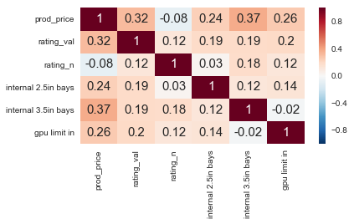
Visualizing and Understanding the Data: CASE dataframe
Correlation Heatmap
Numeric specs of interest
Number of bays
Product price has strongest correlation to rating value
Scraping
PCPARTPICKER
Product landing page
URLs for products
Data from each product
Python Processing
Shiny App

Slide 7
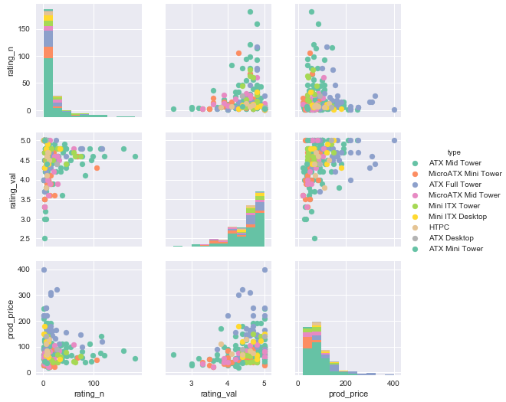
Visualizing and Understanding the Data: CASE dataframe
Rating count (n), value (val) compared with Price, color-coded by Type

Slide 8
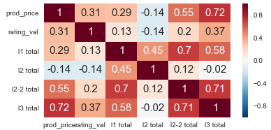
Visualizing and Understanding the Data: CPU dataframe
Correlation Heatmap
Numeric specs of interest
Cache (L1, L2, L3)
L3 Cache strong correlation to Price
L2 Instruction hasn’t changed over time
No relation to Price or Rating
Scraping
PCPARTPICKER
Product landing page
URLs for products
Data from each product
Python Processing
Shiny App

Slide 9
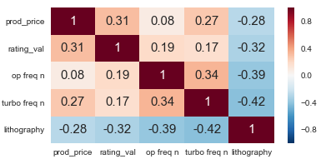
Visualizing and Understanding the Data: CPU dataframe
Correlation Heatmap
Numeric specs of interest
Operating, Max Turbo Frequency
Lithography Node
LithoNode negative correlation as expected
Relative bottleneck for frequencies compared to price, rating
Scraping
PCPARTPICKER
Product landing page
URLs for products
Data from each product
Python Processing
Shiny App

Slide 10
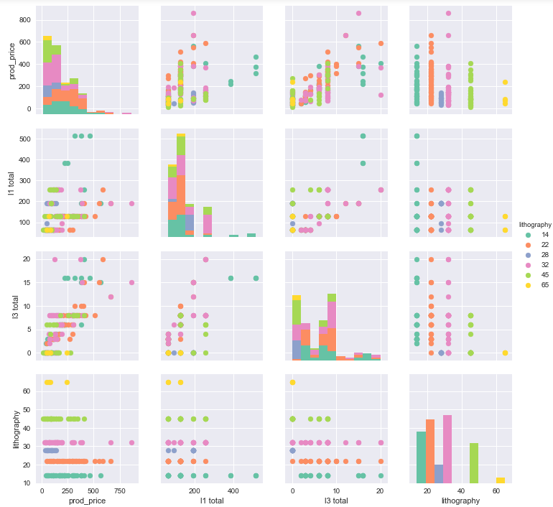
Visualizing and Understanding the Data: CPU dataframe
Price compared with L1 and L3 Cache, color-coded by LithoNode

Slide 11
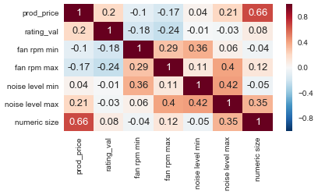
Visualizing and Understanding the Data: Cooler dataframe
Correlation Heatmap
Numeric specs of interest
Fan RPM, Noise level ranges
Size of cooler
Cooler size generally related to performance
Not shown in this dataset
Cooler size correlated to price
Scraping
PCPARTPICKER
Product landing page
URLs for products
Data from each product
Python Processing
Shiny App

Slide 12
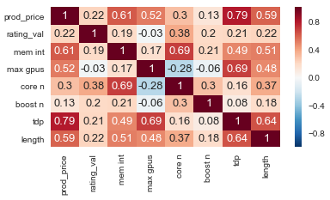
Visualizing and Understanding the Data: GPU dataframe
Correlation Heatmap
Numeric specs of interest
VRAM (mem int), max # GPUs supported
Core freq., Turbo freq., Power (tdp)
Physical length
Power required is strongly correlated to Price
Operating frequency correlated to Rating
Turbo frequency is comparatively irrelevant
Scraping
PCPARTPICKER
Product landing page
URLs for products
Data from each product
Python Processing
Shiny App

Slide 13
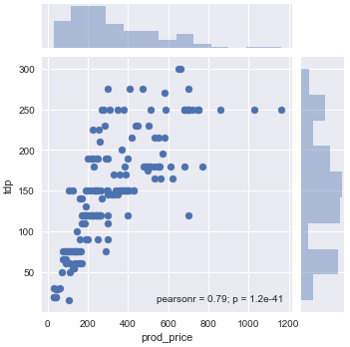
Visualizing and Understanding the Data: GPU dataframe
Required power v. Price

Slide 14
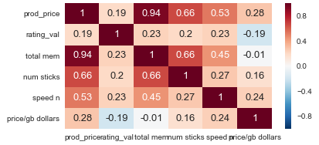
Visualizing and Understanding the Data: Memory dataframe
Correlation Heatmap
Numeric specs of interest
Total amount of memory, # sticks
Speed of memory, $/gb
Total amount of memory strongly correlated to Price
No significant branding effect
More sticks -- higher Price
Scraping
PCPARTPICKER
Product landing page
URLs for products
Data from each product
Python Processing
Shiny App

Slide 15
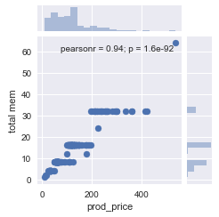
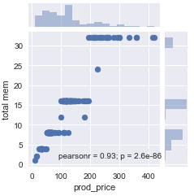
Visualizing and Understanding the Data: Memory dataframe
Total memory v. Price, all points
Total memory v. Price, outlier excluded
Scraping
PCPARTPICKER
Product landing page
URLs for products
Data from each product
Python Processing
Shiny App

Slide 16
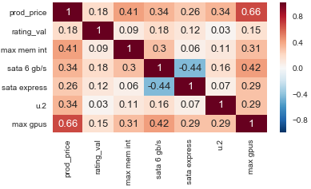
Visualizing and Understanding the Data: Motherboard dataframe
Correlation Heatmap
Numeric specs of interest
Max memory, # GPUs supported
# of ports (SATA and u.2)
More support related to higher price
The 2 SATA port types have little overlap
Scraping
PCPARTPICKER
Product landing page
URLs for products
Data from each product
Python Processing
Shiny App

Slide 17
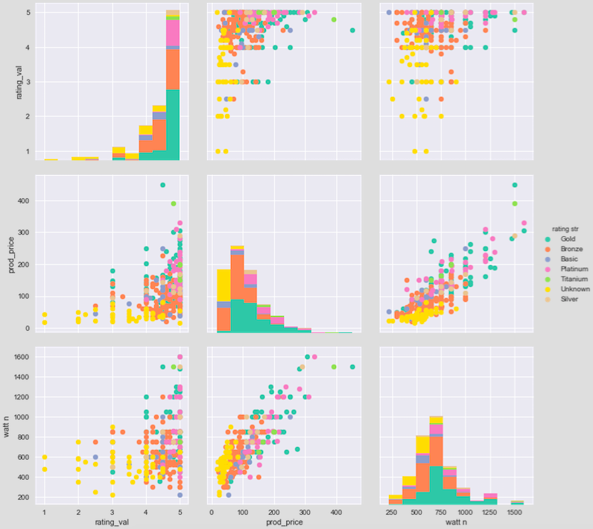
Visualizing and Understanding the Data: PSU dataframe
Output Power (W) v. Rating and Price, color-coded by efficiency
Correlation Heatmap

Slide 18
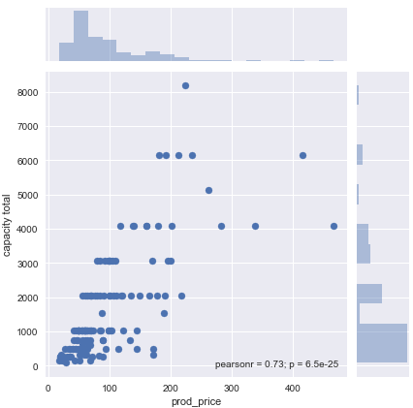
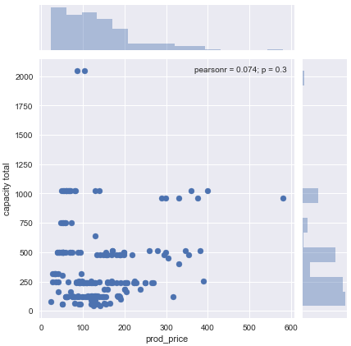
Visualizing and Understanding the Data: Storage dataframe
Total Capacity (GB) v. Price, 3.5” FF
Total Capacity (GB) v. Price, 2.5” FF
3.5” FF = Hard Disk Drives (HDD)
Strong capacity-price correlation
2.5” FF = Solid State Drives (SSD)
No capacity-price relationship

Slide 19
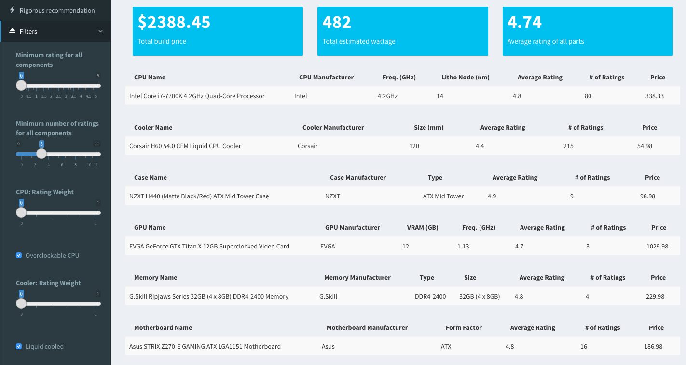
PC Build Recommendation Engine
Scraping
PCPARTPICKER
Product landing page
URLs for products
Data from each product
Python Processing
Shiny App
Final product can be found at: pcbuild_app

