Slide 1
Data Science with Python
In 45 minutes…
Michele Samorani - Santa Clara University

Slide 2
The Main Data Science Packages in Python
Visualization packages
Matplotlib /
Seaborn
scikitlearn
Machine learning package
pandas
Data structures package
numpy
Computation package
Python
Language, syntax

Slide 3
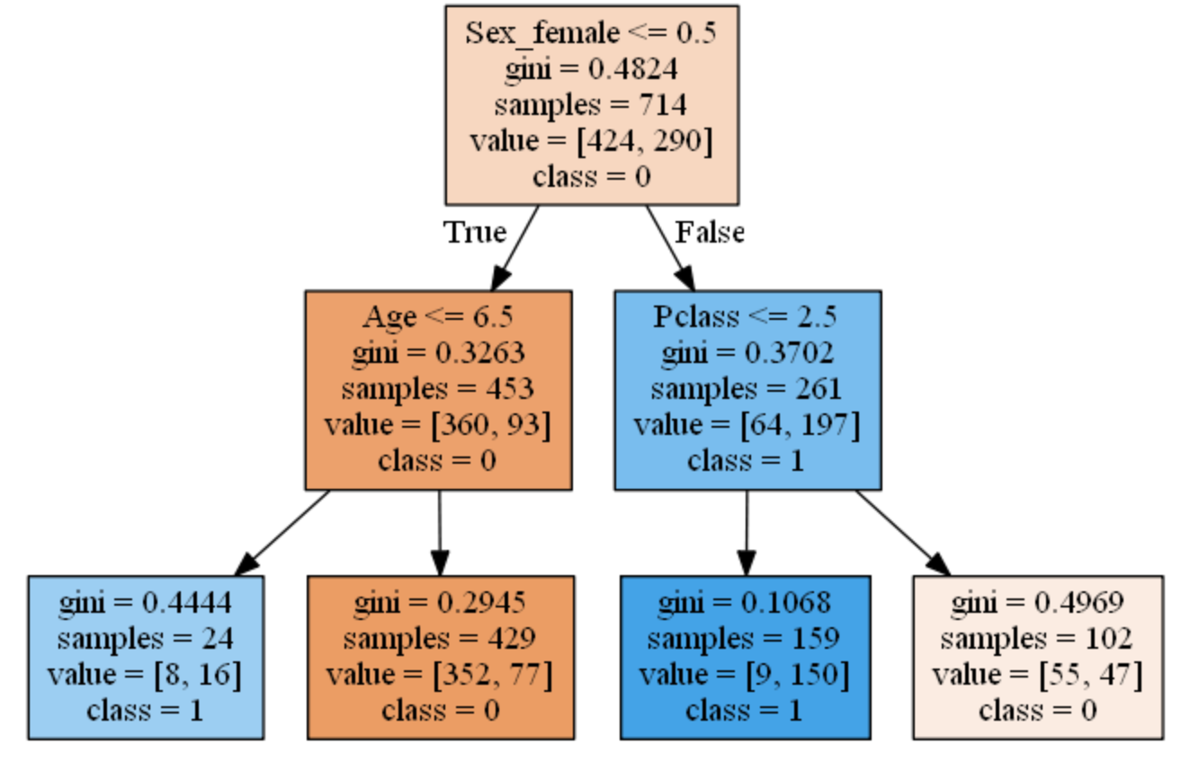
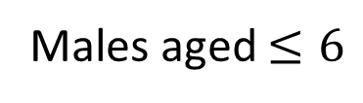
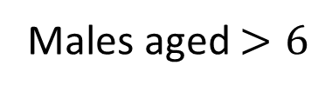
How to read a Decision Tree in pydotplus
gini: measure of diversity
samples: number of observations that fall in the current node
Value = [c0,c1]: the number of observations in class 0 and class 1
Class: the majority class (i.e., prediction at this node)
Males
Females
Males aged $≤6$
Males aged $>6$
Females in 1st & 2nd
Females in 3rd

