Slide 1

Can ChatGPT Forecast Stock Price Movements? Return Predictability and Large Language Model
Samos (Yiguang) Zhu, Dylan (Langxuan) Pan

Slide 2
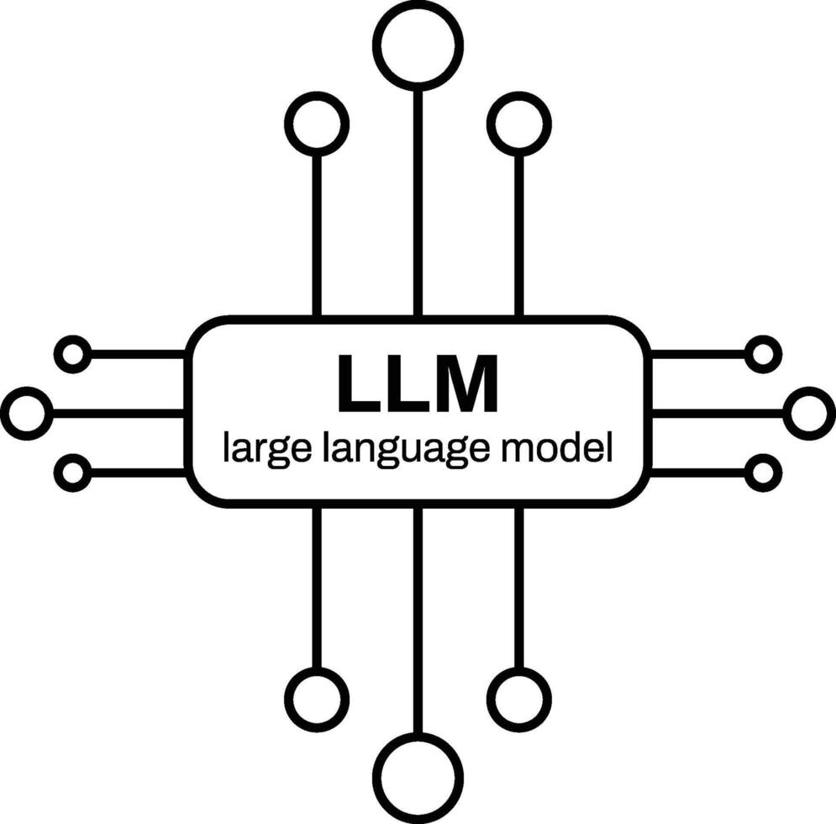
Content
Introduction
Workflow (dodo.py)
Data Collection
Data Cleaning
ChatGPT Sentiment Labeling
Data Exploration
Portfolio Construction (Table 1)
Strategy Evaluation (Figure 5)
Reproduce Results
Final Report
Success and Difficulties

Slide 3
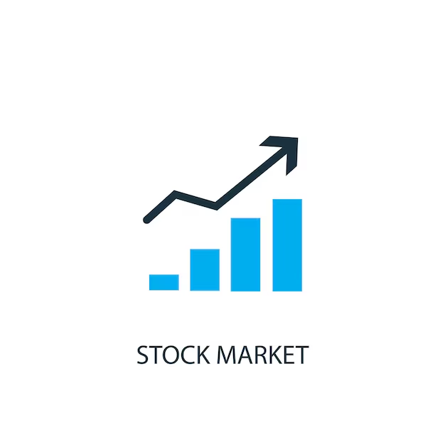
Introduction
Background:
Investigate whether ChatGPT can predict stock price movements using news headlines.
Use LLM to classify news sentiment (positive / neutral / negative).
Construct long–short portfolios based on sentiment signals.
Evaluate return predictability and portfolio performance.
Goal:
Replicate tables and figures from the paper
Reproduce the results using newest data
Apply methods learned in this course
Develop collaboration and communication skills

Slide 4

2. Workflow (dodo.py)
Data Collection
(CRSP + RavenPack + TAQ)
↓
Data Cleaning
↓
ChatGPT Sentiment Labeling
↓
Portfolio Construction (Table 1)
↓
Strategy Evaluation (Figure 5)
↓
Reproduce Results (2021–2025)
↓
Final Report
Contributions:
Samos: Data Collection, Data Cleaning, ChatGPT Sentiment Labeling
Dylan: Portfolio Construction, Strategy Evaluation, Report
Collaboration: Data Collection, Reproduce Results, Report

Slide 5
3. Data Collection
D
src/pull_CRSP_stock.py
1.Common stocks: shrcd = 10, 11
2.Exchanges: exchcd = 1, 2, 3 (NYSE / NASDAQ / AMEX)
src/pull_ravenpack_dj.py
1.relevance = 100
2.event_similarity_days > 90
3.Only CRSP-listed stocks
Exclude stock-gain / stock-loss categories
src/pull_TAQ_intraday.py
1.Aggregated to 1-minute frequency
2.Use last best_bid / best_ask each minute
3.Mid-price = midpoint of bid–ask
4.Trading hours: 09:30–16:00
5.Only stocks with intraday news

Slide 6
4. Data Cleaning
src/clean_crsp_daily.py
1.Price: abs(closeprc)
2.Compute market cap (mktcap)
src/clean_ravenpack_firmday.py
Step 1: Aggregate to firm-day → news_firmday
Step 2: Build intraday stories, label is_intraday, compute t15
Step 3: Remove similar titles by (ticker, date)(Damerau–Levenshtein )
src/clean_taq_nbbo_minute.py
1.Merge nbbo_*.parquet
2.Generate ticker = sym_root + sym_suffix
3.Output: date, ticker, minute_ts, mid

Slide 7
5. ChatGPT Sentiment Labeling
src/label_headlines_gpt_batch.py
Model:gpt-4o-mini via OpenAI Batch API
Task: classify each headline as short-term positive / negative / uncertain
Labels:YES / NO / UNKNOWN
Prompt: stock-price impact of each headline in the short run
Output:gpt_labels.parquet
Coverage: ~248K headlines, 2021.10 – 2024.12

Slide 8
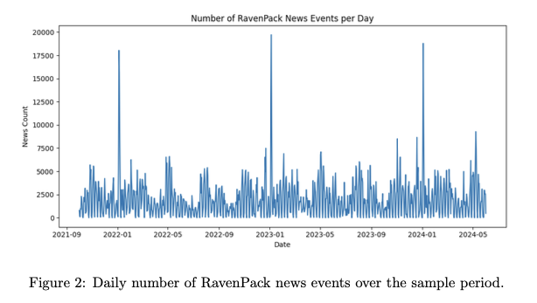
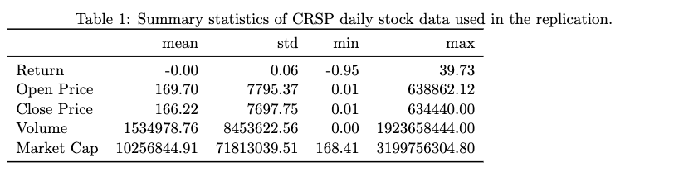
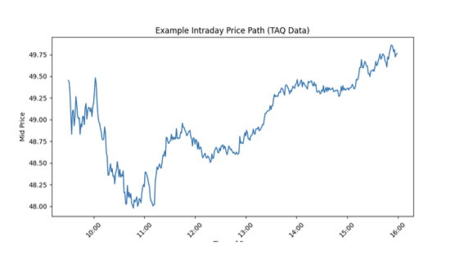
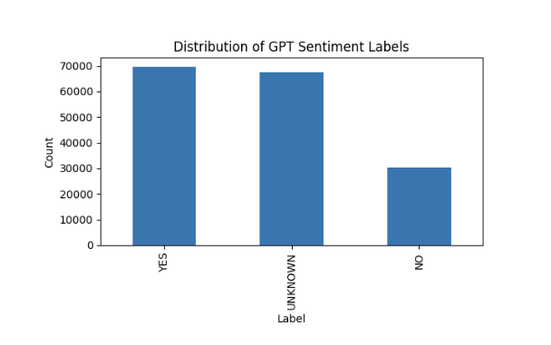
6. Data Exploration
data_exploration.py
CRSP Dataset
3. Ravenpack Dataset
2. TAQ Dataset
4. GPT Labels Dataset

Slide 9
replication_tour.ipynb
Purpose
Provide a guided walkthrough of the replication workflow.
Demonstrate how cleaned datasets are prepared and integrated.
Show how news sentiment, market data, and returns are combined.
Illustrate the steps used to construct trading portfolios.
Present how the code generates the main empirical results (tables and figures).

Slide 10
7. Portfolio Construction (Table 1)
src/compute_portfolio_performance.py
1. Separate News Types
Divide headlines into overnight news and intraday news.
2. Merge with Market Data
Merge headlines with CRSP daily prices and TAQ intraday quotes.
Compute key return measures:
Initial Reaction – immediate market response to news
Drift – subsequent price movement after the initial reaction.
3. Generate Trading Signals
Use ChatGPT sentiment labels: Positive → Long position; Negative → Short position; Neutral → Ignored
4. Construct Portfolios
Long–Short Portfolio, Long-Only Portfolio, Short-Only Portfolio
5. Compute Performance Metrics
Hit Rate, Mean Return, Sharpe Ratio

Slide 11
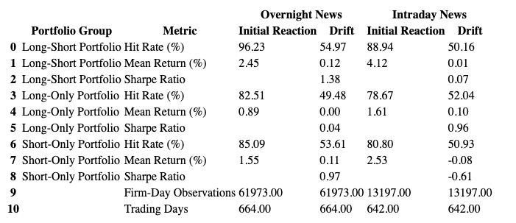
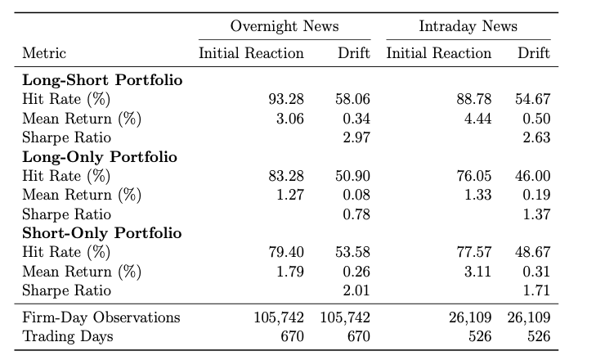
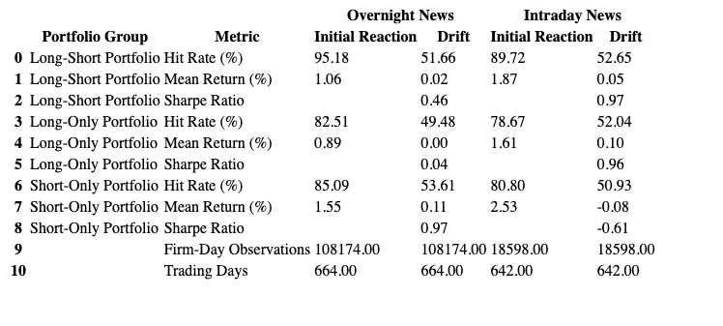
Table 1 Replication Results
Replicated Table 1 （strict filtering)
Original Table 1
Replicated Table 1*

Slide 12
Unit Test
src/test_table1_replication.py
Purpose
Verify that the replicated results are consistent with the original paper’s Table 1.
Testing Approach
Reference Benchmarks
Store the original paper’s metrics (hit rate, mean return, Sharpe ratio).
Compute Replicated Metrics
Run _compute_metrics() to generate portfolio performance results.
Metric Comparison
Compare replicated values with paper values
Test both Overnight News and Intraday News.
Tolerance Thresholds
Allow small differences due to data variation:
Hit Rate tolerance: ±8%
Mean Return tolerance: ±0.8%
Sharpe Ratio tolerance: ±2.6
Potential Issues:
Sharpe ratios drop significantly,
Some short-only portfolio profits reverse sign.
The replication uses fewer firm-day observations

Slide 13
8. Strategy Evaluation (Figure 5)
src/graph_trading_strategy.py
1. Prepare Overnight News Sample
2. Merge News with Stock Data
Match headlines with CRSP daily prices.
Further split into pre-market news and after-market news
Compute tradable returns using:
Same-day return for pre-market news
Next-day return for after-market news
3. Construct Strategy Variants
Long–Short Portfolio: long positive news, short negative news
Price > 5 Portfolio: exclude low-price stocks
Market Portfolio: value-weighted benchmark using lagged market cap
4. Compute Cumulative Returns
5. Plot Figure 5

Slide 14
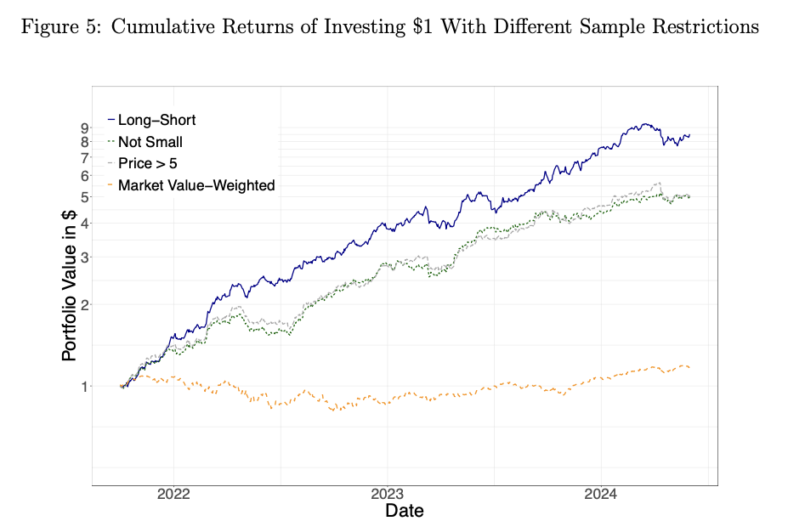
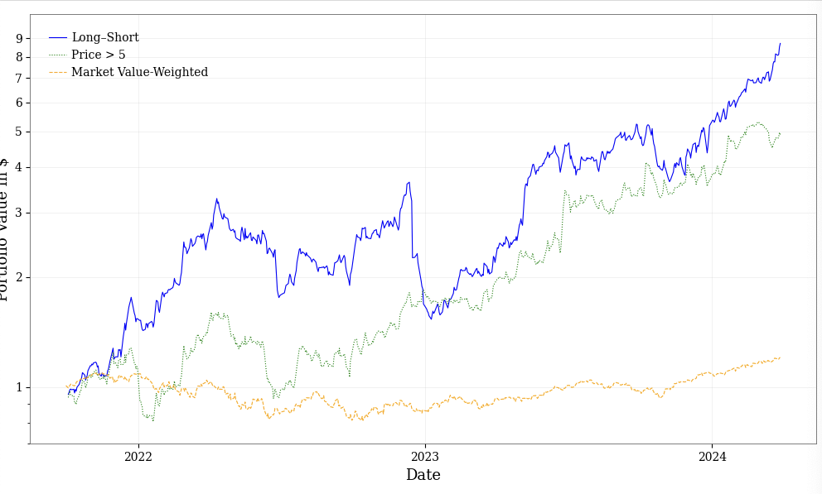
Table 5 Replication Results
Original Figure 5
Potential Issues:
More volatile
Greater maximum drawdown
Replicated Figure 5

Slide 15
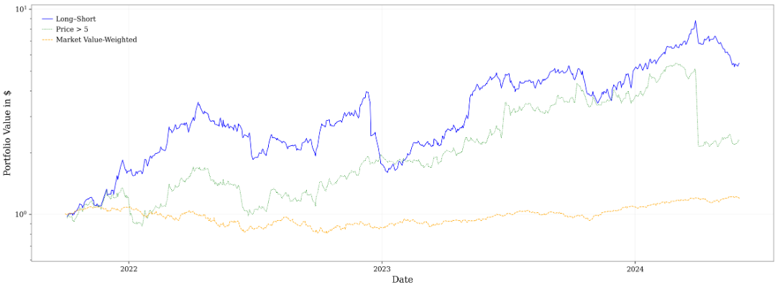
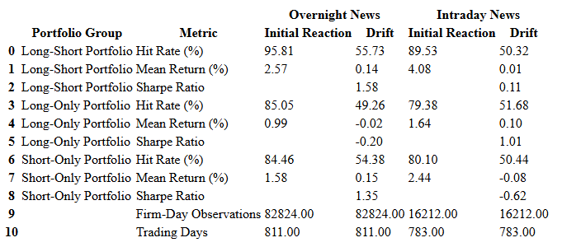
9. Reproduce Results
Here, we selected the data from October 1, 2021 to December 31, 2025. The final result is similar to the pattern in the paper.

Slide 16
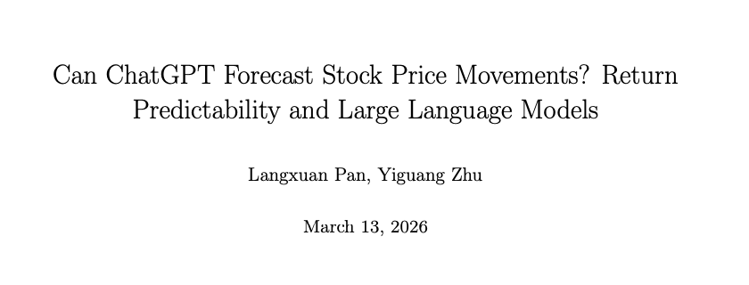
9. Final Report
replication_report.tex
replication_report.pdf

Slide 17
10. Success and Difficulties
Success:
Ssh Midway 3 to clean TAQ
Use polars to process data successfully
From CRSP, RavenPack, TAQ to GPT labels, and then to performance tables and charts, a reproducible empirical process is formed.
Difficulties:
The maximum available date for CRSP's data is only up to December 31, 2024. Besides, the actual test cases provided for us to run in the paper are relatively few.
Processing data locally has high requirements for running memory.
The data required for this project is particularly large.
The data path conflicts frequently after uploading to GitHub.

Slide 18
Thank you!

