Slide 1
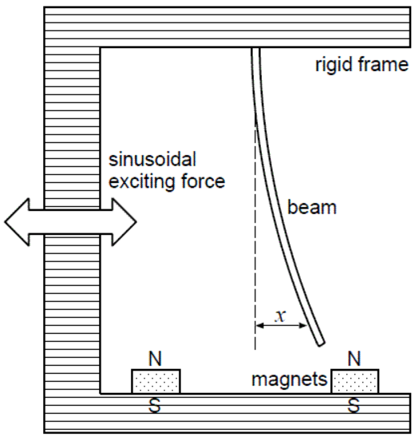

$$ξ$$

Slide 2


$$\dot{ξ}$$
$$ξ$$

Slide 3









$${\tilde{ℓ}}^{\left(2\right)}\left(M \right)$$
$$\tilde{ℓ}\left(M^{∗}\right)$$
Log Likelihood
$$ℓ\left(M \right)$$
$${\tilde{ℓ}}^{\left(1\right)}\left(M \right)$$
$${\overline{M}}^{\left(1\right)}$$
$${\overline{M}}^{\left(2\right)}$$
$$⋯$$
$$\overline{M}=M^{∗}$$
$$M$$

