Slide 1

Course Name: Rural Planning Studio
Course Code: URP 3112
Submitted By :
(Group 14)
1707041
1707044
1707051
1707055
Submitted To:
Nazia Hossain
Assistant Professor
Dept. of Urban & Regional Planning
Dulal Sarker
Lecturer
Dept. of Urban & Regional Planning
Rajshahi University of Engineering and Technology
Date of Submission: 11 August, 2021

Slide 2
PROJECT TITLE
Assessing the impact of flood on farming in the rural area: A case study of Talukkanupur Union, Gaibandha.

Slide 3
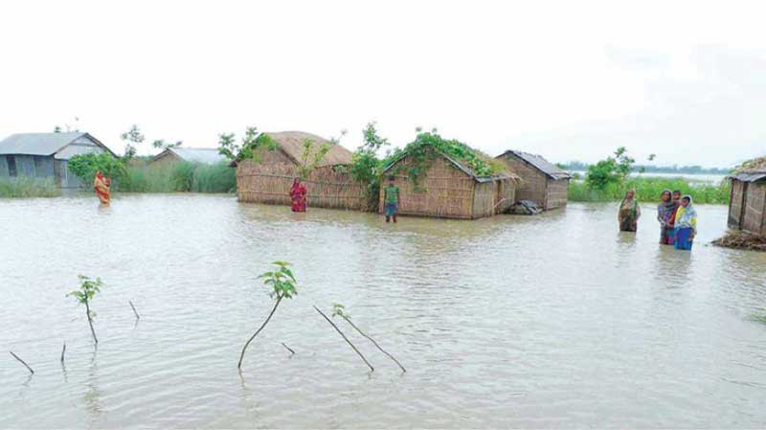
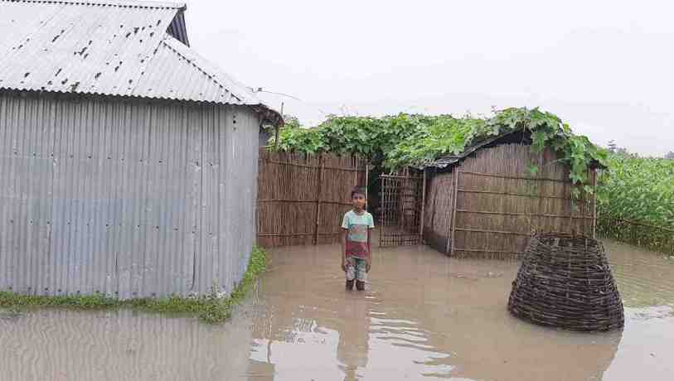
Introduction
Background
Flood has a huge impact on the rural livelihood as well as the agricultural production including livestock’s. Talukkanupur, a union of Gaibandha district is one of the mostly affected areas in Bangladesh by flood where every year the agricultural production hampers by flood badly. This study can help the local government with valuable data for future necessary steps including farming development in the flood prone area.
Objectives
To find out the impact of flood on the farming field.
To find out the outcome of the farming production before flood and after the flood.

Slide 4
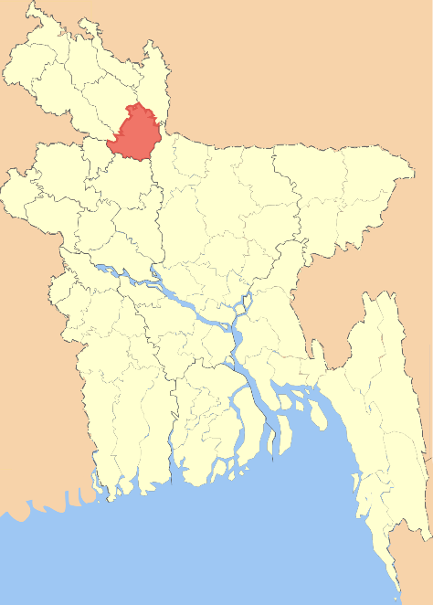
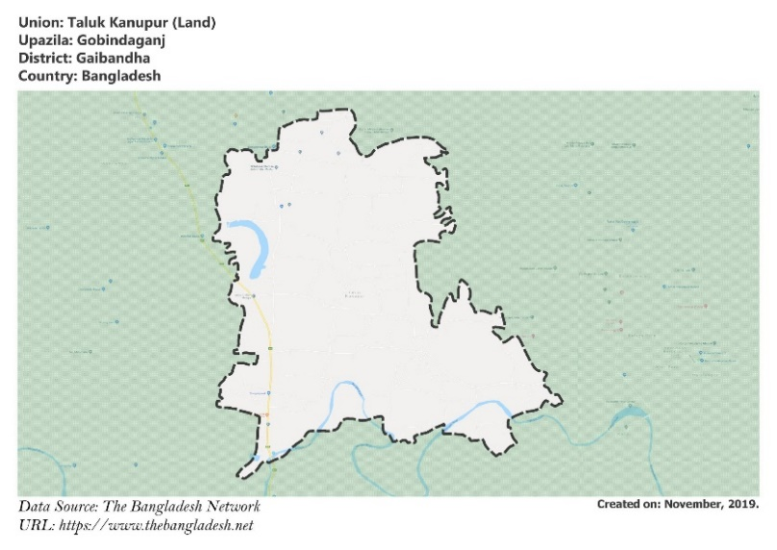
Study Area
Although Talukkanupur area of Gaibandha district is located in Bengal's broader flood-prone floodplain, its land structure and formation differ from those of the other areas of Gaibandha district due to changes in river flow and land raising caused by earthquakes.
The entire Talukkanupur area is made up of fertile soils, which is ideal for growing a variety of agricultural grains.
The area's main issue is river erosion and flooding produced by the Brahmaputra's rivers.
Figure 01: Gaibandha district in Bangladesh Map
Figure 2: Talukkanupur Union

Slide 5
Methodology
Topic Selection
Study Objectives
Site Selection
Preparing Questionnaire
Pilot Survey
Data collection
Primary source
(Questionnaire survey, FGD &KII )
Secondary source
(Google, BBS, Wikipedia)
Data analysis
Data explanation and presentation
Result and Findings

Slide 6
Data Analysis

Slide 7
Data Analysis
Crop Field

Slide 8
Data Analysis
Crop Field

Slide 9
Data Analysis
Crop Field

Slide 10
Data Analysis
Livestock Farm

Slide 11
Data Analysis
Livestock Farm

Slide 12
Data Analysis
Livestock Farm
Effect last for on land | Income of Livestock farm after flood
 | <1000 | 1000-5000 | 6000-10000 | >15000
<1 month | 0 | 1 | 2 | 0
1-2 month | 0 | 3 | 0 | 0
3-4 month | 2 | 1 | 2 | 0
>4 month | 4 | 0 | 0 | 2

Slide 13
Data Analysis
Poultry Farm

Slide 14
Data Analysis
Poultry Farm

Slide 15
Data Analysis
Poultry Farm
Effect last for on land | Income from Poultry farm after flood |  |  | Total
 | <1000 | 1000-5000 | 5000-10000
<1 month | 1 | 1 | 2 | 2
1-2 month | 5 | 2 | 0 | 7
3-4 month | 3 | 2 | 0 | 5
>4 month | 0 | 0 | 2 | 2

Slide 16
Data Analysis
Fish Girdle

Slide 17
Data Analysis
Fish Girdle
Effect last for on land | Income from Fish girdle after flood
 | <1000 | 1000-5000 | 6000-10000
<3 month | 2 | 2 | 1
3-4 month | 2 | 2 | 2
>4 month | 2 | 0 | 1

Slide 18
Data Analysis
Vegetable Garden

Slide 19
Data Analysis
Vegetable Garden
Effect duration | Income of vegetable garden after flood |  |  |  | Total
 | <500 | 600-2000 | 3000-5000 | 8000-10000
<2 month | 0 | 2 | 3 | 1 | 6
3-4 month | 4 | 2 | 0 | 0 | 6
>4 month | 1 | 0 | 1 | 2 | 4

Slide 20
Data Analysis

Slide 21
Findings
Almost all type of farming land affected by flood in July-August and sometimes the flood effects remains more than 4 months.
Most of the farming field face water logging or become flooded away.
Katcha livestock farms are affected more badly than pacca ones.
When the effect last for too long the farming field become unsuitable for next season also.
These effect make a huge impact on the output of the farming production.
The expected outcome do not come and so farmers face a huge loss.

Slide 22
Recommendation

Slide 23
Thank You

