Slide 1

Jobs Recommendation Engine
Match Jobs for a Profile
Match Criteria can be Skills, Experience, Location, Education, Connections etc.
Calculate the Match Score
Track all Strong Profiles for a Job
Emails Recruiter with Profile list
Recommended Jobs Widget on Profile
Job Details with Match Criteria

Slide 2
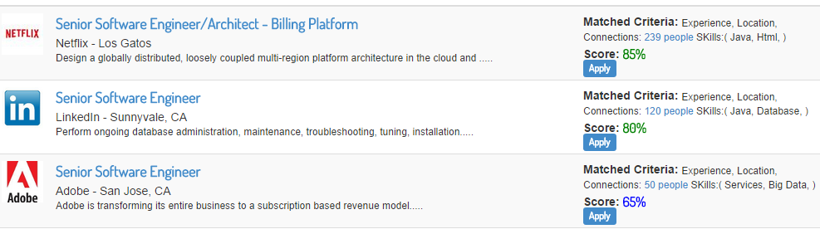
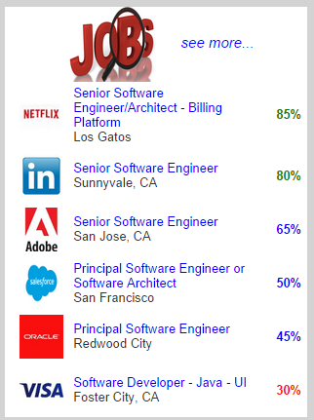
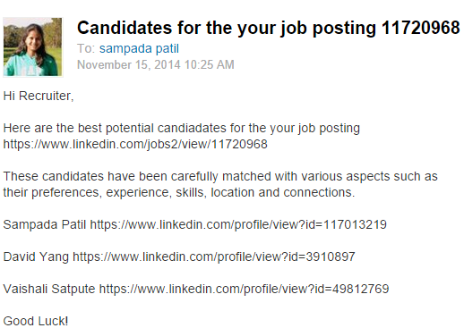
Recruiter Email
Jobs Widget

