Slide 1


SUMMER TRAINING
6 WEEKS PROJECT
TIC TAC GAMING ARENA
FOUNDATION COURSE
IN JAVA WITH DS
BY SAMPADA BHATNAGAR (CSE/2K14)
ROLL NO : 1413488

Slide 2
ABBREVIATIONS USED:
DS - DATA STRUCTURES
OOPS - OBJECT ORIENTED
PROGRAMMING LANGUAGE
OO - OBJECT ORIENTED
AI - ARTIFICIAL INTELLIGENCE

Slide 3
WEEK 1
LOGIC BUILDING

Slide 4
A SNIPPET:
CRIMINAL CUPBEARERS
An evil king has 1000 bottles of wine. A neighbouring queen plots to kill the bad king, and sends a servant to poison the wine. The king's guards catch the servant after he has only poisoned one bottle. The guards don't know which bottle was poisoned, but they do know that the poison is so potent that even if it was diluted 1,000,000 times, it would still be fatal. Furthermore, the effects of the poison take one month to surface. The king decides he will get some of his prisoners in his vast dungeons to drink the wine. Rather than using 1000 prisoners each assigned to a particular bottle, this king knows that he needs to murder no more than 10 prisoners to figure out what bottle is poisoned, and will still be able to drink the rest of the wine in 5 weeks time. How does he pull this off?

Slide 5
WEEK 2
TIME-SPACE COMPLEXITY
+
INTRODUCTION TO OOPS

Slide 6
BASICS OF JAVA
FUNCTIONS
ARRAYS
RECURSION
COMPLEXITY ANALYSIS
OOPS CONCEPTS

Slide 7
WEEK 3
DATA STRUCTURES

Slide 8
STACKS
QUEUES
LINKED LISTS
TREES

Slide 9
WEEK 4
ADVANCED DATA STRUCTURES

Slide 10
HASH TABLES
HEAPS
GRAPHS
LINKED LISTS

Slide 11
WEEK 5 & 6
DYNAMIC PROGRAMMING
(INTRODUCTION TO BASIC GAMING)

Slide 12
A SNIPPET:
Consider a game, in which you have two types of powers, A and B and there are 3 types of Areas X, Y and Z. Every second you have to switch between these areas, each area has specific properties by which your power A and power B increase or decrease. We need to keep choosing areas in such a way that our survival time is maximized. Survival time ends when any of the powers, A or B reaches less than 0.
Examples:
Initial value of Power A = 20
Initial value of Power B = 8
Area X (3, 2) : If you step into Area X,
A increases by 3,
B increases by 2

Slide 13
Area Y (-5, -10) : If you step into Area Y,
A decreases by 5,
B decreases by 10
Area Z (-20, 5) : If you step into Area Z,
A decreases by 20,
B increases by 5
It is possible to choose any area in our first step.
We can survive at max 5 unit of time by following
these choice of areas :
X -> Z -> X -> Y -> X

Slide 14
GAME: TIC TAC TOE

Slide 15
BASIC TO COMPLEX TIC TAC TOE GAME HEIRARCHY
I. 2 PLAYER CONSOLE NON OO GAME
II. 2 PLAYER CONSOLE OO GAME
III. GRAPHICS SIMPLE OO GAME
IV. COMPLEX VARIATIONS OF GRAPHICS OO GAME

Slide 16
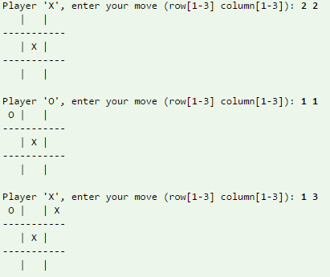
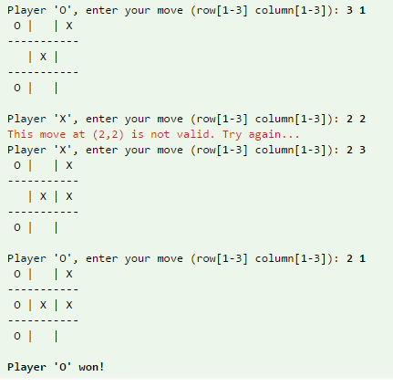
I. CONSOLE NON OO

Slide 17
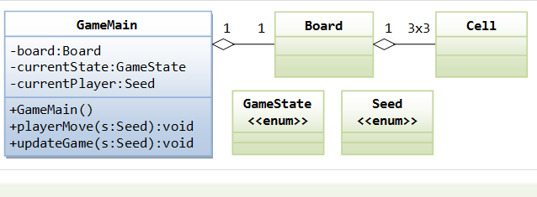
II. CONSOLE OO

Slide 18
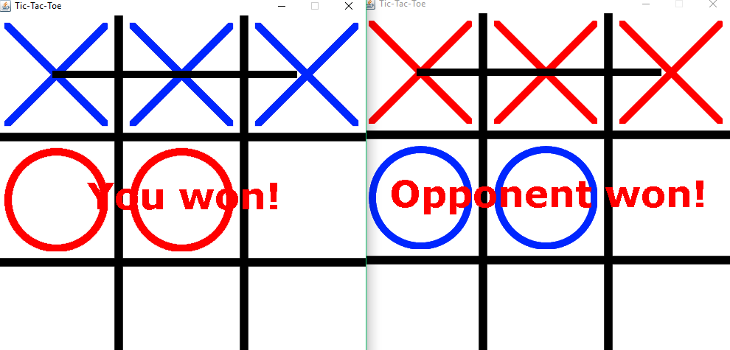
III. SIMPLE GRAPHICS OO

Slide 19
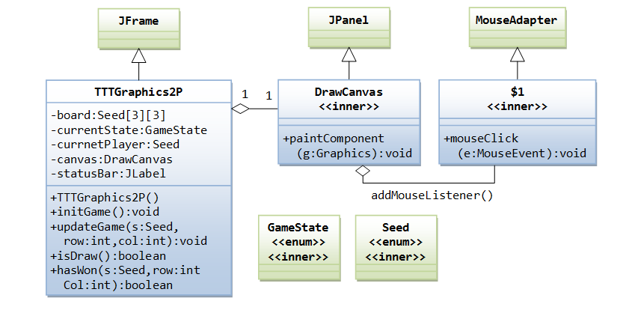

Slide 20
VARIATIONS OF A
BASIC TIC TAC TOE
1. Connect Four
2. Quantum tic tac toe (used in AI)
3. Sudoku
4. Othello (Reversi)

Slide 21
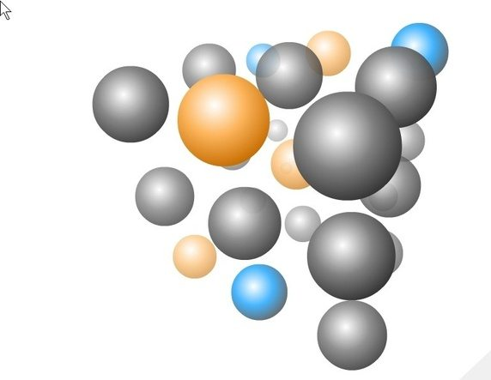
NOUGHTS AND CROSSES
(3D STRUCTURE)

Slide 22
CONNECT 4
The two players then alternate turns dropping one of their discs at a time into an unfilled column, until the second player, with red discs, achieves four discs in a row, diagonally, and wins.

Slide 23
QUANTUM TIC TAC TOE

Slide 24
The Rules of this game capture three phenomena of quantum systems:
SUPERPOSITION
the ability of quantum objects to be in two places at once.
ENTANGLEMENT
the phenomenon where distant parts of a quantum system display correlations that
cannot be explained by either a common cause.
COLLAPSE
the phenomenon where the quantum states of a system are reduced to classical states.
Collapses occur when a measurement happens.
To summarise, This game is a conceptual foundation for understanding the meaning of quantum mechanics

Slide 25
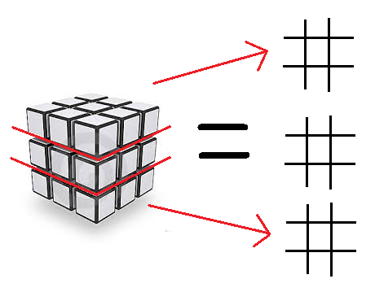
SUDOKU

Slide 26

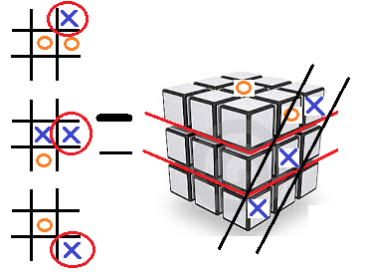
TO WIN THE GAME
OR

Slide 27
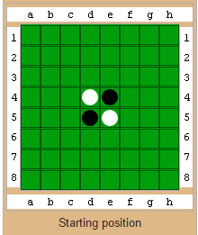
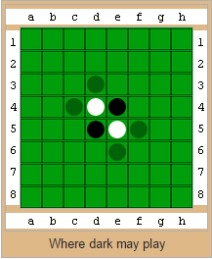
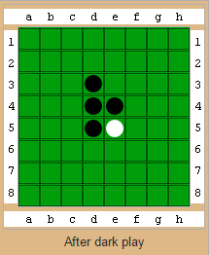
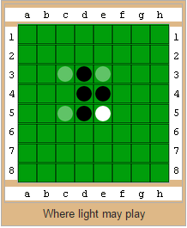
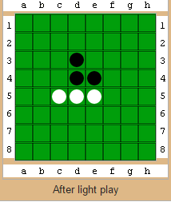
OTHELLO

Slide 28
-THE END-

