Slide 1
CAR POOLING SYSTEM
Presented by:
Ashwini shinde 219175 sampada kalbande 219161

Slide 2
Points to be discussed
1. Introduction 2. Motivation 3. Objective 4. UML Diagram 5. Screenshot 6. Specification 7. Software and Hardware requirement 8. Advantages 9. Disadvantages 10. future enhancement 11.References

Slide 3
INTRODUCTION
Carpooling is the concept of sharing your car to accommodate more than one person at a time, eliminating the need for riders to drive themselves in separate vehicles. With increasing road demands due to congestion, growing populations and infrastructure needs, carpooling has grown in popularity more recently and we need it now more than ever.Carpooling (also car-sharing, ride-sharing and lift-sharing) is the sharing of car journeys so that more than one person travels in a car, and prevents the need for others to have to drive to a location themselves.

Slide 4
Motivation
The motivation to build this project was the constant degradation of environment due to pollution which was a matter of concern.
The hike in fuel prices is also an important player in bringing up the idea of car pooling system.

Slide 5
Objectives
Reducing overall traffic congestion on the roads.
Reduce peak hour congestion Reducing single occupancy car trips by implementing Car Pooling System.
Promoting alternative modes of transport.
Improve parking in areas that are experiencing parking congestion
Saving the environment by using less fuel hence less pollution.

Slide 6
Technologies used
Front end: JSP and CSS
Backend: Spring boot API
Database connectivity: Postgres

Slide 7
USE CASE DIAGRAM
USER ID
PASSWORD
OFFER RIDE
REQUEST RIDE
EMAIL
CONTACT NUMBER
REVIEW
PAYMENT
DRIVER
PASSANGER

Slide 8
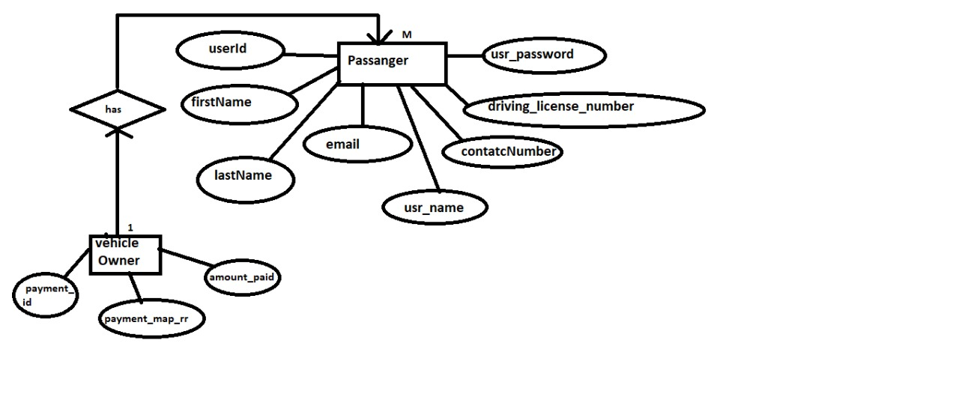
ER diagram

Slide 9
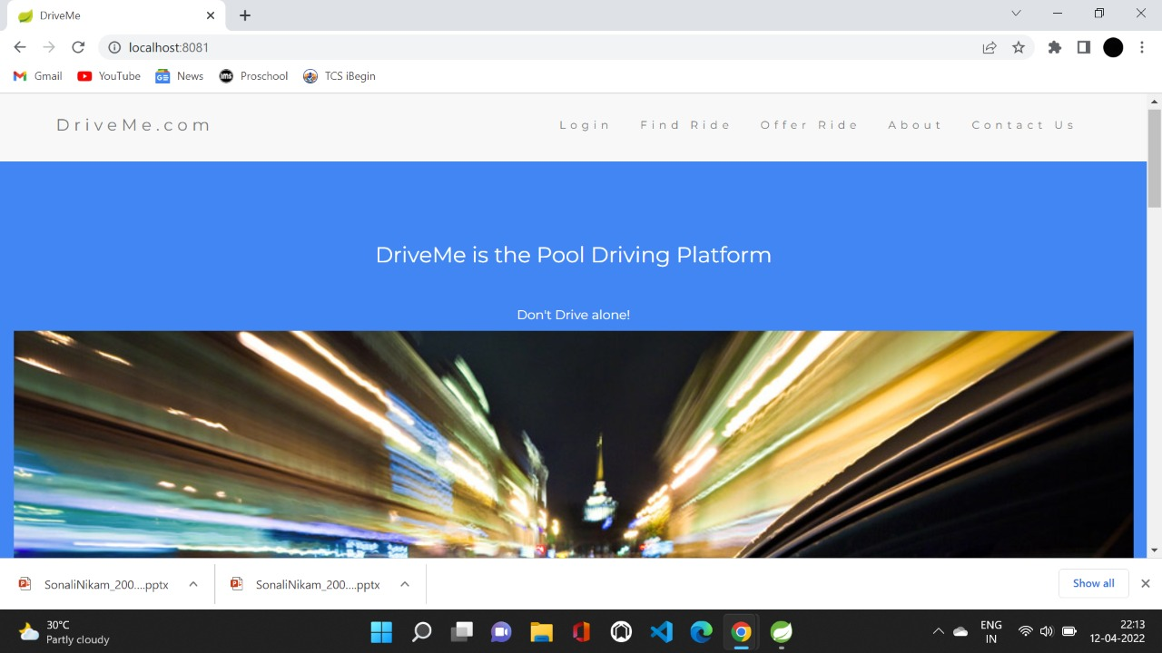
SCREENSHOTS

Slide 10
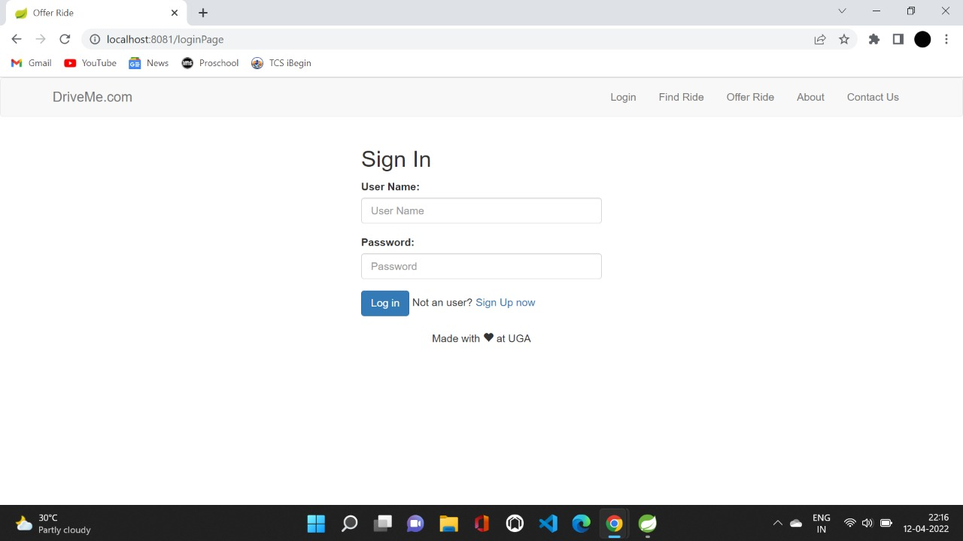

Slide 11
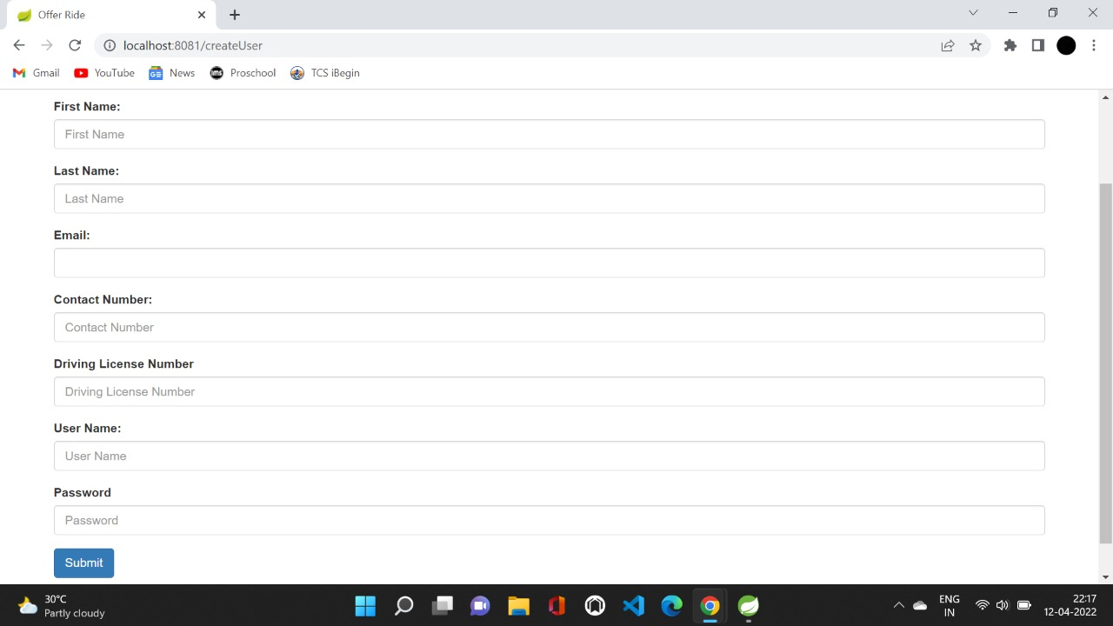

Slide 12
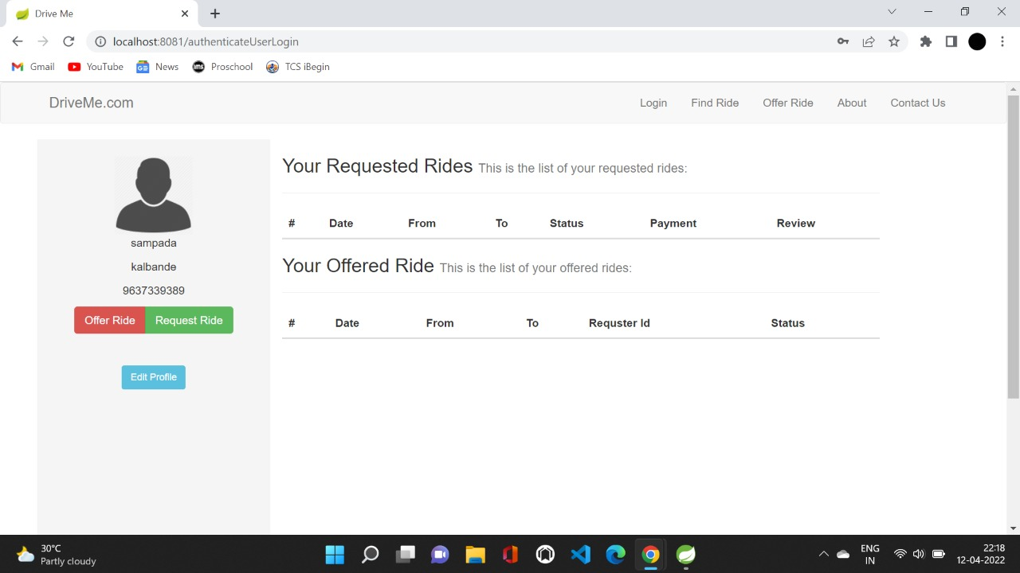

Slide 13
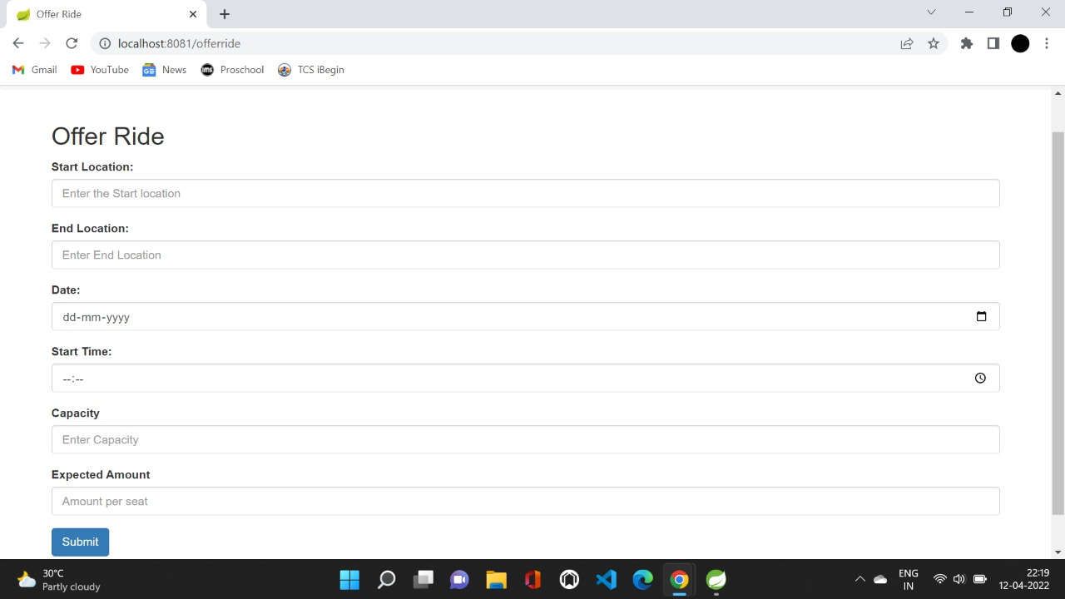

Slide 14


Slide 15
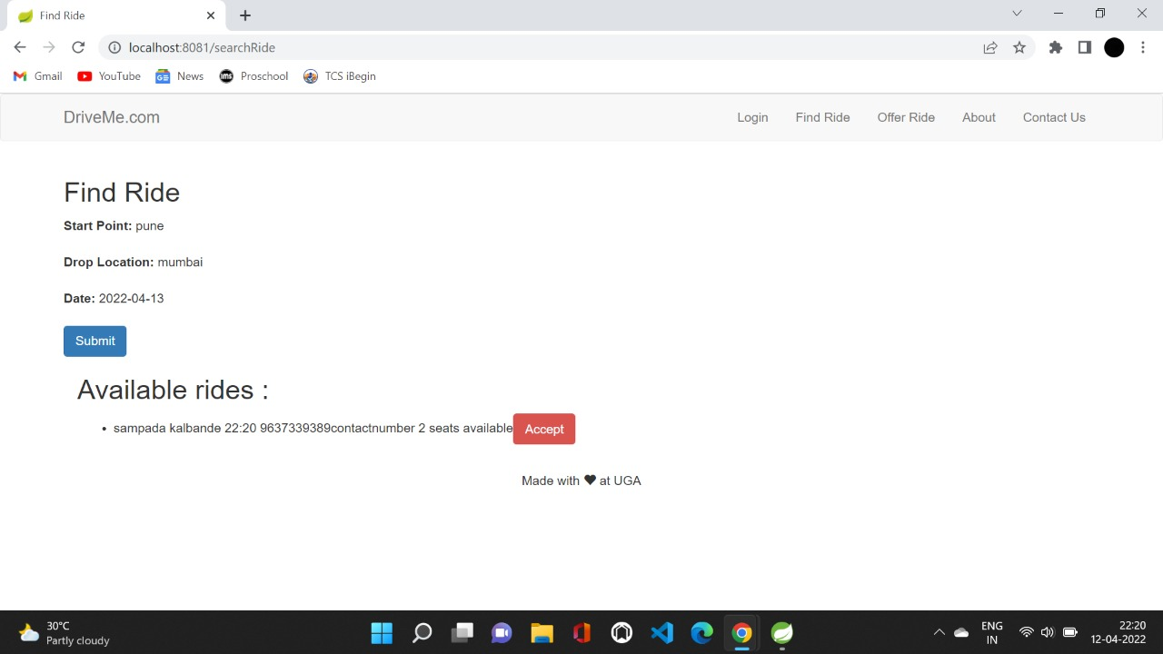

Slide 16
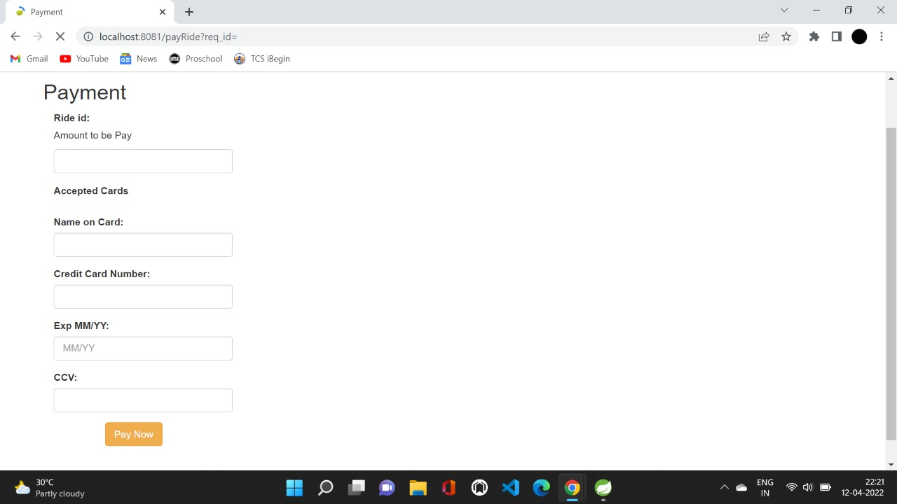

Slide 17
Specification
OS: Windows 10, Linux Web Browser: The system is a web-based application; clients need a modern web browser such as Mozilla Firebox, Internet Explorer, Opera, and Chrome. The computer must have an Internet connection in order to be able to access the system.
This system uses communication resources which includes but not limited to, HTTP protocol for communication with the web browser and web server and TCP/IP network protocol with HTTP protocol. • This application will communicate with the database that holds all the booking information. Users can contact with server side through HTTP protocol by means of a function that is called HTTP Service. This function allows the application to use the data retrieved by server to fulfil the request fired by the user.

Slide 18
Hardware and software requirements
External Interface Requirements
OS: Windows 10, Linux
Internet connection
The system is a web-based application; clients need a modern web
browser such as Mozilla Firebox, Internet Explorer, Opera, and Chrome.

Slide 19
Advantages
Carpooling will save your money
Carpooling is better for the environment
Carpooling is convenient
Carpooling improves your commuting options

Slide 20
Disadvantages
If rides are not available the commutation will be difficult.
Sharing ride with unknown people

Slide 21
Conclusion
Carpooling system is very effective means to reduce pollution and the congestion of vehicles in cities. It also provides an eco-friendly way to travel. It also provides an opportunity to meet new people. As today most people prefer private vehicle to travel due to delay caused in public transport system and luxuries provided by private vehicles. Pre-registration ensures that only identified people get into the vehicle so that trust can be established. Thus the proposed carpooling system will be effective in reducing environment pollution.

Slide 22
FUTURE SCOPE
The concept of live ride tracking can be added.
Can select from the passengers interested in taking ride.

Slide 23
References
Stack overflow
Git hub
javaPoint

Slide 24
THANK YOU

