Slide 1
Timers
Produce delays and counts numbers – timers and counters
IC 555 – trivial and versatile to use
555 includes Built in timer circuit
Precise delays
Flexible to design large number of applications

Slide 2
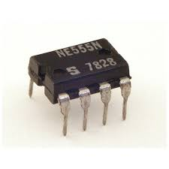
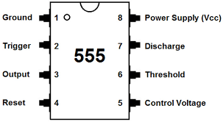
PIN diagram

Slide 3
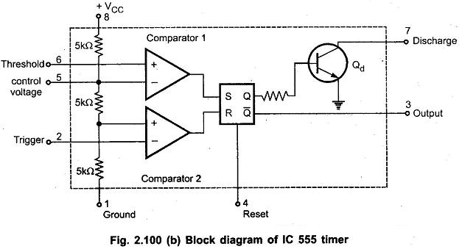
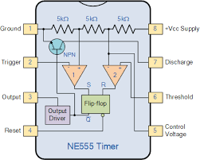
Block Diagram

Slide 4
PINS
Trigger – inverting input to OPAMP 1; provides a input (2)
Output – output taken here (3)
Reset - To disable or reset the timer. When this pin is not to be used for reset purpose, it should be connected to + VCC to avoid any possibility of false triggering (4)
Control voltage – control threshold; either the external voltage or a pot connected to this pin determines the pulse width of the output waveform (5)
Threshold – non inverting input
Discharge – capacitor discharges (7)

