Slide 2

Simulator
A simulator is a collection of hardware and software systems which are used to mimic the behavior of some entity or phenomenon

Slide 3
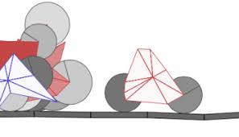
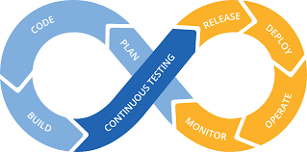
Why Simulator?
Risk free – innovate and explore alternate strategies
Develop critical thinking – Analysis, assess, plan
Big Picture – Decision of impacts
Reduces effective time

Slide 4
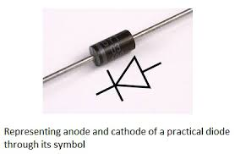
Diode
A diode is an electrical device allowing current to move through it in one direction with far greater ease than in the other.
Applications –
Rectifier
To switch circuits
Zener diode

