Slide 1

Automated Email & Document Delivery System
Designed for Lighthouse Communities Foundation
Developed by Sampada Swami

Slide 2
Problem Statement
Challenges in Traditional Email Process
Sending emails manually to many users takes a lot of time
High chances of wrong attachment or wrong email
Difficult to personalize emails for each person
Managing offer letters, NDAs, and policies manually is inefficient
No centralized system for bulk HR communication

Slide 3
What is SandeShika?
SandeShika is a Flask-based web application
Allows users to send bulk personalized emails
Supports Excel / CSV input for employee data
Automatically attaches individual PDFs to respective users
Uses secure Gmail SMTP(Simple Mail Transfer Protocol ) with App Password

Slide 4
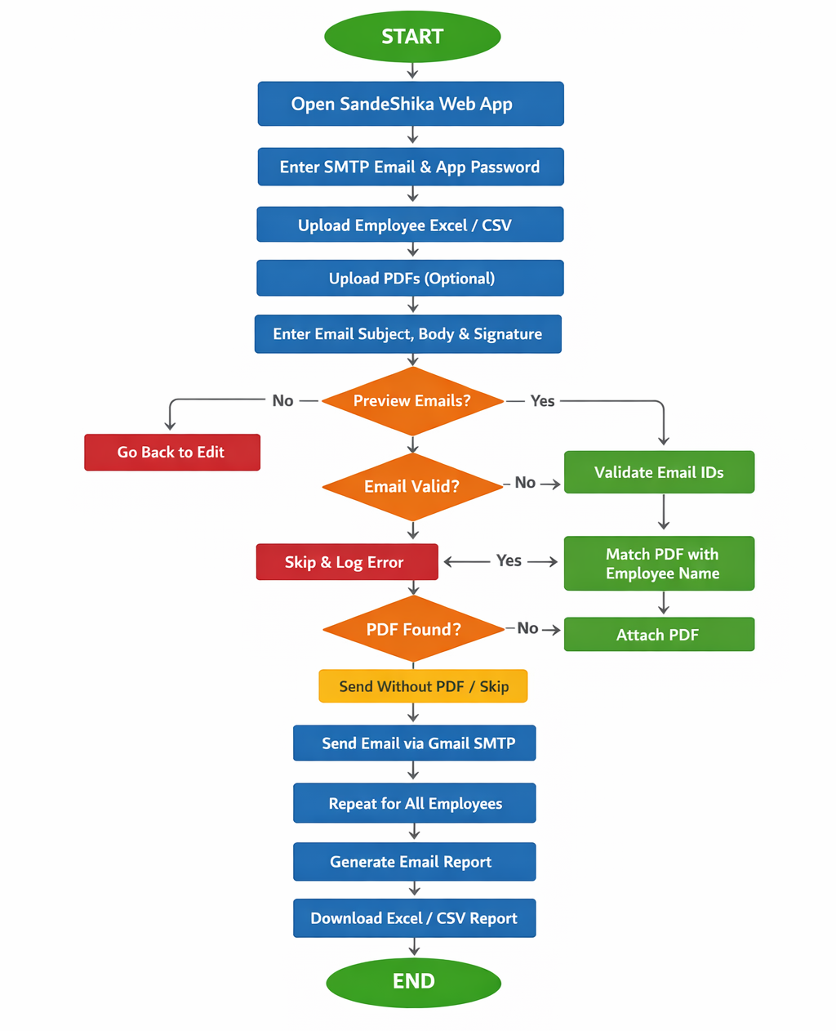
How SandeShika Works

Slide 5
Core Features
Key Functionalities
📧 Bulk Email Sending – Send hundreds of emails at once
👤 Personalization – Use {name} and {full_name} placeholders
📎 Auto PDF Attachment – Attach correct document to correct user
🔐 Secure Email Authentication – Gmail App Password
⚠️ Smart Validation – Prevents wrong or missing attachments
🌙 User-Friendly UI – Clean layout with light/dark mode

Slide 6
Tools & Technologies Used
Layer | Technology / Description
Frontend | HTML, CSS, JavaScript (Responsive UI)
Backend | Python with Flask Framework
Data Processing | Pandas for Excel / CSV Handling
Email Service | Gmail SMTP (Secure & Reliable)
Deployment | Can run locally or on Cloud Server

Slide 7
Time Efficiency Comparison
Manual Email Sending
Sending 100+ emails manually takes around 3 hours
Requires repeated typing, attaching documents, and verification
High chances of delay and mistakes
Depends completely on human effort
Using SandeShika
Sending 100+ emails takes only 2–3 minutes
Single upload and one-click email sending
Automatic personalization and attachment
No repetitive manual work

Slide 8
Why SandeShika Is Better Than Excel Mail Automation
Real-World Need | Excel Mail Automation | Why SandeShika Is Better
Sending emails to many people | Can send mails | Designed only for bulk emailing
Correct document to correct person | Manual matching | Auto-matches PDFs with users
Avoid legal mistakes (NDA/Offer) | High risk | Blocks wrong attachments
HR team usability | Needs technical Excel skills | Anyone can use (Web UI)
Security of email credentials | Stored / exposed | App Password (safe)
Repeating task every month | Rework again & again | Reusable system
Organizational accountability | No tracking | Controlled process
NGO / Foundation usage | Not reliable | Built for NGOs & HR
Scaling (100 → 10,000 mails) | Breaks / slow | Scales easily
Professional image | Looks manual | Looks like an official system

Slide 9
Benefits
Saves time and manual effort
Reduces human errors
Ensures correct document delivery
Easy to operate without technical knowledge
Scalable for large organizations

Slide 10
Conclusion
SandeShika is a smart and efficient solution for automated bulk email and document delivery
It replaces slow, manual email processes with fast and accurate automation
Tasks that take around 3 hours to send 100 emails manually can be completed in just 2–3 minutes using SandeShika
The system reduces human errors, ensures correct document delivery, and improves productivity
Its user-friendly interface allows even non-technical users to operate it easily
Suitable for HR departments, NGOs, educational institutions, and large organizations

Slide 11
Thank You!

