Slide 1

UCE-Dockets
Open Source initiative

Slide 2

NYPTI
NYPTI – New York Prosecutors Training Institute
Non-profit operating custom Case Management software for 55 out of 62 counties in NYS
Have been importing OCA feed for more than 20 years
Critical infrastructure for prosecutors' offices
No promises. However, NYPTI expects to maintain/upgrade/patch this system for the next 10 years

Slide 3
We are all on the same timeline
2021
Prepare/Plan
2022
Design/Implement/Deploy
2023+
Monitor/Upgrade/Support

Slide 4
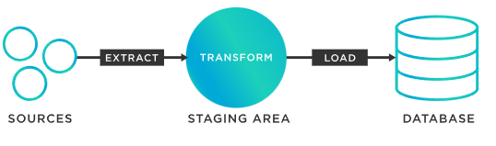
We are building the same things

Slide 5
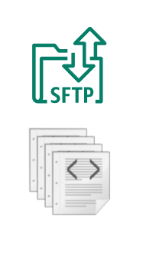
Steps
Download only new files from sftp.nycourts.org
Handle Incremental vs. Full Update logic
Extract the new zipped files
Parse XML, Extract Docket-IDs and update
Implement Case Sealing and Deletion rules
Use the data in other systems

Slide 6

Fragmentation

Slide 7

Cooperative Goal

Slide 8

Open API Specification
https://www.openapis.org/

Slide 9
Supported Languages – you are on this list
ActionScript, Ada, Apex, Bash, C, C# (.net 2.0, 3.5 or later, .NET Standard 1.3 - 2.0, .NET Core 2.0, .NET 5.0. Libraries: RestSharp, HttpClient), C++ (Arduino, cpp-restsdk, Qt5, Tizen, Unreal Engine 4), Clojure, Crystal, Dart, Elixir, Elm, Eiffel, Erlang, Go, Groovy, Haskell (http-client, Servant), Java (Apache HttpClient, Jersey1.x, Jersey2.x, OkHttp, Retrofit1.x, Retrofit2.x, Feign, RestTemplate, RESTEasy, Vertx, Google API Client Library for Java, Rest-assured, Spring 5 Web Client, MicroProfile Rest Client), k6, Kotlin, Lua, Nim, Node.js/JavaScript (ES5, ES6, AngularJS with Google Closure Compiler annotations, Flow types, Apollo GraphQL DataStore), Objective-C, OCaml, Perl, PHP, PowerShell, Python, R, Ruby, Rust (hyper, reqwest, rust-server), Scala (akka, http4s, scalaz, sttp, swagger-async-httpclient), Swift (2.x, 3.x, 4.x, 5.x), Typescript (AngularJS, Angular (2.x - 11.x), Aurelia, Axios, Fetch, Inversify, jQuery, Nestjs, Node, redux-query, Rxjs)

Slide 10
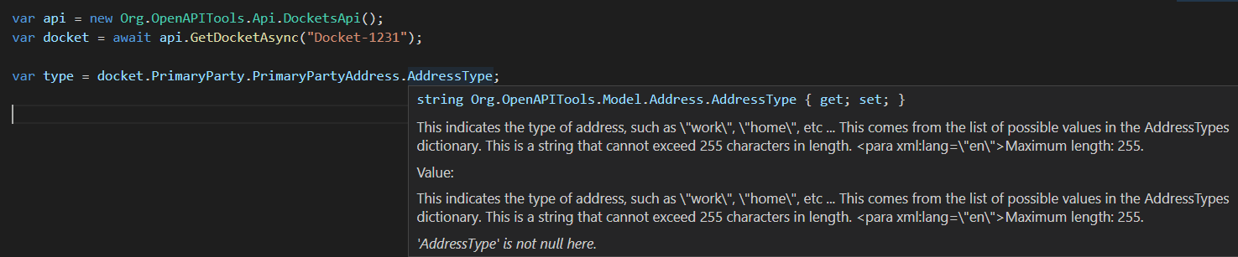
Preserved documentation intellisense/Code-completion

Slide 11
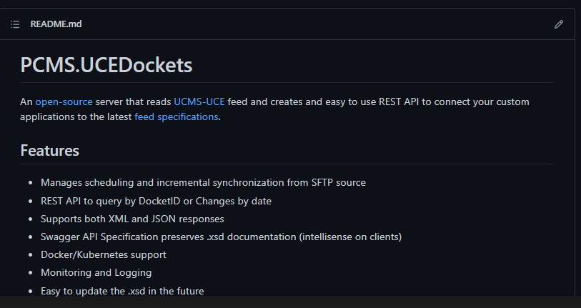
Join the effort at Github
https://github.com/NYPTI/PCMS.UCEDockets

Slide 12
Licenses
MIT License for this project
MIT License for runtime, deployed dependencies
Apache2 License for XSD tools used only at compile time

