Slide 1
Hackathon 2022
Name Pronunciation Service
Jagadeesh Kumar Sampatha Rao
Durga Vijay Sunkavalli
Rajasekhar Uppalapati
Durga Dwarapudi
May 2022

Slide 2
Agenda
Problem Statement
Solution Approach
Design
Demo
Documentation
User Stories
Q & A

Slide 3
Problem Statement
Employees and contingent workers come form an amazing diversity of backgrounds, and the variety of names within the company is profound. Often, employees find themselves struggling with the pronunciation of others’ names. We need to develop a solution to make it easier for employees to share and understand the pronunciation of others’ names.
Key Deliverables
Standard Pronunciation: API to provides standard aural pronunciation for names, based on rules.
Non-Standard Pronunciation: API to override standard pronunciations and provide custom pronunciations for cases where employees prefers pronunciation that differs from the standard solution.
User interface to intract with to play and record pronunciation.

Slide 4
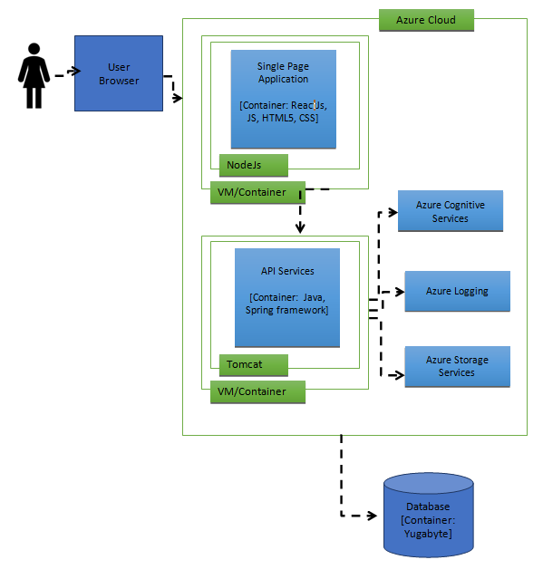
Solution Approach

Slide 5
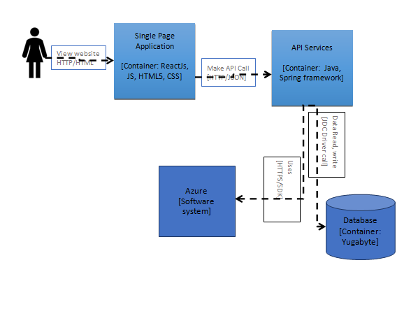
Design

Slide 6
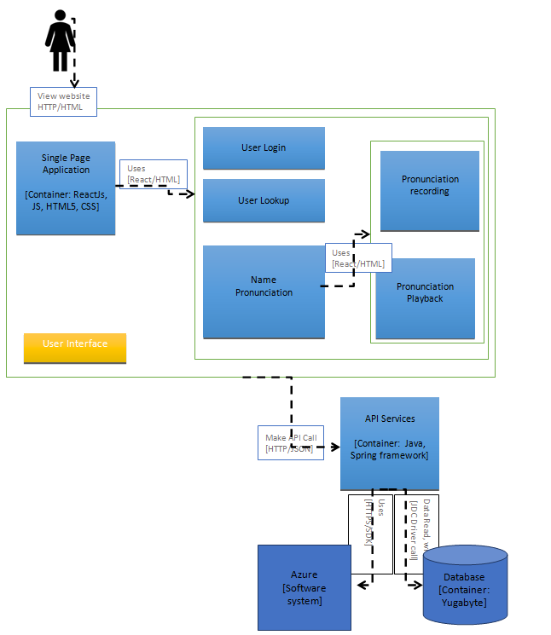
Design cont…

Slide 7
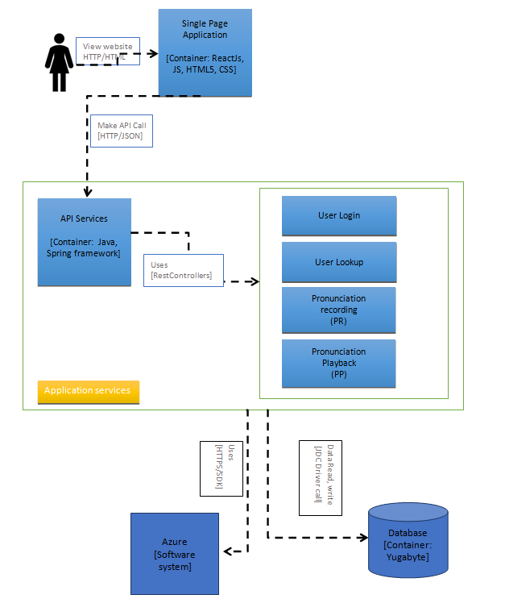
Design cont…

Slide 8
Demo

Slide 9
Documentation
Open API – Services Documentation
https://name-pronunciation-service.azurewebsites.net/swagger-ui/index.html
Junits
Run Book

Slide 10
User Stories

Slide 11
Q & A

Slide 12
Thank You

