Slide 1
AWS Identity and Access Management (IAM)
Chapter 6 AWS
Presented by
Sampath Talluri

Slide 2


Introduction
Why do we need Access Management?
What is IAM?
Components of IAM.
Multi Factor Authentication
Hands-on

Slide 3




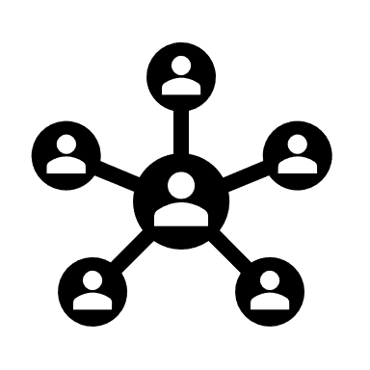
Why do we need Access Management
Server
It will be granting all the permissions
Only Analytics Module will be assigned to this role
ADMIN
UI Developer
Business Analyst
Only Graphics Module will be assigned to UI Developer

Slide 4

What is IAM
Identity and access management (IAM) in enterprise IT is about defining and managing the roles and access privileges of individual network users and the circumstances in which users are granted (or denied) those privileges.
Those users might be customers (customer identity management) or employees (employee identity management. The core objective of IAM systems is one digital identity per individual.

Slide 5

AWS IAM
AWS Identity and Access Management (IAM) is a web service that helps you securely control access to AWS resources for your users. You use IAM to control who can use your AWS resources (authentication) and what resources they can use and in what ways (authorization).

Slide 6
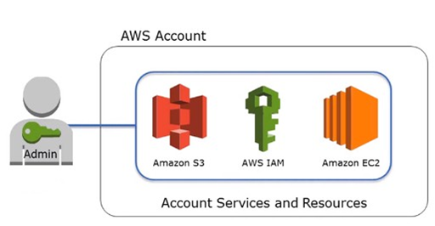
Components of IAM - User
With IAM, you can securely manager access to AWS services.
You can create an IAM user when there is a new employee to your corporate

Slide 7
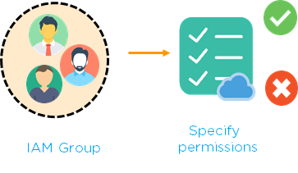
Components of IAM - Groups
A collection of IAM users in IAM group
We set the single permission for entire group
Any permission applied for group, are applied for all the user’s in the group

Slide 8
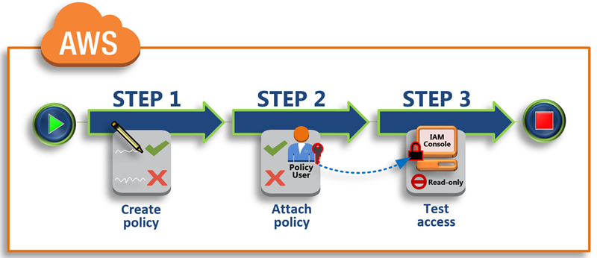
Components of IAM – Policies
In AWS Policy set the permissions and control the access to AWS resources.
We can create an own policy
We can also use existing policy
Policy set permissions like how can access the resources and set what type of actions to be performed.

Slide 9
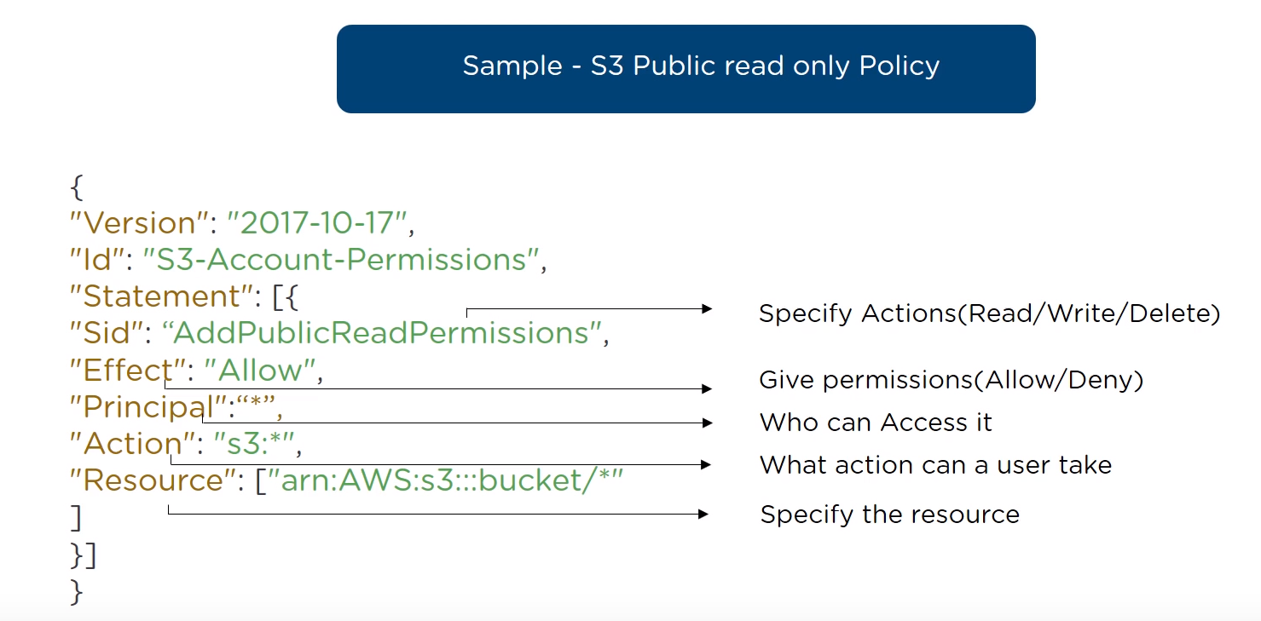
Components of IAM – Policies

Slide 10
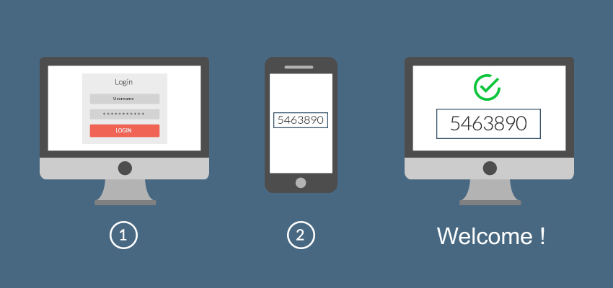
Multi Factor Authentication
Multi-factor authentication is an authentication method in which a computer user is granted access only after successfully presenting two or more pieces of evidence to an authentication mechanism: knowledge, possession, and inherence. Two-factor authentication is a type, or subset, of multi-factor authentication

Slide 11
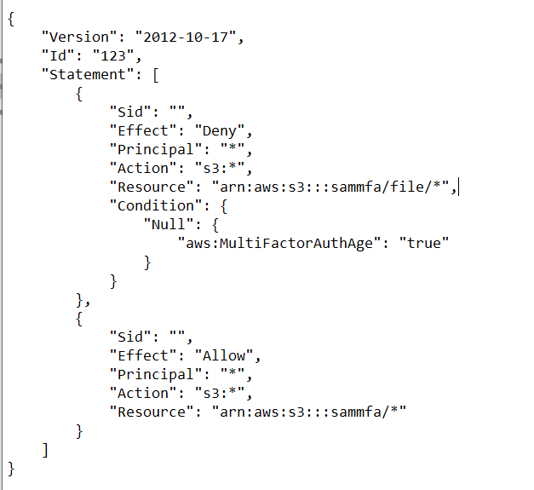
Hands-on
Creating a bucket and setting bucket policy.
IF the user has Multi Factor Authentication the he can access the bucket services.

