Slide 1
Review 2
Grievance Redressal Portal for Institutions
Database Systems Engineering and Distributed Backend Development (25CS1302E)
Sec 10 | Team 06
M S S M V Sampath (2520090005)
M Susheel Rao (2520080064)
Koneru Lakshmaiah Education Foundation | Y25 – 2026-27 Trimester 4

Slide 2
Problem Statement
Traditional grievance handling in institutions is manual, slow and opaque.
No transparency
Manual & slow
Students and staff cannot see where a complaint stands.
Paper/email complaints and lengthy back-and-forth.
Poor routing
No accountability
Grievances reach the wrong department or get lost.
No priority, deadlines or audit trail for resolution.
Grievance Redressal Portal | 2

Slide 3
Objectives
1
Provide one centralized portal to submit grievances on academics, exams, hostels, infrastructure and administration
2
Enable real-time tracking with status notifications
3
Automate categorization and priority-based assignment
4
Secure role-based access using JWT authentication
5
Build a scalable, containerized microservices backend with SQL + MongoDB
Grievance Redressal Portal | 3

Slide 4
Proposed System
An intelligent, centralized, technology-driven grievance platform for students, faculty and staff.
Submit & Track
Auto-Categorize
Notify
Smart Search
Secure submission with real-time status tracking
Automated categorization and priority-based assignment
Event-driven status notifications via Kafka
Semantic search to find similar complaints (optional AI)
Role-based access: Student • Faculty/Staff • Department Officer • Admin
Grievance Redressal Portal | 4

Slide 5
System Architecture
Auth Service
PostgreSQL
Apache
Kafka
Grievance Service
Client
(Web UI)
FastAPI
Gateway + JWT
Notification Service
MongoDB
Admin Service
Docker containers • REST APIs • CI/CD pipeline (GitHub) • Postman testing
Grievance Redressal Portal | 5

Slide 6
Modules / Functionalities
Authentication
Grievance Management
Assignment & Routing
Register, login, JWT, roles
Submit, categorize, prioritize, track
Route to department / officer
Notifications
Admin
Search & Classification
Status alerts via Kafka events
Users, departments, reports
Similar-complaint search, AI classify
Grievance Redressal Portal | 6

Slide 7
Frontend Design
Home page
Login / Registration
Forms
Dashboard
Hero, about, "Submit grievance" and "Track" buttons
Role-based login, student/staff signup
Grievance form: category, description, attachment
Status cards, grievance list, filters, notifications
Grievance Redressal Portal | 7

Slide 8
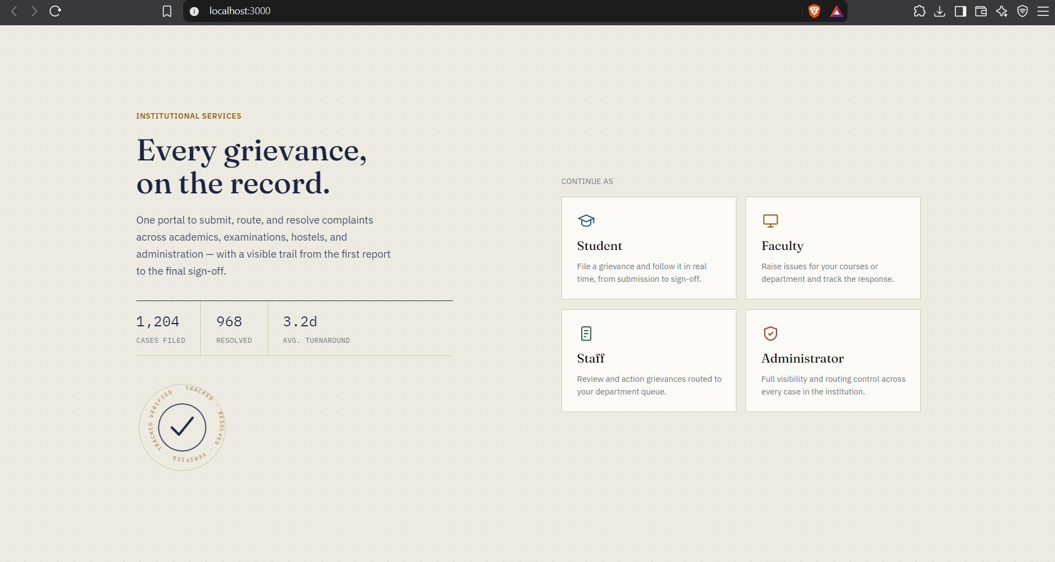
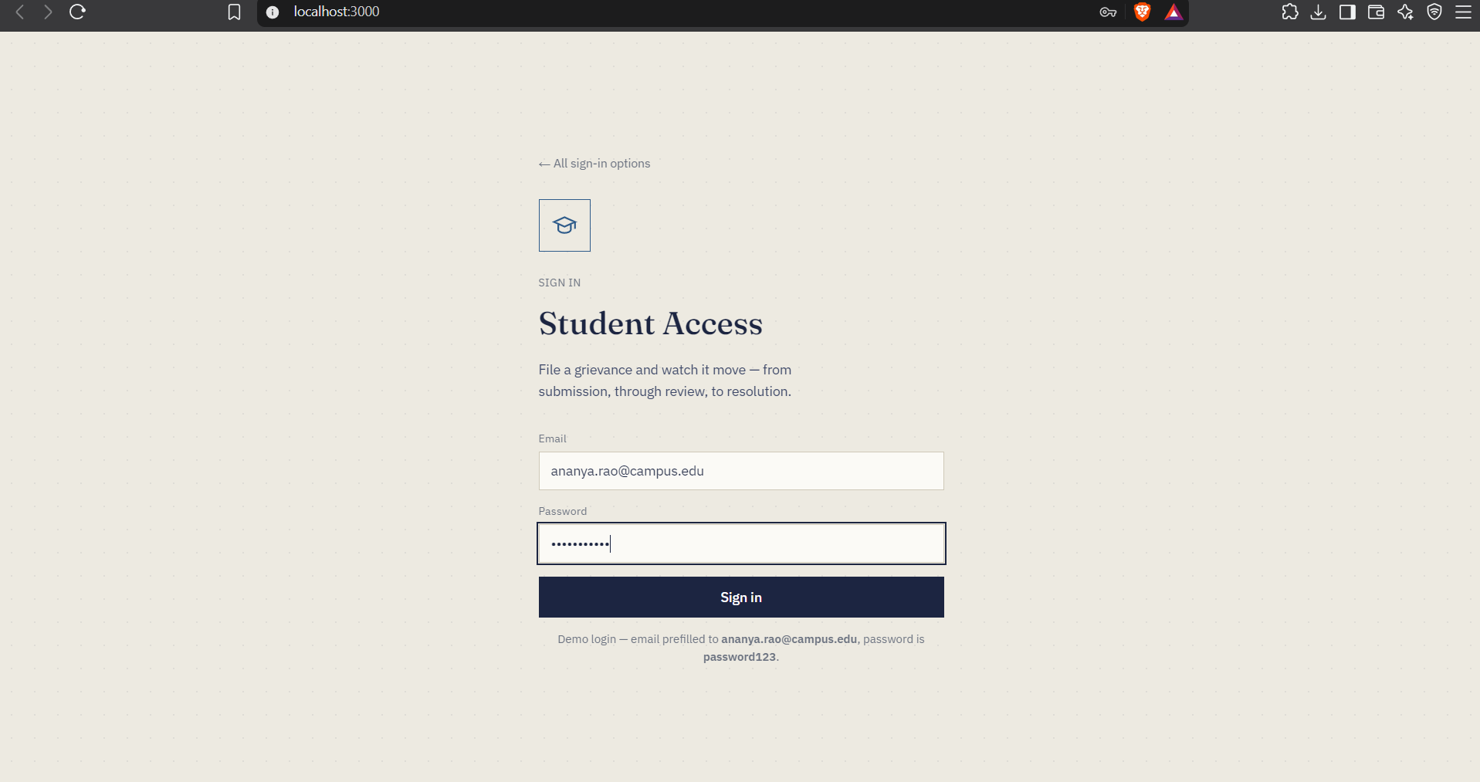
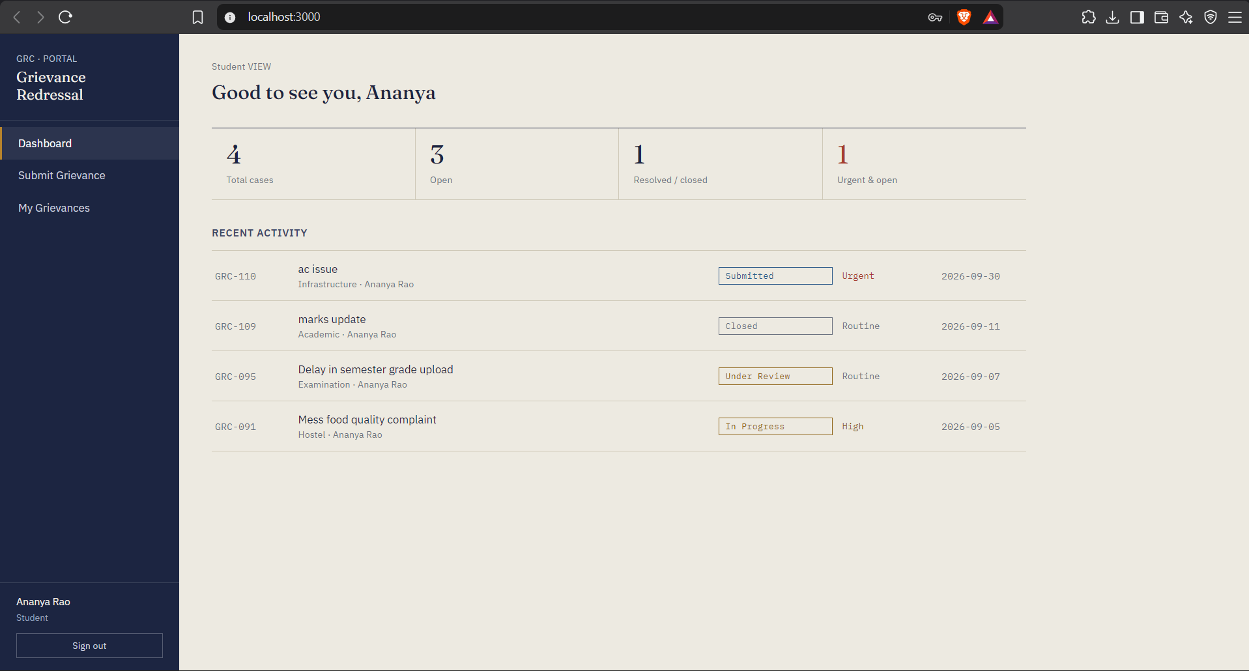
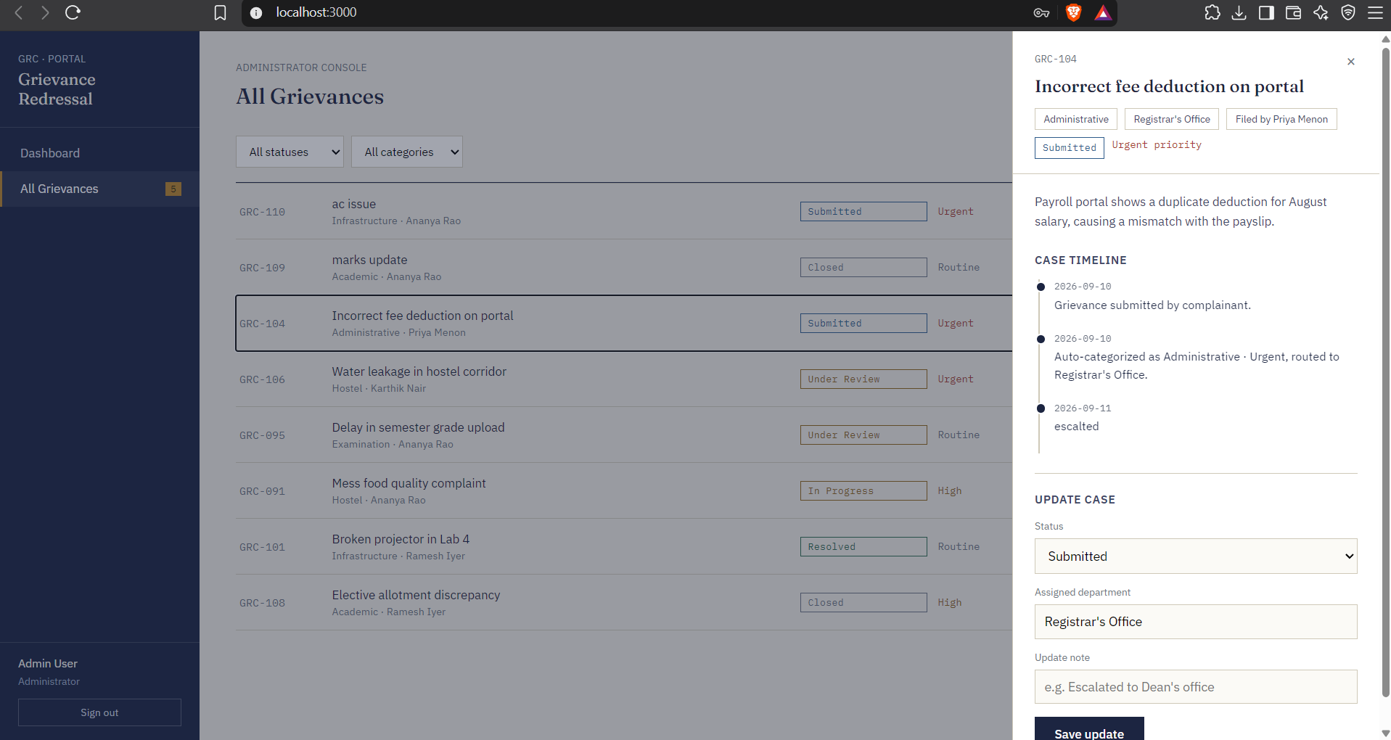
Frontend Implementation – Screenshots
Home page
Login (Student access)
Student dashboard
Admin console – case details
Grievance Redressal Portal | 8

Slide 9
Database Design
PostgreSQL (Relational)
MongoDB (NoSQL)
Structured, transactional data:
• Users and roles
• Departments
• Grievances (status, priority)
• Assignments
• Notification log
Ensures integrity via keys and constraints.
Flexible, semi-structured data:
• Grievance descriptions
• Attachments metadata
• Comments / discussion thread
• Status history & audit events
• Classification tags
Schema flexibility for evolving fields.
Grievance Redressal Portal | 9

Slide 10
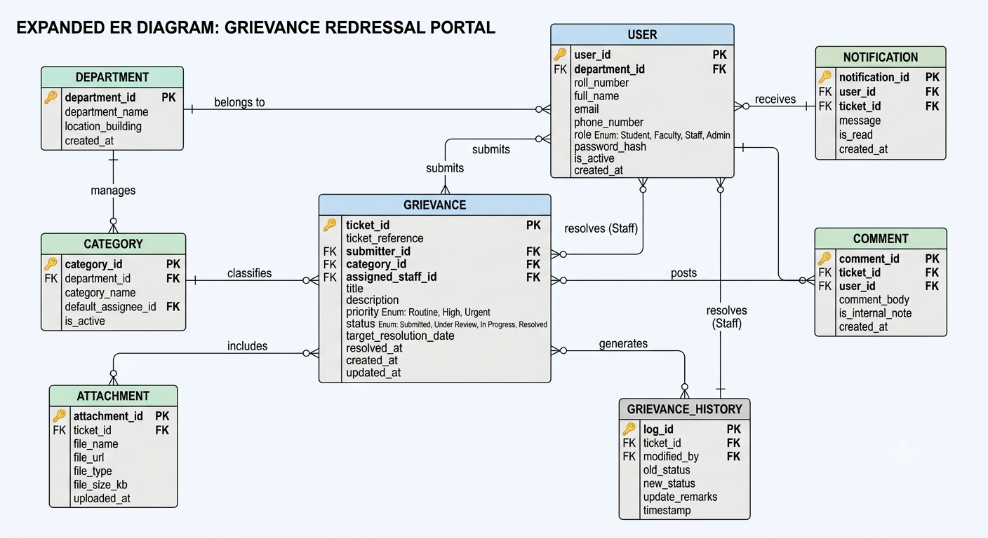
ER Diagram
Grievance Redressal Portal | 10

Slide 11
Database Tables / Schema
Table | Key columns
users | user_id (PK), name, email, password_hash, role, dept_id (FK)
departments | dept_id (PK), name, head_id (FK→users)
grievances | grievance_id (PK), user_id (FK), dept_id (FK), category, title, priority, status, created_at
assignments | assignment_id (PK), grievance_id (FK), assigned_to (FK), assigned_at
notifications | notif_id (PK), user_id (FK), grievance_id (FK), message, is_read
MongoDB: grievance_details | grievance_id, description, attachments[], comments[], history[]
Grievance Redressal Portal | 11

Slide 12
Sample Database Records
ID | Submitted by | Category | Title | Priority | Status
G-1001 | Student | Examination | Revaluation result delay | High | In Progress
G-1002 | Student | Hostel | Water supply issue in Block B | High | Assigned
G-1003 | Faculty | Infrastructure | Projector not working in Lab 3 | Medium | Resolved
G-1004 | Staff | Administration | Pending reimbursement | Low | Submitted
G-1005 | Student | Academics | Timetable clash for elective | Medium | Under Review
Illustrative sample data
Grievance Redressal Portal | 12

Slide 13
Current Progress
Abstract & requirements
Done
Database design & ER diagram
Done
Frontend UI (home, login, forms, dashboard)
In progress
FastAPI backend + JWT auth
In progress
Kafka, Docker, CI/CD integration
Planned
Grievance Redressal Portal | 13

Slide 14
Challenges / Issues Faced
Choosing SQL vs MongoDB
Service communication
Deciding which data belongs in which store
Designing Kafka events between microservices
Security
Environment setup
JWT auth and role-based access control
Docker networking and consistent deployment
Grievance Redressal Portal | 14

Slide 15
Future Work
Complete all microservices and connect frontend to APIs
Integrate Kafka notifications (email / in-app)
AI-based grievance classification and semantic search
CI/CD pipeline with automated tests and Docker deployment
Analytics dashboard and SLA/escalation rules
Grievance Redressal Portal | 15

Slide 16
Conclusion
The portal replaces manual complaints with a transparent, trackable and accountable system — combining SQL + MongoDB, FastAPI, microservices, Kafka, Docker and CI/CD into a scalable solution for institutions.
Thank you | Questions?

