Slide 1
DATABASE SYSTEMS ENGINEERING & DISTRIBUTED BACKEND DEVELOPMENT (25CS1302E)
Grievance Redressal Portal for Institutions
A centralized, transparent platform to submit, track and resolve grievances — built on FastAPI microservices, PostgreSQL + MongoDB, Kafka and Docker.
Sec 10 | Team 06
M S S M V Sampath (2520090005) • M Susheel Rao (2520080064)
Koneru Lakshmaiah Education Foundation | Y25 – 2026-27 Trimester 4

Slide 2
Why traditional grievance handling fails
Colleges and universities receive recurring complaints on academics, exams, hostels, infrastructure and administration — still handled through paper, email and verbal escalation.
No transparency
Manual & slow
Students and staff cannot see where a complaint stands.
Paper/email complaints cause long back-and-forth before review.
Poor routing
No accountability
Grievances reach the wrong department or get lost.
No priority, deadlines or audit trail to enforce resolution.
Grievance Redressal Portal | 2

Slide 3
Objectives and proposed solution
1
One centralized portal for academics, exams, hostel, infrastructure and admin grievances
Proposed system
Submit & track with live status
Auto-categorize and prioritize
Event-driven notifications via Kafka
Semantic search for similar complaints
Academic doubts: students ask, faculty answer
Roles: Student • Faculty/Staff • Officer • Admin
2
Real-time tracking with status notifications
3
Automated categorization and priority-based assignment
4
Secure role-based access using JWT
5
Scalable, containerized microservices with SQL + MongoDB
Grievance Redressal Portal | 3

Slide 4
System architecture
Auth :8001
PostgreSQL
Grievance :8002
PostgreSQL + MongoDB
Apache Kafka
grievance / auth / doubt events
Client
(Web UI / Postman)
API Gateway :8000
routing • rate-limit • JWT
Notification :8003
MongoDB
Admin :8004
PostgreSQL
Doubt :8005
PostgreSQL
Docker containers • REST APIs • GitHub Actions CI • Postman testing
Grievance Redressal Portal | 4

Slide 5
How the design evolved: abstract → implementation
Aspect | Abstract (Phase 1) | Implementation (Review 2)
Architecture | Three-tier monolith | Six microservices behind an API gateway
Backend | Node.js + Express | Python FastAPI (async)
Database | MySQL only | PostgreSQL (relational) + MongoDB (flexible)
Auth | JWT middleware | JWT + role-based access + login rate limiting
Notifications | Direct alerts to client | Kafka events consumed by Notification Service
Deployment | Not specified | Docker Compose + CI/CD via GitHub
Frontend | React JS SPA | Web UI served through the gateway
Grievance Redressal Portal | 5

Slide 6
Microservices and responsibilities
Service | Port | Responsibility
Gateway | 8000 | Path routing, login throttling, health aggregation, request-ID propagation, serves the UI
Auth | 8001 | Registration (students/faculty), login, JWT issuing, roles
Grievance | 8002 | Submit, categorize, prioritize, track, timeline, similar-complaint search
Notification | 8003 | Consumes Kafka events; stores and serves in-app notifications
Admin | 8004 | Categories, department mapping, users, analytics and reports
Doubt | 8005 | Academic Q&A threads between students and faculty
Grievance Redressal Portal | 6

Slide 7
Polyglot persistence: PostgreSQL + MongoDB
PostgreSQL
MongoDB
Users & roles, departments, grievances (status, priority), assignments, notification log. Integrity via keys and constraints.
Descriptions, attachment metadata, comments, status history & audit events, classifier output. Flexible schema.
Table | Key columns
users | user_id (PK), name, email, password_hash, role, dept_id (FK)
departments | dept_id (PK), name, head_id (FK → users)
grievances | grievance_id (PK), user_id, dept_id, category, title, priority, status
assignments / notifications | assigned_to (FK), grievance_id (FK), message, is_read
Grievance Redressal Portal | 7

Slide 8
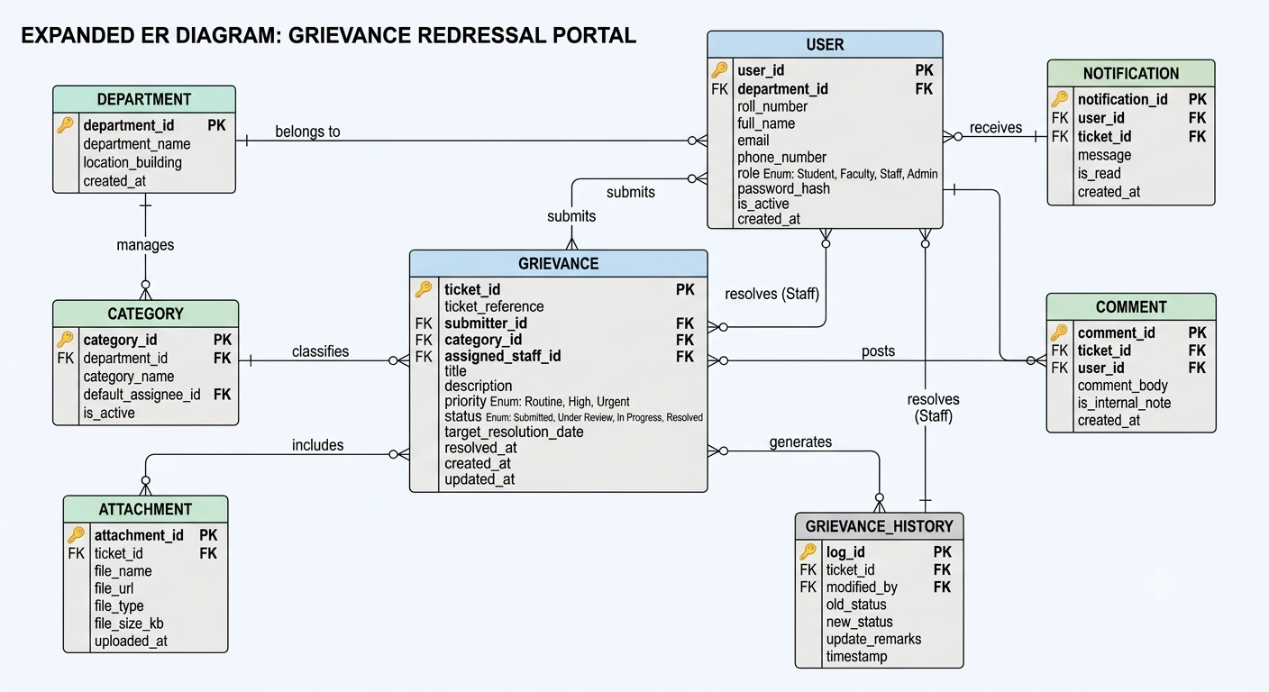
ER diagram
Grievance Redressal Portal | 8

Slide 9
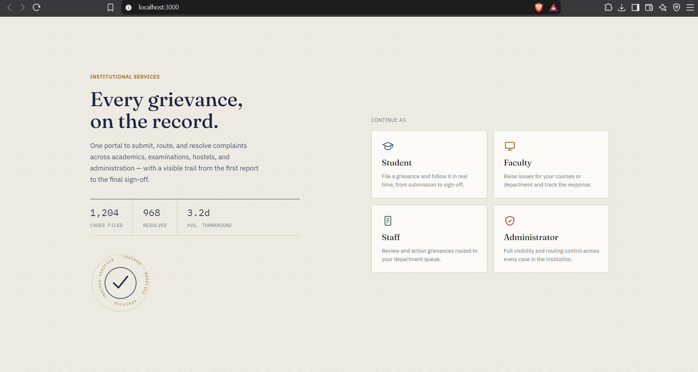
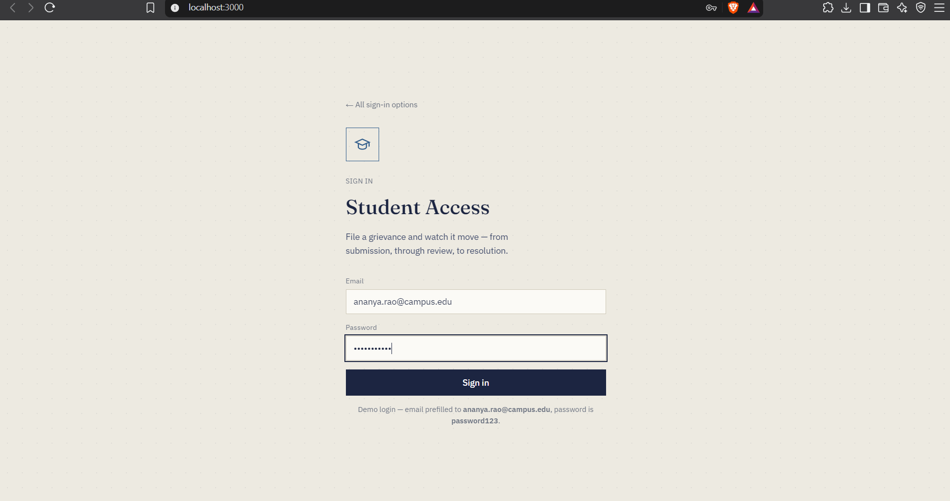
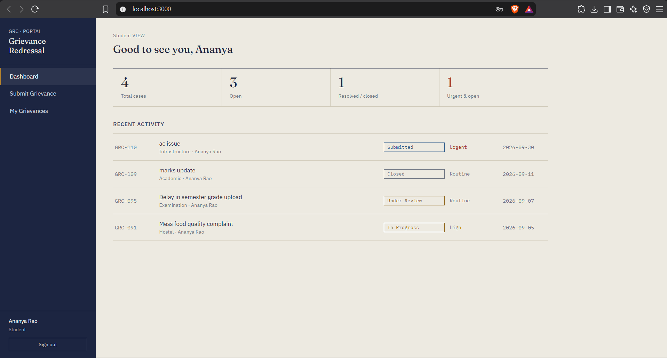
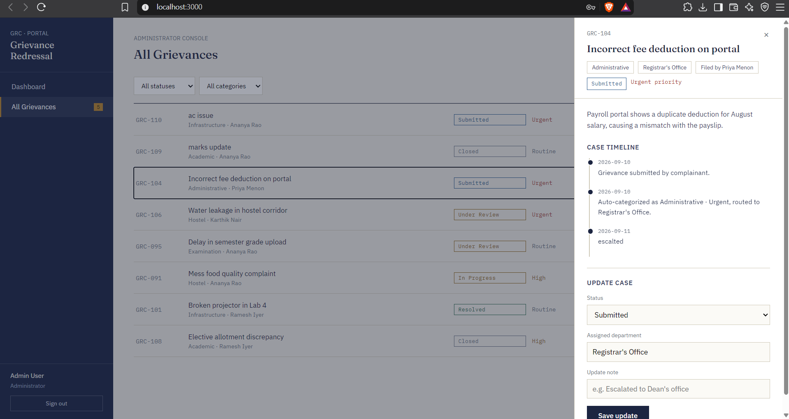
Frontend implementation
Home page
Login (Student access)
Student dashboard
Admin console – case details
Grievance Redressal Portal | 9

Slide 10
Key features implemented
6
2
53
3
microservices
databases: SQL + NoSQL
automated tests
Kafka event topics
Auto-classification
Similar-complaint search
Keyword classifier tags category and priority, then routes to the right department.
Finds related grievances to reduce duplicates.
Timeline & audit trail
Secure gateway
Every status change is logged in MongoDB.
JWT roles, login rate-limit, internal routes never exposed.
Grievance Redressal Portal | 10

Slide 11
Progress and challenges
Milestone | Status
Abstract, requirements, DB & ER design | Done
FastAPI services + JWT auth | Done
Kafka events, Docker Compose, CI workflow | Done
Postman collection and test suite | Done
Frontend–API polish, analytics, SLA rules | Planned
Design challenges
SQL vs MongoDB data split; designing Kafka events between services.
Engineering challenges
JWT + RBAC across services; Docker networking and consistent deployment.
Grievance Redressal Portal | 11

Slide 12
Future scope and conclusion
AI sentiment & root-cause analysis
Analytics dashboard, SLA & escalation
Multi-institution support
Chatbot-assisted filing
Mobile app & push notifications
Immutable audit & compliance logs
The portal replaces manual complaints with a transparent, trackable and accountable system — combining SQL + MongoDB, FastAPI microservices, Kafka, Docker and CI/CD into a scalable solution for institutions.
Thank you | Questions?
Grievance Redressal Portal | 12

