Slide 1
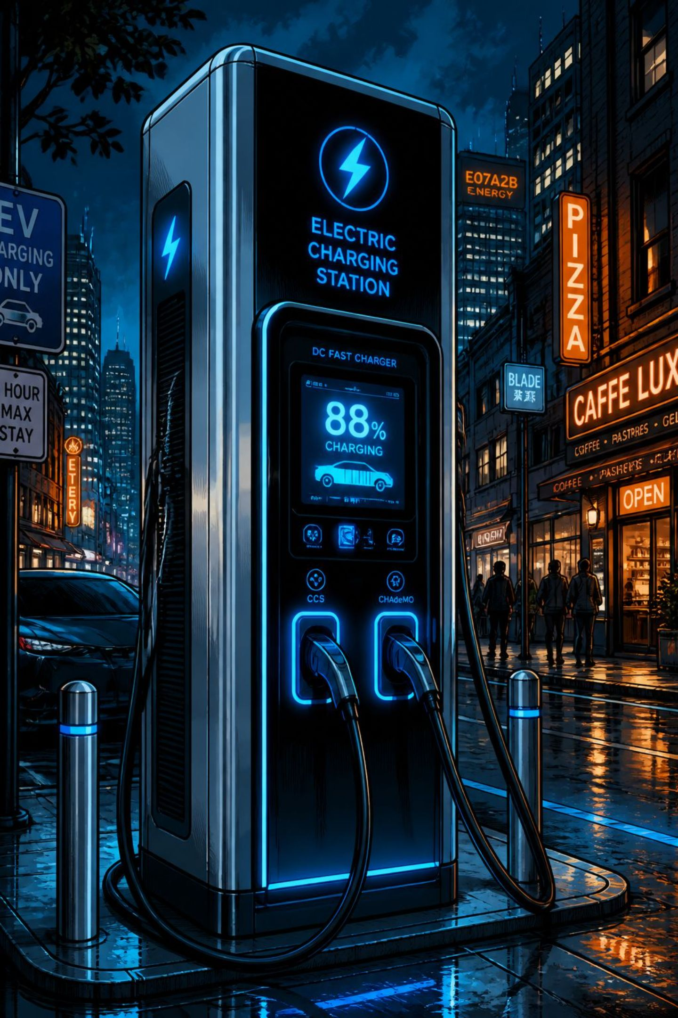
Global EV Charging Infrastructure & Adoption Analysis
Data Visualization Final Project · Summer 2026
NREL AFDC DATASET
STREAMLIT DASHBOARD
GITHUB REPOSITORY

Slide 2

Dataset & Scope Overview
Sourced from the NREL Alternative Fueling Stations repository — 105,000+ records spanning the US and Canada, covering four analytical dimensions.
Numerical
Level 2 & DC Fast port counts per station
Categorical
EV networks, connector standards, access types
Spatial
Latitude, longitude, state, and country
Temporal
Installation years spanning 1995–2026

Slide 3


Executive Takeaways
Exponential Public Expansion Post-2018
Public station growth accelerated sharply after 2018, outpacing private network deployment as mass-market EV adoption scaled.
Tesla & ChargePoint Lead Port Volume
Together, Tesla and ChargePoint dominate DC Fast and Level 2 port volume across North America.
California's 3× Infrastructure Lead
California holds over 3× the total charging port volume of any other US state or Canadian province.

Slide 4
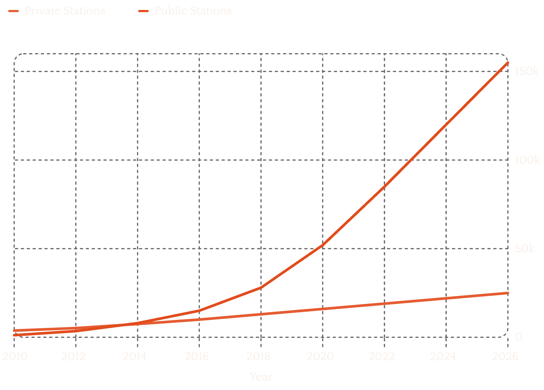

TEMPORAL TREND
Public Accessibility Drives Post-2018 Infrastructure Scaling
Key Observations
Public chargers experienced steep acceleration after 2020 to meet mass consumer EV adoption
Private network growth remained linear and modest by comparison
Public-to-private ratio widened from ~0.3× in 2010 to over 6× by 2026
The post-2018 inflection aligns with federal EV incentives and major OEM electrification commitments.

Slide 5
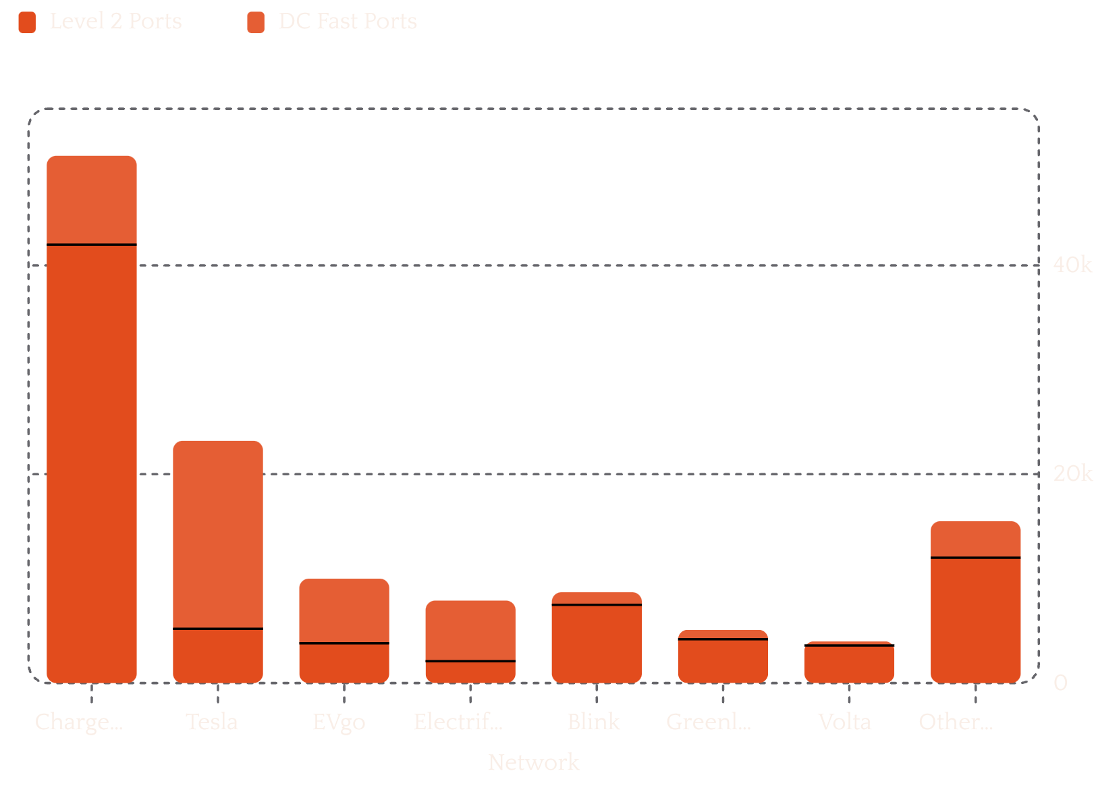
NETWORK ANALYSIS
ChargePoint and Tesla Network Lead Port Densities
Network Insights
ChargePoint leads total station footprint, especially in Level 2 deployment
Tesla dominates high-kW ultra-fast corridor deployment across North America
EVgo and Electrify America form the secondary DC Fast tier
Blink and Volta skew heavily toward Level 2 commercial and retail sites

Slide 6


SPATIAL ANALYSIS
Coastal Corridors Maintain Dense Charger Clusters Over Rural Interiors
Metro Concentration
High spatial density in major metro areas — Los Angeles, San Francisco, New York, and Toronto — drives the majority of port volume.
Charging Deserts
Significant gaps persist along rural interstate corridors, limiting long-distance EV travel viability outside coastal regions.
California Dominance
California alone accounts for over 3× the port volume of any other state or province, reinforcing coastal infrastructure asymmetry.

Slide 7
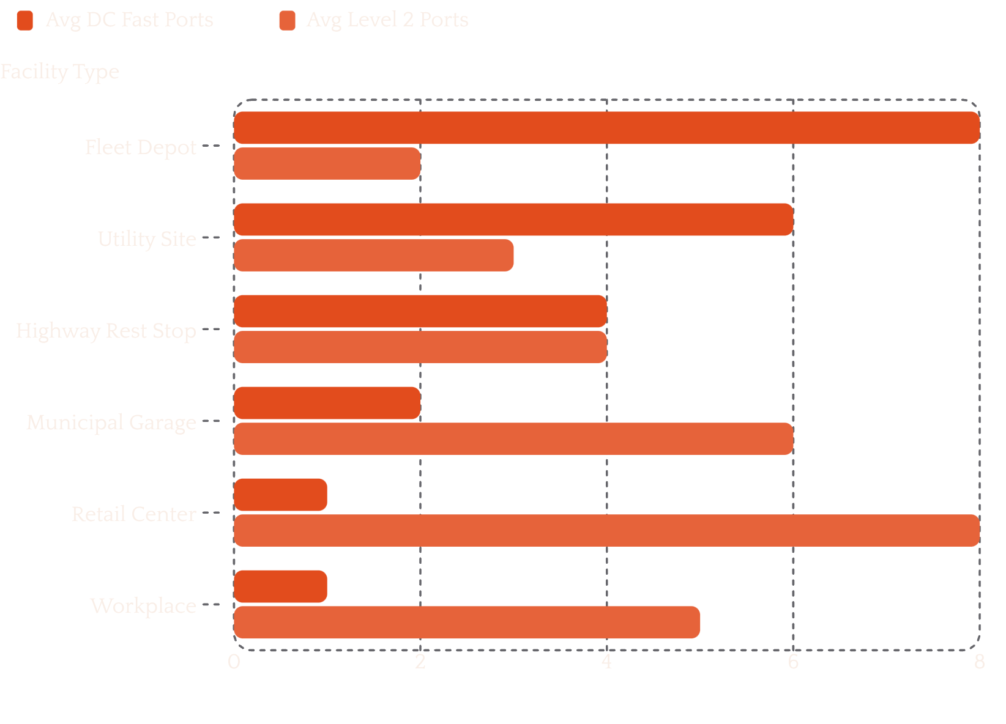
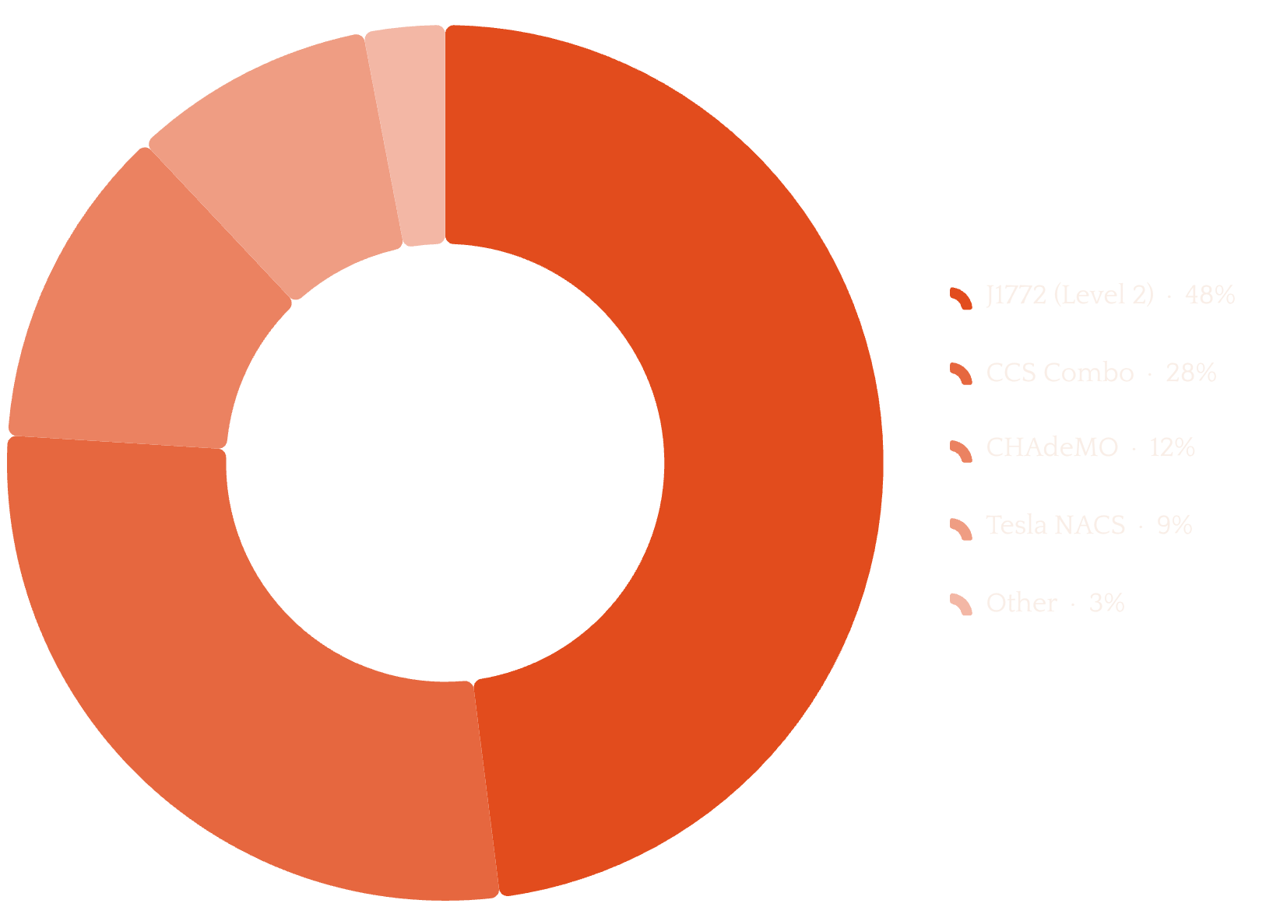
TECHNOLOGY & STANDARDS
Utilities Prioritize Fast Ports; J1772 and CCS Remain Base Standards
Connector Standards Share
Fleet and utility depots favor high-kW DC Fast ports, while commercial retail centers skew toward Level 2. J1772 and CCS collectively represent over 75% of connector share, though NACS adoption is accelerating.

Slide 8
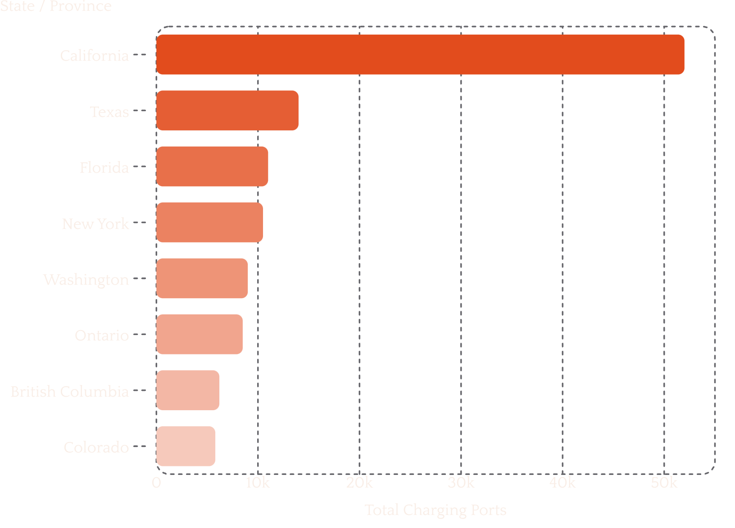
GEOGRAPHIC DISTRIBUTION
Level 2 Ports Comprise Over 80% of Total Infrastructure in US & Canada
Key Geographic Insights
Top 5 US states account for over 50% of total public ports nationwide
Level 2 ports comprise over 80% of total infrastructure in both the US and Canada
Ontario and British Columbia mirror US coastal concentration patterns
California's 52,000-port lead is nearly 4× that of second-place Texas

Slide 9
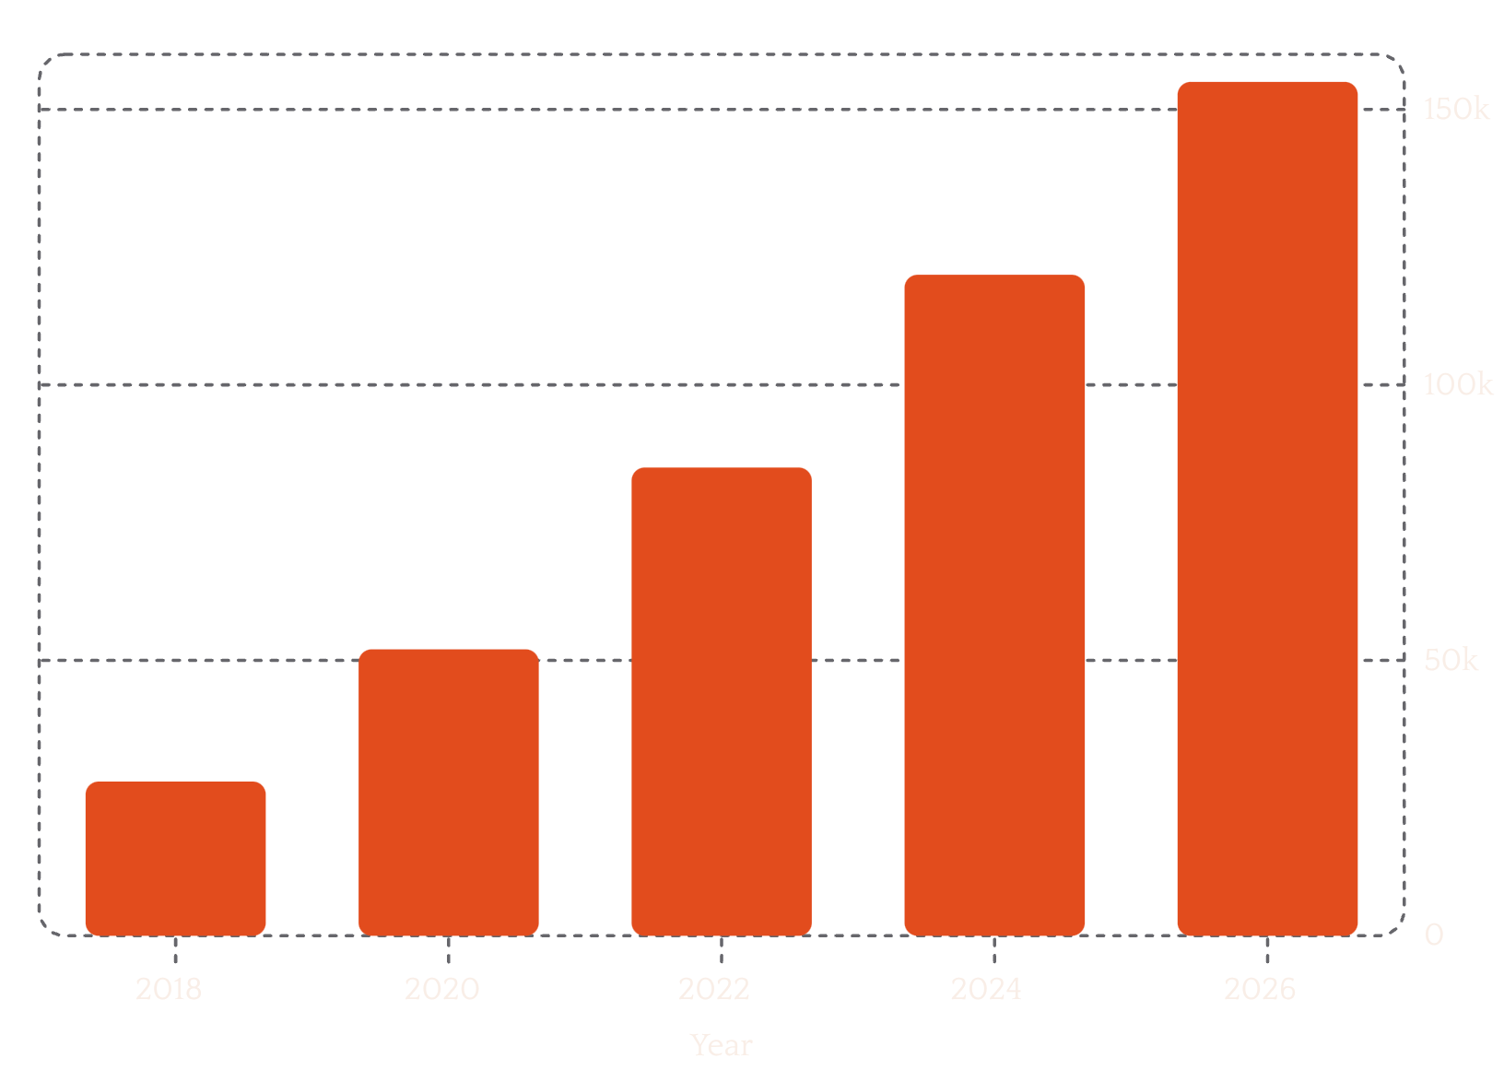
MARKET DYNAMICS
Workplace Access Lags Public Growth; Pricing Reporting Varies by Network
Market Observations
High variation exists in public fee disclosures across major networks
Workplace charging infrastructure remains secondary to commercial hubs
Pricing transparency is inconsistent — many operators do not publicly report rates
Workplace growth has not kept pace with the broader public expansion curve

Slide 10
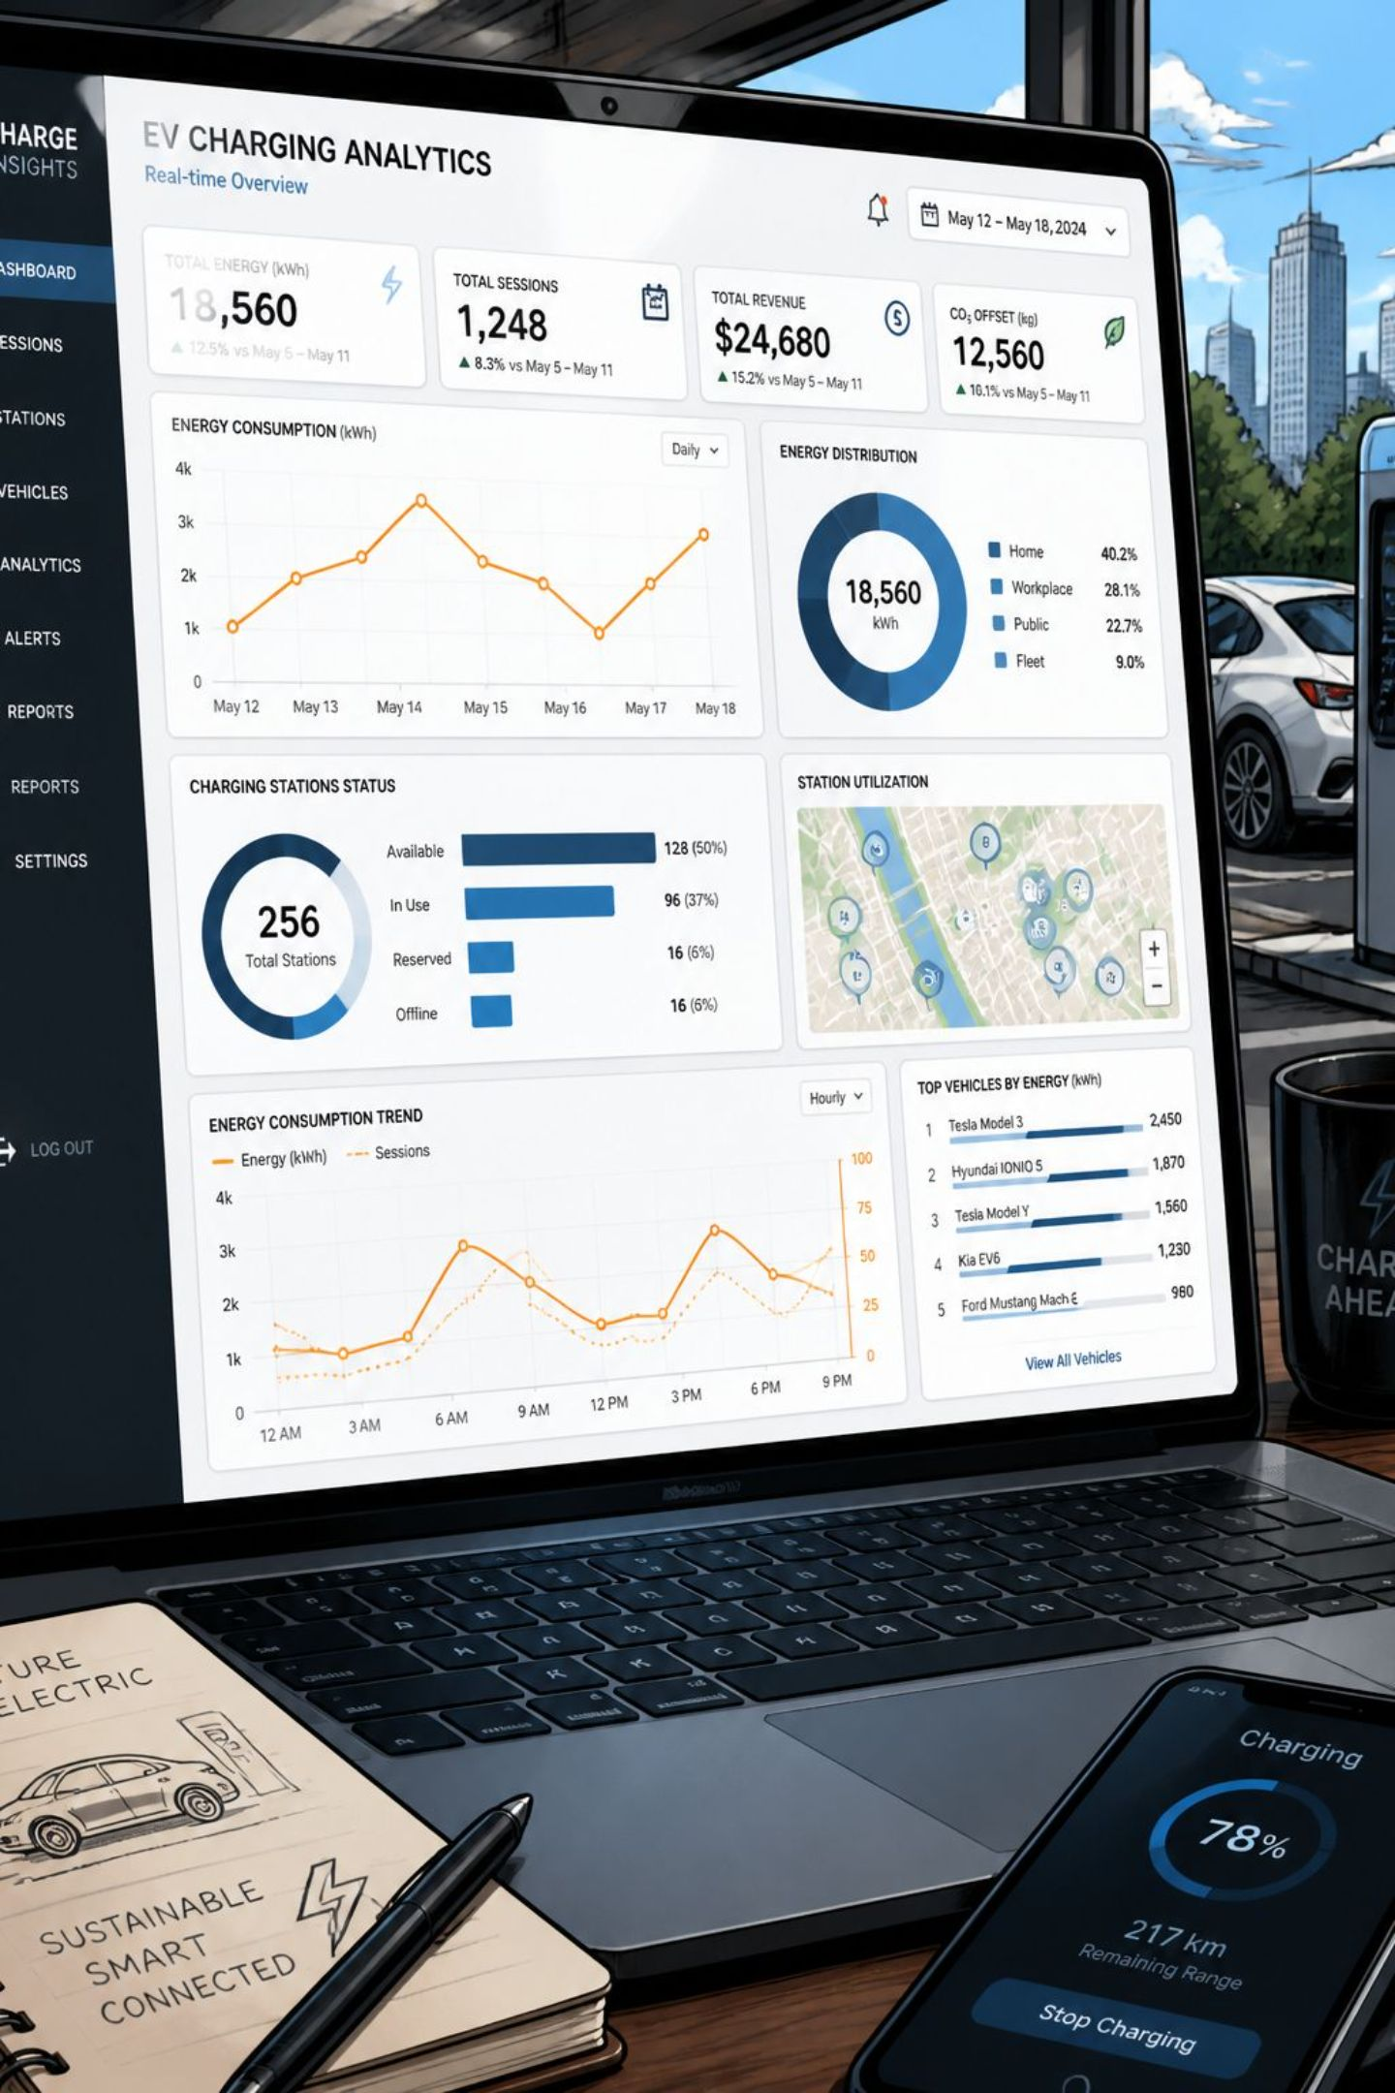
Interactive Dashboard & Key Conclusions
Streamlit Dashboard
Interactive filters for Country, Network, and Year across 3 structured tabs — live exploration of the full NREL dataset.
Grid Capacity
DC Fast corridor expansion requires coordinated grid upgrades and demand-response planning at utility scale.
Rural Corridors
Interstate charging gaps remain a critical barrier to equitable, nationwide EV adoption and long-distance travel.
NACS Consolidation
Tesla's NACS connector is rapidly becoming the North American standard, reshaping network compatibility.

