Slide 1

Crowdfunding
Kickstarter
Presented By Group 2
Allam Sampath Kumar
Sumaiya Ummer
Nithin Reddy Lenkala
Ankit Kumar Sahu
Rohit Kunjilal Gupta
Shrutika Thorat

Slide 2
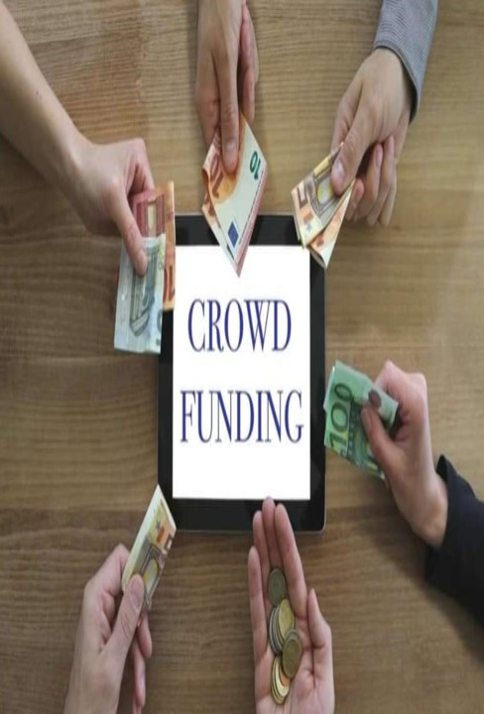
Crowdfunding
CROWDFUNDING IS THE PRACTICE OF FUNDING A PROJECT, BUSINESS, OR CAUSE BY COLLECTING SMALL AMOUNTS OF MONEY FROM A LARGE NUMBER OF PEOPLE, TYPICALLY VIA THE INTERNET.
IT ALLOWS INDIVIDUALS, ORGANIZATIONS, OR STARTUPS TO RAISE FUNDS FROM A DIVERSE RANGE OF PEOPLE, BYPASSING TRADITIONAL FUNDING SOURCES LIKE BANKS, INVESTORS, OR VENTURE CAPITALISTS.

Slide 3
Crowdfunding BENEFITS
1. It's about so much more then money.
2. A free page dedicated to your business.
3. Investor groups regularly Surf crowd funding platforms Feedback and sense of community.
4. A willing audience interested in you and success.
5. Cheerleaders for your brand.

Slide 4

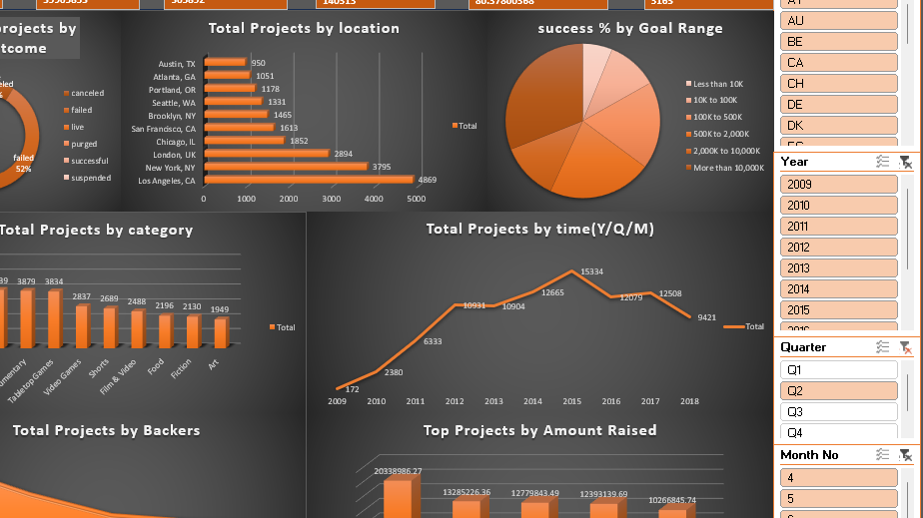
Excel Dashboard

Slide 5
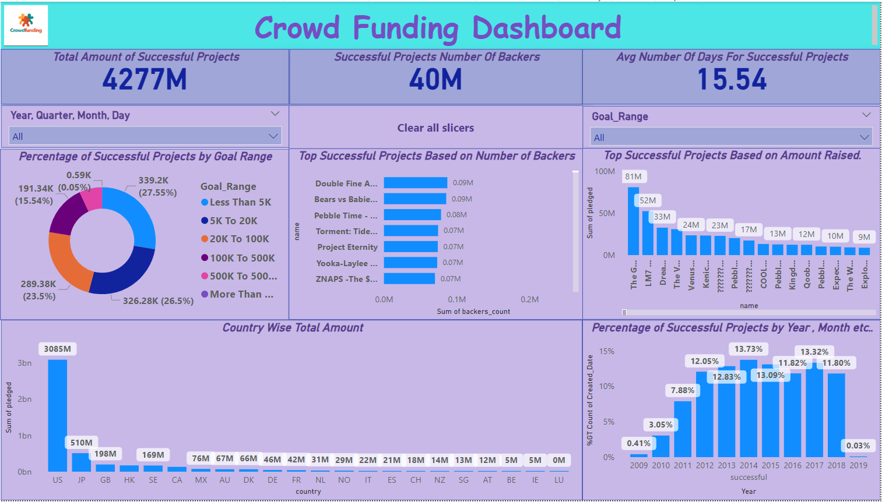
Power BI Dashboard

Slide 6
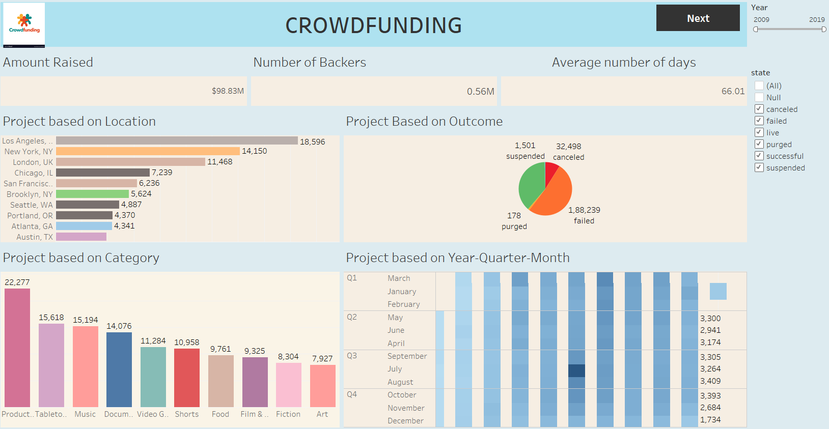
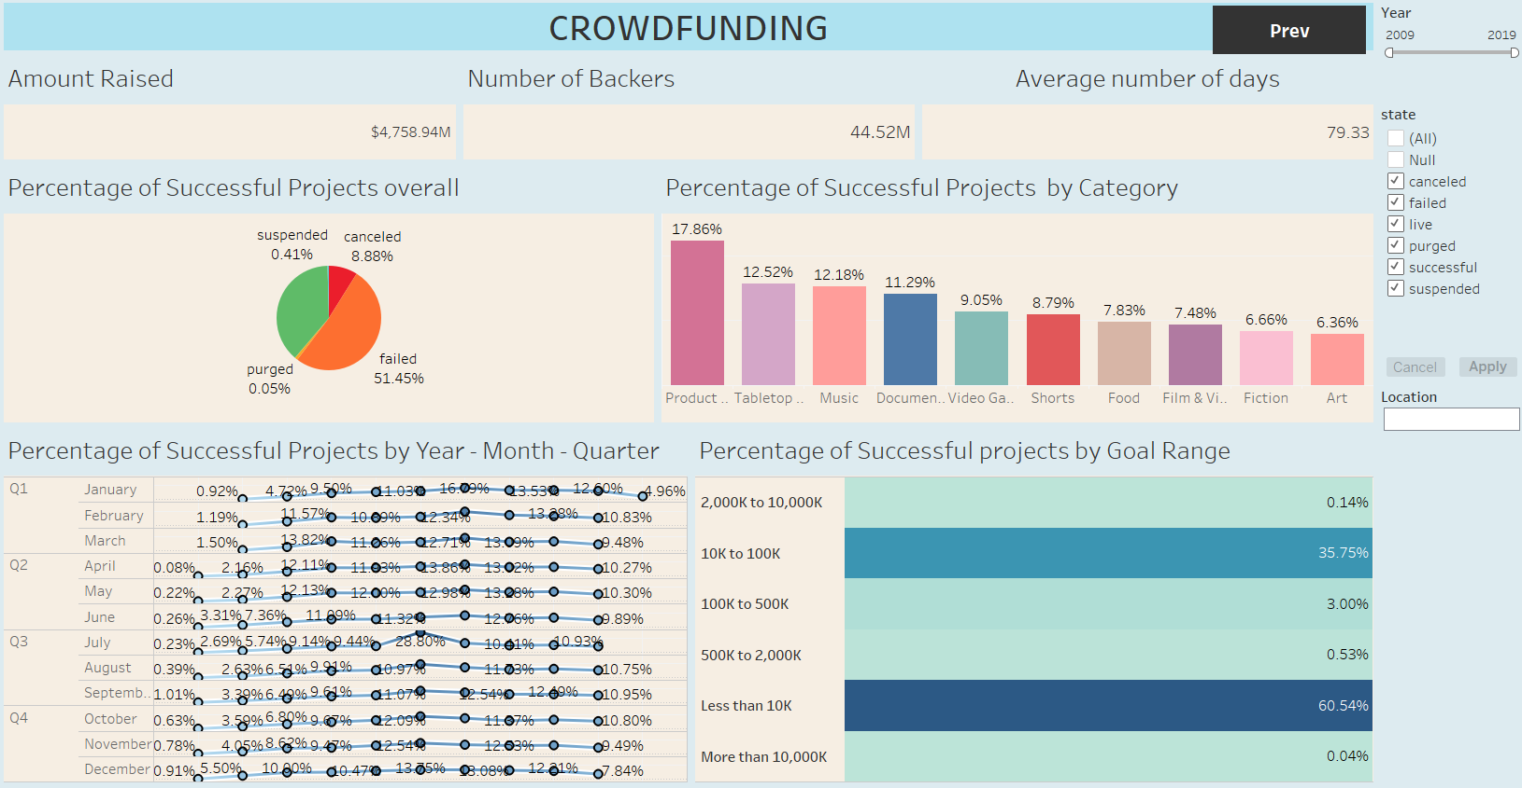
Tableau Dashboard

Slide 7
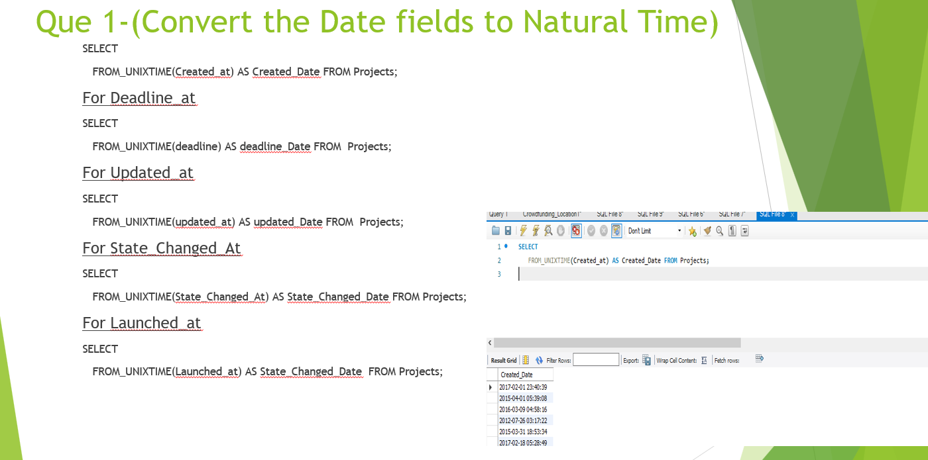
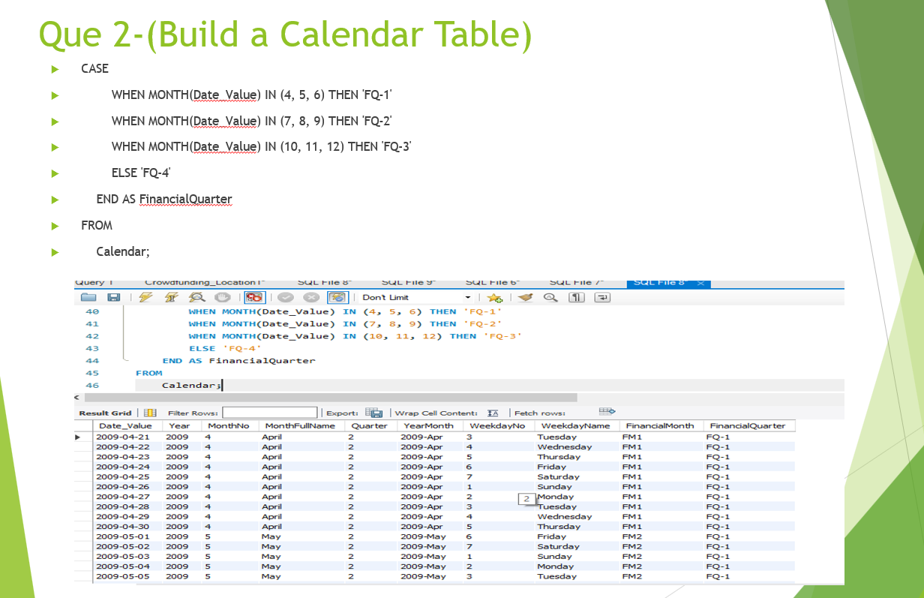
SQL Queries

Slide 8

CONCLUSION
The data model and KPIs provide a comprehensive look into crowdfunding dynamics on Kickstarter, making it possible to anticipate factors associated with successful outcomes.
This analysis supports strategic decision-making for potential project creators, as it outlines ideal goal ranges, popular categories, and optimal timing.
Through these insights, stakeholders can develop targeted strategies, increasing their likelihood of successful project funding and backer engagement.

Slide 9

ACKNOWLEDGEMENT
The successful completion of any task would be incomplete without mentioning all those people who made it possible, the constant encouragement, crowns the efforts with success. I wish my sincere gratitude to our project mentor for providing guidance throughout the Project. I am indebted to my well-wishers and friends who encouraged me in successful completion of the project.

Slide 10


