Slide 1


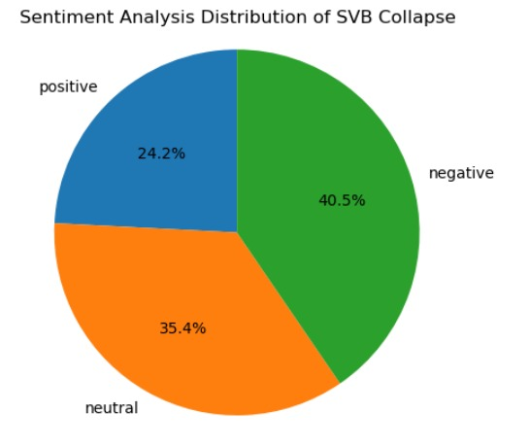
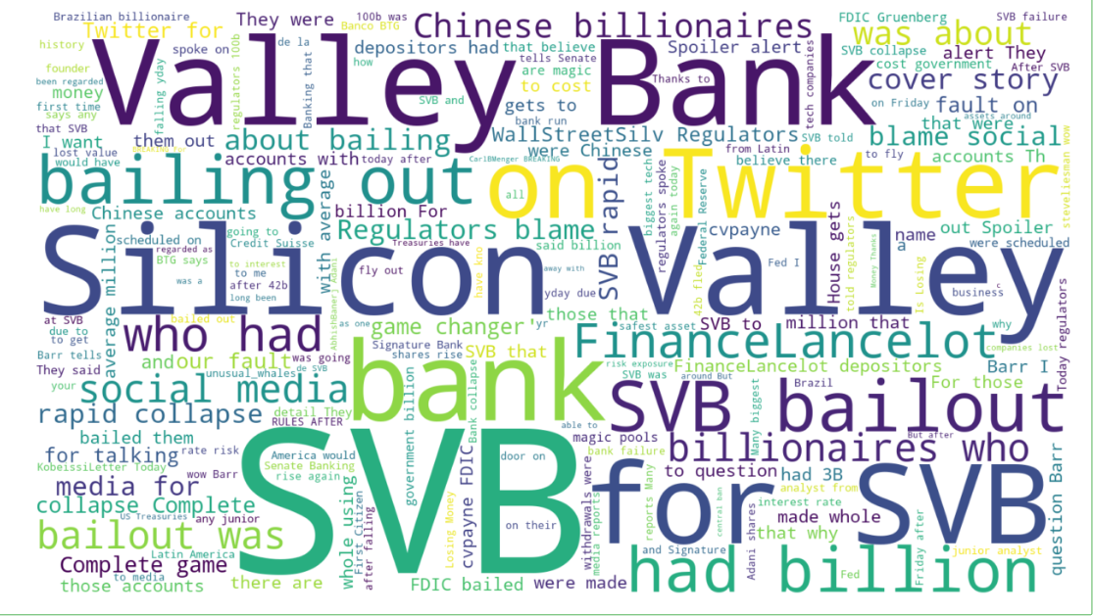
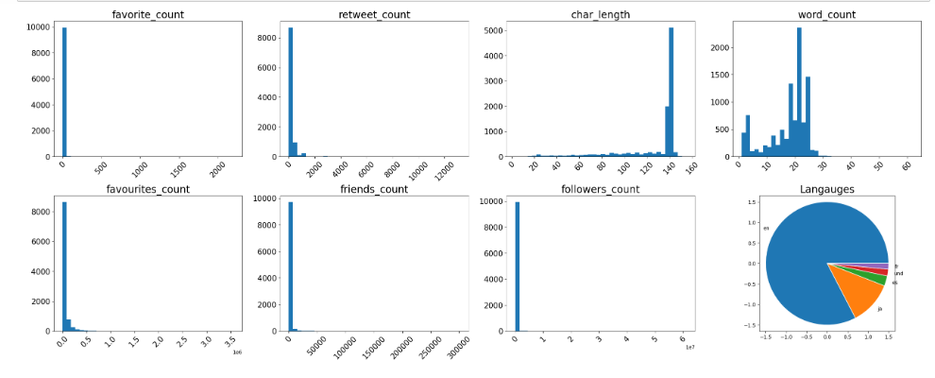
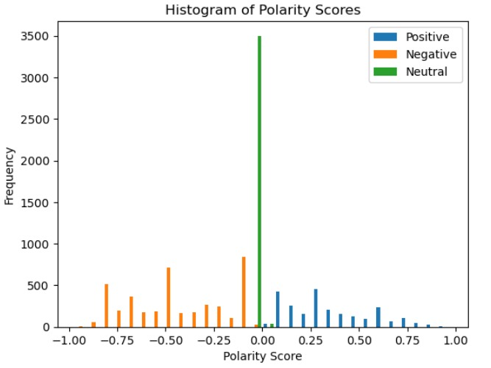
Principles of Big Data Management
Project: Silicon Valley Bank Collapse Twitter Data Analysis Project
Sampath Kumar Arpula K R P N S Santhosh
Project Overview
This study analyzed a large amount of Twitter data related to the collapse of SVB Bank using big data and advanced data management technologies like Hadoop and Spark. By leveraging machine learning functions like sentiment analysis, we were able to perform sentiment analysis on the tweets to determine whether they were negative, positive, or neutral. Using the VADER sentiment analysis library in Python, we accurately classified the sentiment of each tweet and gained a deeper understanding of the public's perception of the event. By enhancing data visualization with Spark Dataframes, we gained essential insights that could guide decision-making and promote corporate success. The project emphasizes the importance of using various tools and methodologies when analyzing large datasets, particularly with social media data. Additionally, the study highlights the critical role that efficient data management and analysis methods play in extracting valuable insights from large datasets.

