Slide 1

Analysis

Slide 2
Overview
Data Used
Key Takeaway
Descriptive Statistics
Analysis
Future Work

Slide 3
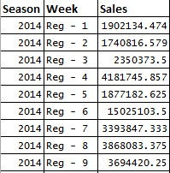
Meet the data
The dataset has 40 observations with 3 variables:
Season
Week
Sales
It has two seasons 2014 and 2015, 17 weeks of regular season and 3 weeks of post season for each year respectively.
Corresponding sales for each week of the season.

Slide 4
Key Takeaway
Net sales of 2015 is 45% less compared to 2014
Regular season 6, 12 and post season 1 and 3 of 2014 attributes to high sales.
Regular season 17 and post season 1 sales in 2014 are anomalous and it contributes to 44% of total sales

Slide 5
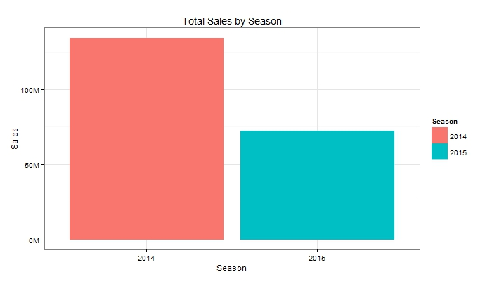
Total Season Sales
Total sales of 2015 is 45% less compared to 2014 sales

Slide 6
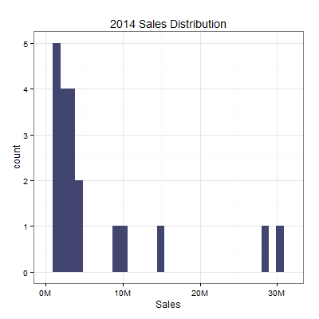
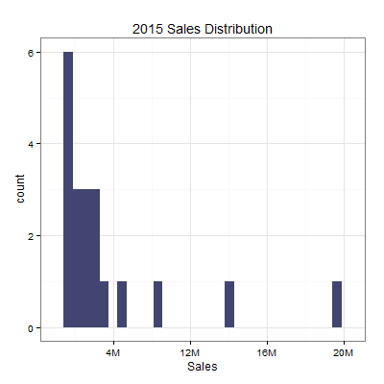
Sales distribution by season
Right skewed most of the sales are around 1 million to 10 million dollars but there are few anomalies around 20M to 30M dollars

Slide 7
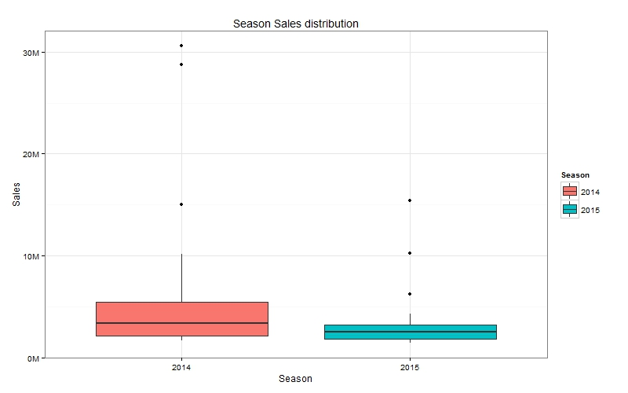
Anomaly in sales
Regular season 17 and post season 1 sales are extreme outliers and it
contributes to 44% of 2014 total sales

Slide 8
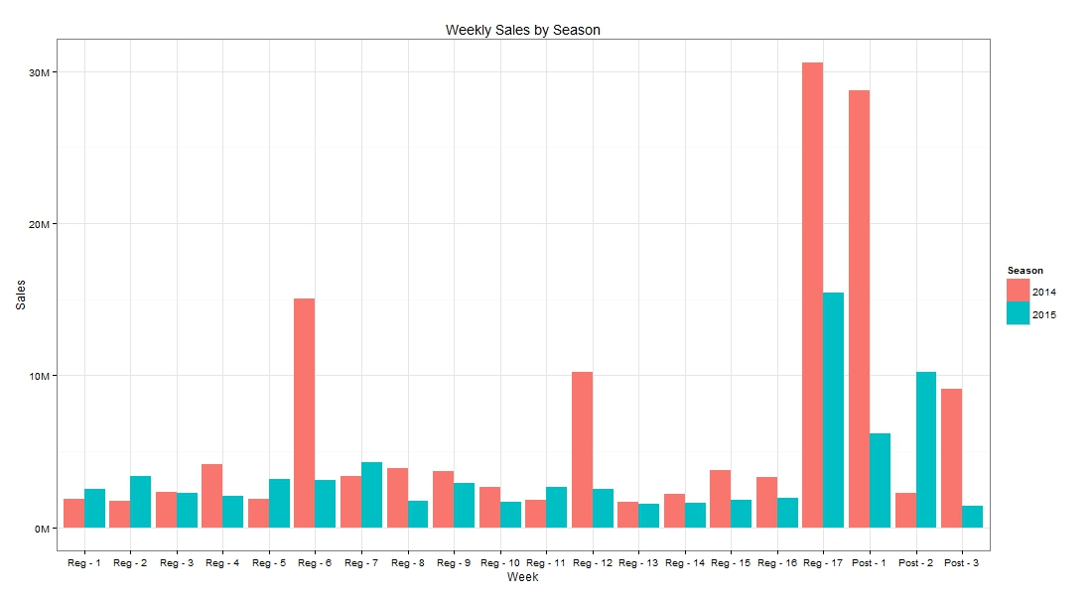
Total Sales by each week
Regular season 6, 12 and post season 1 and 3 of 2014 attributes to high sales compared to 2015.

Slide 9
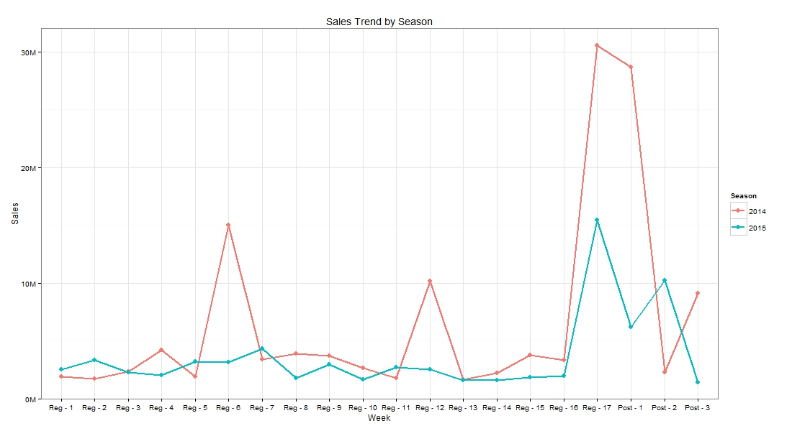
Sales Trend line
Regular season 17 has peak sales in both years 2014 and 2015, seems to be seasonal
2014 has peak sales in regular season 6,12, 17 and post season 1
2015 sales seems to be random but there is substantial increase in sales at regular season 17 and post seasons

Slide 10
Sample Dashboard
Developed R Shiny application pertaining to analysis done on the given data set.
Hosted the application in shiny server, can be accessed with the following link,
https://bgsuapps.shinyapps.io/NFLApp/

Slide 11
Future Work
Forecast 2016 sales using Time series models
Develop a model to find key drivers that impact the sales, provided additional features like,
Stadium characteristics
Weather data
Demographics

Slide 12


