Slide 1
MapReduce and Apache Spark

Slide 2
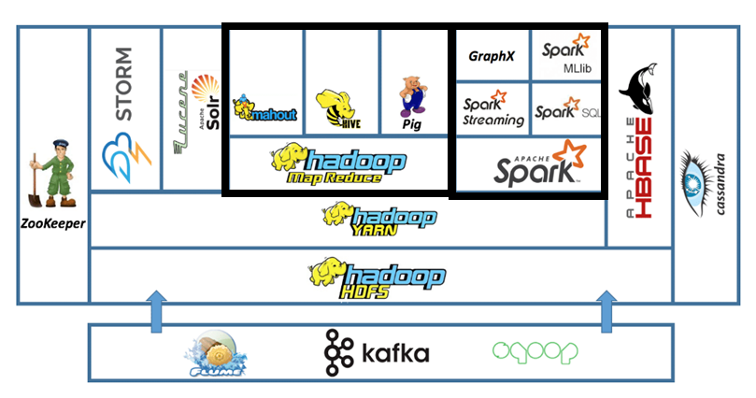
Compare Map Reduce and Apache Spark

Slide 3
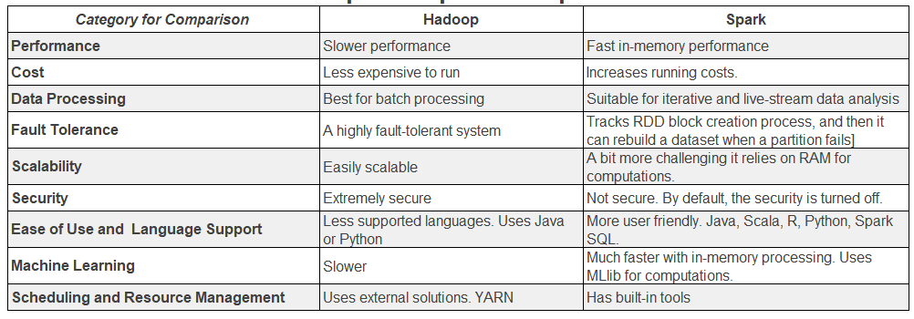
Compare Map Reduce and Apache Spark

Slide 4
The steps to compare MapReduce and Spark
1. Create a new s3 bucket and upload .csv file
2. Create EMR Clusters (MapReduce, Spark)
3. Connect using SSH with New KayPair
4. Create DB in Hive and Run Queries
5. Create Data Frame in Spark and Run Queries
6. Compare Performance

Slide 5
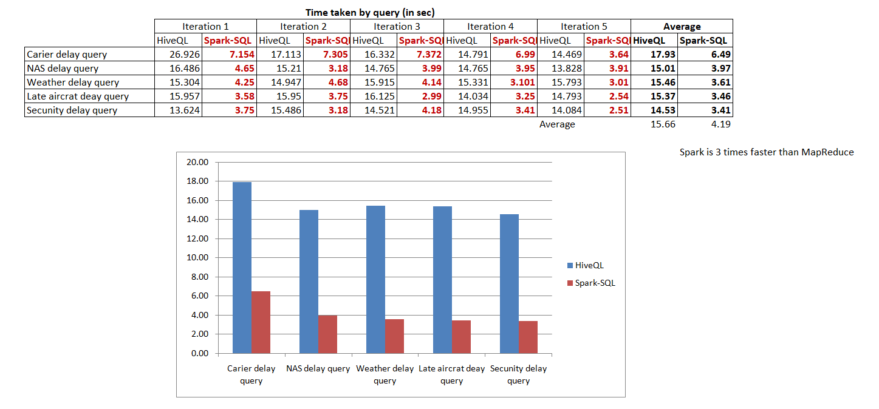
Conclusion

