Slide 1


Project proposed by :
EAST
(Eradication of Accidents using Sensing Technology)
IV –YEAR
Batch no : 13MNCSED-06
A.Surendhar (13881A05L1)
Y.V.S.R.Sampath (13881A05N5)
B.Shravan (13881A05J3)
L.Srikanth (13881A05K8)
Supervised By : S.VenuGopal

Slide 2
Contents
Objective.
Problem Description.
Components.
Working Principle.
Features.
Working Model.
Prototype.
Actual Working Model.
Testing.
Expected Results.
Actual Results.
Maintenance.
Interfacing SIM800 with Aurdino UNO.
Sending Alerts to the Maintenance Department.
Conclusion.

Slide 3

Problem Description
We all know that many accidents are being taking place at steep curves, bends and hilly areas and ruining out many lives of people and cattle.
We can prevent these accidents by proposing an idea on SENSORS.

Slide 4
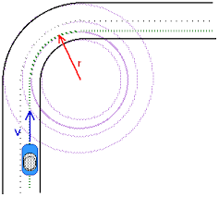
Proposed Idea
In this project with the help of Ultra-Sonic Sensors, Micro Controllers(Aurdino), and LED’s we can prevent accidents at steep curves and hilly areas.
By this project we can prevent many accidents irrespective of the vehicles having horns and lights.

Slide 5
Components of Ultra-Sonic Sensor
Beam Transmitter
Beam Receiver
Voltage Supply( V cc )
Ground(GND)

Slide 6
Working Principle
The major components of this project are Ultra- Sonic Sensors(HC-SR04), Micro Controllers (Aurdino UNO),Light Emitting Diode(LED) ,Transistors(NPN) and Batteries(9 Volts).
Working Of Ultra-Sonic Sensors:
The principle of Photo-Electric Sensor is based on reflection of beam which is being emitted by an inbuilt transmitter and this reflected beam is received by the inbuilt receiver whenever an obstacle has appeared.

Slide 7
Working Model
Initially when we provide power supply to this sensor, this gets activated and emits a beam of light to a certain range.
When this beam of light is caught by any obstacle the light gets reflected and this reflected light gets caught by the receiver present in the sensor.
This sensor consists of four pins. They are as follows:
1.Vcc(5 V) 3.Echo(INPUT pin)
2.Trig(Trigger) 4.GND(Ground)

Slide 8
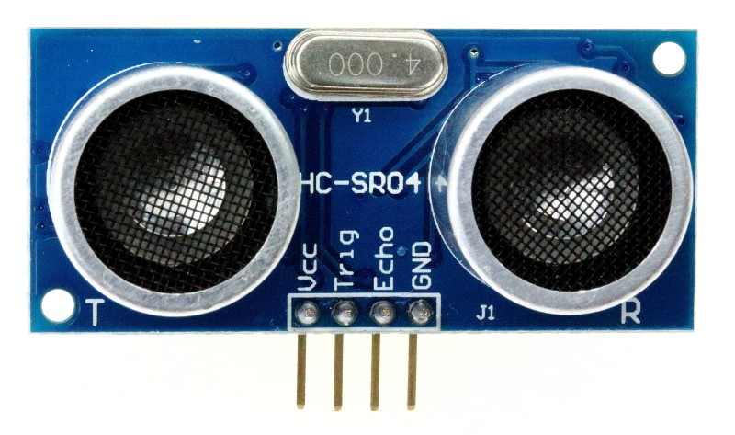
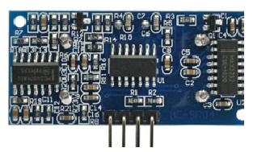
Features
Power Supply :+5V DC
Working Current: 15mA
Effectual Angle: <15°
Resolution : 0.3 cm
Measuring Angle: 30 degree
Trigger Input Pulse width: 10uS
Dimension:45mmx20mmx15mm

Slide 9
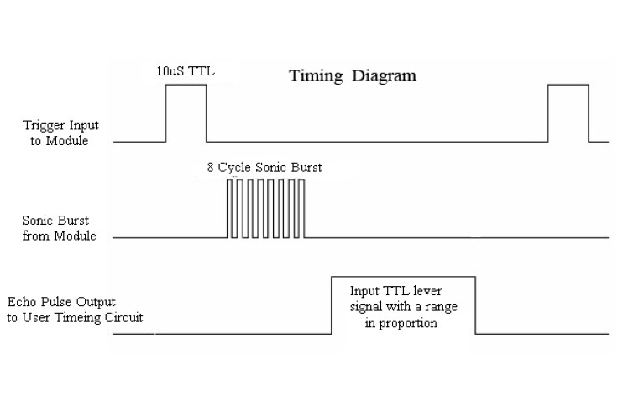
Ultra-Sonic Sensor (HC-SR04) Working Principle
A high pulse of time period not less than 10 micro seconds is applied across Trigger(Trig) pin.
Sensor will generate a wave of 40KHz,we calculate the travel time by starting a timer with Echo pin as control.

Slide 10
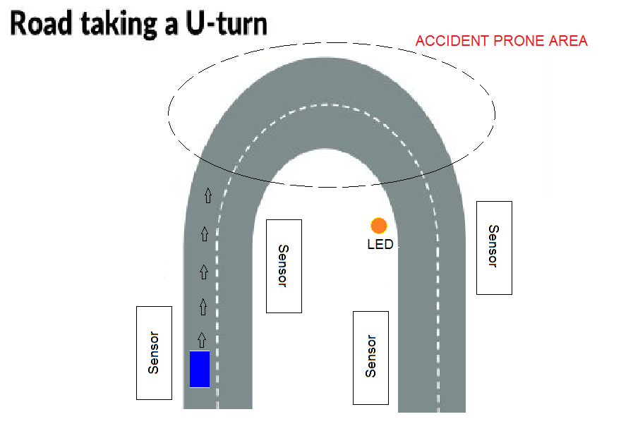
Diagrammatic Representation of Module

Slide 11
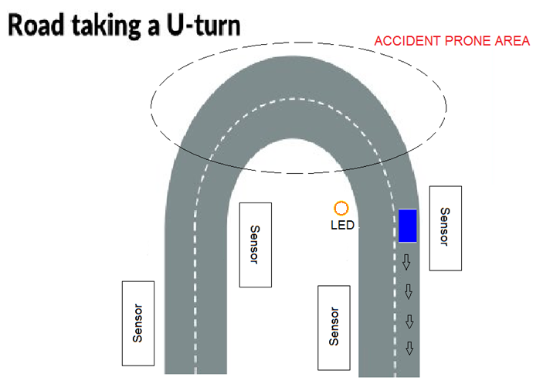
Diagrammatic Representation of Module

Slide 12
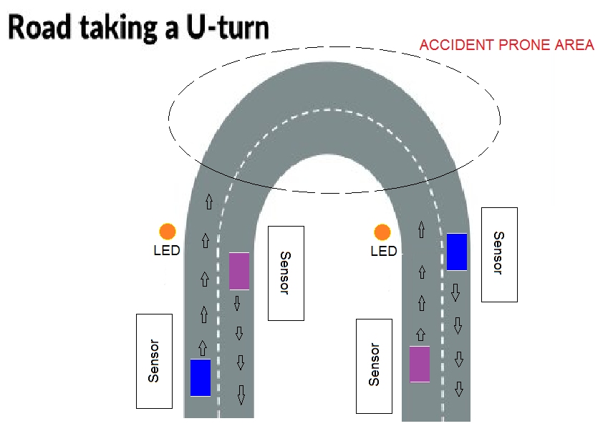
Diagrammatic Representation of Module

Slide 13
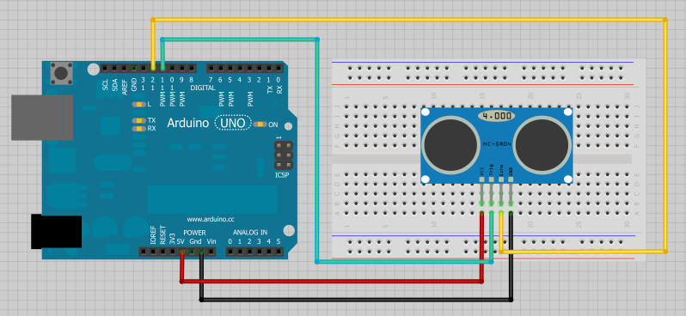
Connecting Ultra-sonic Sensor(HC-SR04) with Micro-controller( Aurdino UNO )

Slide 14
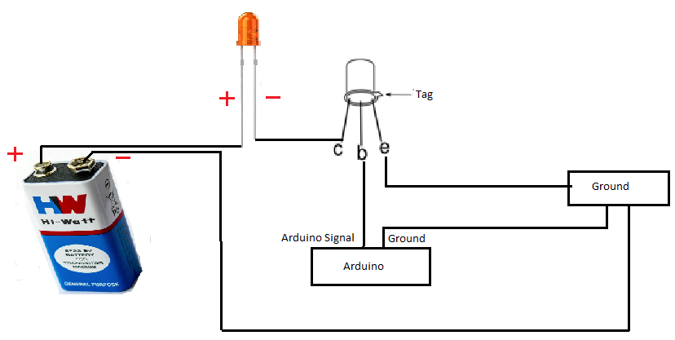
LED Connection with help of Transistor
e - Emitter
b - Base
c - Collector

Slide 15
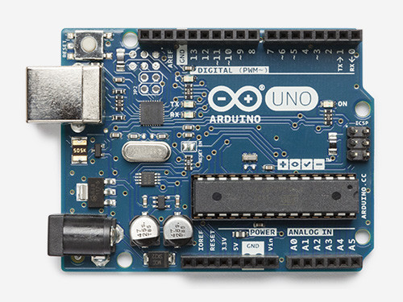
Software Used
Arduino

Slide 16
Hardware Used
Parts | Quantity
Breadboards | 4
Sensors | 4
LED lights | 8
Connecting wires | Required no:
Arduino | 1
Batteries | 2
Metal Plates | 2
Power Supply | 5v

Slide 17
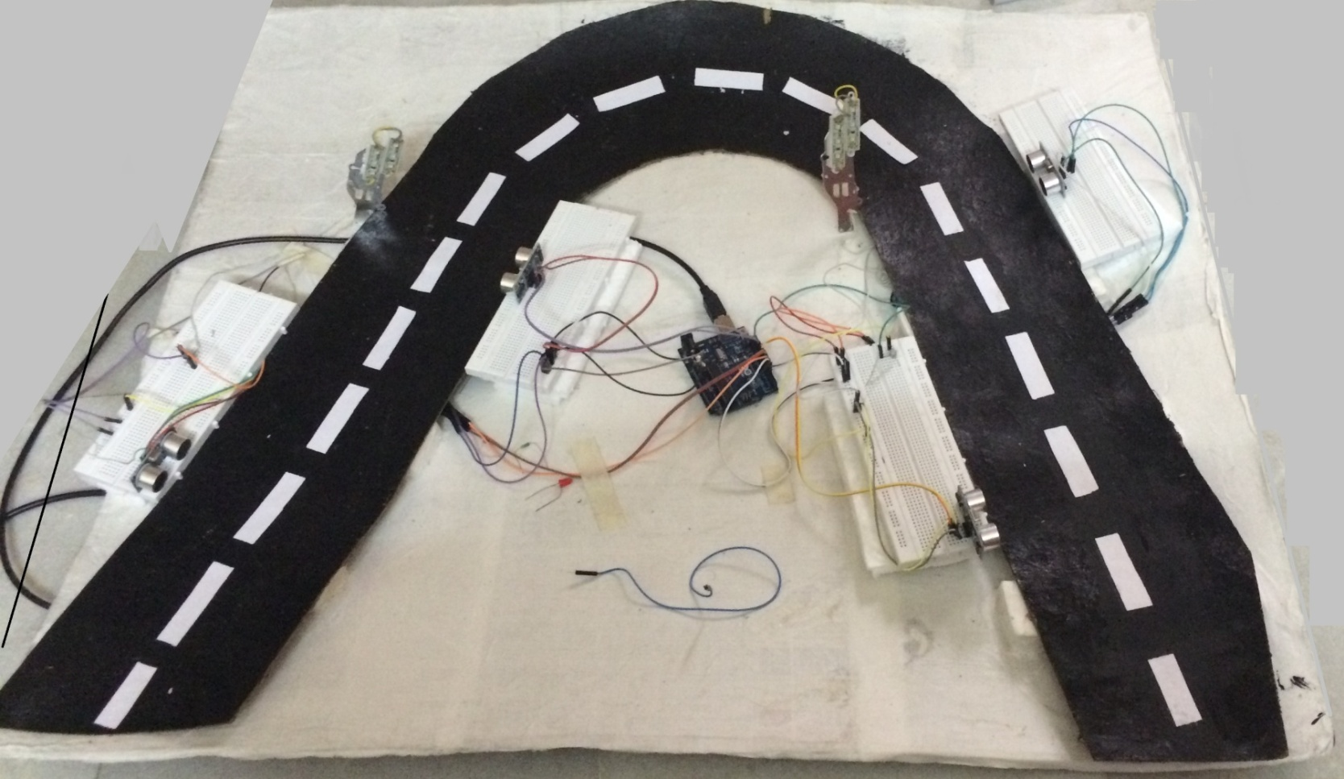
Outlook of Our Project

Slide 18
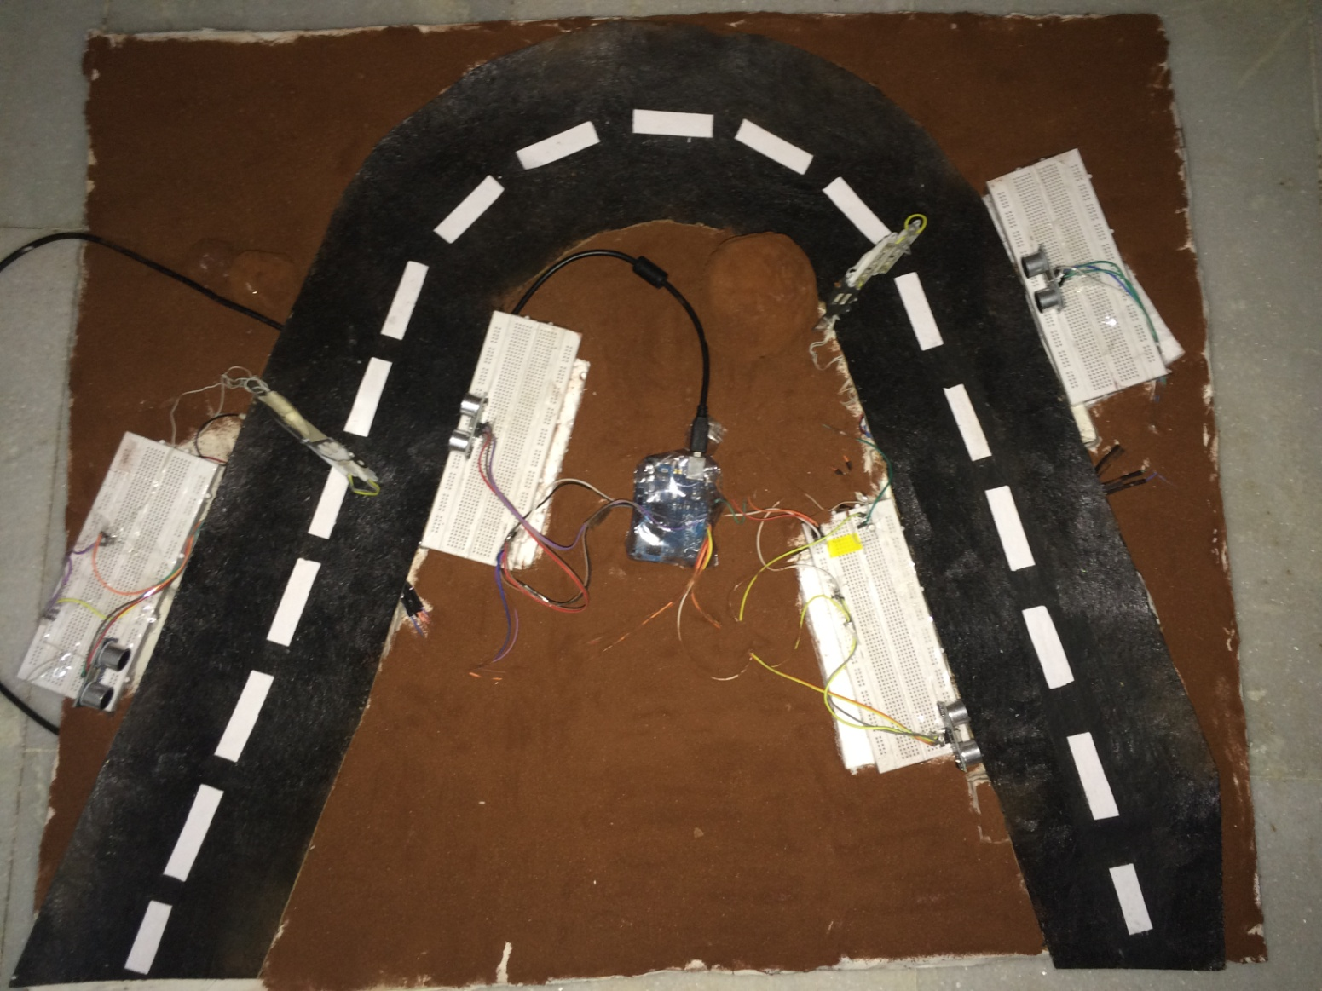
Outlook of Our Project How It Will Be

Slide 19
Test Cases
Here we have done different test cases such as
Test Case | Expected Result | Pass/fail
Passing an object in front of a sensor1 | The led should glow | pass
Passing an object in front of a sensor2 | The led should get off | Pass
Passing an object in front of a sensor1 | The count should increment | Pass
Passing an object in front of a sensor2 | The count should decrement | Pass
Place an object in front of a sensor1 | Count should increment only once | Pass
Place an object in front of a sensor2 | Count should increment only once | Pass

Slide 20
Test Case

Slide 21
Test Case

Slide 22
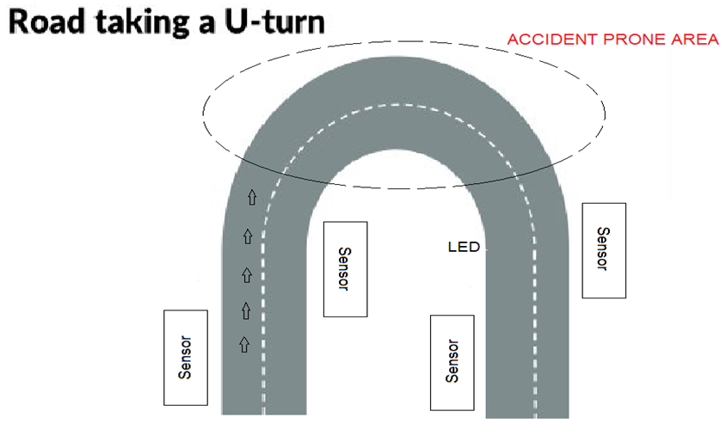
Sample Test Case What Should Happen

Slide 23

Sample Test Case Practically

Slide 24
Sample Test Case

Slide 25
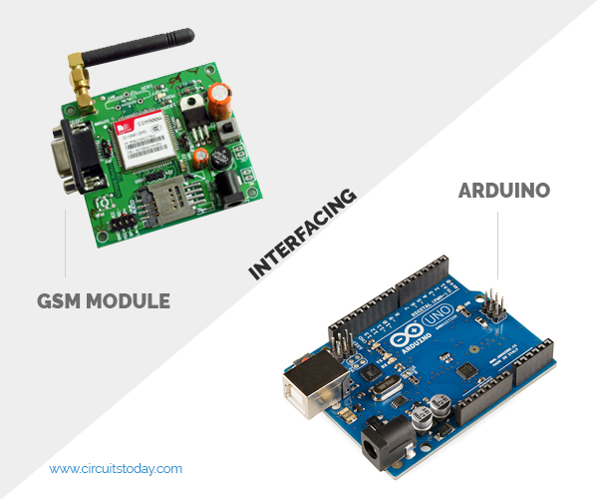
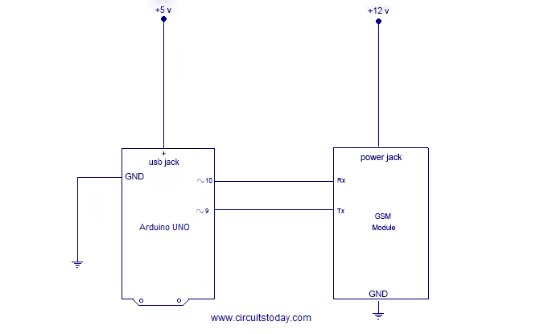
Maintenance
Interfacing SIM800 With Aurdino UNO

Slide 26
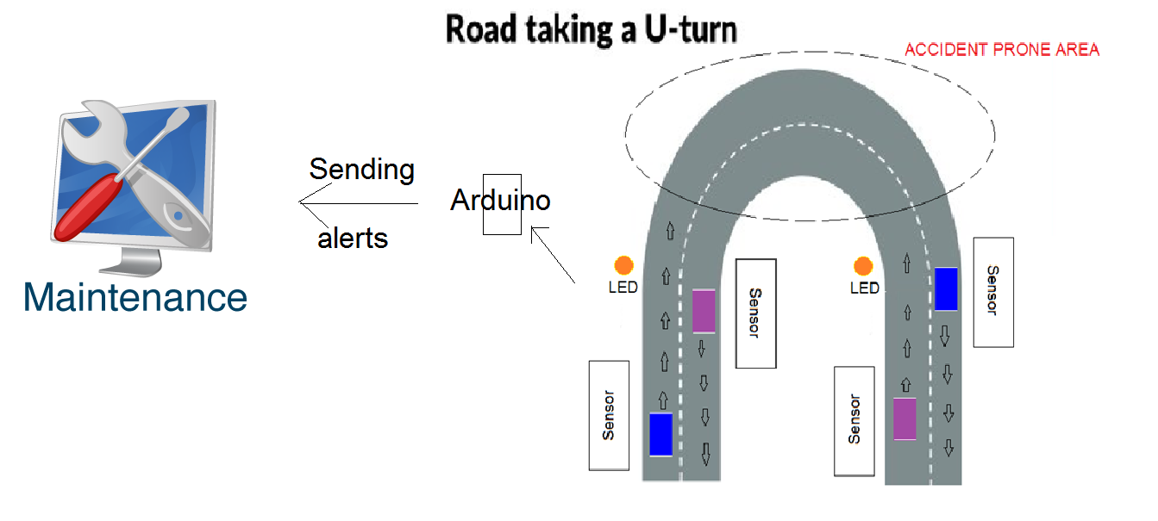
Sending Alerts to Maintenance Department
via
SIM800 Module

Slide 27
Conclusion
By this we conclude that by implementing
our project , accidents near the steep curves
especially in ghat roads, villages, forests etc
This is more helpful at nights.
This is cost effective, easy to install and maintain.

Slide 28
THANK YOU
Any Questions..?

