Slide 1
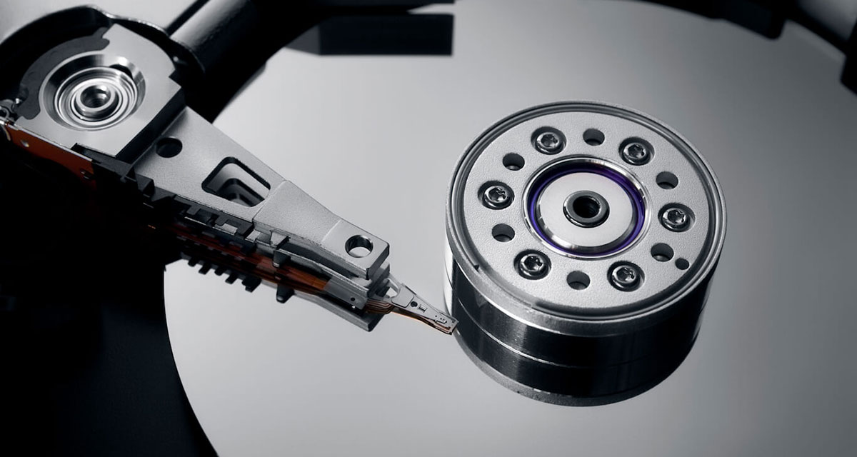

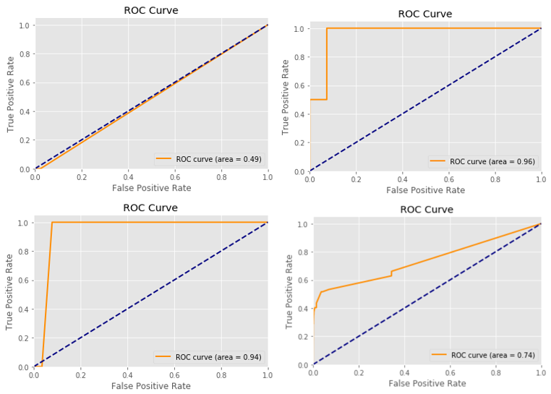
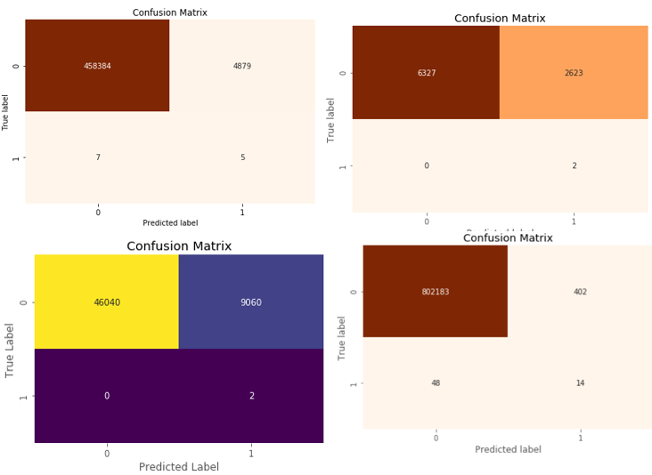
Hard Drive Failure:
Why it Happens ?
Non-Cognitive Predictors of Student Success:
A Predictive Validity Comparison Between Domestic and International Students
Non-Cognitive Predictors of Student Success:
A Predictive Validity Comparison Between Domestic and International Students
DISCUSSION
In this research, we try to compare the importance of various SMART features of the different hard-drive manufacturers by applying RFE with the features that were used by the previous authors.
We have produced some good results for the 2017-Q1 data set.
Different manufacturers have different SMART features responsible for hard drive failures.
PEARSON CO-RELATION COEFFICIENT
ROC GRAPHS
Predicting Hard Drive Failures using Machine Learning
Asanga, Upksha, Shadi and Sampath
INTRODUCTION
In the modern world, people are producing a massive amount of data. To store large volumes of data, we have different kinds of storage devices used, but still, hard drives are the most commonly used storage devices in the world. Usually, hard disk drives are durable and reliable; however, recent studies have shown that hard drive is the most frequently replaced device in data centers. Hard drive failures are highly expensive for any company or a user because it can lead to an irreplaceable data loss or a live server crash, which can cost millions of dollars damage. By analyzing different SMART attributes, researchers were able to predict the failures of the hard drives that were manufactured by different companies.
METHODS
Split the Black blaze data set based on manufacturers.
Clean and Normalization of data.
Recursive Feature Elemination (RFE)
Resampling using SMOTE/ADASYN.
Predictive Models.
RESULTS
MACHINE LEARNING METHODS
Random Forest Classifier.
Logistic Regression.
Decision Tree Classifier.
ADA Boost Classifier.
How to Prolong the Life of Your Hard Drive ?
Notes:
Notes:
In Powerpoint, click View > Guides
Keep text within gutter guides.
Author list: Don’t split names onto two lines (e.g., “Jimmy [break] Smith”). If that happens, use a new line, unless you need the space. Bold the first names of anybody who’s presenting in person.
Intro/methods/result: Do not drop below font size 28, but if you have extra space, jack up the font size until the space is full.
Do not use color in the sidebars except in graphs/figures. It’ll pull attention from the center and slow interpretation for passersby.

