Slide 1
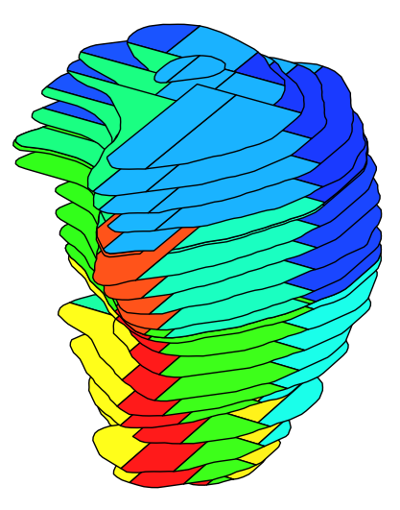
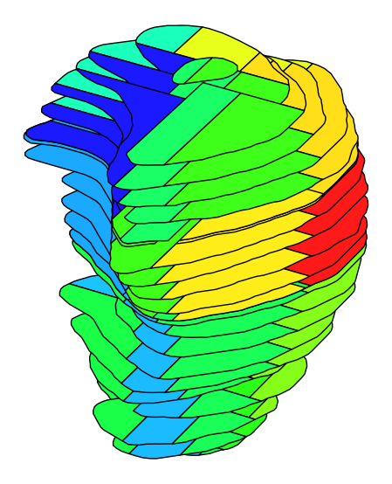

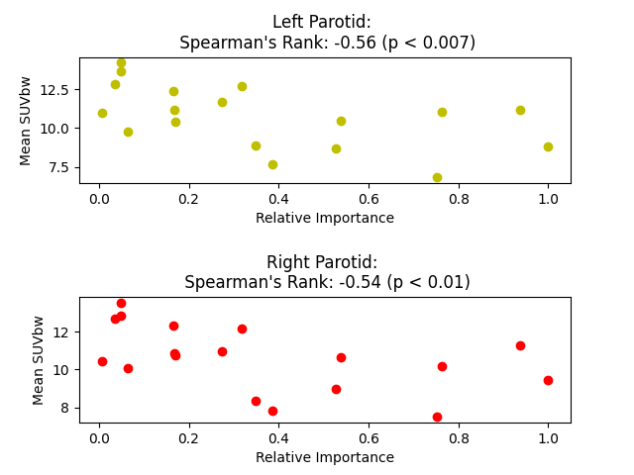
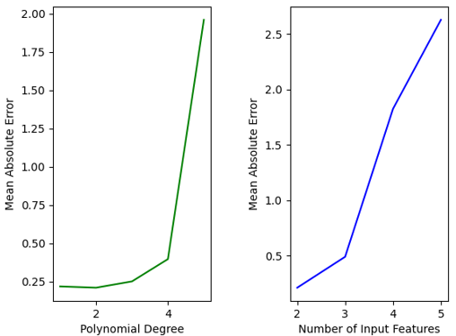
1
1
Fig 1a: A left parotid gland sub-segmented into 18 sub-regions of equal volume is illustrated using a heat map which depicts sub-region relative importance (left) and sub-region mean, normalized SUVbw (right) for the study cohort.
Relative Importance
Normalized Mean SUVbw
Superior
0
Anterior
Lateral
0
Fig 1b: The population mean of SUVbw and relative importance for each left and right parotid gland sub-region are illustrated on scatter plots, illuminating the negative correlation between the two mentioned variables.
Fig 1: The model which generated the lowest mean absolute error had a polynomial degree of 2 and used 2 input features. Here shows the trend of mean absolute error for all models with varying degrees (left) and a varying number of input features (right).

