Slide 1
Alternative Programming
Andrew Gleibman
Sampletalk Research
Yokneam Illit, Israel
Reference for more info:
A. Gleibman. Knowledge Representation via Verbal Description Generalization: Alternative Programming in Sampletalk Language. Workshop on Inference for Textual Question Answering. July 09, 2005 – Pittsburgh, Pennsylvania.. AAAI-05 – the Twentieth National Conference on Artificial Intelligence.

Slide 2
Let us define alternative programming using a Metaphor:
Conventional Medicine
Chemistry
Physics
Electronics
Mechanics
…
Alternative Medicine
Natural adaptation of the
organism to the environment
Conventional Programming
Formal Grammar Theory
DB theory
Logic
Calculus
…
Alternative Programming
Patterns of natural texts
define everything
via text alignment

Slide 3
Examples of text alignment: structurization, generalization
and composition of natural texts:
Aligned Reasonings
What can John see? A book
What can Mary see? The red table
Aligned Facts
John can see a book
Mary can see the red table
Question Answer
Generalization
what can [A] see? [X]
Generalized Reasoning
[A] can see [X]
Generalized pattern of facts
The composed Sampletalk clause containing reasoning:
what can [A] see? [X] :– [A] can see [X]..

Slide 4
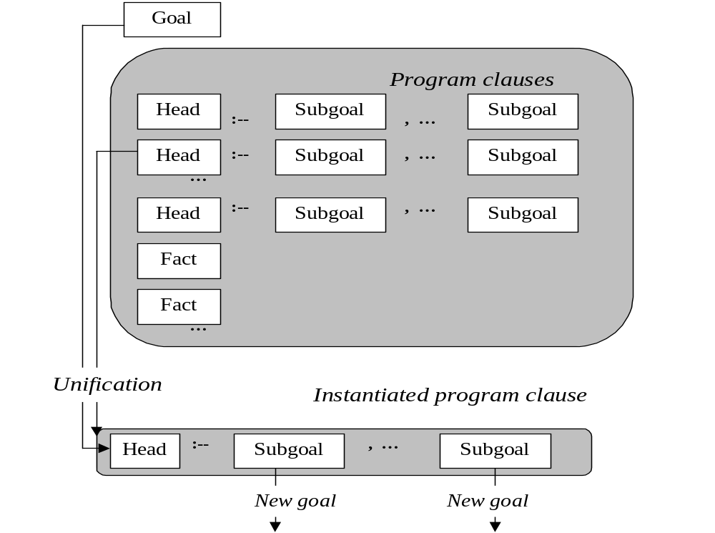
A scheme of logic program

Slide 5
A scheme of logic program
In Prolog:
Logical Atoms

Slide 6
A scheme of logic program
In Prolog:
Logical Atoms
In Sampletalk:
Unrestricted
Generalized Texts

Slide 7
Sampletalk Program Example:
Logico-linguistic inference rules:
can [A] see [X]? :– [A] can see [X]..
what can [A] see? [X] :– [A] can see [X]..
what is in [A]? [X] :– [X] is in [A]..
what is visible on [A]? [X] :– [X] is visible on [A]..
what is invisible on [A]? [X] :– [X] is in [B] ,, [B] is on [A] ,, ~~[X] is visible on [A]..
what is on [A]? [X] :– [X] is on [A]..
what is on [A]? [X] :– [X] is in [B] ,, [B] is on [A]..
[A] can see [X] :– [A] is standing near [B] ,, [X] is visible on [B]..
[A] is visible on [B] :– [A] is on [B]..
[A] is visible on [B] :– [A] is in [open X] ,, [open X] is visible on [B]..
[A] is standing near [B] :– [A] has approached [B]..
Negation
Facts:
[book] is in [open box]..
[notebook] is in [closed box]..
[open box] is on [red table]..
[closed box] is on [red table]..
[john] has approached [red table]..

Slide 8
Sampletalk Program Example:
Logico-linguistic inference rules:
can [A] see [X]? :– [A] can see [X]..
what can [A] see? [X] :– [A] can see [X]..
what is in [A]? [X] :– [X] is in [A]..
what is visible on [A]? [X] :– [X] is visible on [A]..
what is invisible on [A]? [X] :– [X] is in [B] ,, [B] is on [A] ,, ~~[X] is visible on [A]..
what is on [A]? [X] :– [X] is on [A]..
what is on [A]? [X] :– [X] is in [B] ,, [B] is on [A]..
[A] can see [X] :– [A] is standing near [B] ,, [X] is visible on [B]..
[A] is visible on [B] :– [A] is on [B]..
[A] is visible on [B] :– [A] is in [open X] ,, [open X] is visible on [B]..
[A] is standing near [B] :– [A] has approached [B]..
Negation
We use natural syntax & semantics of the original NL phrases
rather than
invent artificial syntax and
semantic model
Facts:
[book] is in [open box]..
[notebook] is in [closed box]..
[open box] is on [red table]..
[closed box] is on [red table]..
[john] has approached [red table]..
!

Slide 9
Example Inputs:
1) can [john] see [book]?
2) can [john] see [notebook]?
3) can [john] see [open box]?
4) what can [john] see? [X]
5) what is visible on [red table]? [X]
6) what is invisible on [red table]? [X]
7) what is on [red table]? [X]
8) what is in [open box]? [X]
9) what is in [closed box]? [X]
The Outputs:
1) can [john] see [book]? Yes.
2) can [john] see [notebook]? No.
3) can [john] see [open box]? Yes.
4) what can [john] see? [open box]. Yes;
what can [john] see? [closed box]. Yes ;
what can [john] see? [book]. Yes.
5) what is visible on [red table]? [open box]. Yes;
what is visible on [red table]? [closed box]. Yes;
what is visible on [red table]? [book]. Yes.
6) what is invisible on [red table]? [notebook]. Yes.
7) what is on [red table]? [open box]. Yes;
what is on [red table]? [closed box]. Yes;
what is on [red table]? [book]. Yes;
what is on [red table]? [notebook]. Yes.
8) what is in [open box]? [book]. Yes.
9) what is in [closed box]? [notebook]. Yes.
Note that the above Sampletalk program, which does this reasonong, consists only of generalized text patterns!

Slide 10
Parsing
NL Query
Formal Representation
of the Query
Inference Engine,
Ontology,
Formal Model
Formal Response
NL Phrase
Generation
NL Response
Common FOL+NLP approach: The need to design predicates,
grammars, a semantic model, and implement a parser,
a formal reasoning engine and a NL phrase generator

Slide 11
NL Query
Inference Engine,
Ontology,
Formal Model
NL Response
This is the alternative NLP approach: No predicates, no grammars,
no artificial semantics, no parsers. Everything is defined via
immediate interaction of patterns of the existing NL phrases.

Slide 12
Advantages of Alternative Programming --
Logico-Linguistic Inference:
Logico-linguistic inference rules:
can [A] see [X]? :– [A] can see [X]..
what can [A] see? [X] :– [A] can see [X]..
what is in [A]? [X] :– [X] is in [A]..
what is visible on [A]? [X] :– [X] is visible on [A]..
what is invisible on [A]? [X] :– [X] is in [B] ,, [B] is on [A] ,, ~~[X] is visible on [A]..
what is on [A]? [X] :– [X] is on [A]..
what is on [A]? [X] :– [X] is in [B] ,, [B] is on [A]..
[A] can see [X] :– [A] is standing near [B] ,, [X] is visible on [B]..
[A] is visible on [B] :– [A] is on [B]..
[A] is visible on [B] :– [A] is in [open X] ,, [open X] is visible on [B]..
[A] is standing near [B] :– [A] has approached [B]..
!
This is the alternative NLP approach: No predicates, no grammars,
no artificial semantics, no parsers. Everything is defined via
immediate interaction of patterns of the existing NL phrases.

Slide 13
Advantages of Alternative Programming --
Logico-Linguistic Inference:
Ontology:
Set of NL phrase patterns with model usage of terms
Query: NL phrase pattern
Inference and Linguistic Knowledge:
Representation of inferences in the form of generalized verbal descriptions
Current Knowledge:
Representation of facts in the form of verbal descriptions
Response: NL phrase
!
This is the alternative NLP approach: No predicates, no grammars,
no artificial semantics, no parsers. Everything is defined via
immediate interaction of patterns of the existing NL phrases.

Slide 14
Advantages of Alternative Programming --
Generating Verbal Explanation of the Sampletalk Reasoning:
can [john] see [book]? Goal
Explanation:
1 [open box] is on [red table], DB Fact
2 [open box] is visible on [red table], From 1
3 [book] is in [open box], DB Fact
4 [book] is visible on [red table], From 2,3
5 [john] has approached [red table], DB Fact
6 [john] is standing near [red table], From 5
7 [john] can see [book]. From 6,4
can [john] see [book]? Yes From 7

Slide 15
Advantages of Alternative Programming -- Inheritance of the
Syntax and Semantics from the Original NL Phrases:
Predicate Notation
Sampletalk Notation
hasChild (anna, jacopo)
is_in (book, open_box)
is_in (notebook, closed_box)
is_on (open_box, red_table)
is_on (closed_box, red_table)
has_approached (john, red_table)
can_see (X,Y)
is_visible_on (X,Y)
is_standing_near (X,Y)
[jacopo] is child of [anna]
[anna] has child [jacopo]
[anna] is parent of [jacopo]
[book] is in [open box]..
[notebook] is in [closed box]..
[open box] is on [red table]..
[closed box] is on [red table]..
[john] has approached [red table]..
[A] can see [B]
[A] is visible on [B]
[A] is standing near [B]

Slide 16
Algorithmic properties of Sampletalk language –
Turing completeness: Any Markov algorithm can be represented as a Sampletalk theory:
THEOREM:
Let M be any Markov algorithm written in a base alphabet U and a local alphabet V, where (U ∪ V) ⊂ L and L is the alphabet of terminal symbols applied in text theories.
There exists a text theory P_{M}, which, given a goal [ξtξ] ⇒ [W] (where t is a string, ξ and ⇒ are terminal symbols not belonging to alphabets U and V, W is a variable), does the following:
Transforms the goal into a text [ξtξ] ⇒ [ξt′ξ] and stops if M transforms string t into a string t′ and stops;
Produces a text [ξtξ] ⇒ [[fail]] and stops if no rule of M is applicable to some derivation of t, produced by M;
Never stops if string t leads M to an infinite application of the Markov rules.

Slide 17
Algorithmic properties of Sampletalk Language --
Alternative Version of the Church-Turing Thesis
THESIS 1.
Every effective computation can be carried out using generalized patterns of some data examples and a limited set of rules for combining such patterns and the input data.
!
THESIS 2 (no previous generalization needed):
Every effective computation can be carried out using a set of pairs of similar data examples and a limited set of rules for combining such pairs and the input data.
!
Philosophical aspects of the Sampletalk Technology

Slide 18
Discussion
Alternative Programming:
Prolog → Sampletalk
Sampletalk as the generalization of Prolog
Alternative Logic:
First Order Predicate Calculus → First Order Text Calculus
Alternative Logic as the generalization of Predicate Logic.
Unification of the generalized texts (axioms) defines the inference
Artificial Semantics vs. Alternative Semantics
Application issues of the two ways to
build a semantic model
should be analyzed

Slide 19
Discussion (Continued)
Pair-wise Alignment and Generalization of a Corpus of Sentences:
a book is in an open box
a notebook is in a closed box
cat is in the cage
a fox is in zoo
john is in his red car
this large table is red
a [X] is in [D] [Y] box
[X] is in [D] [Z]
a [X] is in [Z]
[X] is in [Z]
[X] is [A]
A building material for constructing
Sampletalk theories for NLP

Slide 20
Discussion (Continued)
Machine-Learning Setting –
Extracting Sampletalk Theories from Examples:
A set of positive and negative text examples:
E₊ = {(s_{i}, t_{i}): i = 1, 2, …, n} (positive examples)
E– = {(s′_{j}, t′_{j}): j = 1, 2, …, m} (negative examples)
Objective function for learning a Sampletalk theory P:
f(Q) = ( |{(s_{i}, t_{i}) ∈ E₊ : Q(s_{i}) = t_{i} }| – |{(s′_{j}, t′_{j}) ∈ E– : Q(s′_{j}) = t′_{j} }| ) / |Q|,
where Q is a Sampletalk theory;
P = argmax (f (Q))

Slide 21
Discussion (Continued)
Machine-Learning Setting –
Extracting Sampletalk Theories from Examples:
A set of positive and negative text examples:
[[a + b]] ⇒ [+ a b]
[[x + y]] ⇒ [+ x y]
¬[[u + v]] ⇒ [u + v]
[[a]] ⇒ [a]
[[x]] ⇒ [x]
[[a + [b + c]]] ⇒ [+ a + b c]
[[u – v]] ⇒ [– u v]
[[e + [f + g]]] ⇒ [+ e + f g]
[[e + [f – g]]] ⇒ [+ e – f g]
[[e / [f – g]]] ⇒ [/ e – f g]
[[[a + b] + c]] ⇒ [+ + a b c]
[[[a1 / b2] + c3]] ⇒ [+ / a1 b2 c3]
[[a * b]] ⇒ [* a b]
[[[a + b] * [c – d]]] ⇒ [* + a b – c d]
Theory of the above set of examples:
[[A Z B]] ⇒ [Z C D] :-- [[A]] ⇒ [C] ,, [[B]] ⇒ [D]..
[[A]] ⇒ [A]..

Slide 22
Discussion (Continued)
Suggested Research:
1) Experiments with automatic Sampletalk theory generation for specific data (e.g., geographical, biological) and applications;
2) Alignment of Non-Text Data: FOPC → FOTC → FOIC → FOOC
First Order Predicate Calculus
First Order Text Calculus
First Order Image Calculus
First Order Object Calculus

Slide 23
Additional Sampletalk Theory Example:
A Theory of Morphological Analysis
Goal:
result of morphological analysis of word [q u e r i e s]: this is X.
The Outputs:
result of morphological analysis of word [q u e r i e s]: this is 2-sg form of verb "q u e r y";
result of morphological analysis of word [q u e r i e s]: this is plural form of noun "q u e r y".
The Theory:
result of morphological analysis of word [X i e d]: this is past form of verb "X y" :–
word “X y” has canonical morphological tag “verb”..
result of morphological analysis of word [X e d]: this is past form of verb "X e" :–
word “X e” has canonical morphological tag “verb”..
result of morphological analysis of word [X e d]: this is past form of verb "X" :–
word “X” has canonical morphological tag “verb”..
result of morphological analysis of word [X i e s]: this is 2-sg form of verb "X y" :–
word “X y” has canonical morphological tag “verb”..
result of morphological analysis of word [X e s]: this is 2-sg form of verb "X e" :–
word “X e” has canonical morphological tag “verb”..
Continued

Slide 24
result of morphological analysis of word [X s]: this is 2-sg form of verb "X" :–
word “X” has canonical morphological tag “verb”..
result of morphological analysis of word [X i e n]: this is past-p form of verb "X y" :–
word “X y” has canonical morphological tag “verb”..
result of morphological analysis of word [X e n]: this is past-p form of verb "X e" :–
word “X e” has canonical morphological tag “verb”..
result of morphological analysis of word [X e n]: this is past-p form of verb "X" :–
word “X” has canonical morphological tag “verb”..
result of morphological analysis of word [X y i n g]: this is ing-form of verb "X y" :–
word “X y” has canonical morphological tag “verb”..
result of morphological analysis of word [X i n g]: this is ing-form of verb "X e" :–
word “X e” has canonical morphological tag “verb”..
result of morphological analysis of word [X i n g]: this is ing-form of verb "X" :–
word “X” has canonical morphological tag “verb”..
result of morphological analysis of word [X]: this is canonical verb form "X" :–
word “X” has canonical morphological tag “verb”..
result of morphological analysis of word [X i e s]: this is plural form of noun "X y" :–
word “X y” has canonical morphological tag “singular noun”..
result of morphological analysis of word [X e s]: this is plural form of noun "X e" :–
word “X e” has canonical morphological tag “singular noun”..
Continued

Slide 25
result of morphological analysis of word [X s]: this is plural form of noun "X" :–
word “X” has canonical morphological tag “singular noun”..
result of morphological analysis of word [X]: this is canonical singular form of noun "X" :–
word “X” has canonical morphological tag “singular noun”..
result of morphological analysis of word [X]: this is adverb "X" :–
word “X” has canonical morphological tag “adverb”..
result of morphological analysis of word [X]: this is adjective "X" :–
word “X” has canonical morphological tag “adjective”..
…
word “b a c k” has canonical morphological tag “singular noun”..
word “b a c k” has canonical morphological tag “adverb”..
word “b a c k” has canonical morphological tag “verb”..
word “b a k e” has canonical morphological tag “singular noun”..
word “b a k e” has canonical morphological tag “verb”..
word “b a k e r” has canonical morphological tag “singular noun”..
word “b a k e r y” has canonical morphological tag “singular noun”..
word “q u e r y” has canonical morphological tag “singular noun”..
word “q u e r y” has canonical morphological tag “verb”..
…

Slide 26
Additional Sampletalk Theory Example --
A Theory for Logic Formula Transformation:
The goal (variable W stands for the transformation result):
(∀ x0)[a(x0,y)] \/ (∀ x0)[b(x0,t)] --> W..
The theory:
(Q X)[F] \/ (Q X)[H] --> (Q X)(Q Z)([F] \/ [G]) :–
X is variable,,
Z is variable,,
not(F contains Z),,
(Z/X)[H]=[G]..
x0 is variable..
X10 is variable :– X0 is variable..
AXB contains X..
(Y/X)[AXM]=[AYN] :- (Y/X)[M]=[N]..
(Y/X)[A]=[A]..
The result:
(∀ x0)[a(x0,y)] \/ (∀ x0)[b(x0,t)] --> (∀ x0)(∀ x10)([a(x0,y)] \/ [b(x10,t)]).

Slide 27
Additional Sampletalk Theory Example --
Another Theory for Logic Formula Transformation:
The goal (variable W stands for the transformation result):
according to the rule R, the result of shifting quantifiers
in the formula (∀ x0)[a(x0,y)] \/ (∀ x0)[b(x0,t)] is formula W..
The program:
according to the rule 2a from chapter 5, the result of shifting quantifiers
in the formula (Q X)[F] \/ (Q X)[H] is formula (Q X)(Q Z)([F] \/ [G]) :-
X is notation for variable,,
Z is notation for variable,,
not(word F contains word Z),,
the result of replacing X by Z in formula H is G..
x0 is notation for variable..
X10 is notation for variable :- X0 is notation for variable..
word AXB contains word X..
the result of replacing X by Y in formula AXM is AYN :-
the result of replacing X by Y in formula M is N..
the result of replacing X by Y in formula A is A..
The result:
according to the rule 2a from chapter 5, the result of shifting quantifiers in the formula
(∀ x0)[a(x0,y)] \/ (∀ x0)[b(x0,t)] is formula (∀ x0)(∀ x10)([a(x0,y)] \/ [b(x10,t)]).

