Slide 1

Big_Shop_Sales Project
https://datasquirrel.ai/

Slide 2
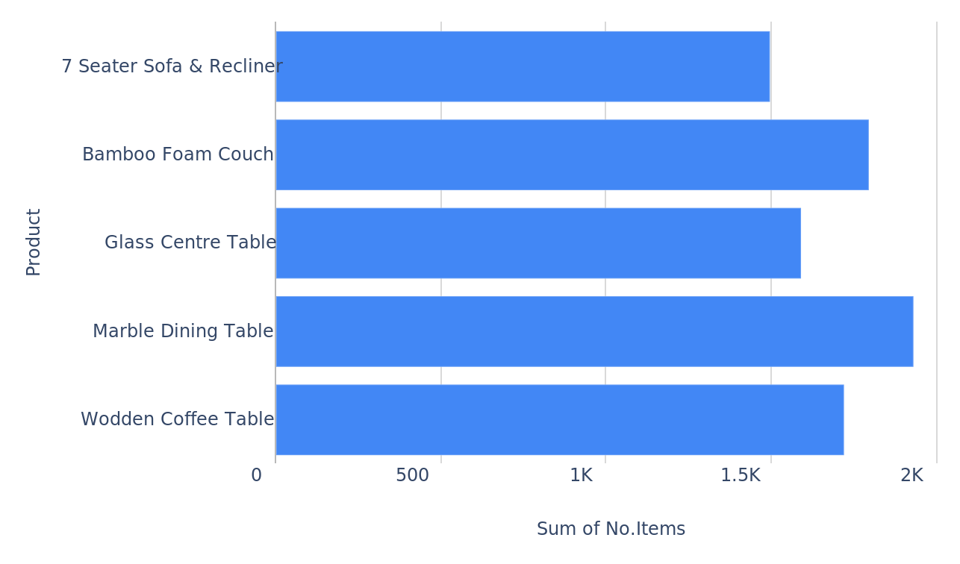
Identifying top selling products based on total quantity sold.
No.Items per Product
Big_Shop_Sales_Project_20241013_070246.pptx
2

Slide 3
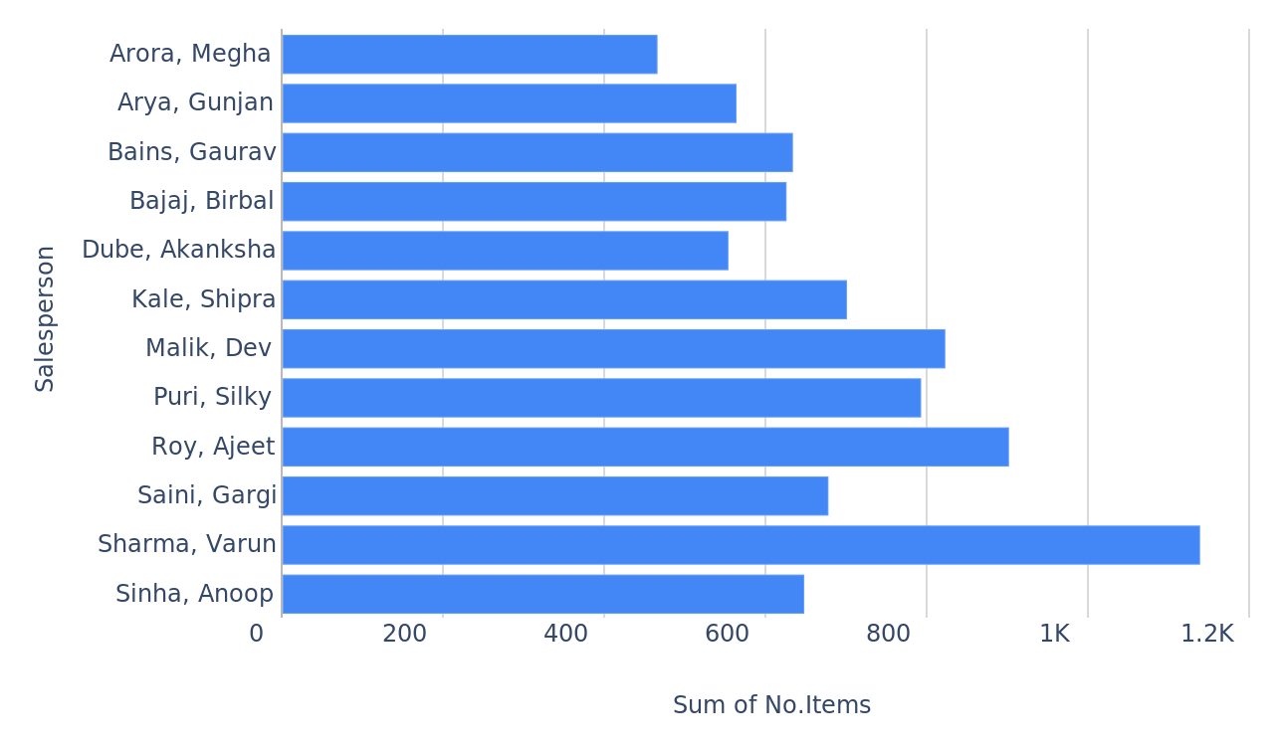
Analyzing sales performance of individual salespeople based on total quantity sold.
No.Items per Salesperson
Big_Shop_Sales_Project_20241013_070246.pptx
3

Slide 4
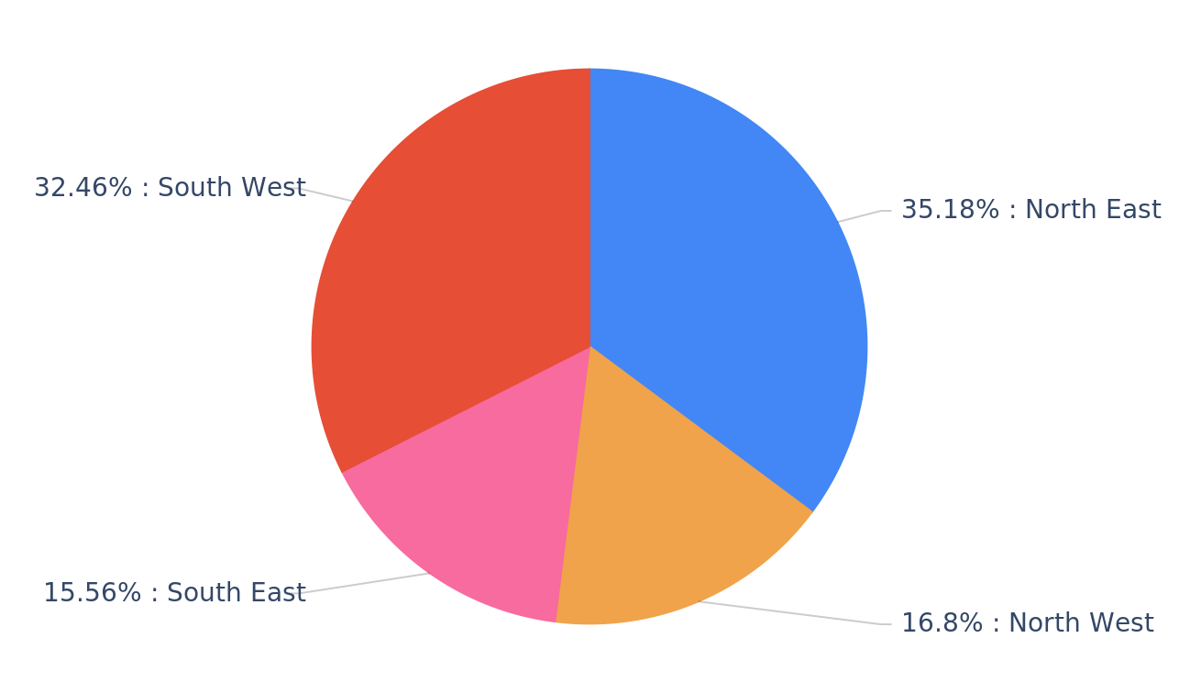
Understanding the contribution of each region to the total sales.
No.Items per Region
Big_Shop_Sales_Project_20241013_070246.pptx
4

Slide 5
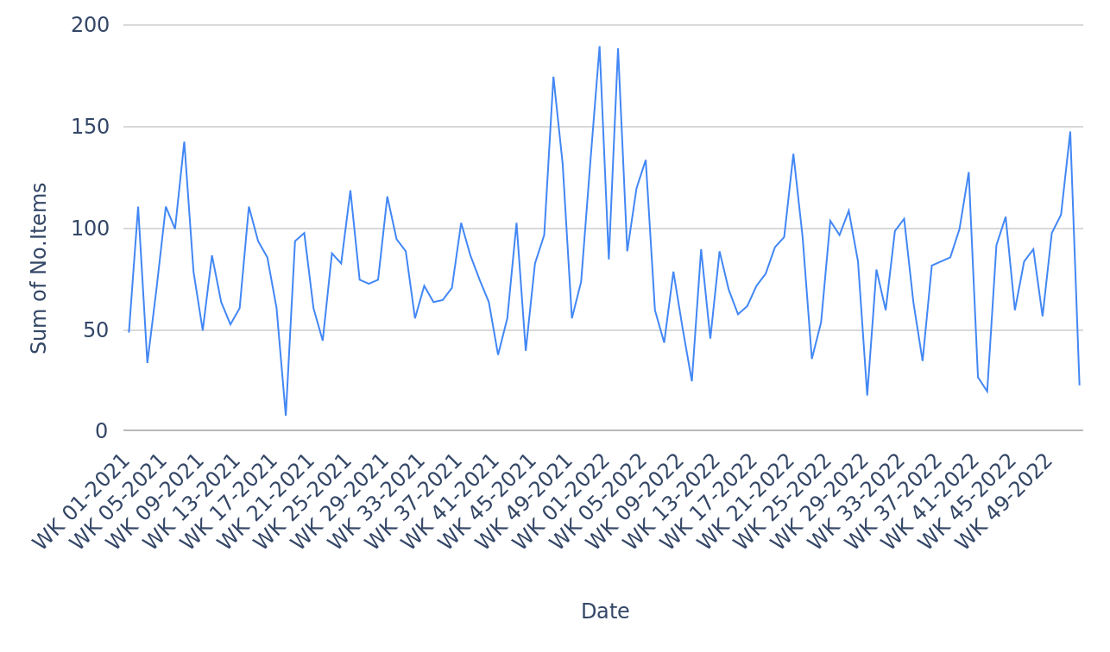
Tracking daily sales trends over time.
No.Items per Date
Big_Shop_Sales_Project_20241013_070246.pptx
5

Slide 6
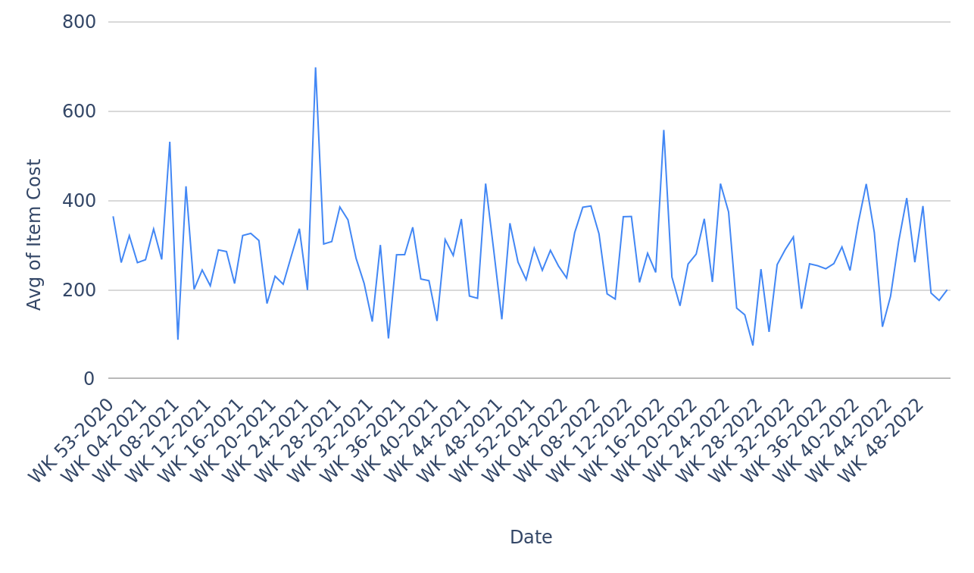
Monitoring average item cost over time.
Item Cost per Date
Big_Shop_Sales_Project_20241013_070246.pptx
6

Slide 7
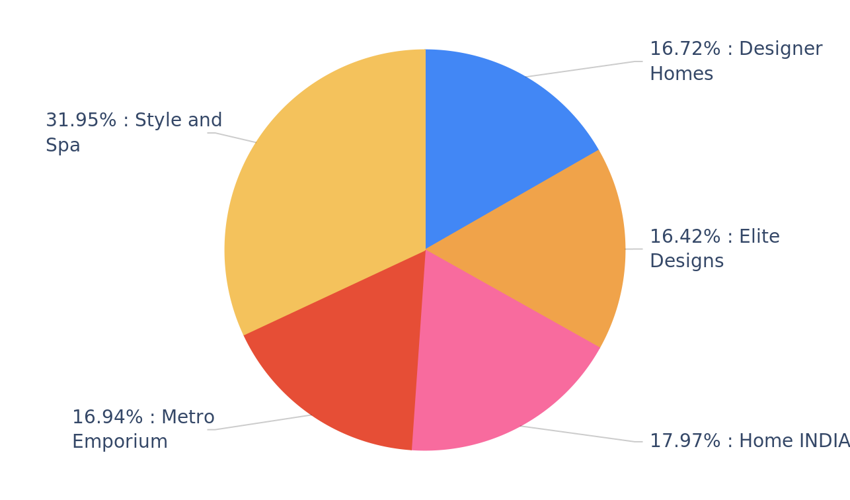
Assessing customer preferences based on sales.
No.Items per Customer
Big_Shop_Sales_Project_20241013_070246.pptx
7

Slide 8
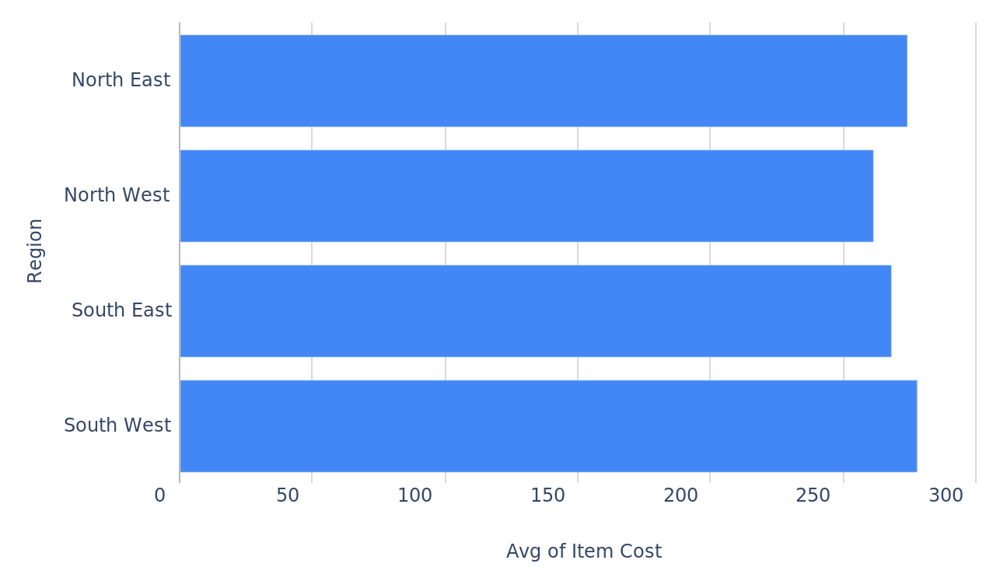
Comparing average item cost across different regions.
Item Cost per Region
Big_Shop_Sales_Project_20241013_070246.pptx
8

Slide 9
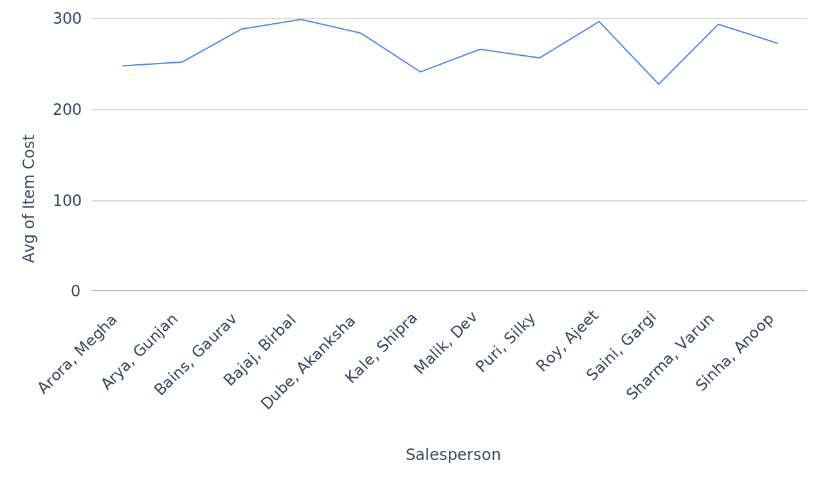
Tracking average item cost for each salesperson over time.
Item Cost per Salesperson
Big_Shop_Sales_Project_20241013_070246.pptx
9

Slide 10
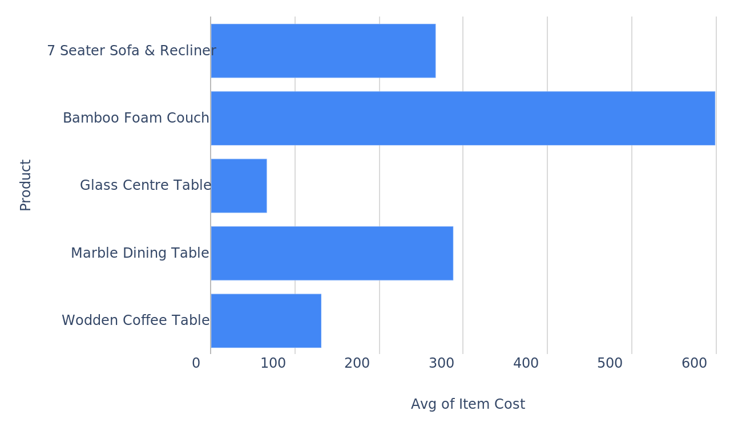
Analyzing average item cost for different products.
Item Cost per Product
Big_Shop_Sales_Project_20241013_070246.pptx
10

Slide 11
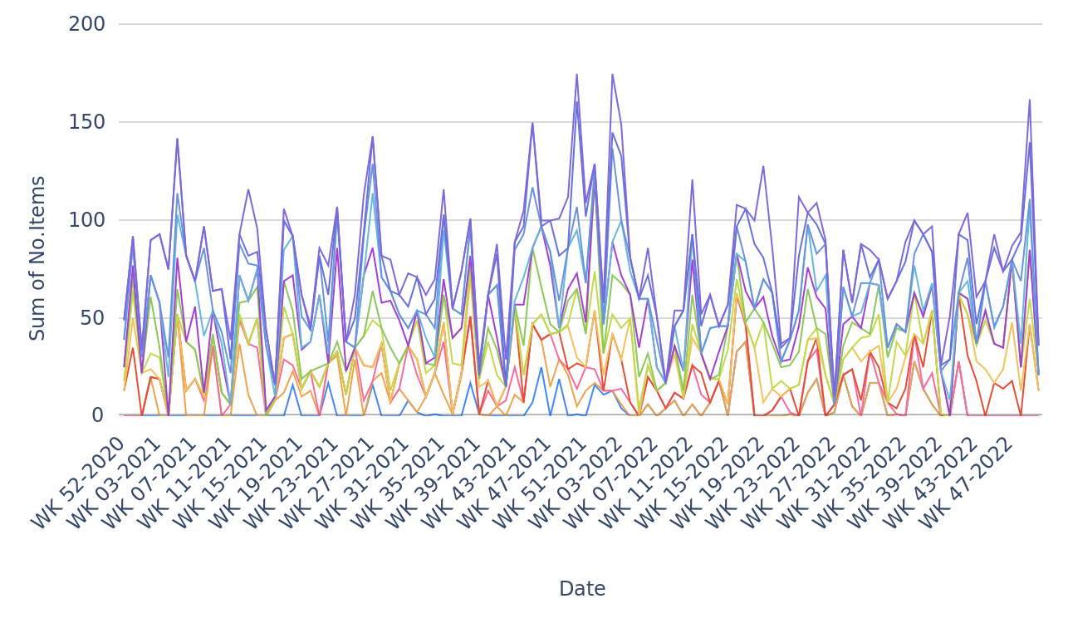
Assessing daily sales performance of individual salespeople.
No.Items per Date, grouped by Salesperson
Big_Shop_Sales_Project_20241013_070246.pptx
11

Slide 12
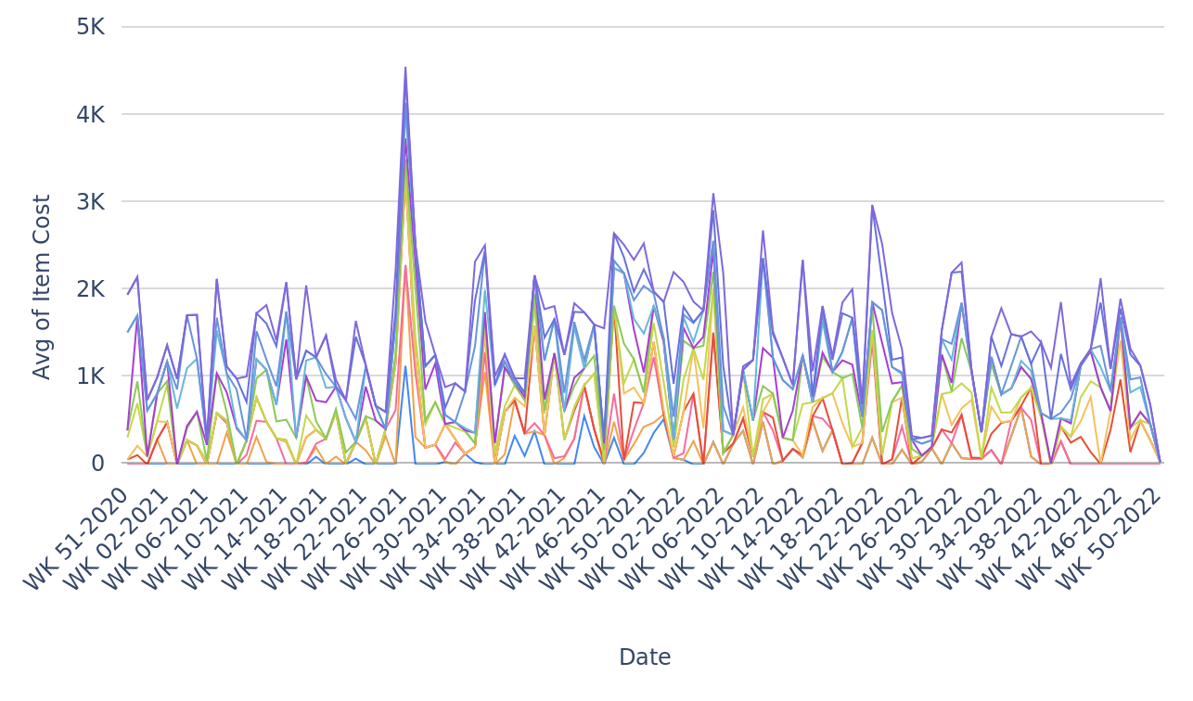
Tracking average item cost for each salesperson over time.
Item Cost per Date, grouped by Salesperson
Big_Shop_Sales_Project_20241013_070246.pptx
12

Slide 13
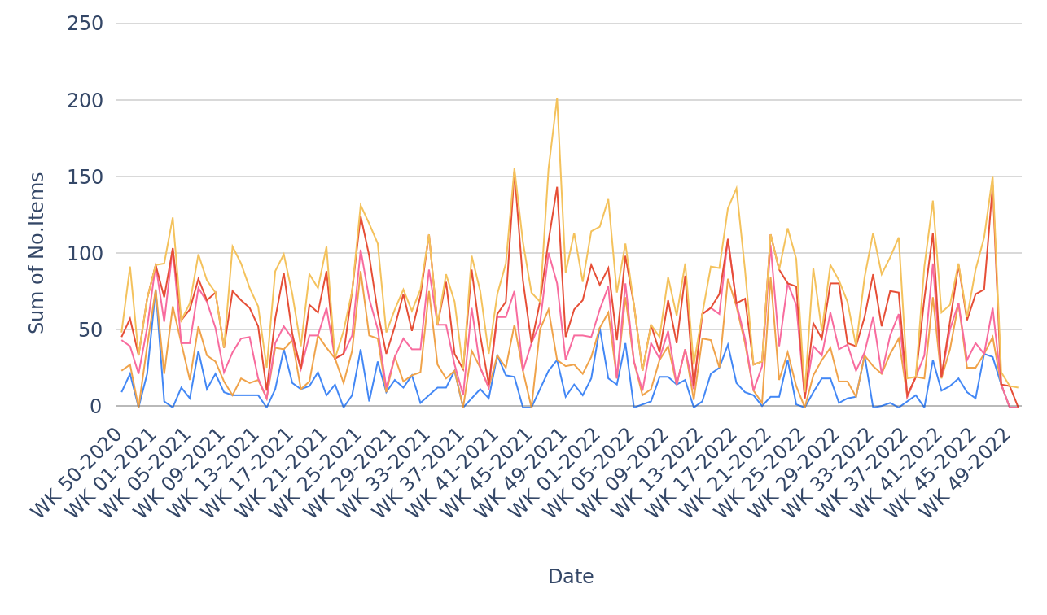
Analyzing daily sales for each product.
No.Items per Date, grouped by Product
Big_Shop_Sales_Project_20241013_070246.pptx
13

Slide 14
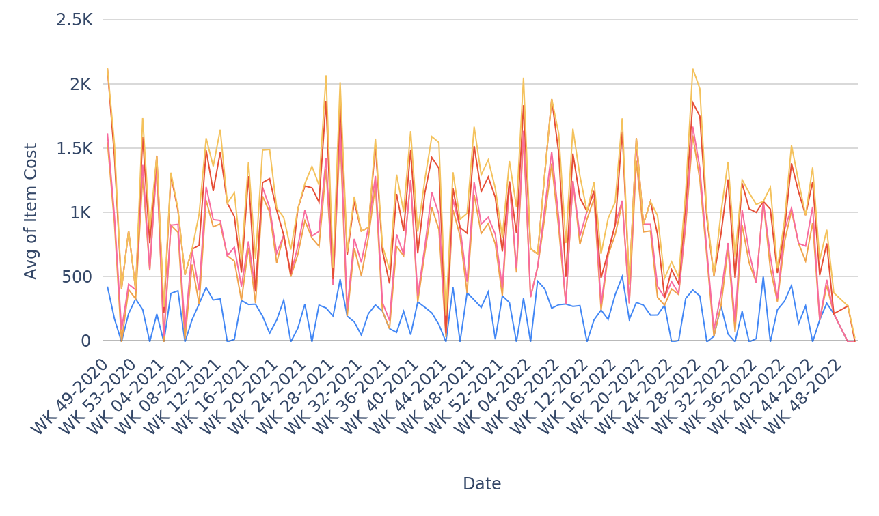
Monitoring average item cost for each product over time.
Item Cost per Date, grouped by Product
Big_Shop_Sales_Project_20241013_070246.pptx
14

Slide 15
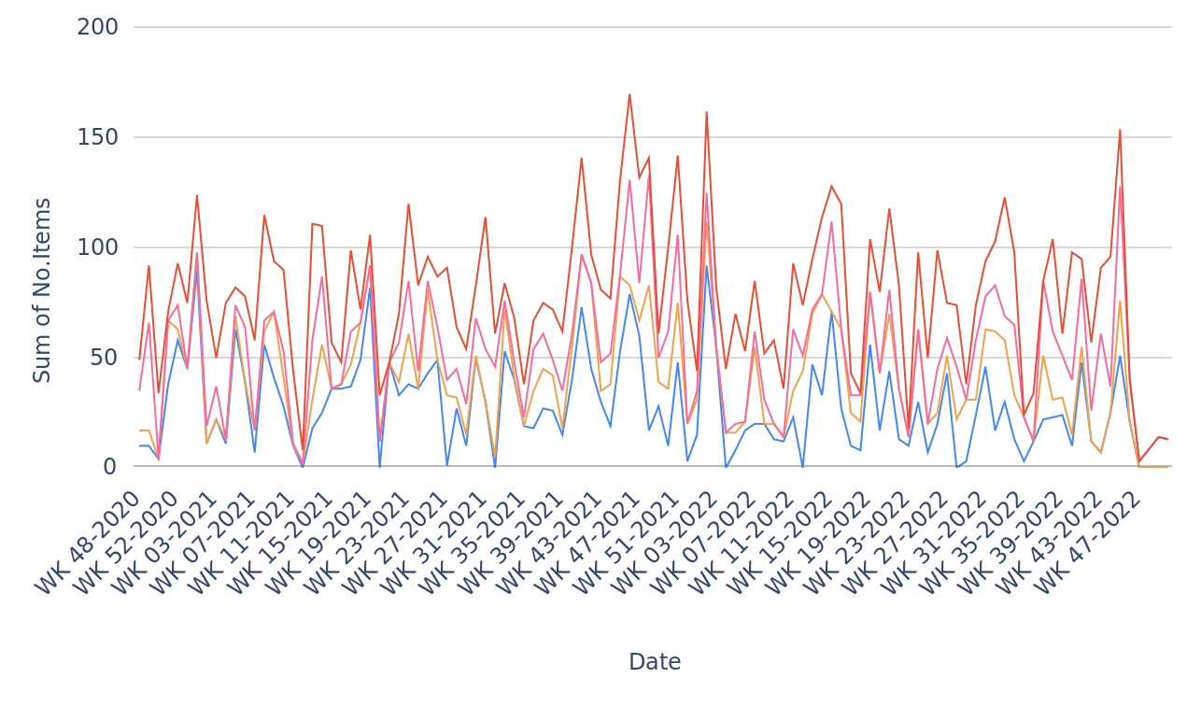
Evaluating daily sales performance for each region.
No.Items per Date, grouped by Region
Big_Shop_Sales_Project_20241013_070246.pptx
15

Slide 16
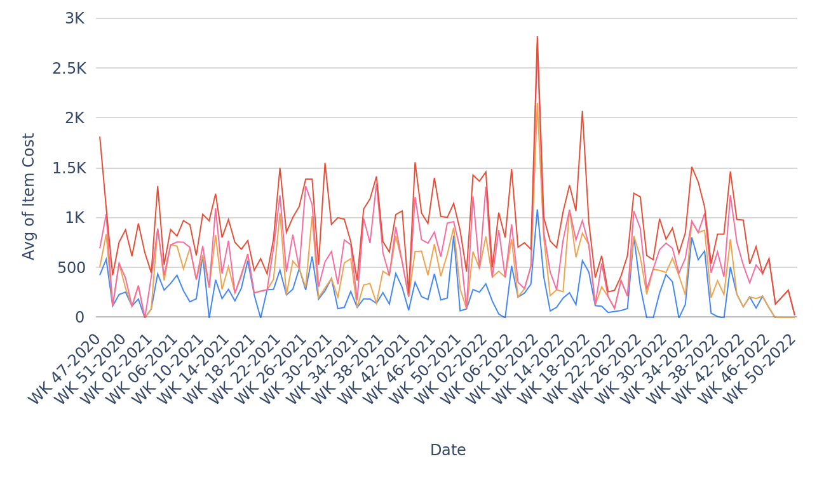
Tracking average item cost for each region over time.
Item Cost per Date, grouped by Region
Big_Shop_Sales_Project_20241013_070246.pptx
16

Slide 17
Created By: vivekanandgy@gmail.com
Created At: Sun 13 Oct 2024 07:02 AM UTC
https://datasquirrel.ai/

