Slide 1
PostgreSQL Data Warehouse (Bronze–Silver–Gold)
End-to-end analytics pipeline built in PostgreSQL with DBeaver, modeled for BI consumption in Looker Studio
Tools: PostgreSQL, DBeaver, SQL, Looker Studio

Slide 2
Business Goal
Create a clean, scalable warehouse structure for CRM + ERP data.
Standardize and document transformations from raw ingestion to business-ready marts.
Enable self-serve reporting with a Gold layer designed for BI.

Slide 3
Architecture Overview
Bronze: raw, minimally transformed source extracts.
Silver: cleaned, standardized, conformed datasets with quality checks.
Gold: analytics-ready tables/views (star schema) optimized for reporting and ad-hoc SQL.

Slide 4
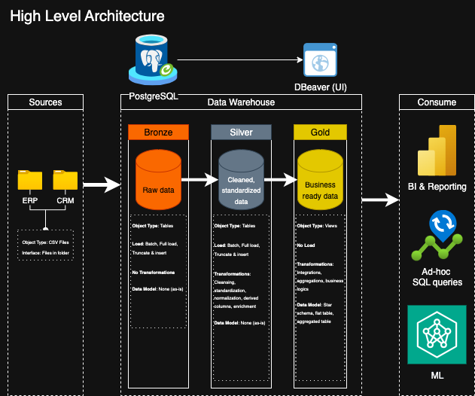
High-Level Architecture
Warehouse layers (Bronze / Silver / Gold) and consumption patterns (BI, ad-hoc SQL, ML).

Slide 5
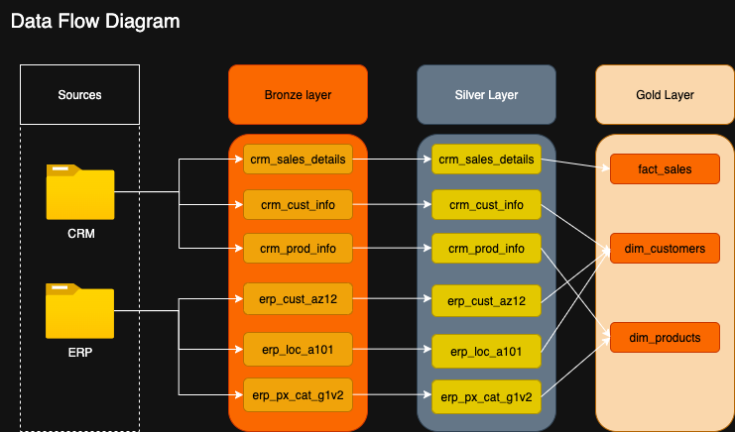
Data Flow Diagram
Entity flow from source extracts to curated marts.

Slide 6
Data Modeling (Gold Layer)
Star schema design for reporting performance and semantic clarity.
Fact table: sales (measures, event grain).
Dimensions: customers and products (conformed attributes for slicing).

Slide 7
Transformation Pattern (Silver Layer)
Cleaning: null handling, type casting, deduplication, and standard formats.
Standardization: naming conventions, conformed keys, and reference mappings.
Derived fields: business metrics and canonical attributes for reuse.

Slide 8
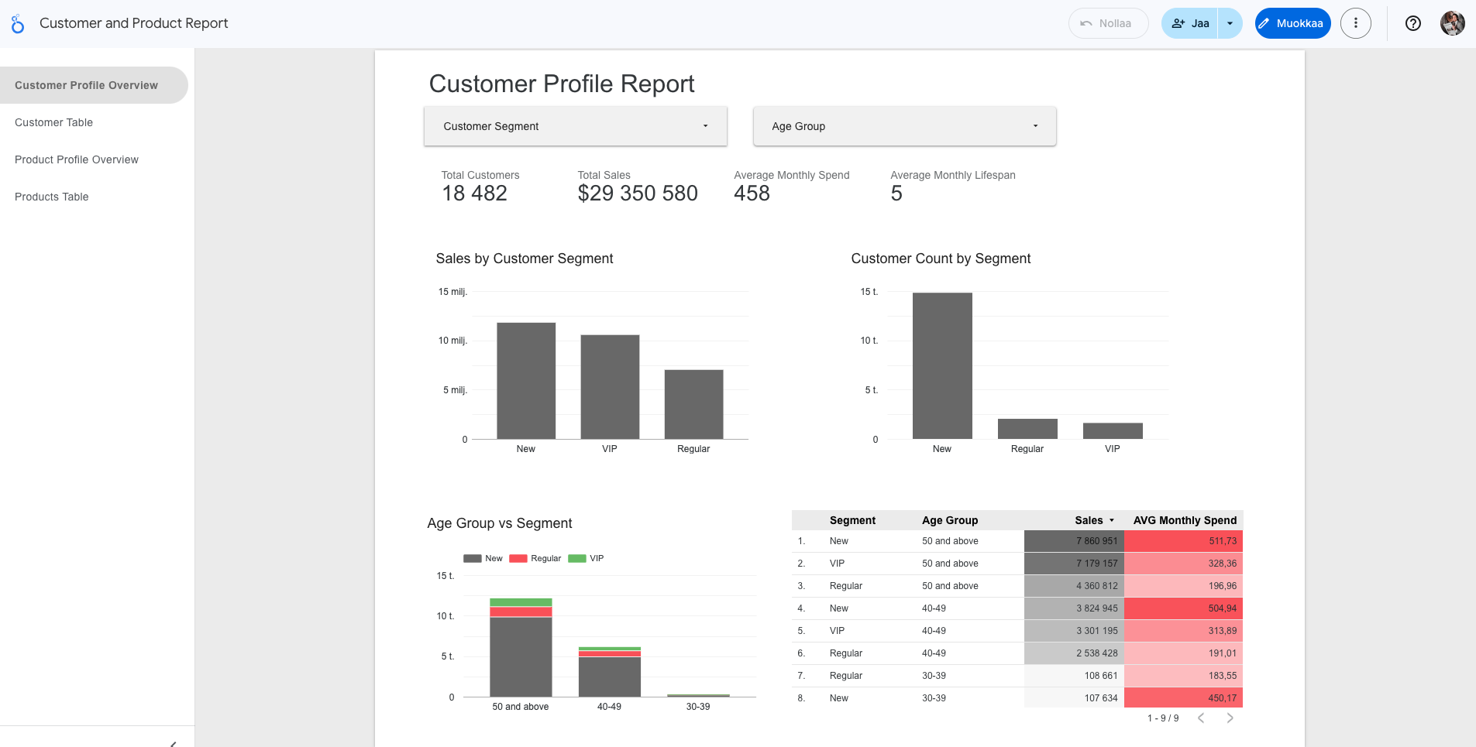
Looker Studio Dashboard (Gold Layer)
Sample BI output powered by Gold-layer tables/views.

Slide 9
Quality & Governance
Clear separation of concerns by layer (raw vs standardized vs curated).
Repeatable SQL scripts and deterministic transformations.
Extensible: new sources can be landed in Bronze and promoted forward with minimal refactoring.

Slide 10
Next Steps
Add automated data quality tests (row counts, freshness, key uniqueness).
Introduce incremental loading patterns and change tracking.
Deploy orchestration (e.g., scheduled jobs) and version-controlled SQL migrations.

