Slide 1
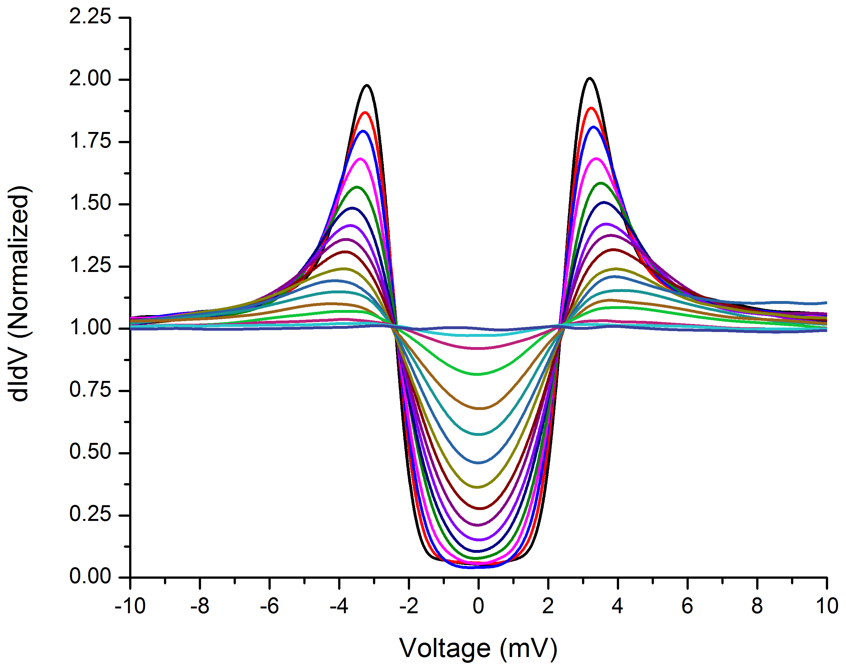
Point contact tunnelling data from Nb3Sn sample
Data taken by Thomas Proslier, ANL

Slide 2
