Slide 1
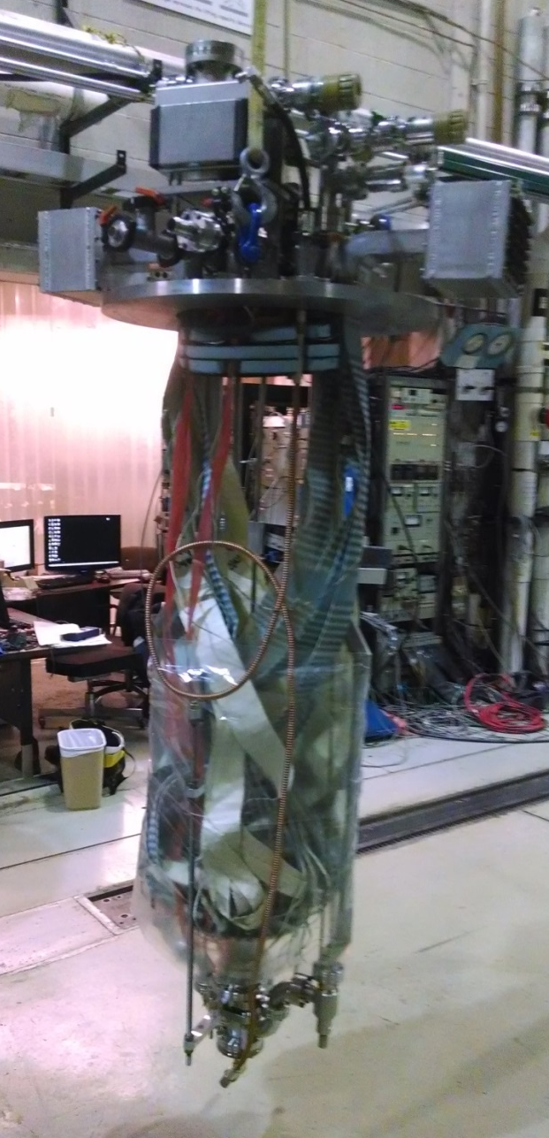
Nb₃Sn Cavity ERL1-4
History of ERL1-4
Nb₃Sn coating, just HPR
Test shows relatively flat Q vs E up to quench at ~13 MV/m, Q~1e10
5x HF rinse, HPR
November test shows Q-slope
120 K Torture
Test shows no degradation
Remove coating with BCP
Baseline test: good performance up to 20 MV/m
Recoat with same parameters
Test shows performance is repeatable

Slide 3
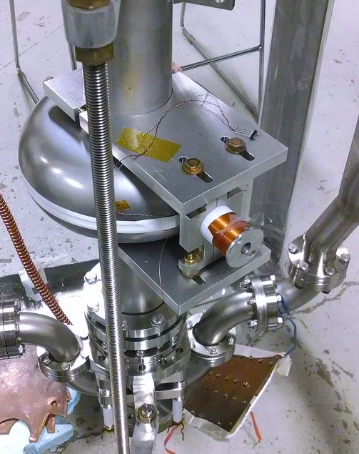
Measuring DC Flux Penetration Field
Nick made a 1760-winding NbTi solenoid
Get cavity to a few MV/m, then apply DC field, watch Pt (or Pr)
When RF field drops, flux from DC field has penetrated to RF surface
Hall probe measures magnetic field

Slide 4
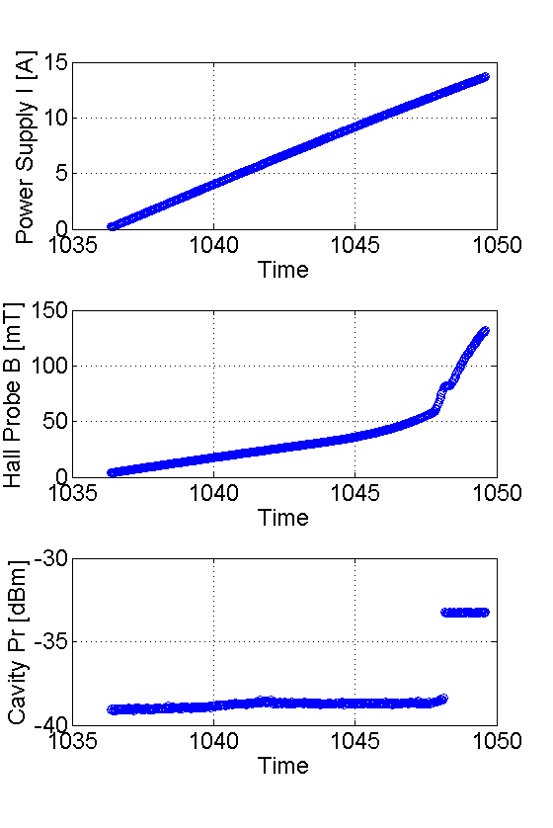
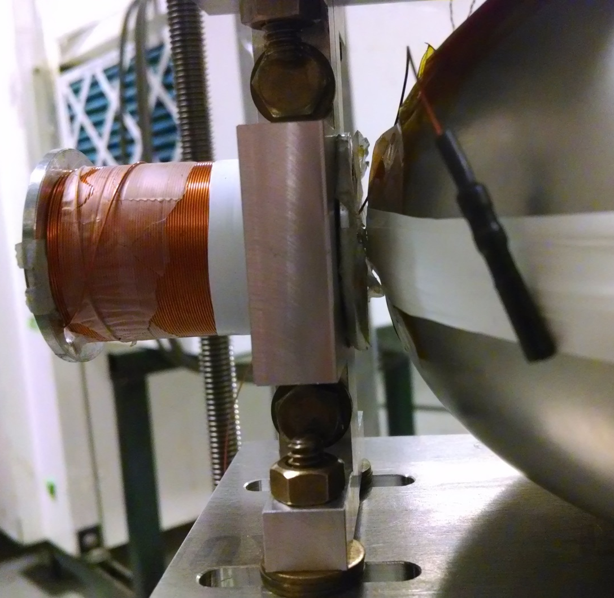
T = 6.3 K
Flux penetration

Slide 5
Flux penetration as a function of T²
Lines with x-intercept matching T_{c} of Nb or Nb₃Sn and y-intercepts fitted by eye
Approximate B_{sh} of Nb with correction for field at hall probe

Slide 6
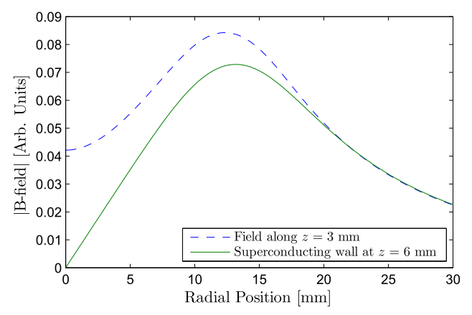
From Nick’s thesis:
Ratio of X’s gives magnetic field correction for hall probe

