Slide 1

Smart Library
Book Locator System
A Web-Based Solution to Find Books Quickly in College Library
Search by Title or Author • Exact Shelf Location • Instant Results
Academic Project | College Library Management

Slide 2



Problem Statement
Time Wasted
Dependency on Staff
Poor Experience
Students spend excessive time searching manually through shelves — an inefficient use of valuable study time.
Students must repeatedly ask professors or library staff for help, creating unnecessary bottlenecks.
The manual process is slow, inconvenient, and frustrating — reducing the overall quality of library usage.

Slide 3
Proposed Solution
What We're Building
Example Output
Book:
Fundamentals of Java
1
A website where users search for books by title or author name
Author:
Example Author
Status:
Available
2
The system displays the exact physical location on the shelf
Rack:
Second Rack
Column:
Second Column
3
Fast, accurate results without needing staff assistance
Row:
Third Row
Position:
Fourth Book

Slide 4




How the System Works
Step 1
Step 2
Step 3
Step 4
Step 5
Open Website
Search Book
Query Database
View Result
Find the Book
User opens the library website
Enter title or author name
System searches library DB
Book details & location shown
User goes directly to the shelf

Slide 5


Key Features
Search by Title
Search by Author
Exact Location
Find any book instantly using its full or partial title.
Locate all books by a specific author in seconds.
Pinpoints rack, column, row, and position on the shelf.
Availability Status
RFID Ready
Simple Web Interface
Instantly shows whether a book is available or issued.
Architecture supports future barcode/RFID integration.
Accessible from any device with no installation needed.

Slide 6
Project Objectives
01
Make book searching easy and fast for students and professors
02
Provide exact shelf-location details for every available book
03
Reduce dependency on manual searching and staff support
04
Improve library management and overall user satisfaction

Slide 7




Benefits
Saves Time
More Efficient
Students and professors locate books in seconds, not minutes.
Organized digital records replace inefficient manual shelf searches.
Better Experience
Digital Transform
Cleaner, simpler access to learning resources reduces frustration.
Supports the college's transition towards a modern smart library.

Slide 8


Future Enhancements
Live shelf map for visual navigation inside the library
RFID integration for smart real-time book tracking
Book reservation and hold system for students
Student and librarian login with role-based access control
Mobile-friendly version and Android app

Slide 9
Conclusion
✓
The Smart Library Book Locator System is a practical, effective solution for helping students and professors find books easily in the college library.
✓
By displaying the exact location of any book, the system saves time, reduces effort, and greatly improves the library experience for all users.
✓
Simple, useful, and fully suitable for academic presentation and real-world implementation in colleges.
Thank You
Smart Library Book Locator System

Slide 10
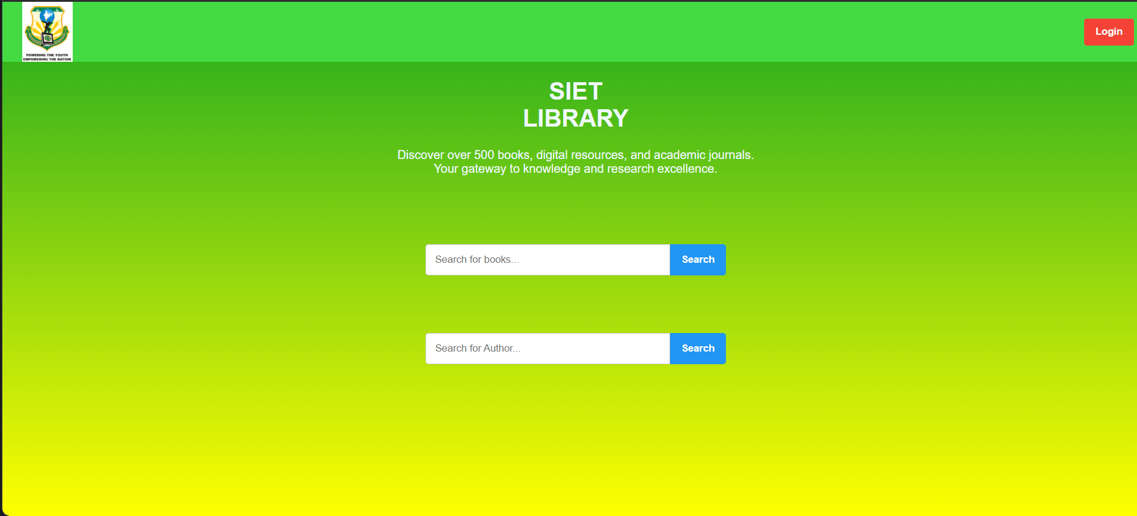
Current Status of the Project..

