Slide 1
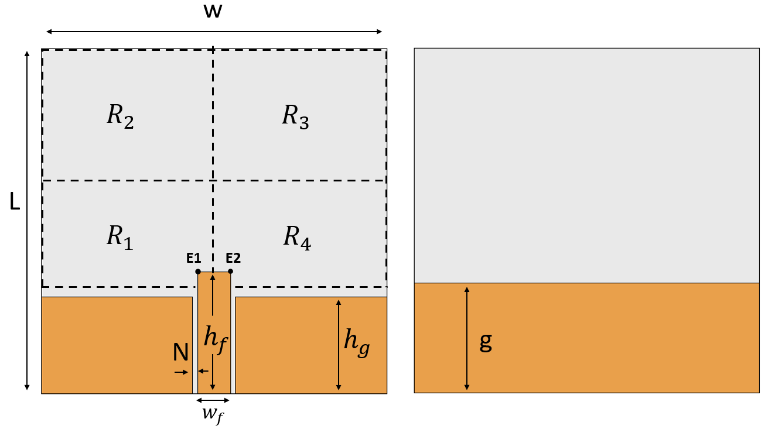
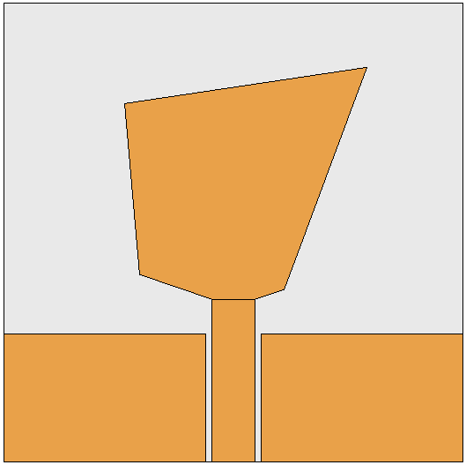
Antenna Design Synthesis Framework using Machine Learning
The proposed framework was evaluated using the initial setup, as shown in Fig.1, and the exploration region (marked in a dashed boundary) is divided into four regions (i.e., R1, R2, R3, R4). The vertices P1 (x1,y1) ϵ R1, P2 (x2,y2) ϵ R2, P3 (x3,y3) ϵ R3 and P4 (x4,y4) ϵ R4 were randomly chosen to form a patch.
Example shape
(a)
(b)
Fig. 1. (a) Top view and (b) Bottom view of the initial setup. Where N = 0.6 mm, hf = 44.25 mm, hg= 35 mm, wf = 12 mm, W = 125, L = 125 mm, g = 39 mm.
The exploration region can be sampled finely, and the shape of the exploration region can be altered (from square to sectors or other shapes) to increase the degree of freedom and further avail unique patch shapes inconceivable to the human mind.
The framework can be applied to optimize different patch antenna feed types (ex: pin fed, edge feed, inset feed, electromagnetically couple feed).
For this example, the size of the substrate (25 mm x 25 mm) and the height of the substrate (5 mm) are provided as design constraints.

Slide 2
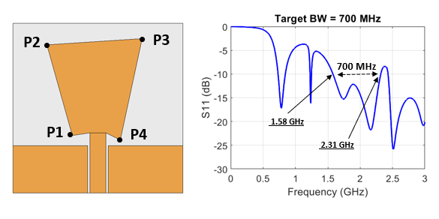
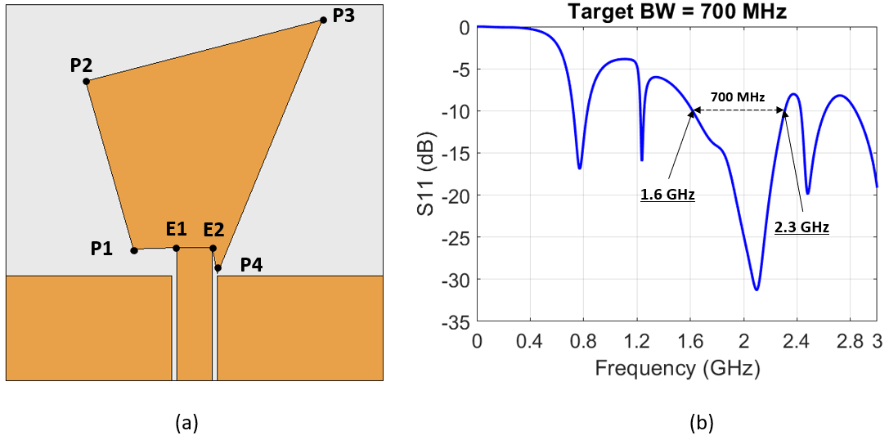
Condition 1: Find the vertices of P1,P2,P3,P4 to achieve a bandwidth of 700 MHz
(a)
(b)
Fig. 2. (a) Antenna design build using vertices estimated by the framework, and the corresponding (b) S11 for the above condition 1
Fig. 3. (a) Antenna design build using vertices estimated by the framework, and the corresponding (b) S11 for the above condition 1
Obtained vertices | No. of iterations | Computational time
P1 = (-20.2,-18.7); P2 = (-36.2,37.1); P3=(42.3,57.4); P4 = (7.5,-26.9) | 55 | 1 sec*
Obtained vertices | No. of iterations | Computational time
P1 = (-18.8,-20.2); P2 = (-37.7,46.7); P3=(32.6,51.2); P4 = (16.4,-23.6) | 638 | 2 sec*
*Time taken by the framework to predict the vertices.

Slide 3
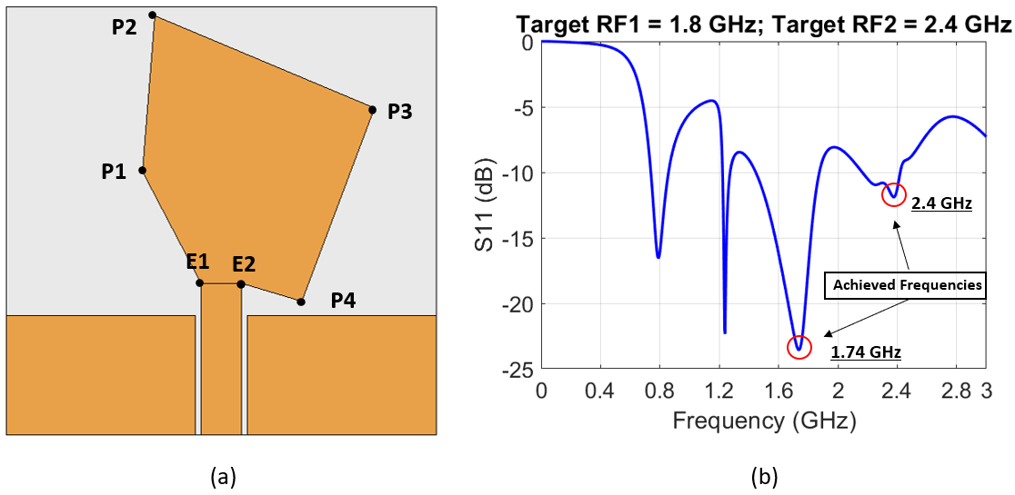
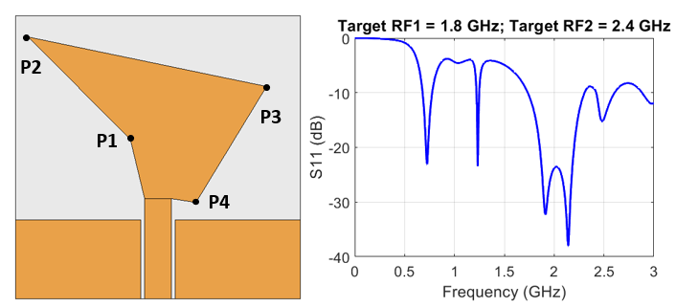
Condition 2: Find the vertices of P1,P2,P3,P4 to achieve frequency resonance at 1.8 GHz and 2.4 GHz
2.45 GHz
1.8 GHz
(a)
(b)
(a)
(b)
Fig. 4. (a) Antenna design build using vertices estimated by the framework, and the corresponding (b) S11 for the above condition 2
Fig. 5. (a) Antenna design build using vertices estimated by the framework, and the corresponding (b) S11 for the above condition 2
Obtained vertices | No. of iterations | Computational time
P1 = (-22.9,14.5); P2 = (-19.4,59.8); P3=(44.6,33.0); P4 = (23.5,-23.5) | 959 | 4.5 sec*
Obtained vertices | No. of iterations | Computational time
P1 = (-12.1,8.0); P2 = (-57.0,53.2); P3=(47.8,31.2); P4 = (16.8,19.8) | 551 | 2 sec*
*Time taken by the framework to predict the vertices.

Slide 4
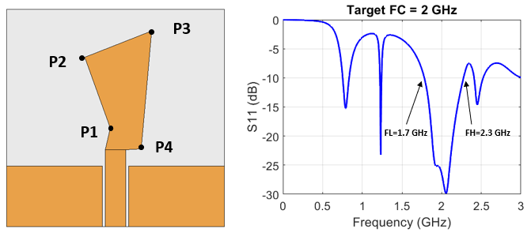
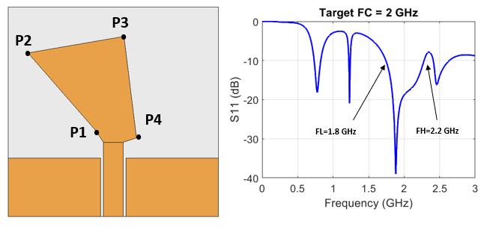
Condition 3: Find the vertices of P1,P2,P3,P4 to achieve center frequency at 2 GHz
(a)
(b)
(a)
(b)
Fig. 6. (a) Antenna design build using vertices estimated by the framework, and the corresponding (b) S11 for the above condition 3
Fig. 7. (a) Antenna design build using vertices estimated by the framework, and the corresponding (b) S11 for the above condition 3
Obtained vertices | No. of iterations | Computational time
P1 = (-3.1,-5.7); P2 = (-17.6,34.9); P3=(20.7,50.1); P4 = (14.7,17.8) | 11 | 1 sec*
Obtained vertices | No. of iterations | Computational time
P1 = (-10.3,-11.5); P2 = (-50.9,35.1); P3=(6.3,44.9); P4 = (13.8,-15.6) | 1 | 1 sec*
*Time taken by the framework to predict the vertices.

