Slide 1
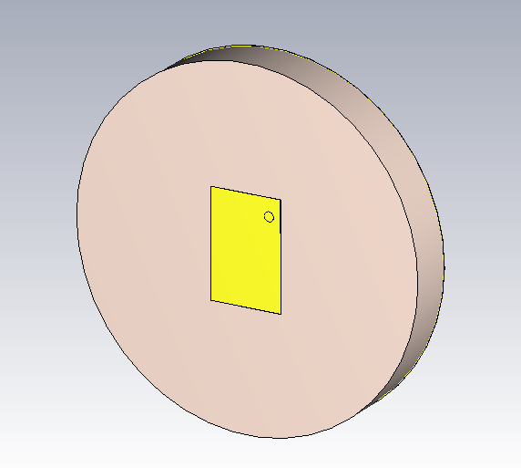
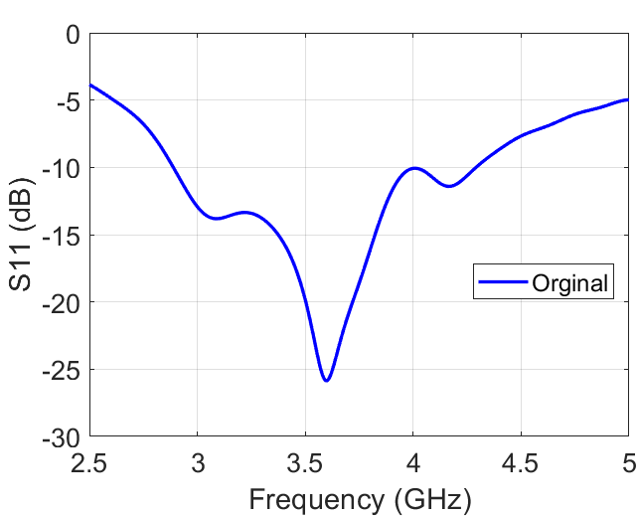
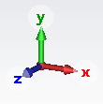
Evaluation of ML-based antenna synthesis framework
The framework proposed in the research proposal is tested with a new test case: optimum pin location identification for a square patch antenna shown in the figure below. The original* antenna design has achieved a bandwidth of 1.4 GHz.
(a)
(b)
Figure 1. (a) Original antenna design and (b) corresponding S11 result obtained using CST
The above antenna geometry was used to generate 600 samples of data with input (x, y coordinates) as pin location and output as S11 (at 25 frequency points over 2.5 GHz to 5 GHz ). These samples were used to train a k-nearest neighbor algorithm. Through hyperparameter tuning, I determined the optimal combination of 'k' and training data size 't' as 2 and 435, respectively. Notably, the framework could accurately identify multiple pin locations and produce excellent results in seconds.
*Original refers to the results/model obtained by Bidisha

Slide 2
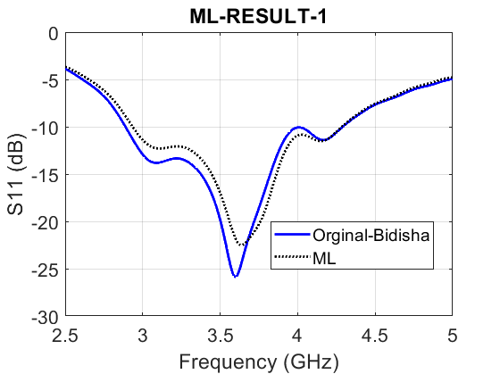
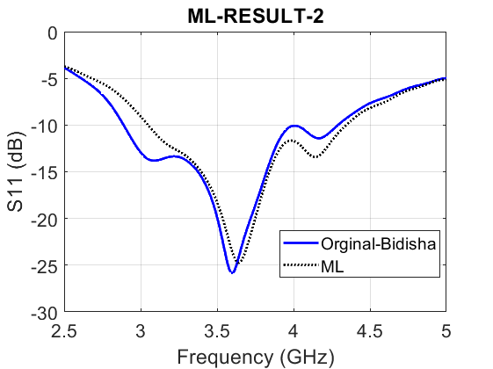
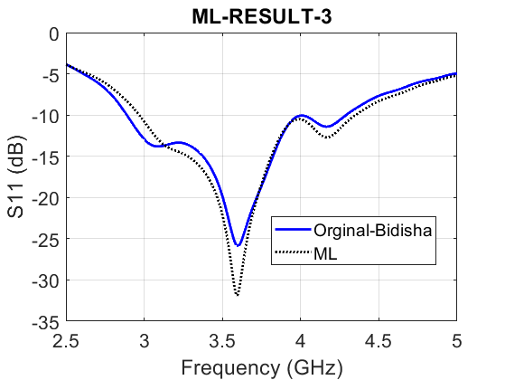
Figure 2. Comparison of S11 results between the pin location estimated by the framework and the original S11, obtained from CST
Three simulations of the framework were conducted to obtain three different pin locations, namely, ML-1, ML-2, and ML-3. The simulations had the same objective, which was to maximize the bandwidth.
ML-1 has achieved almost 98.5% of the original bandwidth while only taking a few seconds; The framework can be reused N times with the same or different objectives for desired results
Table: Comparison of pin location, bandwidth (BW), and % BW
 | Xp | Yp | FL (GHz) | FH (GHz) | FC (GHz) | BW (GHz) | % BW
Orginal | 3.2 | 4.8 | 2.89 | 4.29 | 3.59 | 1.4 | 38.99
ML-1 | -3.3 | 5 | 2.9 | 4.28 | 3.59 | 1.38 | 38.43
ML-2 | 2.4 | -5.4 | 3.05 | 4.34 | 3.69 | 1.29 | 34.95
ML-3 | 2.6 | 5 | 2.97 | 4.35 | 3.66 | 1.38 | 37.7
The estimated pin location ML-2 and ML-3 have a larger difference in terms of BW and %BW than the original, this can be avoided by using a neural network or ML model with better accuracy than the current KNN model.

