Slide 1
Computer Principles for Programmers
Course Overview
Notes:
Welcome. Bienvenue. There are many other languages our colleagues speak; please say "welcome" in another language.
Embracing diversity is being willing to understand an issue from many points of view (the Apple formula for success). You encountered greetings you didn't understand –words are code for concepts. Given the context, you knew they meant something friendly. Greetings in some cultures can mean much more than a simple hello, e.g. "Shalom or Namaste or Salam". To really appreciate the person we refer to as the end user, we must also understand what they mean culturally, not just what they say in words.
Gender diversity is an issue in the IT industry. We need more women in this business for another point of view – a special welcome to the women in our class who are willing to put up all the guys. Since 2011, the percentage of women in ICT has ranged from 29.5% to a low of 26.4% with 26.7% in 2018. the ICT industry is facing a talent shortage. Canada will need to fill more than 200,000 technology-related positions by 2021. The growth in these jobs has outpaced the overall economy in the last two years by 4 to 1. Our supply of ICT graduates and workers will not meet this demand. (https://www.thestar.com/opinion/contributors/2018/07/01/its-time-to-close-the-gender-gap-in-tech.html)
Diversity is strength in IT – especially in software design and in the creation of the UX – User eXperience. Different points of view from various languages, cultures, genders, industries, disciplines are all valuable in designing and building good software. Facebook, Amazon, Apple, Netflix, Google (FAANG) would not be as successful, without multiple POV. Apple used to hire liberal arts majors. Steve Jobs: "technology alone is not enough—it’s technology married with liberal arts, married with the humanities, that yields us the results".
Students are not only here to learn from professors and course materials, students are also here to learn from each other – something you cannot do on YouTube. People come to college to improve their social skills for the business world, learn how to interact and work with others, how to compromise, how to deal with rejection and failure, and to learn what it is you don’t know. These are all things you cannot do on YouTube.
Programming isn't about coding; it is about solving problems. When problems are reduced to abstractions, the meaning of the application you coded can be lost. Think of a manufacturing robot – it has no idea of the importance of its work or how someone will appreciate the accuracy of its creation. The physical work of crafting a real object in a workshop is abstracted to a manual procedure which is abstracted to an algorithm which is abstracted to source code which is compiled for a computer to run a robot that reproduces that object. We must understand the original work that our source code represents—crafting that real object—in order to create a good UX – User Experience. Otherwise, our systems will solve users' problems only with luck. And being lucky is no way to be a professional.
[1] https://www.newyorker.com/news/news-desk/steve-jobs-technology-alone-is-not-enough
https://www.npr.org/2011/10/06/141115121/steve-jobs-computer-science-is-a-liberal-art

Slide 2
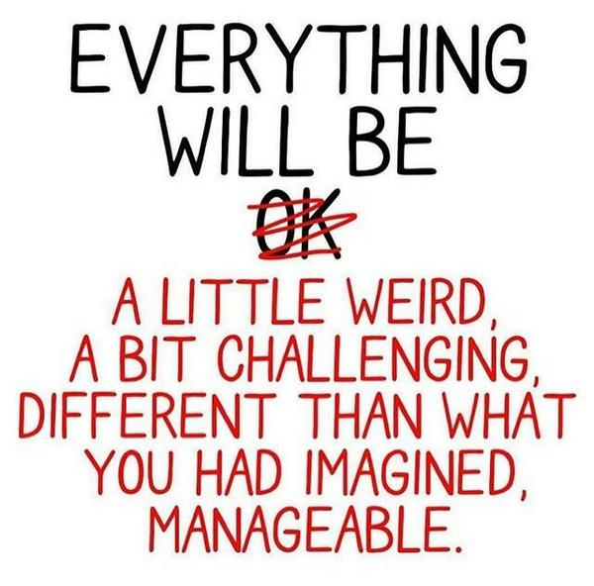
Agenda
Course Intro
Who is your professor?
What will you learn?
Notes:
these slides will be available to you
That does not mean you don't have to take notes
Your notes are not for the lecture you hear and see –
Write down your questions, topics of interest, topics that you want to investigate further.

Slide 3
Our School of …
School of Computer Programming (no URL yet)
as of Summer 2023
for CPA and CPP diploma programs
… Software Design & Data Science (SDDS)
as of Fall 2019
for degree and graduate-certificate programs
and until CPA & CPP are set up as SCP
Notes:
https://students.senecacollege.ca/spaces/15/school-of-software-design-data-science/home Use the SDDS URL until the school-of-computer-programming is fully set up
Because, at 51 characters, the "School of Information and Communications Technology" (SICT) was not a long enough name, it was split in two schools in August, 2019 called
School of Software Design & Data Science and School of Information Technology Administration & Security which, at 98 characters total, is almost twice as long as SCIT – and so it should be: there were now twice as many schools.
SICT was bigger than the universities of New Brunswick, Winnipeg, Laurentian, and many others. Also, bigger than the colleges of St. Lawrence, Cambrian, Sir Sandford Fleming. Now, with about half of our 7,500+ students in either (CP + SDDS) or ITAS, each of our sub-schools are bigger than Lambton, Confederation, Loyalist, and 3 other Colleges…as well as St. Francis Xavier, Acadia, Nipissing, OCAD and many other Universities.
SDDS = school of palindromic initialism. Initialism is first letters of a term pronounced separately. E.g. “C-P-U” for Central Processing Unit; S-D-D-S Acronym is the initial letters of a term pronounced as a word. e.g. “RAM” for Random Access Memory;
An abbreviation is a shortened version of a word that may be meaningful only in context. E.g. "comms" for communications, "comp-sci" for computer science
Circa 1999 when the internet was a toddler, all these schools were known only as the School of Computer Studies.
https://www.ontario.ca/data/college-enrolment
https://www.univcan.ca/universities/facts-and-stats/enrolment-by-university/

Slide 4

Goal of Computer Principles for Programmers: Become an ICT professional
CP4P CP4P
UNIX Linux
Applied Problem Solving
Programming
with C
Notes:
Computer Principles for Programmers offers global concepts in ICT and a view into the things a professional programmer knows in addition to how to write programming code.
What is a professional? Someone who gets paid? One insightful consultant described it as "a professional is someone who does a good job even when they don't want to."
All students are now professional programmers (yes, the money is going in the wrong direction): you are paid, paid in marks, but paid nonetheless. So, you are now a professional.
C programming and Unix/Linux courses focus on detail level technical skills. Notice "Applied Problem Solving" is a world-wide skill.
CP4P offers context for C & *nix skills in the business and ICT worlds.
CP4P is the "big picture" course. We cover many things that the ICT industry expects programmers to be aware of and things that help you be a better programmer. C programming and Linux/Internet courses focus on detail level technical skills. This course hopes to help you put those skills in context within the business and ICT worlds.
Image from https://apod.nasa.gov/apod/ap000420.html

Slide 5
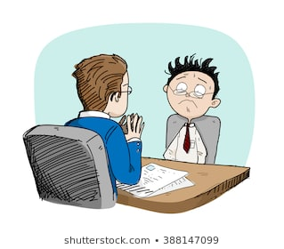
Ultimate Goal of CP4P
Grok ICT terminology and concepts so you can nod knowingly in a job interview …to words like “grok”.
Notes:
Grok is ICT industry slang for “I get it, really get it.” https://en.wikipedia.org/wiki/Grok
One objective in this course is conveying the terminology and concepts of ICT so you can nod like you know what they are talking about during a job interview.
When a question comes up, preceding your answer with “Let me just Google that…” will bring the interview to an abrupt end.
That is why our quizzes are closed book, open mind. Retrieving those answers from memory is where they will come from during your conversations with ICT professionals. So during a quiz, resist the temptation to Google for answers.
The great philosopher and mathematician Bertrand Russell said, “The hardest thing to learn in life is which bridge to cross and which to burn.“ Crossing the bridge from integrity to cheating automatically burns that bridge -- and many others.
https://www.shutterstock.com/search/job+interview+cartoons

Slide 6
Goals of CP4P
Professional programmers do more than just code.
Problem identification, solving, and communication
ICT news for current and emerging trends
Systems Development and Programming – is more than writing code. Much more.
use IDEs, interact with Servers – directly and in the Cloud, Platforms, Networks, Dev.Stacks, Backup, Security, Project Management, Systems Development Life Cycle (SDLC)
Know of Licensing, Regulations, Intellectual Property (IP).
Windows operating system (OS) is the default template
Notes:
"As computer scientists we are trained to communicate with the dumbest things in the world – computers –
so you’d think we’d be able to communicate quite well with people." – Prof. Doug Fisher
You do not need a personal Windows machine to be successful at Seneca. Our programs cover all major Operating Systems (IBM, *nix, Windows, with some Apple specific courses); Seneca labs give you access to all OS flavours. There will be times when it is necessary to work on the native OS.
There is a focus on Windows because Business, industry, and gaming on the desktop is almost exclusively Windows.
Windows runs ~90% of the desktop & laptops in the world with personal use a little lower in North America because of higher Apple macOS use at the consumer level. Apple macOS ranges from 8.5% worldwide to 16% in North America. macOS has significantly less usage in business enterprise environments. N.B. avoid using personal computers with ARM64 processors at Seneca, i.e. some Microsoft Surface and newer Apple Mac or iPad with M1 (i.e. ARM64) CPUs. ARM64 may not yet be compatible with all necessary software.
RE: IDEs
There is a Visual Studio Code for all platforms and "Visual Studio for macOS" but neither is the full Visual Studio IDE (Integrated Development Environment) which runs only on Windows.
VS (Visual Studio) IDE is a professional, enterprise-grade IDE. It is the IDE most used in industry because it is the best there is. The Community version is licenced for individuals, Open Source development, or small scale consultancies. The VS Professional licence is for "enterprise" organizations: >250 PC users, or >USD$1B annual revenue. VS Code is an lightweight text editor similar to Sublime Text or Atom. It’s a great editor that is faster than the full-featured Visual Studio IDE. VS Code is gaining more and more functionality; it is now sufficient for cross-platform C programming in Seneca courses.
Apple macOS users: Create a VM or dual boot partition for Windows, then install the Visual Studio Community and choose the option C++ to install during the VS installation. Optionally, VS Code, Apple Xcode or Eclipse
Macs are lovely and have vertical market advantages in the consumer space, but are not generally used in business or gaming.
https://hostingtribunal.com/blog/operating-systems-market-share/ https://www.gartner.com/en/newsroom/press-releases/2021-07-12-gartner-says-worldwide-pc-shipments-grew-4-point-six-in-second-quarter-of-2021
Servers: ~25% Microsoft Server, remaining ~75% are mostly *nix (Red Hat Enterprise, Linux, IBM AIX) and a much smaller number of IBM Z mainframes & Power systems (midrange) which do 2/3 of the world’s server workload.
https://www.itjungle.com/2023/02/13/aix-the-last-standing-commercial-unix/
From Microsoft: "If you just want a lightweight tool to edit your C++ files, VS Code has you covered but if you want the best possible experience for your existing Visual C++ projects or debugging on Windows, we recommend you use a version of Visual Studio such as Visual Studio Community IDE." see https://visualstudio.microsoft.com/vs/community/
https://social.msdn.microsoft.com/Forums/en-US/ef99e9f5-2a48-423b-b6c0-fa5617d7c63d/how-do-i-get-c-to-work-on-visual-studio-for-mac?forum=visualstudiogeneral
https://docs.microsoft.com/en-us/dotnet/core/tutorials/using-on-mac-vs
Personal use Operating System Market Share - August 2021
Worldwide North America Android 42.61% 24.26%
Windows 30.66% 30.96%
iOS 16.55% 27.65%
OS X (mac) 6.5% 12.65%
Unknown 1.54% 0.99%
Linux 0.98% ChromeOS 2.26%
Statcounter Global Stats -- https://gs.statcounter.com/os-market-share and https://gs.statcounter.com/os-market-share/tablet/united-states-of-america

Slide 7
Course Format and Evaluation
Each week ICT News, Lecture Activity (assignment) walkthrough
follow up Quiz on previous week

Slide 8
ICT News of the Week
student presentation(s) of an ICT news item
schedule of who & when to be available soon
3 to 4 minutes plus Q & A
worth 5% of course, optional
Subscribe to a news service
Build your ICT vocabulary
Learn the TLAs
Your future employers read and make the news
Notes:
Students present a software development topic of their choosing in the coming weeks as per schedule TBA.
ICT is Information and Communications Technology. It used to be just "I–T", Information Technology, until Communications became an essential part. E.g. How do you feel about using a computer or phone without an Internet connection?
ICT is a TLA. TLA is an in-joke: Three Letter Acronyms, There are lots of TLAs -- a few Two Letter Acronyms, but no FLAs -- Four Letter Acronyms, there are only xTLAs – eXtended Three Letter Acronyms (also an in-joke).
In 1988, in a paper titled "On the cruelty of really teaching computer science", eminent computer scientist Edsger W. Dijkstra wrote "Because no endeavour is respectable these days without a TLA ...“ https://en.wikipedia.org/wiki/On_the_Cruelty_of_Really_Teaching_Computer_Science https://www.cs.utexas.edu/users/EWD/transcriptions/EWD10xx/EWD1036.html
When someone asks what does ICT, CPU, FPU, AI, USB, or RAM mean, you say, "It's a TLA." If anyone laughs, you know they are part of the ICT club. For the others who are frowning, you apologize for the ICT industry being full of TLAs, then explain TLA and the TLA itself—without using more TLAs.
All vertical industries have their own shorthand TLAs. Just don't use them to impress and intimidate others.
https://en.wikipedia.org/wiki/Three-letter_acronym
http://www.nickh.org/computer/glossary.html
Also see http://www.catb.org/~esr/jargon/index.html
worth 5% of course, optional – not needed to pass the course but worth +0.5 GPA if done.

Slide 9
ICT News Sources – unreadable slide
Web search: ICT NEWS General News
http://www.itworldcanada.com/
http://www.itworld.com/
mozilla/news/
http://www.computerweekly.com/
http://www.computerworld.com/
http://www.wired.com/
Guardian – International USA
News Aggregators
Slashdot - http://slashdot.org/ (with human editing)
YC Hacker News - http://news.ycombinator.com (with voting)
Hacker News - http://hackernews.org/ (rss feeds)
Ars Technica - http://arstechnica.com/
CNET - http://www.cnet.com/ ZDNet - http://www.zdnet.com/
Digital Trends - http://www.digitaltrends.com
Engadget - http://www.engadget.com/
GigaOM - http://gigaom.com/
Gizmodo - http://gizmodo.com/
HuffPost - https://www.huffingtonpost.com/...
Mashable - http://mashable.com/
ReadWrite - http://www.readwrite.com
The Next Web - http://thenextweb.com/
The Verge - http://www.theverge.com/
TechCrunch - http://techcrunch.com/
TechRadar - http://www.techradar.com/
Technowize - https://www.technowize.com/
Notes:
Start reading the news now. Select a software development topic soon to be ready to present later.
Web Search: ict news canada, it news websites
https://webfoundation.org/ The World Wide Web Foundation was established in 2009 by web inventor Sir Tim Berners-Lee to advance the open web as a public good and a basic right.
https://blog.mozilla.org/ We make the internet safer, healthier and faster for good. Mozilla is the not-for-profit behind Firefox, the original alternative browser. We create products and policy to keep the internet in service of people, not profit.

Slide 10
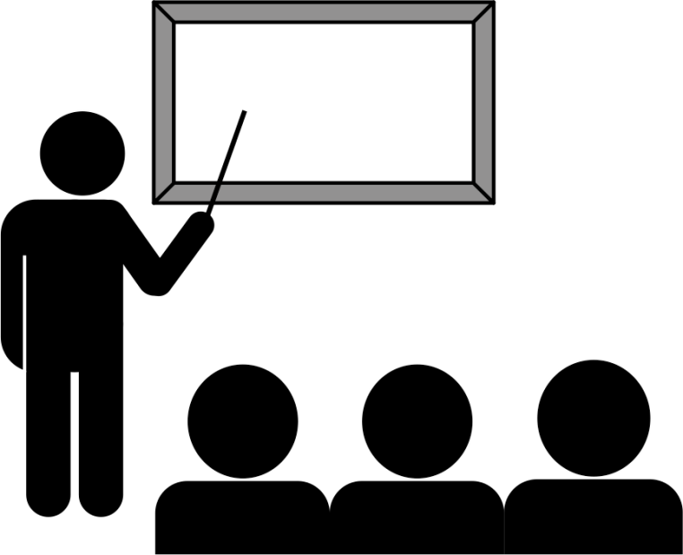
Weekly Lecture
Lectures deliver the content of the week's topic and activity which will become next week's quiz.
Ask questions during the lecture.
Put away away your smartphone. (It makes you stupid .)
Notes:
In industry, if you arrive after the start time but the boss is not there yet, lucky you, you’re not late. If the boss is already there, you have a decision to make: avoid being obviously late by not going in, or go in late thereby disturbing the meeting and annoying the boss. You must decide which option is more “career limiting” than the other.
The social rules in class may be more relaxed than in some environments, even more so online world. Here ia rule you don't often see followed online: Be respectful of others. Treat the lecture as a business meeting where the client is telling you about their business and their requirements. Your job is to fulfill those requirements within the next week.

Slide 11
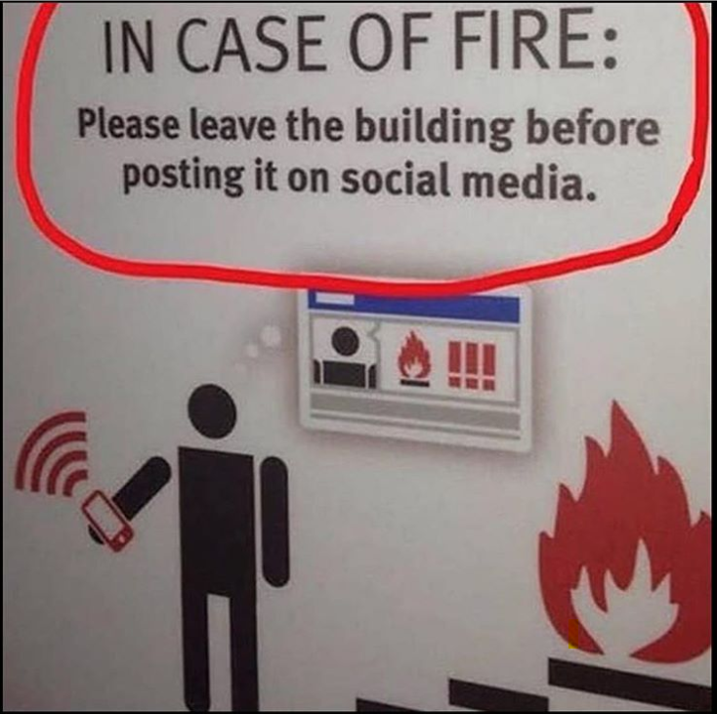
Weekly Lecture
Your
smartphone makes you stupid .
Notes:
"compared to reading on a paper medium, reading on a smartphone … promotes brain overactivity in the prefrontal cortex, and results in reduced comprehension. " Honma, M., Masaoka, Y., Iizuka, N. et al. Reading on a smartphone affects sigh generation, brain activity, and comprehension. Sci Rep 12, 1589 (2022). https://doi.org/10.1038/s41598-022-05605-0
https://www.theglobeandmail.com/technology/your-smartphone-is-making-you-stupid/article37511900/
'TikTok Brain' is killing students' ability to learn - The Hub https://thehub.ca/2022-09-19/paul-w-bennett-tiktok-brain-is-killing-our-students-ability-to-learn/
https://news.utexas.edu/2017/06/26/the-mere-presence-of-your-smartphone-reduces-brain-power
https://www.psychologytoday.com/blog/the-athletes-way/201706/are-smartphones-making-us-stupid
https://hbr.org/2017/04/a-new-more-rigorous-study-confirms-the-more-you-use-facebook-the-worse-you-feel
https://hbr.org/2018/03/having-your-smartphone-nearby-takes-a-toll-on-your-thinking
https://www.theglobeandmail.com/opinion/article-squirrel-we-must-zero-in-on-improving-our-attention-management/

Slide 12

Weekly Activity
Weekly Activity (assignment) is your investigation of the week's topic
Activities are reviewed in class.
Submit by class date + 2 calendar days
Five 'Grace Days' available.
10 activities, the best 8 count
When life happens, you have a no cost option
Minimum 50% average of the best 8
5% each, 40% of course grading
Notes:
Activities are due via submission through Blackboard (my.senecacollege.ca) Click on the activity title / topic to see the due date. It is usually two calendar days after your class by end of day (23:59). It does not mean procrastinate for a day. Most people gain more success by creating a draft or detailed outline on one day, and completing the final version the next. It is due by midnight to encourage you to go to bed; take care of yourself by getting enough sleep – it helps with learning.
You can give yourself an extension by using one of your Grace Days. Need an extra day? Take a Grace Day. See the Addendum.

Slide 13
Weekly Quiz
Done online within ~20 minute timebox. Plan to be early to finish on time.
10 quizzes, only the best 8 count
When life happens, you have a no cost option
Minimum 50% average of the best 8
3.75% each, 30% of course grading
Notes:
The quiz is given at the professor's discretion any time during scheduled class. Students arriving late for class or leaving early might miss the quiz timebox or have a shorter time to complete it.
e.g. if quiz is given at beginning of class and you arrive 10 minutes late, you will have only 10 minutes to complete the quiz. It doesn't matter when you start – it matters when the test ends. Submitting 10 minutes late result in 5% * 10 = 50% deduction for the extra time.
Quiz is CLOSED book, OPEN mind. The objective is to have enough in your head to have a conversation about ICT. The person you talk to might be your boss, your client, your end user, or your colleague. They won't be impressed if you take out your phone and google the basics. It is OK to say, "I don't know" because no one can know everything about any area of ICT anymore. But not knowing the terminology and the basic concepts will bring the conversation/interview to a halt.
Timebox is a term used in Agile project management.

Slide 14

Final Project
SDLC project
Group work using MS Teams
Must be completed to pass the course
up to 25% of total course marks
Completed during last 2-3 weeks of the term.
No exam!
Notes:
Systems Development Life Cycle (SDLC) project will be steps within the Implementation phase where code is developed and tested.
It will be a project with explicit Project Management.
Code will be provided, groups will create modules, program comments, test cases, documentation.
The process and tasks will be very similar to ICT world professional projects. Nothing in the project requirements will be academic.

Slide 15

Assessments
Content | %
Quizzes (best 8 of 10) * | 30%
Activities (best 8 of 10) * | 40%
ICT News Item (optional) | 5%
Final Project (required) | 25%
Total * | 100%
* minimum 50% average – 49.99999% is below the minimum
See Course Information and Addendum for details
Notes:
What is the passing mark in business?
-- as close as possible to 100%. Every day.
What happens when you get 50% in business? -- a security guard is beside your desk saying, “Hands off the keyboard! Put your personal stuff in this box and come with me.”

Slide 16
Success is not goals, it is process.
Do the right things: attend class, do the work.
Do things right: with integrity -- it's not just academic.
Web sites and email do not push. You must pull.
Follow ICT tech news and come prepared to discuss.
Take notes. ICT professionals do this in every meeting.
TL;DR not an option. Follow all steps in the activity.
Discuss during the activity. Talking is part of learning.
Talk all you want, but don't copy anything.
Do it every week. Focus on process before payout.
Notes:
Do the right things: attend class, do the activity, do the quiz
Do things right: with integrity -- it's not just academic. In business, copying from a white paper without attribution or using Open Source code contrary to its license can get you fired, your company sued, and the boss to lose her house.
If you do your own work and properly cite and reference anything that isn't, then you don't have to be aware of Seneca’s integrity policy. Professors invigilate tests and check for plagiarism to preserve the value of your marks which are diluted when others cheat.
Student learning recommendations
Review the entire activity / lab / workshop / assignment instructions by end of class day to understand the objective, the process, and the deliverables.
discuss with student colleagues
ask for professor's help as needed
Even if you don't complete the activity during class/lab time, by reviewing the entire activity before you do it later, your brain will be better prepared when you do work on it.
review slide deck, textbook, handouts, lecture resources, and your own notes for 10 minutes the next day, 5 minutes the next week, 2.5 minutes the next month, and you will never have to cram for an exam.
review things the night before a quiz or test.
Sleep is important for learning, memory consolidation, and many other things, just like Mom said.
Go to bed at a consistent time and get a full night's sleep. Do this regularly and you will rarely need to set a morning alarm.
Staying up late borrows time from tomorrow—with interest. After a full night's sleep, you will get more done in less time. Sleep deprived people get sick more often than the well rested, and the well rested with a consistent sleep schedule have greater academic success. Want to be 10 – 15 IQ points smarter? Do what your Mom said.
Attend class. It has been said that "80% of success is showing up."
Pull is the business world. Web pages are pull – you must load a page and read it. Email is pull. You may not know if there is new email until you look or PULL from the server. Unlike social media which is always trying to get your attention by pushing new events to your phone, you have to consciously pull at Seneca and when working in the industry.
3. Taking notes is not for recording the factoids of a lecture, it is for making meaning.
Take notes during the lecture.
Even though learning resources are available to you on demand, it does not mean you don't have to take notes.
Your notes are not for the data and info you hear and see, your notes are to make meaning, mind maps, mental constructs, and understanding of the material.
Take notes for things important to you. What questions do you want to ask? What interests you? What do you want to look further into? What matters? Why does it matter? When will it matter?
Research says even just doodling during a lecture will help you focus on the proceedings.
All businesspeople, yes all, go into a meeting with pen and paper, and come out with key insights and action items.
4. Thoroughly read all steps in the activity. TL;DR is not an option in the ICT business. They pay us to read the manuals.
5. "Talk all you want, don't copy anything." Giving or getting anything to/from another student that will be/has been graded is plagiarism possibly on both the giving and getting sides. In this course, that means quiz answers, activity submissions, and final assignment components. Please discuss anything and everything, just don't exchange quiz answers, activity doc files, program source code, or anything else that is marked by an professor in any course.
All the answers to just about everything in life are out there on the Internet. There is also a lot of junk and half-truths. In some education cultures, the objective is to find the answer. However, in this course and others, having the answer is not meaningful unless you worked it out for yourself – that is what matters. It's the journey, not the destination. If you need help understanding the problem, you can ask for it. If you need help working out the solution, you can ask for it. If you need more time, you can use a Grace Day.
File sharing is not caring, it is not helping each other or quid pro quo. ("Upload your study documents for free access to other study documents in our library." CourseHero.com) It is predatory behaviour by commercial third parties.
6. Goals and dreams are great to have. Goals are what psychologists call Delayed Gratification: invest in short term pain for long term gain.
Your commitment to come to Seneca was huge. It will have long term value. Your goal to complete your program and learn good things gets you started. It is hard to start something so big, and yet, you’ve done that – you are here. But it isn't enough.
So why don’t goals work? Delayed Gratification takes too long, that’s why. Hard work often pays off after time, but laziness always pays off now. What works? Process works. Having a goal to do a marathon does not work. Diligent training and wearing out many pairs of running shoes…that works. Getting up early to go to the gym or run 5 days/week works.
Process is planning your novels while on public transit – that works. Process is writing your novel in longhand whenever your baby daughter sleeps – that works. Keying it on a typewriter—repeatedly—works. The process of doing that for 5 years got the novel written. Spending a year being rejected by agents, then finding one who sent the manuscript to 12 publishers, who all rejected it, all the while training as a teacher in case the novel didn't sell…that works. The 13th publisher, Bloomsbury, agreed to take a chance on Harry Potter and the Philosopher’s Stone publishing it with low expectations. That’s how J.K. Rowling got the first Harry Potter book out into the world. Process got it written. Process got it published. But just having a goal to sell over 500 million books and become the richest author in history does not get it done. Success is about process; that's what is meant by "showing up."
https://getpocket.com/explore/item/how-to-beat-procrastination-backed-by-science
These and other notes to this effect are found in the Class Standards document (under Course Information in Blackboard )
Attend all classes and “be on time.”
“Silence” audible devices or put your call on speakerphone so we can all participate.
Focus on the task at hand – humans cannot multi-task (neither can most computers). Humans task switch. Switching away is easy and quick, switching back takes time and effort. When computers have too much to do, they do more task switching than processing; it’s called thrashing.
Review previous lecture notes to prepare for the quiz. Do it the night before because performance and recall are better after a night’s sleep.
Submit all graded work on time. You can buy extra time at 20% per day.
The ultimate goal is to get you ready for the job market. Treat your program at Seneca as your job, the professor as your manager, and your classmates as colleagues.
During the quiz, looking at others monitors and/or talking before everyone is done is considered as “cheating.”
Check your grades and if you have any concern about them for each week, talk to your professor “no later than the following week.”
You are responsible to “continuously and regularly check and follow” your Seneca emails for this course. There might “always” be important messages!
Based on the emails your professor receives, it might take some time for him/her to reply your email; “be patient!”
If you miss a class, your professor is not going to re-teach that to you (even during office hours). You are responsible for your learning. Back each other up by sharing your notes (but NOT graded items).
Don’t rush to leave the class early; instead, “concentrate on studying the steps needed to be done and doing them right!” Also, there might be “some directions or explanations needed from your professor before doing the activities”. Talking about the issues with your colleagues is a great way to make learning easier.
Quizzes and activities are done through Blackboard..
You have the right to ask help from your professor or other students. When you have questions about the work, review and search the lecture slides and activity instructions first. (Search the web as a last resort.) The ultimate answers should be yours.

Slide 17
Blackboard’s “Activity Stream”
DO NOT LET IT RUN YOUR LIFE Just because it works today, does not mean it will work tomorrow.
Be the master of your fate, use your own calendar app.
If you fail (like a student last year) because the Activity Stream did not tell you about critical items, sue Blackboard.
Notes:
We are in ICT. We should know better than to let a computer tell us what to do or when to do it.
Use the activity stream ONLY as a double-check and reminder of your own tasks list.
It seems like the Activity Stream is good at tracking important things like tests and assignment due dates. One student FAILED the course because of a) their reliance on the Activity Stream, and/or b) unpredictability of the Activity Stream. (It is a bug, not a feature.) Others have ended with a lower grade.
If you miss a quiz, test, or deadline because you relied on the Activity Stream to organize your life – and it didn’t tell you about something – sue Blackboard. It is neither an excuse nor a reason that your professor will accept. Blackboard's documentation does not explain the logic it uses to make an item appear in your Activity Stream. We do know Blackboard changed the logic because Activity Stream results changed from one semester to another, but Blackboard course administrators (your professor) to this day have not reversed-engineered exactly what the factors are. Effectively, no one knows how it works. Of, if it will work. There have been demonstrated incidents of one student having a notice and another student in the same class not getting a notice. It is like playing an RPG where the rules keep shifting: you can't win, can't quit, can't even break even.
Message exchange between Professor and a student who FAILED the course during the Winter 2022 term because they gave their personal agency to the Activity Stream:
Teams Chat:
[2022-03-30 21꞉43] Student [ Week 11 of 14 ]
Good evening sir, I was having a problem in this subject that I was going through my grades and course addendum and got to know that I stoped receiving quizes after quiz #6 Software Development. I am sorry sir that I am reporting you late about this issue but I recently noticed it. I’ll be very thankful to you if we could have a solution for it, I can give all the remaining quizes if possible. I really need grades.
[2022-03-31 07꞉17] Professor
at this late date, any opportunity to take those quizzes is long past.
[2022-03-31 13꞉13] Student
But sir with all due respect thats was not my fault, it didn’t showed up and a technical fault in the blackboard is not my fault but it leads me to a failure. Sir, please give me a solution for it I can’t bear failing this subject.
[2022-03-31 16꞉47] Professor
That very issue was addressed clearly in the week 1 slides, #17 which said RE Blackboard’s “Activity Stream” DO NOT LET IT RUN YOUR LIFE
Email from Student to Professor:
You notified me on March 30 "that I stoped receiving quizes after quiz #6", that is in weeks 7 – 10, from March 4 through March 25.
Email from Professor to Student:
What misled you to stop doing the weekly quizzes? At the beginning of the course, everyone was warned not to depend on Blackboard’s “Activity Stream”. If that is what misled you, that is not a problem your professor is responsible for. All quizzes were set up in exactly the same way. Blackboard does not document how its activity stream works so professors do not know how to configure tests and assignments to feed the stream. And you were told that "sometimes it works, and sometimes it doesn't"
There is no apparent technical reason why you were unable to take the quizzes when all other students in the class could do so. Your professor cannot know why you did not take a quiz unless you notify the professor. That is what the notes say at the top of the Blackboard Quizzes area – those notes were always visible and unavoidably displayed each time you did take a quiz.

Slide 18
Our School has found…
In the beginning …
By the end …
How did you learn to ride a bicycle?
Notes:
In the beginning of the program, students vary widely in their computing "literacy" and overall programming abilities. By the end of the program, there is little noticeable difference.
Entrance experience is NOT correlated with graduating GPA.
Humans naturally compare themselves to others: it's good for self-motivation but bad for self-evaluation/esteem. “Comparison is the thief of joy.” —Theodore Roosevelt
How did you learn to ride a bicycle? …How? Not by falling off, that was learning how NOT to ride a bicycle. You learned by getting on again.
Lots of people obviously already knew how to ride a bicycle – you didn't – but you didn't compare yourself unfavourably to them. Why not?
Everyone accepts riding is a skill no one is born with; it has to be learned, that it is OK to fall off, that if you are willing to get back on again, you will learn to do it. How many people do you know who ever said, "Yeah, I tried bicycle riding but it wasn't for me. I don't think I'm cut out for it so I just walk."? Hmmm? How many? How long did it take to learn? Weeks? Not likely. Days? Hours? In any case, it's likely that learning happened much sooner than you thought it would when you started.
https://www.theglobeandmail.com/life/facts-and-arguments/i-am-25-years-old-and-i-cant-ride-a-bike/article14147665/
https://en.wikipedia.org/wiki/Social_comparison_theory
individuals evaluate their abilities by comparing themselves to others in order to reduce uncertainty in these domains, and learn how to define the self. (Festinger, 1954)
https://www.psychologytoday.com/basics/social-comparison-theory
http://www.cnn.com/2015/10/27/health/comparing-yourself-with-peers/index.html
Galinksy and Schweitzer (2015) write that "when it comes to using social comparison to boost your own motivation, here is the key rule to keep in mind: Seek favorable comparisons if you want to feel happier, and seek unfavorable comparisons if you want to push yourself harder.“
https://theconversation.com/theres-more-than-practice-to-becoming-a-world-class-expert-60430
https://knowledge.wharton.upenn.edu/article/anders-ericsson-book-interview-peak-secrets-from/

Slide 19
I came to Seneca …
because it was easy.
hard
to learn the answers.
questions
to get good grades.
do the work
Notes:
Why are you here? [click] …because it was easy?
No graduating student ever said, "I'm glad I came to Seneca because it was easy." [click]
"Discomfort is the price of admission to a meaningful life" – Susan David, PhD
[click]
If you are here to learn the answers, sorry: [click] we only have questions. An effortful investigation of the question leads to the answer, i.e. it really is the journey, not the destination that counts. Winning the Boston Marathon by taking the subway is not a winning strategy; Rosie Ruiz found this out in 1980.
[click]
If you are here to get good grades, sorry: this is not the college for you. [click]
You are here to do the work, not to get marks. Marks are the result, not the goal.
Some marks are awarded for the right answer. The rest of the marks, sometimes the most, are for the work that led you to the answer.
If you google the question to find the answer to get the most marks with the least time and effort, while learning as little as possible, then you are in the wrong place. (Search for a degree mill, they are faster and cheaper than Seneca.)
Learn the ideas, the concepts, the principles. Seek understanding and knowledge.
That work will find an answer, your answer. The marks follow the work, your work. Marks are not awarded for other people's work. Academic integrity reports, not marks, follow the submission of other people's work.
Think of Seneca as the Boston Marathon.
“Without ambition one starts nothing. Without work one finishes nothing. The prize will not be sent to you. You have to win it.” – Ralph Waldo Emerson

