Slide 1
Genome analysis
PRESENTATION
By
Samantha prince

Slide 2
Vibrio cholera
Assembling genome
Confirming sequence
Annotating genome
Average Nucleotide Identity

Slide 3

Assembling genome and checking its quality
Spades assembly Data
Type | Number | N50 | Predicted Genome Length
Scaffolds | 90 | 297545 | 4207398
Contigs | 972 | 205654 | 4206850
Unitigs | 2512 | 88835 | 8451166
ABySS assembly Data
Type | Number | N50 | Predicted Genome Length
Scaffolds | 3807 | 228336 | 3989118
Contigs | 4022 | 53332 | 3983217
Unitigs | 4948 | 7007 | 3996554

Slide 4
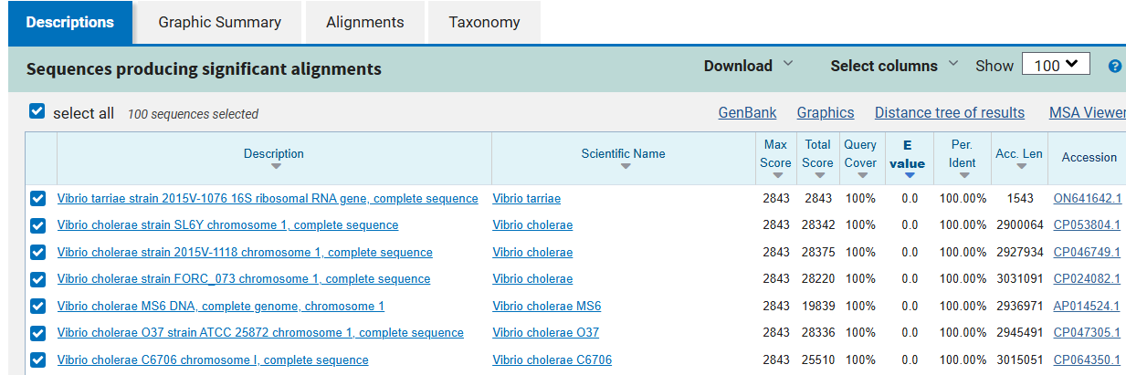
Confirming species using barrnap and NcBI
Notes:
Barrnap was used to take the 16s r rn sequecnes from the assembled scaffolds… the seuqenes was then ranb in NCBI ..

Slide 5
genome annotation using prokka
gene | product | length_bp
argA | Amino-acid acetyltransferase | 1338
sasA_9 | Adaptive-response sensory-kinase SasA | 1323
prpB | 2-methylisocitrate lyase | 897
gntR_1 | putative D-xylose utilization operon transcriptional repressor | 705
mglC | Galactoside transport system permease protein MglC | 1008
mglA | Galactose/methyl galactoside import ATP-binding protein MglA | 1509
mglB | D-galactose-binding periplasmic protein | 975
rstA | Transcriptional regulatory protein RstA | 705
ompV | Outer membrane protein OmpV | 774
acnM | Aconitate hydratase A | 2607
gene | length_bp | product
rpsB | 729 | 30S ribosomal protein S2
recA | 1065 | Protein RecA
gyrA | 2685 | DNA gyrase subunit A
dnaA | 1404 | Chromosomal replication initiator protein DnaA

Slide 6
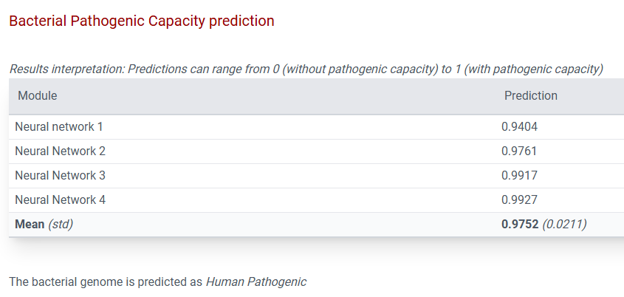
Genome features
Bacterial genome is predicted to be pathogenic
No virulence factors identified
Antibiotic resistance genes
RGI Criteria | ARO Term | AMR Gene Family | Drug Class | Resistance Mechanism
Perfect | almF | polymyxin resistance operon, alm glycl carrier protein | peptide antibiotic | antibiotic target alteration
Strict | almE | polymyxin resistance operon, alm glycyltransferase | peptide antibiotic | antibiotic target alteration
Strict | Vibrio cholerae varG | Subclass B1 Vibrio cholerae varG beta-lactamase | Carbapenem | antibiotic inactivation
Strict | CRP | resistance-nodulation-cell division (RND) antibiotic efflux pump | macrolide antibiotic, fluoroquinolone antibiotic, penicillin beta-lactam | antibiotic efflux

Slide 7
Average nucleotide identity
Species | Percent Identity
Vibrio Tarriae | 95.3965%
Vibrio harveyi | 78.4825%

Slide 8
THANK YOU
Final Project - GitHub

