Slide 1

Alice
“A tool for Learning to Program”
By E&R Team

Slide 2
Agenda
Demo1: Real World, Classes, Objects, Properties and Methods & Message Passing
Demo2: Parameters, Variables and Input
Demo3: Sequential Constructs & Branching Constructs
Demo4: Iterative Constructs

Slide 3
What is Alice?
Alice is a program for building virtual worlds populated by 3D objects. Object s in Alice can move, spin, change color, react to the mouse, and many more.

Slide 4
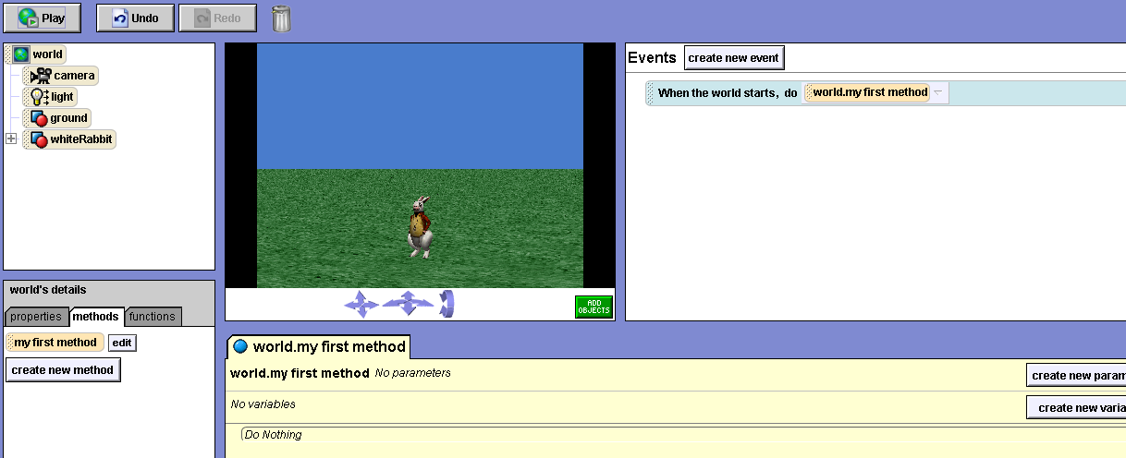
World
This is the world window. It shows you the world you are building.
World

Slide 5
Object Tree
The object tree shown below contains all the objects contained in the world.
Object Tree

Slide 6
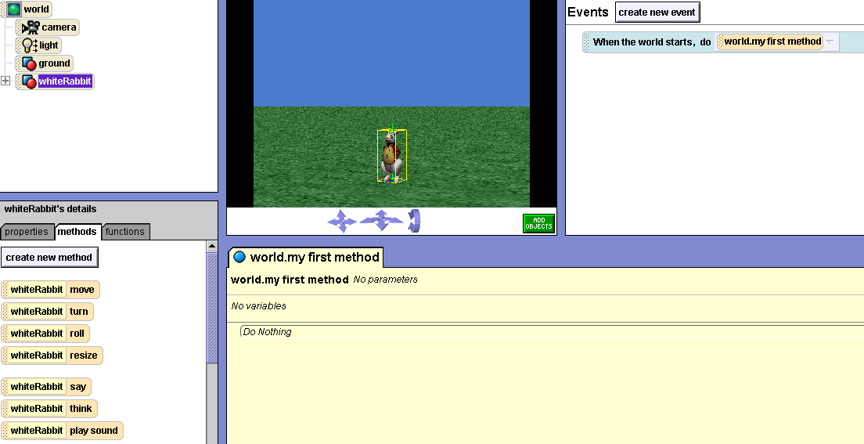
Details Area
This is the details area. It provides more information about the world or an object in the world. The below figure is showing the information about the whiterabbit.
Details Area

Slide 7
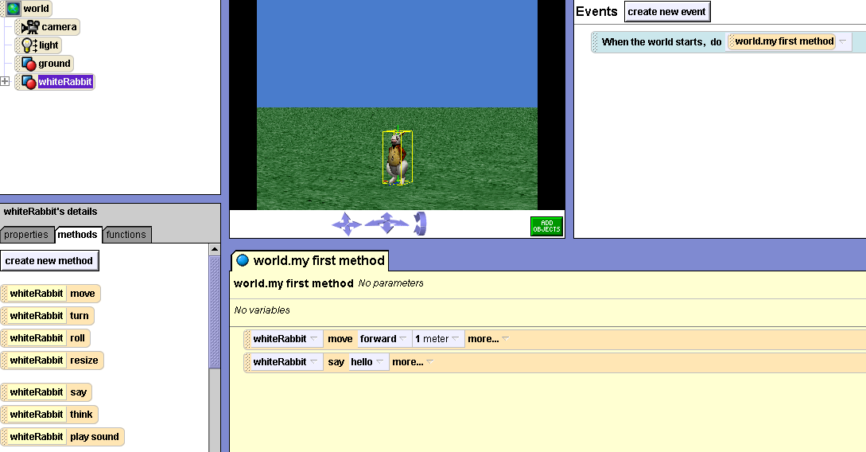
Editor Area
This is the editor area. It allows you to make objects in your world do new things like move and say.
Editor Area

Slide 8
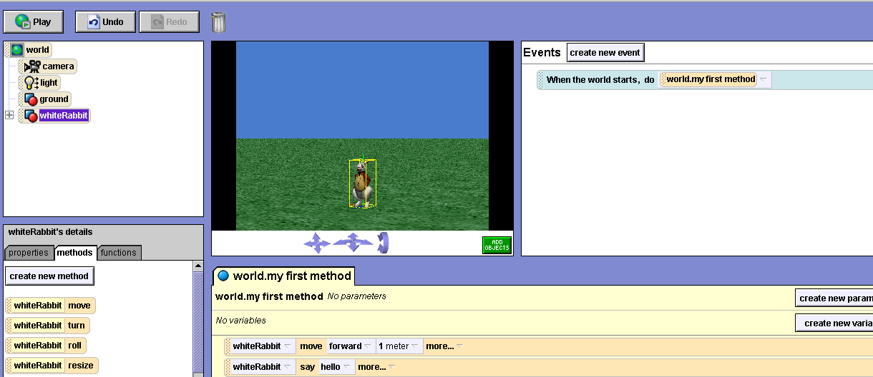
Events Area
The events area allows you to tell Alice when to make objects do certain things.
Events Area

Slide 9
Demo1: Real World, Classes, Objects, Properties, Methods & Message Passing
Program:
Create an Alice world named MyGarden and add one object of WhiteRabbit. When the program starts make the rabbit to say ‘Hello World’

Slide 10
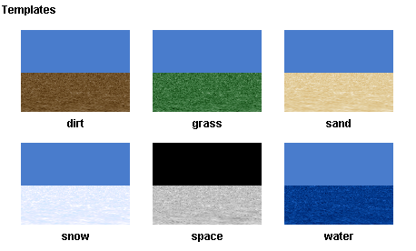
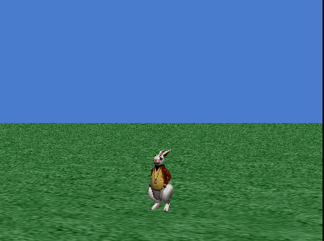
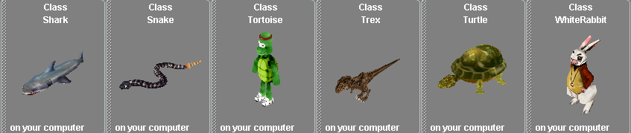
Demo1: Contd..
Object
Real Worlds
Classes

Slide 11
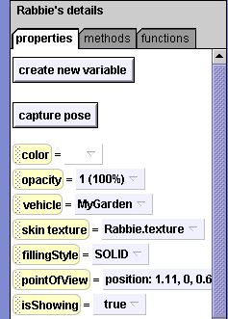
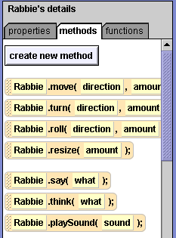
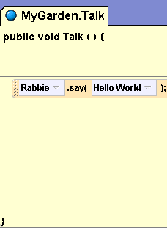
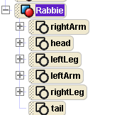

Demo1: Contd..
Methods
Message Passing
Object Tree
Properties
Entry Point

Slide 12
Demo2: Variables, Parameters & Input
Program:
Open the MyGarden world and Make the White Rabbit, Rabbie to point to the Camera. Make the Rabbie to Post a question to the user. The question should be passed from the calling world. Make the Rabbie to say that “I don’t know the answer for” <Question>. Simultaneously wave the right hand.

Slide 13
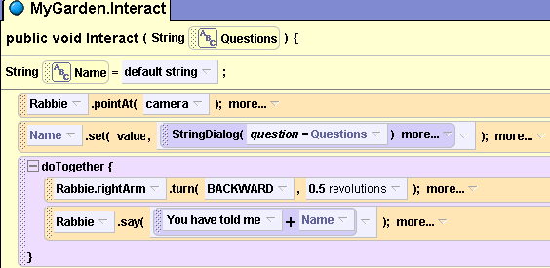
Demo2: Contd..
Parameter Passing – Actual argument
Formal Parameter
Variable
Storing user input
Accessing variable

Slide 14
Demo3: Sequential and Branching Constructs
Program:
Open the MyGarden world and add one Flag Pole. Make the Rabbie to move towards the flag pole. Calculate the Distance between Rabbie and the Flag Pole. If the Distance is less than .5 meters make the Rabbie to hold the Flag Pole and nod the head. Otherwise make the Rabbie to say ‘I am useless’

Slide 15
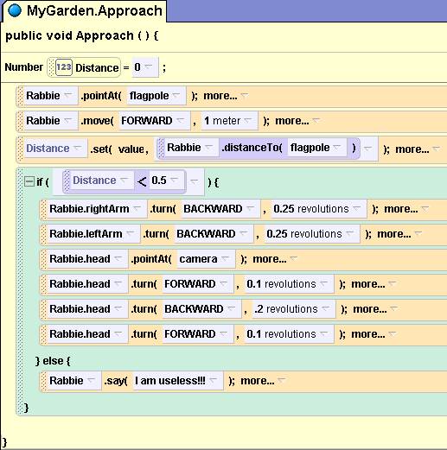
Demo3: Contd..
Decision making statement ‘if’
Condition – Evaluated to be TRUE or FALSE
TRUE Block
FALSE Block

Slide 16
Demo 4: Iterative Constructs
Program:
Create a world ‘Water’ with ‘Rowboat’ object and write a method which moves the rowboat using Loop Construct and While Construct.

Slide 17
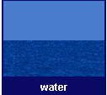
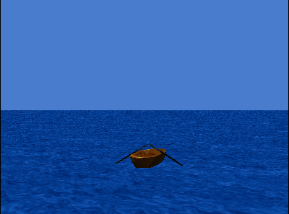
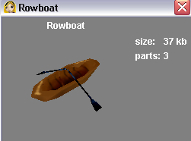
Demo 4: Contd..
World: Water
Object: Rowboat

Slide 18
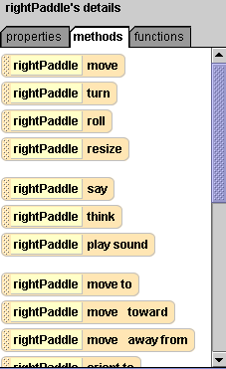
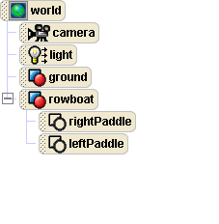
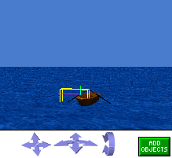
Demo 4: Contd..
Object Tree
Objects in World
Object Details

Slide 19
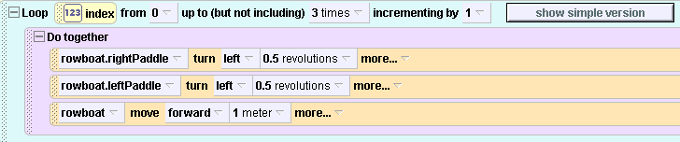
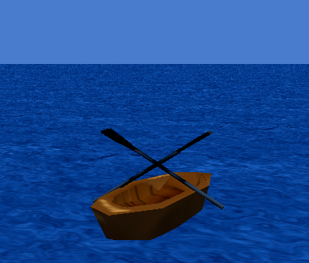
Demo 4: Contd..
Method: Using Loop Construct
Animated Output

Slide 20
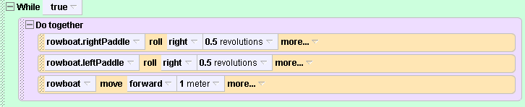
Demo 4: Contd..
Method: Using While Construct
Animated Output

Slide 21
References
URLs:
  http://www.alice.org
  http://www.aliceprogramming.net

Slide 22
Thank You

