Slide 1
Database design
ER/CORP/CRS/<CourseCode>/003
Notes:
After replacing <Course Name> placeholder above with the appropriate course name, make sure to fill the relevant information in ‘File Properties’ dialog box also (File Menu -> Properties)

Slide 2
What is Microsoft Access?
Microsoft Access is a relational database management system (DBMS or RDBMS). At the very core, it is a software “engine” that provides an interface between physical data and user application queries.
Other examples of DBMS applications include:
    Oracle
    mySQL
    SQL Server (Microsoft)
    DB2 (IBM)
    Informix
PA Harris, Vanderbilt University

Slide 3
Why choose MS-Access over Excel?
Although there is always overlap, the following rules might help when deciding when / when not to use MS Access:
MS Access is best used for long-term data storage and/or data sharing.
MS Excel is best used for minor data collection, manipulation, and especially visualization.
Excel is not database management systems
It is easy to export data from MS Access to Excel
PA Harris, Vanderbilt University

Slide 4
Why choose MS-Access over other DBMS systems?
Cheap, readily available (packaged with MS-Office Premium).
Easy to use (relative to other systems –Oracle may require one FTE to maintain the server as a database administrator and another FTE to serve as an application developer).
Includes front-end tools for rapid application development (RAD). This also makes MS-Access a good prototype environment.
PA Harris, Vanderbilt University

Slide 5
Why choose other DBMS systems over MS-Access?
MS-Access can handle a large number of records, but is somewhat slow compared to some of the high-end platforms.
Multiple users may use the database simultaneously, but MS-Access is known to become unstable with greater than 3-5 users.
There is a “snob factor”. I personally recommend the use of other systems (Oracle, SQL Server, mySQL, etc) when writing grant proposals - especially phase II type grants).
PA Harris, Vanderbilt University

Slide 6
What is in MS-Access?
Although the term “database” typically refers to a collection of related data tables, an Access database includes more than just data. In addition to tables, you can add:
Saved queries (stored procedures) - organizing and/or manipulating data
Forms – GUI interaction with data, event programming
Reports – customized results for printing (~ static forms)
Macros and VB programs for extending functionality
Microsoft provides some logical integration of these tools through “wizards”. However, these are pretty basic - most developers must pick and choose the best approach when implementing applications.
PA Harris, Vanderbilt University

Slide 7
What is in MS-Access?
Relational Database: in relational databases such as Access, data is stored in tables made up of one or more fields (Access calls a column a field). The data stored in each column must be of a single data type such as Character, Number or Date. A collection of values from each column of a table is called a record or a row in the table.
Different tables can have the same column in common. This feature is used to explicitly specify a relationship between two tables. Values appearing in column A in one table are shared with another table
Table: tables are the main units of data storage in a database. A table is a collection of data about a specific topic; it is made up of one of more fields.

Slide 8
What is in MS-Access?
Field: a field is a column in a table and defines a data type for a set of values in a table. For example, a mailing list table might include fields for first name, last name, address, city, state, zip code, and telephone number.
Record: a record in a row in a table and is a set of values defined by fields. In a mailing list table, each record would contain the data for one person as specified by the intersecting fields.
Data type: data types are the properties of each field. A field only has one data type, such as Character, Number or Date.
Primary Key: a primary key is a value that can be used to identify a unique record in a table.
Design View: it provides the tools for creating fields in a table.
Datasheet View: it allows you to update, edit, and delete in formation from a table.

Slide 9
Access window
Title Bar:Displays name of the Database
Tabs in ribbon-display different tyes of commands based on the category you select
Ribbon-has commands that reflect the active contextual tab, your position in the database and the selected objects
Navigation Pane: displays database objects of the types you select
Object window : displays any open data base objects
Status bar- indicates the progress of any ongoing process

Slide 10
Object window
Object Tab: displays all open database objects
Close button: To close the active database object with a single mouse click
Opening a data base object displays contextual tabs that contain design and formatting tools
Horizontal Scroll bar: To move to side within the object
Vertical Scroll Bar: To move up and down within your project
Right clicking the control on the body of a database object while you display the object in Design view displays a contextual menu that enables you to edit the selected control

Slide 11
Starting Access and Creating Database
Click on the START button on your computer and position your cursor over the PROGRAMS menu to view a list of installed programs. Once you see the list, position the cursor over Microsoft Office and then click on Microsoft Access 2007.

Slide 12
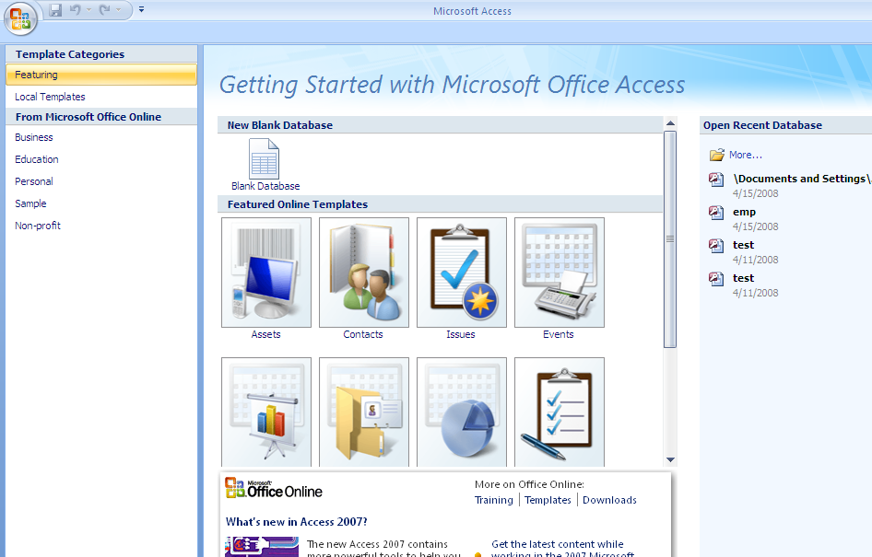
2. After opening Access, you will be presented with the window shown below Figure

Slide 13
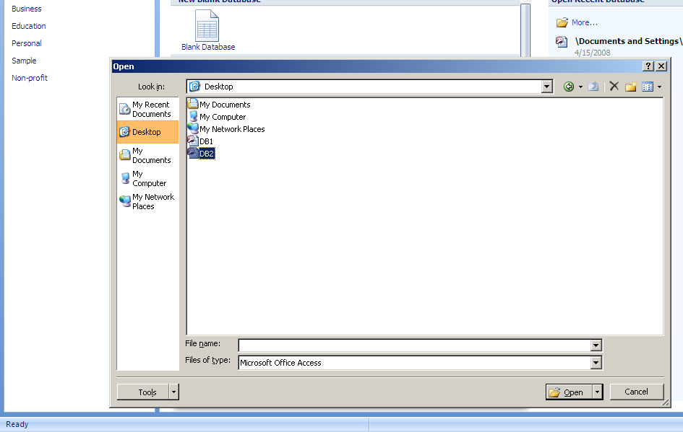
3.Open a database on start up
Click More
Navigate to the folder with the database to be opened
Double click the file to be opened

Slide 14
4.Open recently used database
Start MS Access 2007
In the open recent database section, click the name of the database you want to open

Slide 15
5. Creating Database from a template
Click a template category
Click on the desired template
Type a name for your database
Navigate to the folder where you want to store the newly created database
Click ok
Click download

Slide 16
Database Components
An Access database consists of several different components. Each component listed is called an object.
Tables Tables are where the actual data is defined and entered. Tables consist of records (rows) and fields (columns).
Queries Queries are basically questions about the data in a database. A query consists of specifications indicating which fields, records, and summaries you want to see from a database. Queries allow you to extract data based on the criteria you define.
Forms Forms are designed to ease the data entry process. For example, you can create a data entry form that looks exactly like a paper form. People generally prefer to enter data into a well-designed form, rather than a table.

Slide 17
Database Components
Reports When you want to print records from your database, design a report. Access even has a wizard to help produce mailing labels.
Pages A data access page is a special type of Web page designed for viewing and working with data from the Internet or an intranet. This data is stored in a Microsoft Access database or a Microsoft SQL Server database.
Macros A macro is a set of one or more actions that each performs a particular operation, such as opening a form or printing a report. Macros can help you automate common tasks. For example, you can run a macro that prints a report when a user clicks a command button.
Modules A module is a collection of Visual Basic for Applications declarations and procedures that are stored together as a unit.

Slide 18
Microsoft Access – Module 1 Summary
MS-Access is a powerful relational database program. It has many integrated features and can be greatly customized to fit most personal/departmental needs for data collection and storage.
PA Harris, Vanderbilt University

Slide 19
Microsoft Access – Module 2
Creating / Working with Tables
PA Harris, Vanderbilt University

Slide 20
Creating Tables in Database
Click the Create Tab
In the tables group click Table
Type the data for the first new field and press tab
Repeat step 3 until you have typed all of the data for one record and then press Enter twice to return to the first field.
Click Save
Type a name for your table
Click OK
Click the Close box for the table
Notes:
When you create a database in a hurry, and as you type data into the blank table, Access assigns generic names to the fields such as Field1, Field2 and so on. After the data’s in the table, you can open the table in design view and name the fields, design data types and so on.
When you create a field by typing. Access defines the table’s first field namely Id which is sequentially numbered. It will serve as a Primary Key field.It is better to rename it with a descriptive meaningful name.

Slide 21
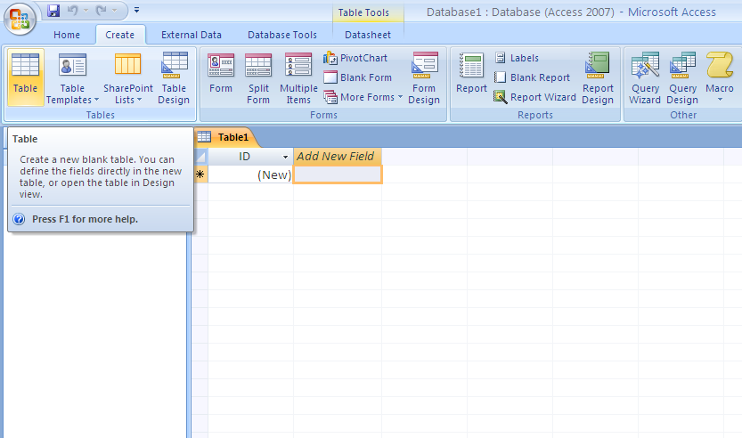
Creating Tables in Database

Slide 22
Modifying Table
Right click the table you want to modify
Click design view
You can either delete/add/reorder fields
  Delete a field: click the row selector of the row you want to delete , click the delete rows button, click yes to confirm
  To add a field, click the row selector of the row below where you want the new field to appear, use the Insert row button to insert and type a name for the field. Click the row’s Data type cell, click the down arrow that appears, and then click the desired data type.
  To reorder the field: Use the row selector drag and drop it to the new desired position

Slide 23
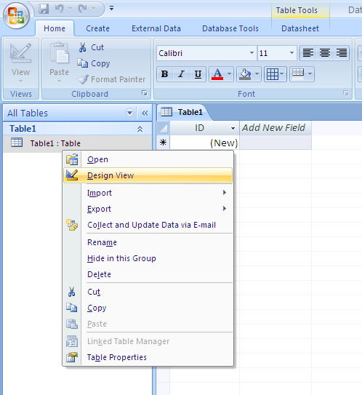
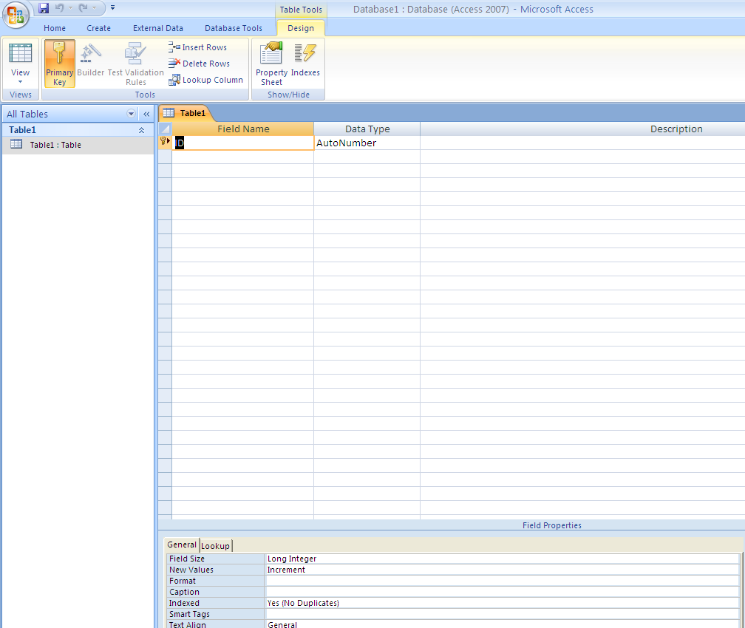
Modifying Table

Slide 24
Adding Data to a Table
Once the table is opened the existing the data can be edited or new data can be added.
Selecting the text
  Move the mouse pointer over cell. When it turns white cross, click in the cell. Double click the text/Drag mouse to extend the selection
Delete text: Select the text and use del key.
Undo operation: Use undo button in the quick access toolbar
Copy and paste text: Select the text to copy. Click the Home tab, click the copy button, click the position where the text is pasted, Click the paste button

Slide 25
Table Relationships
If the primary key in one table is found with another table, relationship can be created between the two tables.
Click Relationships
If the tables needed are not present in the relationships window, click the show table button
Click the first table to add to the Relationships window
Click Add
Repeat steps 4 and 5 as necessary
Once finished adding the tables, click Close
Drag the primary key in first table to the related foreign key field in the second table
Click create, use close button to close the relationships window
PA Harris, Vanderbilt University

Slide 26
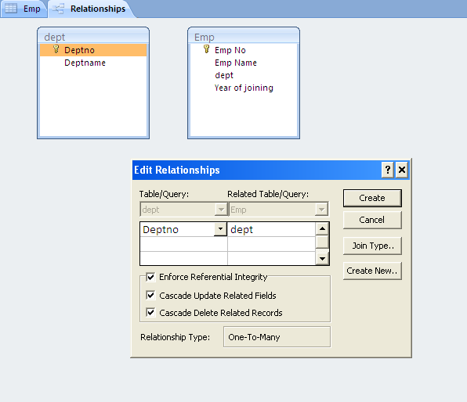
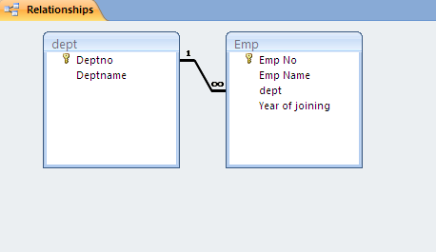
Table Relationships

Slide 27
Importing Data
There are situations where data from one database would be needed in another data base too.
The External data tab will be useful in such cases like
  Copying tables from a data base
You can import data from other types of data base objects like query by choosing the appropriate object type from the Import Objects dialog box and then clicking the object name from which you need to get the data

Slide 28
Copy a table from another Database
Click the External data tab
Click Access
Click Browse
Double click the data base from which you want to import the table
Choose the option “Select the tables, Queries, Forms, Reports, Macros, and Modules Into the current Database option
Click OK
Click the Tables/Table to import
Click OK
Notes:
To deselect a table which has been added into the import table list, you can select the table once again from the list.

Slide 29
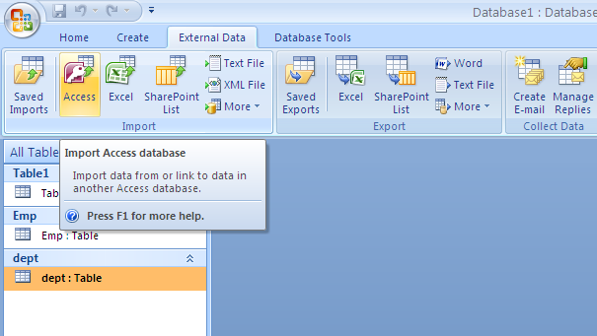
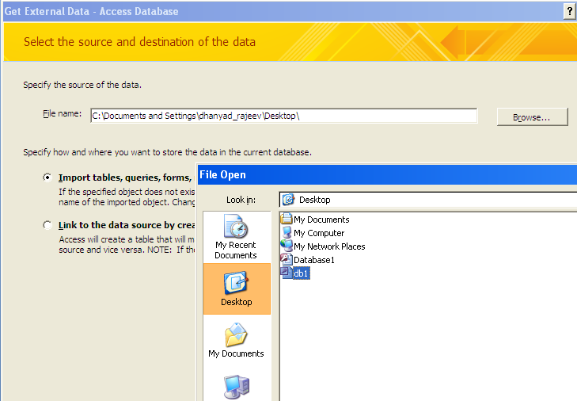
Copy a table from another Database

Slide 30
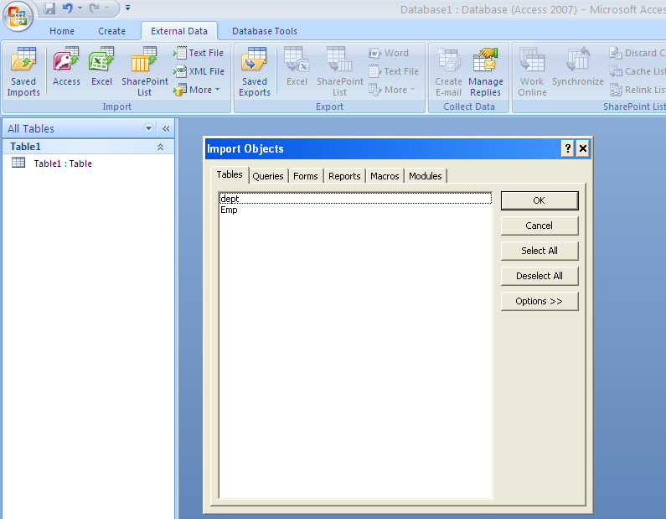
Copy a table from another Database

Slide 31
Exporting Data
Exporting an Access table/query data to an Excel work book takes a few steps
  Click the table /query to be exported
  Click the External Data Tab
  In the Export group, click the export to Excel spreadsheet button
  Type a name for the file (If needed select the Export Data with Formatting and Layout option)
  Click ok
  Click Close

Slide 32
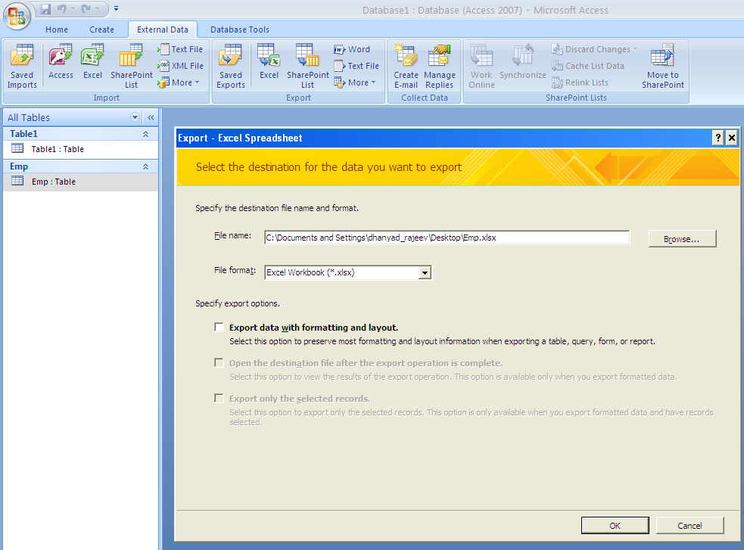
Exporting Data

Slide 33
MS Access – Module 2 Summary
Tables can be added and deleted easily from a data base
The data in the table can be easily edited
Relationship is a powerful tool to link two tables together in the process of making business decisions
Importing and exporting data is possible through the External Data Management option
PA Harris, Vanderbilt University

Slide 34
Microsoft Access – Module 3
Creating / Working with Queries
PA Harris, Vanderbilt University

Slide 35
Query Overview - 1
An MS-Access query is a set of stored SQL instructions that manipulate and/or select data from one or more tables.
Select Query – Data grouping and/or filtering
Make-Table Query – Select + creates/populates new table.
Update Query – Updates fields from specified table data
Append Query – Runs query on one table, appends results to a table
Delete Query – Delete selected records from table
PA Harris, Vanderbilt University

Slide 36
Query Overview - 2
SQL (Structured Query Language) is a very widely used database language designed specifically for communicating with databases
SQL is not proprietary – almost every DBMS supports SQL (including MS-Access).
SQL is relatively easy to learn, but extremely powerful – one of the easiest ways to learn is to use MS-Access Query by Example methods, then look at the generated SQL command
Remember that a query is nothing more than the database engine running the stored SQL command (it looks and sometimes acts like a table, but really adds little mass to the database file)
PA Harris, Vanderbilt University

Slide 37
Extracting Information From the queries
In a select query:
  You identify the table with the data you want to find
  Name of the fields to appear in the query result
The query wizard makes it simpler to do all these tasks

Slide 38
Create a Detail Query
Click on the Create Tab
Click on the Query Wizard
Click the Simple Query Wizard
Give OK
Click the Tables/Queries down arrow and then click the table or query having field to be used in the query under construction
Click the first field to be included in the query results
Click Add
Do the same for the all the field to be included in the query under construction

Slide 39
Create a Detail Query (continued)
Click Next
Click the Detail option button
Click Next
Give a name for the newly created query
Click Finish

Slide 40
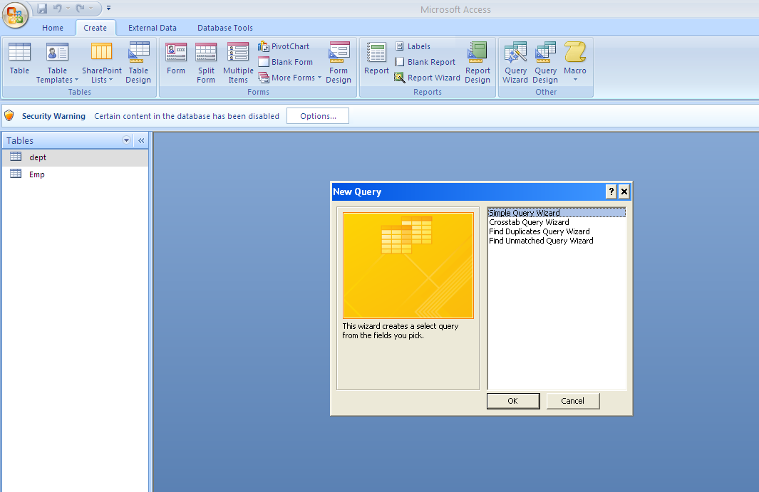
Query Wizard

Slide 41
2-Table Query
Click on Create
Click Query Design
Select the tables to be queried
Select the fields to be shown
Save the query by giving a name
Then go to query wizard
Select the created query to obtain the data

Slide 42
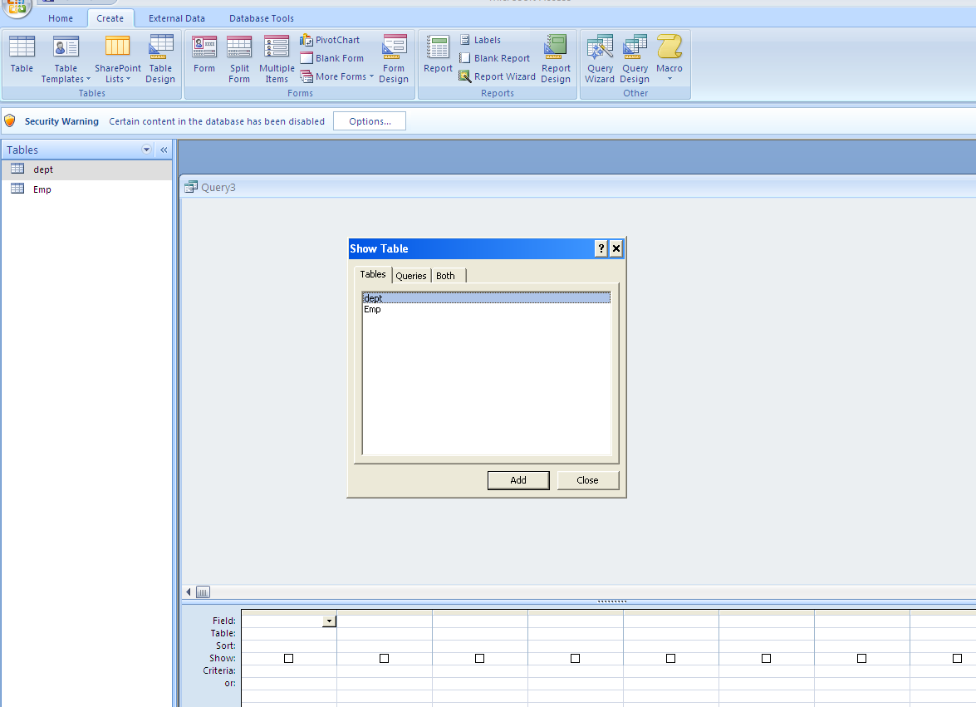
2-Table Query

Slide 43
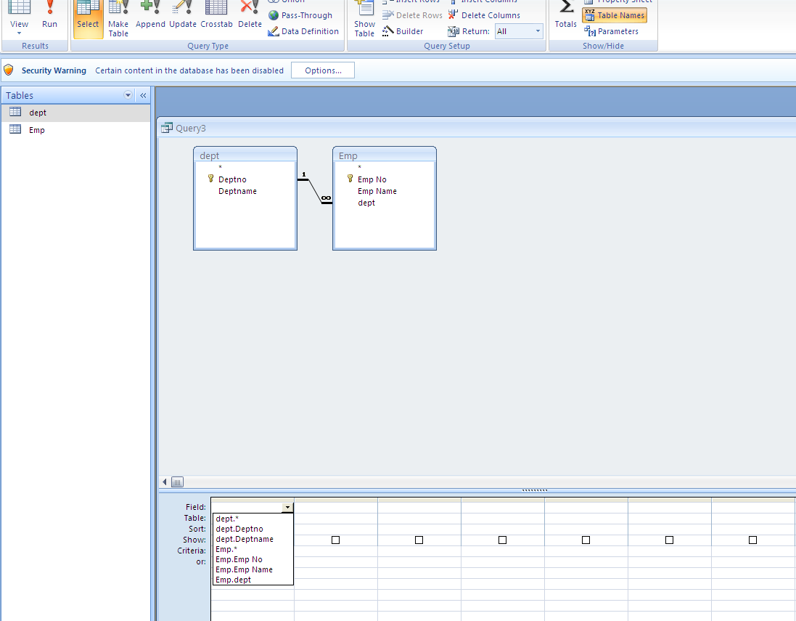
2-Table Query

Slide 44
Query – Calculating Fields
Name the calculated field, then type a colon, then type the equation using brackets ( [ ] ) around table fields. If there is ambiguity in the field names between tables, you may need to type table.[field] format.
Ex: BMI: [Weight]/([Height]/100)^2
Ex: For calculating experience of an employee from years of joining
Exp:Year(Date())-[Year of joining]
Year(Date()) is a function to extract year from current date
PA Harris, Vanderbilt University

Slide 45
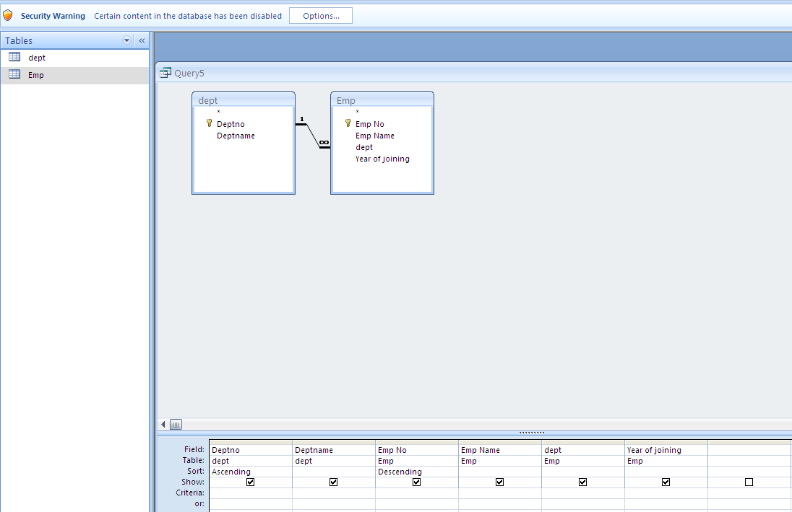
Query – Sorting Data
Choose Ascending or Descending in the Sort Row
This query would sort by Deptno and Empno.
PA Harris, Vanderbilt University

Slide 46
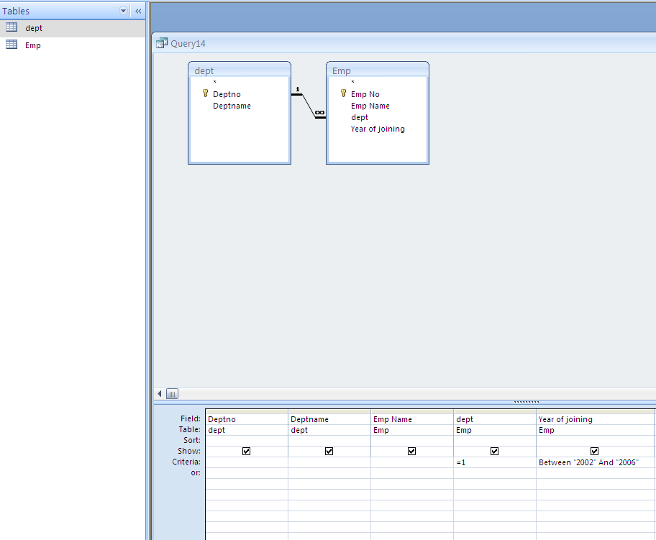
Query – Filtering Data
This query will return all records in the database for:
deptno equal to 1
and year of joining between 2002 and 2006
PA Harris, Vanderbilt University

Slide 47
Query – Filter Operators
= equals
> greater than
>= greater than or equal
< less than
<= less than or equal
<> not equal to
Between between two values
Is Null field is empty
is not null field is not empty
Like Matches a pattern (Like John*)
OR Logical OR (one or other is true)
AND Logical AND (both are true)
etc.
PA Harris, Vanderbilt University

Slide 48
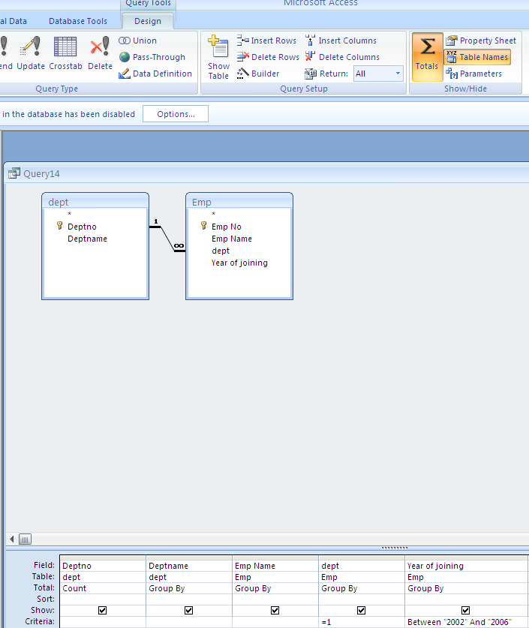
Query – Grouping Data - 1
Clicking the Totals Button Enables Grouping, Counting and Statistical Options
Notice new “Total” row.
Each field (column) can be set.
PA Harris, Vanderbilt University

Slide 49
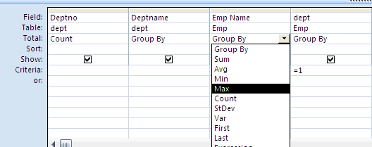
Query – Grouping Data -2
Totals Options Include:
Group By
Sum
Avg
Min
Max
Count
StDev
Var
etc.
PA Harris, Vanderbilt University

Slide 50
MS Access – Module 3 Summary
Queries are extremely easy to set up/use and provide an up-to-date snapshot of your data at any time.
Queries may be used to calculate values based upon existing fields, join fields from separate tables, globally update or delete data, and export linked/calculated data to external programs.
Under the hood, queries are really nothing more than stored SQL statements that are run upon command. They add little mass to the file application.
PA Harris, Vanderbilt University

Slide 51
MS-Access Import/Query Practice
Import data from the one database to the current database. Design and save a new query named to display only the following fields: 1) StudentName; 2) Age; 3) TotalMarks (a calculated field computed by summing up all the marks).
Select filter criteria in the query to show only those records where: 1) students to whom Teacher with teacherid 111 teaches;
      2) students with age greater than 11; and
3) students whom teacher with teacherid 111 or 444 teach.

Slide 52
Query Practice
Design and save a new query named Question2 to provide summary data for each Student(ie we want to see all the students data in separate rows). For each of these compute: 1) Total marks obtained; 2) and average of marks.

Slide 53
Thank You
“The contents of this document are proprietary and confidential to Infosys Technologies Ltd. and may not be disclosed in whole or in part at any time, to any third party without the prior written consent of
Infosys Technologies Ltd.”
“© 2007 Infosys Technologies Ltd. All rights reserved. Copyright in the whole and any part of this document belongs to Infosys Technologies Ltd. This work may not be used, sold, transferred, adapted, abridged, copied or reproduced in whole or in part, in any manner or form, or in any media, without the prior written consent of Infosys Technologies Ltd.”
ER/CORP/CRS/<CourseCode>/003
Notes:
Make sure that the copyright notice is present in this last slide. It is inserted as a text box in this slide only and not part of ‘Slide Master’.

