Slide 1
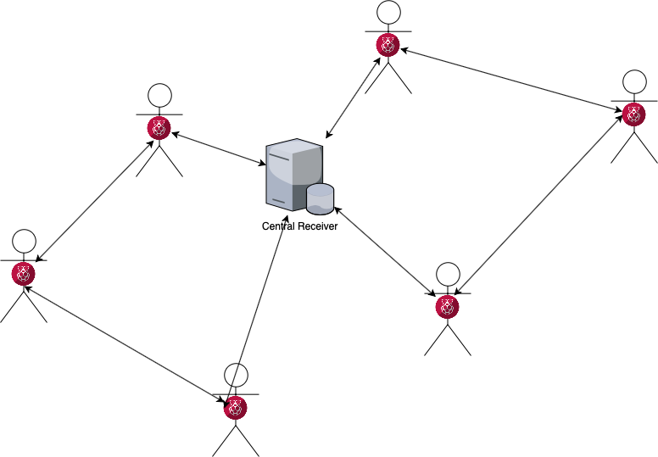
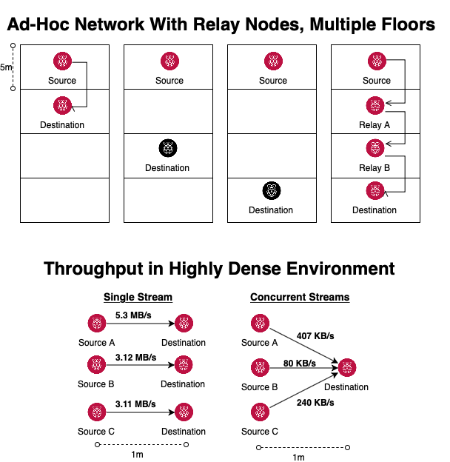


Patient Monitoring in a Hospital Environment
Course Project - Wireless Networking and Applications
Chelsea Chen, Samuel Kim
Motivation
Goal: Allow continuous monitoring and secure transmission of patient vitals while allowing patients to move freely in the absence of reliable wireless infrastructure.
System Design
Problems and Implications
Continuous monitoring → minimal packet loss
Dense environments → high traffic rate
Patient privacy → encrypted transmission
Patients should be able to…
  move freely → ad-hoc network
  roam far → packet resiliency, ECC
  roam for long durations → energy efficiency
Implementation
Ad-hoc network
  8-10 Raspberry Pi’s as nodes
  B.A.T.M.A.N. routing protocol (open source)
TDMA implementation
  Improve throughput in dense environment
Secure path routing
  Protect B.A.T.M.A.N. from byzantine failures
  Node authentication and authorization
Approach
Each patient has multiple sensor nodes (e.g. HR, BP, CO2) and one coordinator node (aggregates data and broadcasts to the network).
  For this project, no sensor nodes; only coordinator nodes with mock patient vitals.
Use an ad-hoc mesh network
  Improve overall range for patient mobility
  Each patient also acts as a relay node
  Assumption: Patient coordinator nodes are high medical grade and won’t fail
TDMA to fix high collision rates
  Idea is to increase overall throughput
  Vary QoS for different nodes (prioritization)
Path routing
  Implement efficient and smart path routing
Security
  Encryption
  Proxy Certificate
Evaluation

