Slide 1


Slide 2
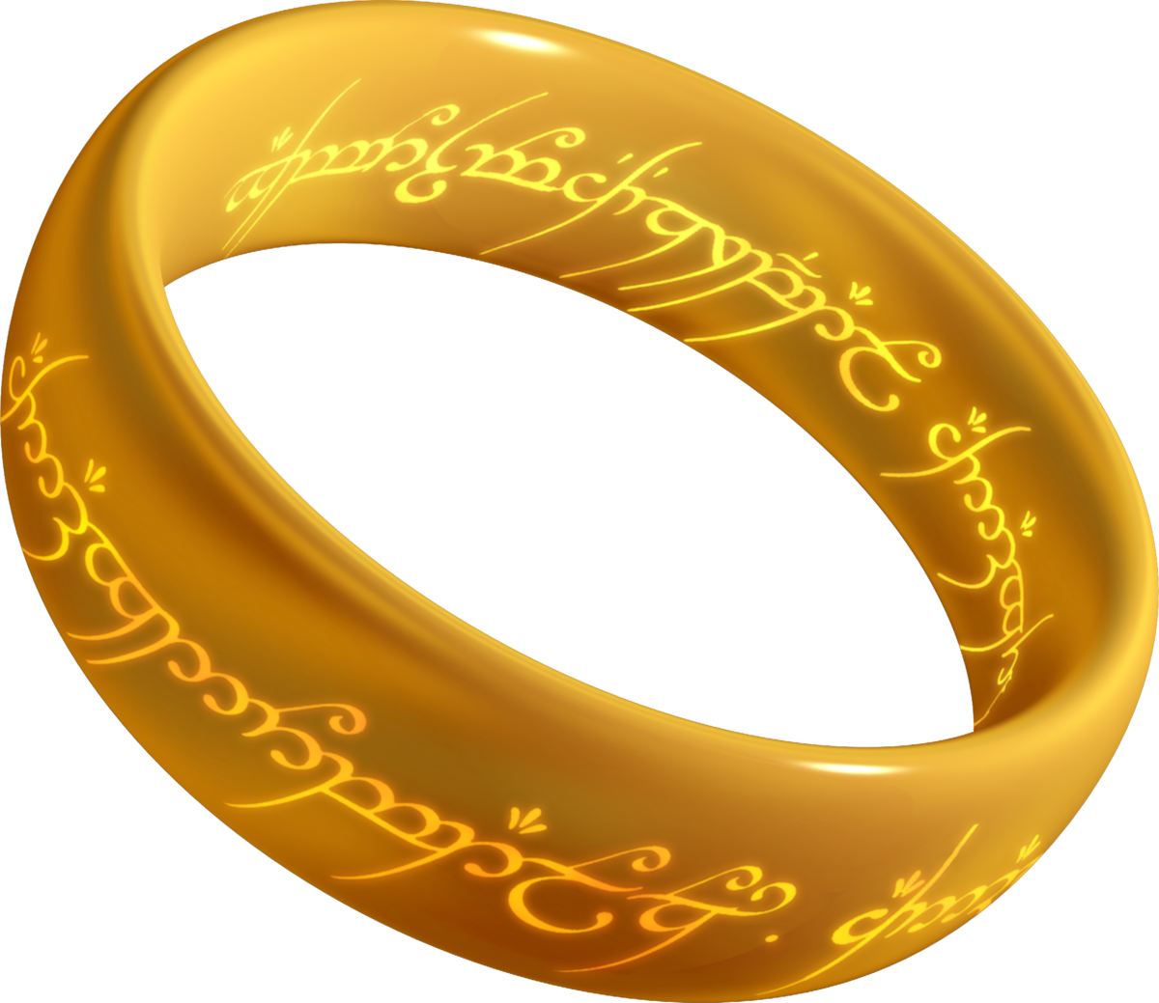
Lord of the Rings Tracker (a.k.a. Frodo 2.0) Team LOTR Shane Gifford, Geoff Greene, Linda Holland, John Klaczynski, Michael Reichelt, Clay Sampson, Scott Summerford, James White
One Ring to rule them all One Ring to find them One Ring to bring them all And in the darkness bind them J.R.R. Tolkien

Slide 3
Frodo 2.0 Concept & Design
Concept:
Tracker searching for the Ring (a.k.a. as The Hobbit)
Once Ring is located, pick up (a.k.a. more of The Hobbit)
Take Ring and throw into the fires of Mt Doom (LOTR)

Slide 4
Frodo 2.0 Concept & Design
Design:
Central Controller to accept commands and switch modes between Tracking & Ring Acquisition
Tracking:
2 Track Tank Design
Left & Right tracks each powered by a large motor allowing full independent forward & backward motion
2 Color sensors mounted sideways – for tracking pathway
Ring Acquisition
1 front scoop arm powered to open & close
Fine-motion control to move
Color Sensor – for locating Ring close enough to scoop

Slide 5
Frodo 2.0 Engineering Approach & Discoveries
3 teams
Robot construction
Structure stability
Weight and sensor location considerations
Etc…
Engineering Process & Lessons Documentation & Pathway construction
Overall Presentation
Gitlab repo
Peripheral items (path)
Software Development
Sensor data analysis,
Tracking Motion control,
Arm movement

Slide 6
Frodo 2.0 Engineering Approach & Discoveries
Development Environment
Initial attempt to download & install EV3 firmware image
Could not load on SD card to update brick to allow python coding
Fell back to Graphical Click & Drag Design/Coding interface
Discovery of brick& remote interfaces:
top – motor ports labeled A, B, C, D
Bottom - sensor ports labeled 1,2,3,4
Disovered channel switch on remote to select correct channel

Slide 7
Frodo 2.0 Engineering Approach & Discoveries
Robot Chassis
Legos flex
Tape provides tension member
Hobbit Ergonomic factors
Passive blade management (for orc suppression)
Robot Actuators
Mounting locations & pointing directions
Counterweight for Ring Capture Arm
Path Detection
Retreated to masking tape

Slide 8
https://www.youtube.com/watch?v=Iz-8CSa9xj8

Slide 9
Backup

