Slide 1
EDUVO REWARDS
E
Loyalty Member
Website
Implementation and testing presentation
ASP.NET Core MVC with Loyalty App V2 API
2 October 2026
Notes:
Source: supplied Loyalty Program Flows and Functions requirements and the completed local project.

Slide 2
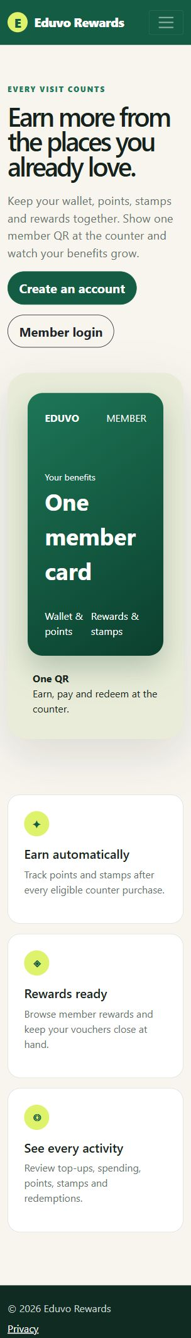
Member website scope
One responsive portal for the loyalty functions shared by web and mobile
Account access through email/password or phone OTP
The public and authenticated pages use the same visual system across desktop and mobile sizes.
Live wallet, points, stamps and member QR
Rewards, vouchers, history and notifications
Outlets, referrals, profile and feedback
EDUVO LOYALTY MEMBER WEBSITE
02
Notes:
Source: requirementTraining.docx, Member app functions and Web vs mobile sections.

Slide 3
Solution architecture
The browser communicates with the MVC server, which owns the API token
Member browser
MVC application
Integration services
Loyalty App V2 API
Razor pages and forms
Cookies, validation and routes
JWT cache and API mapping
Shared member data
JWT credentials stay in .NET User Secrets and never enter browser code.
EDUVO LOYALTY MEMBER WEBSITE
03
Notes:
Source: project Program.cs, LoyaltyTokenProvider.cs and LoyaltyApiClient.cs.

Slide 4
Account workflows and security
Member workflows
Security controls
Registration with OTP and optional referral code
HTTP-only authentication cookie
Email/password and phone OTP login
Anti-forgery protection on form posts
Password recovery and email verification
Rate limiting on account routes
Cookie logout and account deactivation
Friendly handling for upstream failures
EDUVO LOYALTY MEMBER WEBSITE
04
Notes:
Source: AccountController.cs, Program.cs and ApiExceptionFilter.cs.

Slide 5
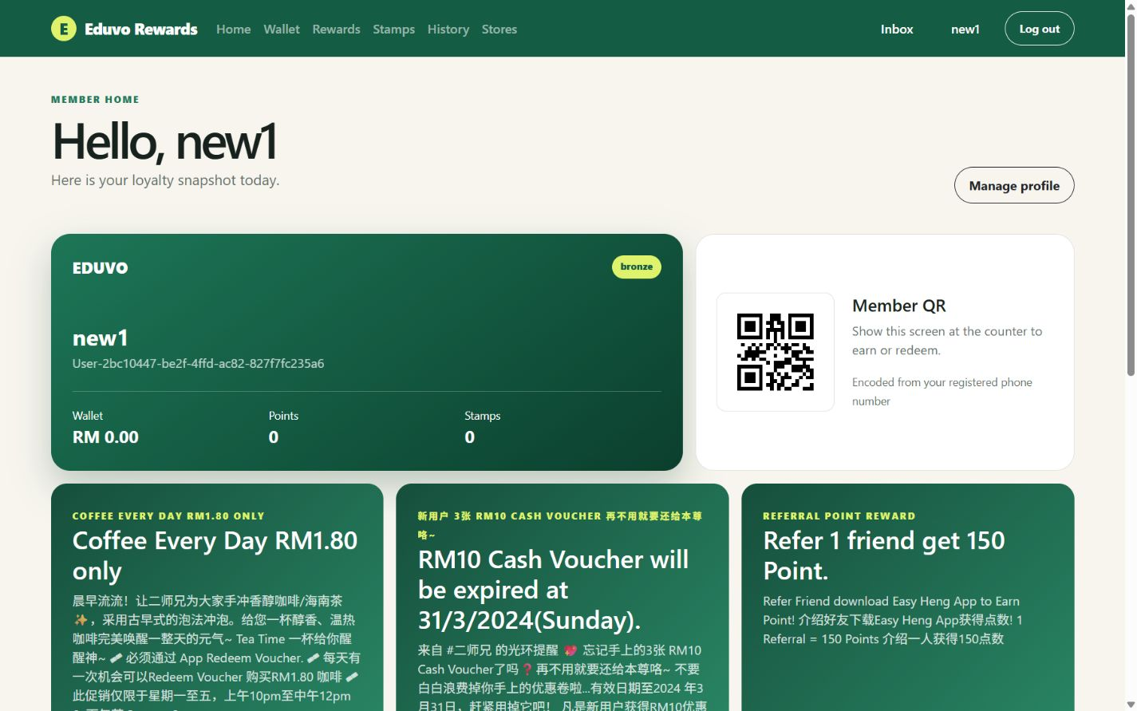
Live member dashboard
Balances, tier, member identity and QR come from the authenticated account
Member QR
The QR contains the registered phone number because the merchant scan operation accepts a phone number.
Campaign content is cleaned into readable plain text before display.
EDUVO LOYALTY MEMBER WEBSITE
05
Notes:
Source: live local website connected to the supplied Loyalty App V2 API.

Slide 6
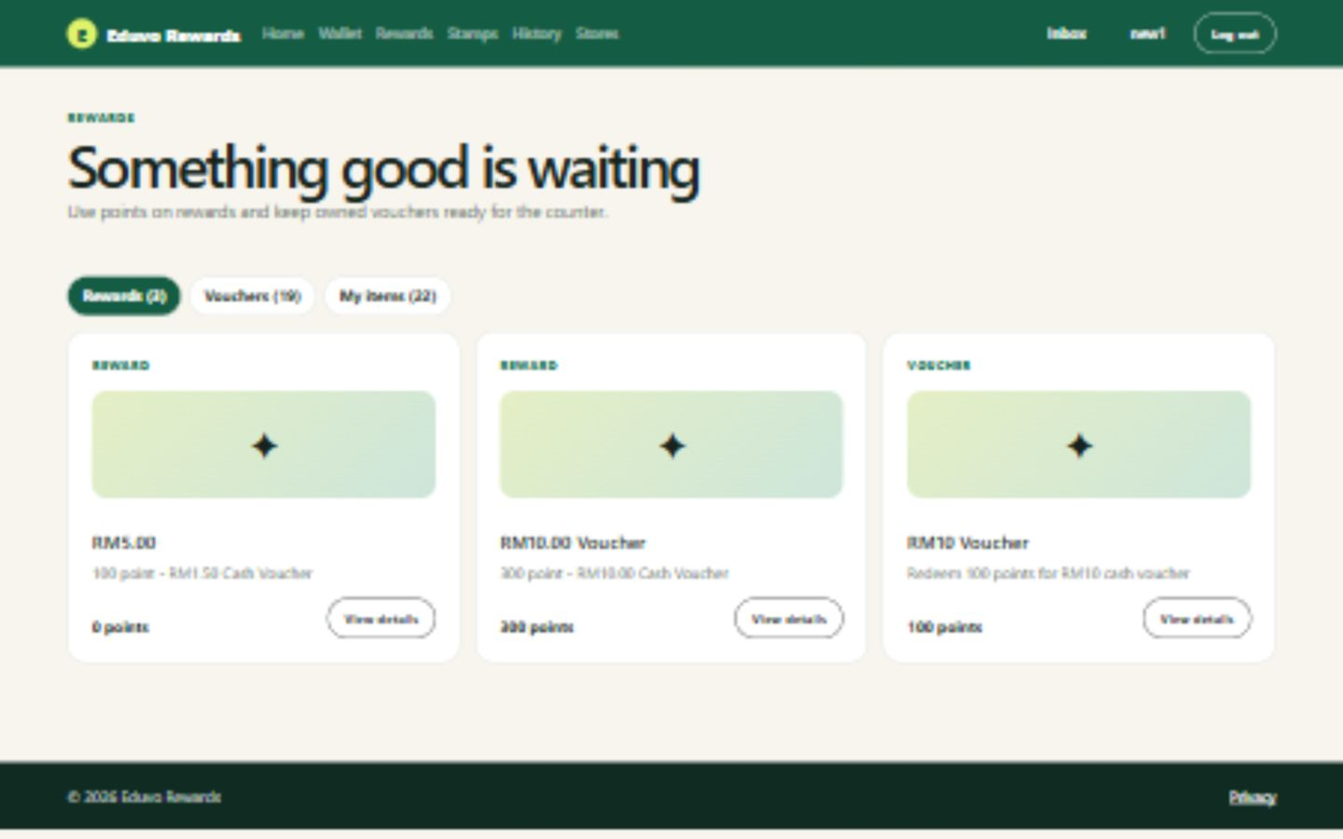
Rewards and vouchers
Catalogue details and owned redemption items use live API data
Reward and voucher tabs
API-backed detail pages
Owned-item QR codes
Expiry and point values
EDUVO LOYALTY MEMBER WEBSITE
06
Notes:
Source: MemberReward, MemberVoucher and owned-item API integrations in LoyaltyFeatureService.cs.

Slide 7
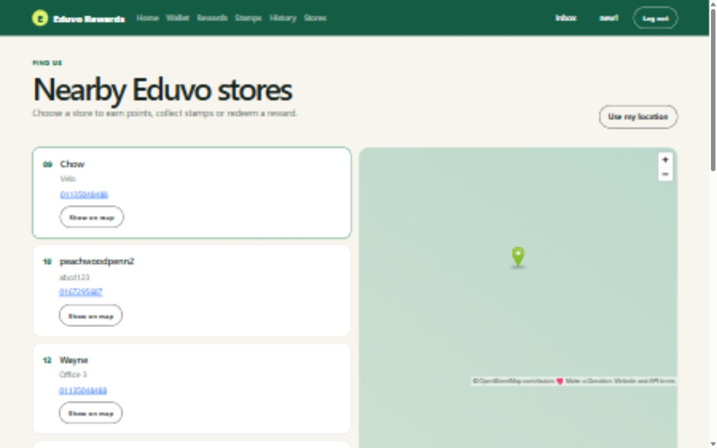
Stores and browser location
Outlet coordinates drive the map and optional distance calculation
Outlet list
Loaded from GetAllOutlets
Map
OpenStreetMap updates when a member selects a store
EDUVO LOYALTY MEMBER WEBSITE
07
Notes:
Source: live local website and ManageOutlets/GetAllOutlets API data.

Slide 8
Verification results
Final checks against the live service
0
0
20
200
build errors
build warnings
authenticated routes
HTTP result
Responsive layouts checked at mobile and 1440 x 900 desktop sizes. API credentials and member test credentials are absent from source control.
08
Notes:
Source: dotnet build and scripts/SmokeTest.ps1 results from 2 October 2026.

Slide 9
API limitations and project handoff
Documented constraints
Submission contents
No online payment operation for optional ordering
Completed ASP.NET Core MVC source
Account deletion only deactivates the member
Implementation and testing report
Tier, earning and expiry rules remain undocumented
Presentation and website screenshots
Several response formats remain undocumented
README setup and smoke-test script
EDUVO LOYALTY MEMBER WEBSITE
09
Notes:
Source: supplied API requirements, OpenAPI documentation and completed repository.

