Slide 1
ARCF Introduction
--Xinpeng Guo

Slide 2
Basic Concepts

Slide 3
Two Basic Entity
Song
Singer
Song List
MV
Album
…
User
Item

Slide 4
Three Basic Relationships
Circle
Discover New People (Famous People)
People U may know (Social Relation Chain)
User-User
Similar Songs
Single Song Radio
Buy This Also Buy
View This Also View
User-Item
Item-Item
Guess U like

Slide 5







Knowledge Graph
Song List
Follow
Singer
Create By
UGC
Create
Comments
User
Listen
Favorite
Belong To
Album
Listen
Trash
Switch
Song
Radio

Slide 6
Data Flow

Slide 7
Three Steps
User
Item
Action
User
Item
Preference
U2U
U2I
I2I
把事情说清楚
把事情总结一下
数据挖掘结果
明细
汇总
应用

Slide 8
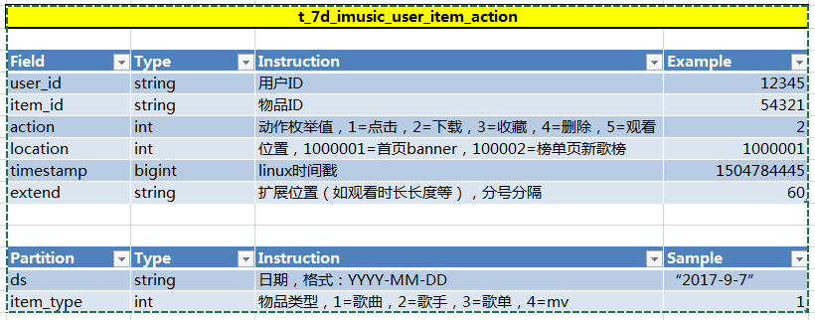

UIA=Who+Where+When+What
Notes:
t_存储周期_业务名称_表名

Slide 9
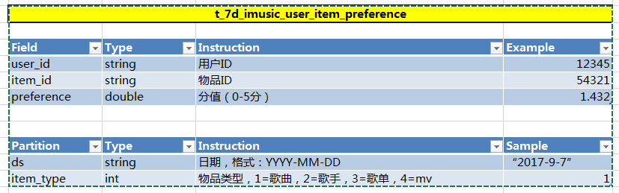
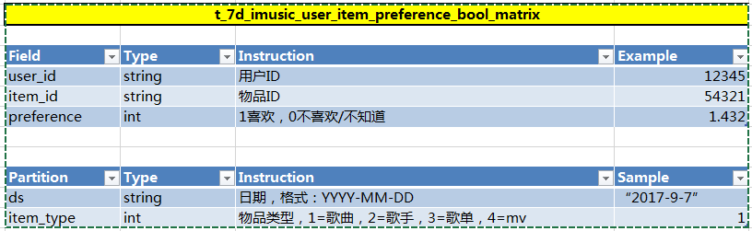
UIP =Who+How+What
Real Matrix
Bool Matrix

Slide 10


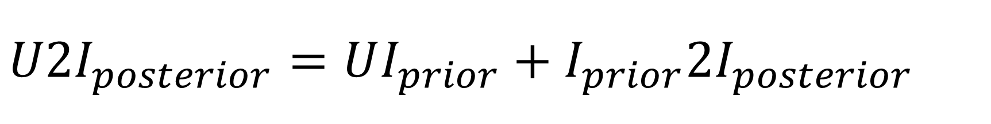

$$U2I_{posterior}=UI_{prior}+I_{prior}2I_{posterior}$$
Listen
Favorite
$$U$$
$$I_{prior}$$
$$I_{posterior}$$
Trash
Switch

Slide 11


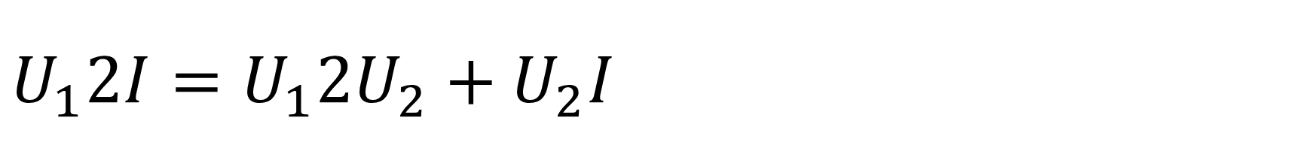

$$U_{1}2I=U_{1}2U_{2}+U_{2}I$$
Listen
Favorite
$$U_{1}$$
$$U_{2}$$
$$I$$
Trash
Switch
App Use
Relation Chain

Slide 12
Two Thoughts
Action Based：CF
Content Based：Profile + pCTR

Slide 13
Architecture

Slide 14
Three Layers
Operation System
Emergency
CPT AD
Op+Rec System
Head Optimization
Bad Case Analysis
Recommendation
System
Solve Information Overload
Discover

Slide 15
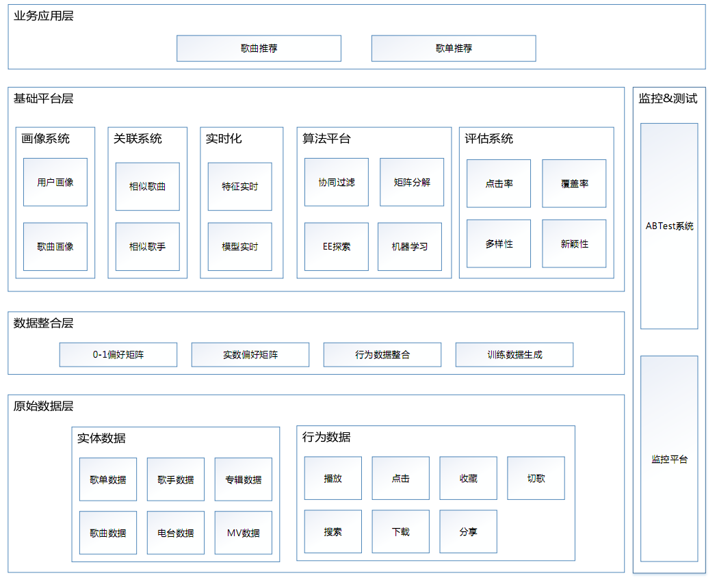
Framework

Slide 16
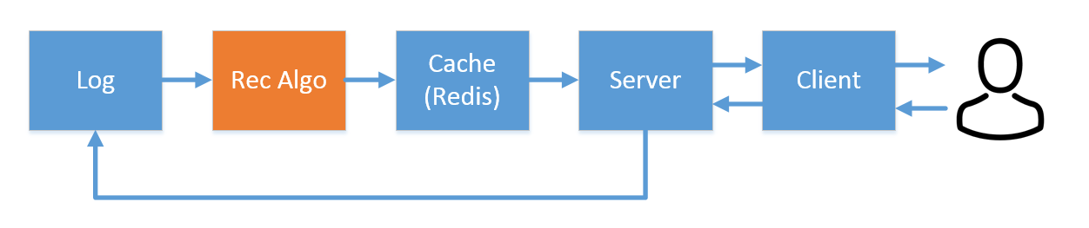
Data Closed Loop

Slide 17
AR—Bool Matrix

Slide 18
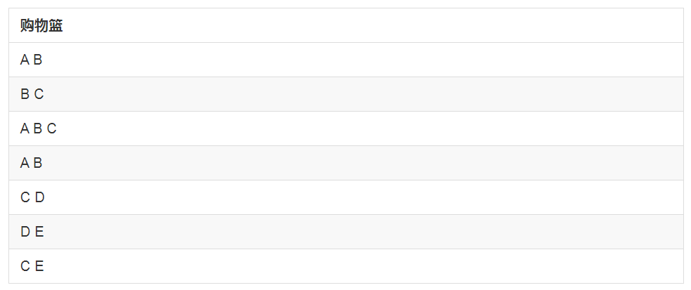
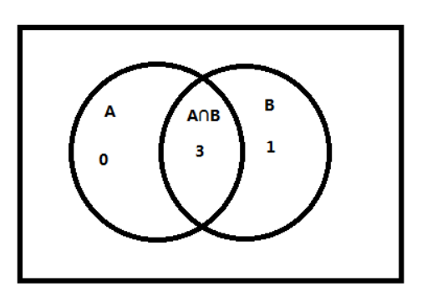
Basket Analysis

Slide 19
AR Metrics—Pair Frequency
Hot Items？
Count(A, B) = 3

Slide 20
AR Metrics—Jaccard
All Transactions？
Jaccard(A, B) = count(A∩B) / count(A∪B) = 3/4

Slide 21
AR Metrics—Support
Prior & Posterior？
Support (A, B) = count(A∩B) / count(ALL) = 3 / 7

Slide 22
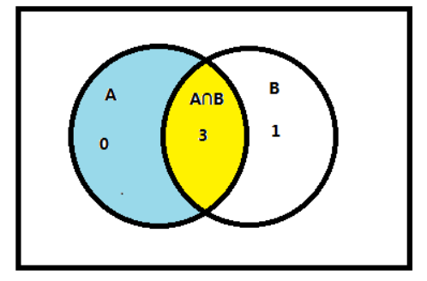
AR Metrics—Confidence
Hot Items？
Confidence(A->B) = P(A∩B|A) = P(yellow|yellow+blue) = 1.0

Slide 23
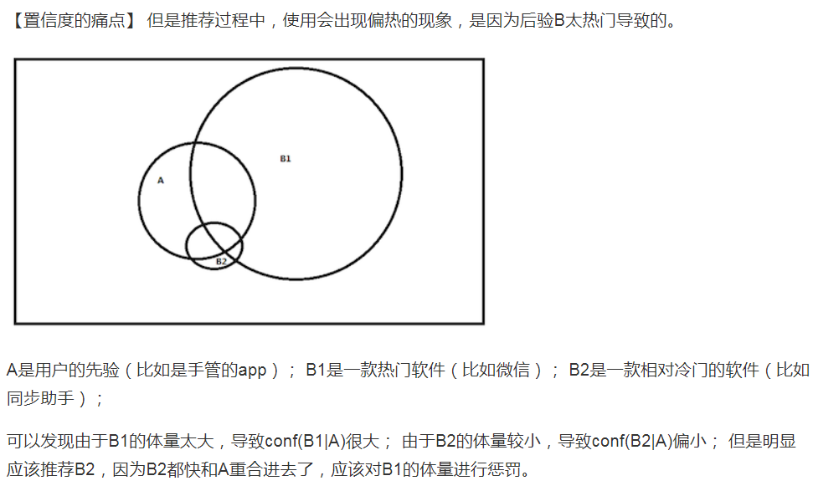
AR Metrics—Confidence Pain Point

Slide 24
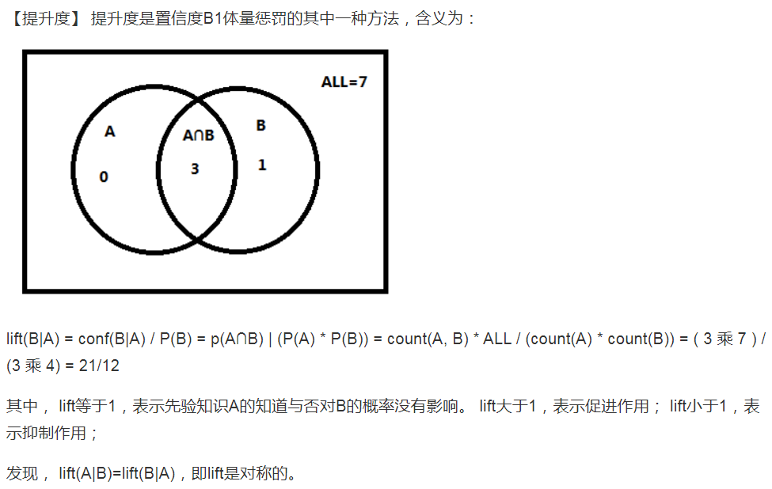
AR Metrics—Lift

Slide 25
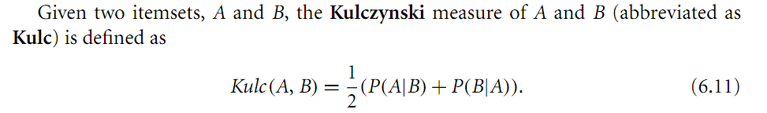
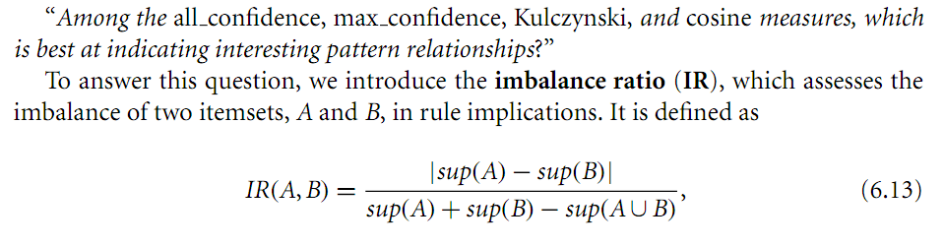
AR Metrics—KULR/IR
Notes:
Data Mining _ Concepts and Techniques _ Concepts and Techniques (3rd Edition)

Slide 26
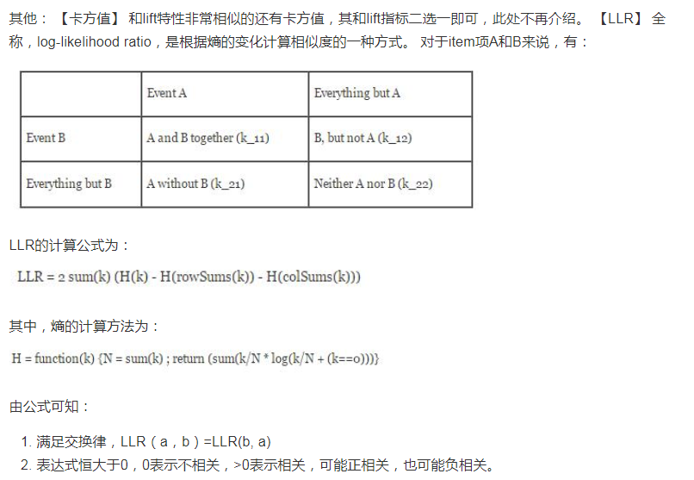
AR Metrics—LLR

Slide 27
Sim—Real Matrix

Slide 28
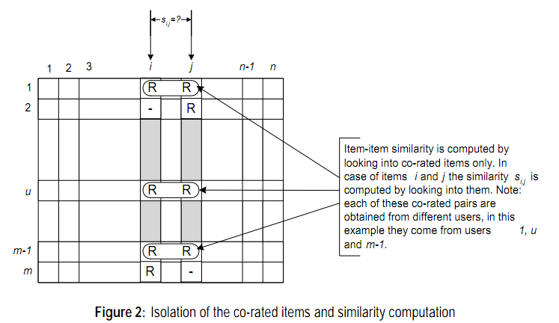
Sim Metrics—Cos

Slide 29
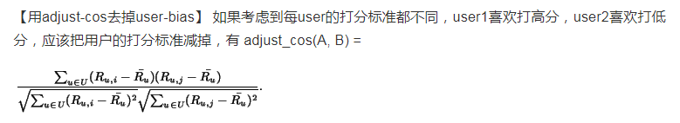
Sim Metrics—Adjust Cos

Slide 30
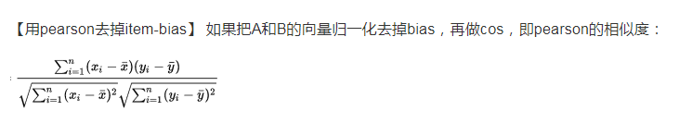
Sim Metrics—Pearson

Slide 31
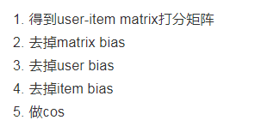
Sim Metrics—Hybrid

Slide 32
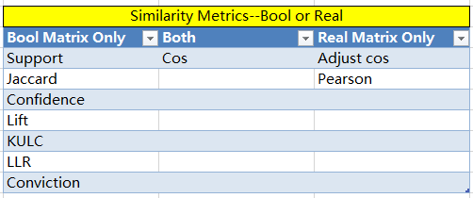
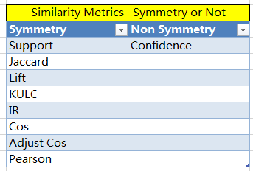
Similarity

Slide 33
XX CFs
Item2Vector CF
Content CF
LDA CF
Simhash CF
Node2Vector CF
DNN Embedding CF

Slide 34
Refinement Prior

Slide 35
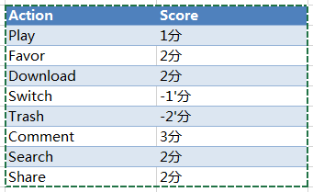
Action Rating

Slide 36
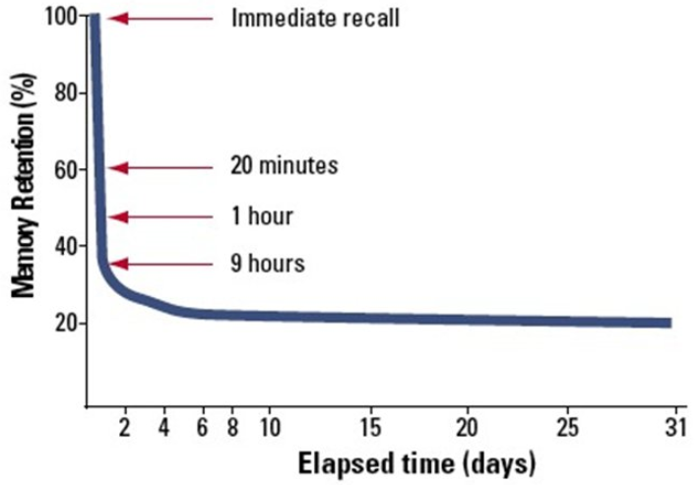
Time Decay

Slide 37
Session Split
有行为
无行为
有行为
私人电台
最近30分钟无行为

Slide 38
Best Practice

Slide 39
Data Sparsity
(i1, i2)
(i1, i3)
(i2, i3)
(i1, i3)
(i2, i4)
((i1, i2), 1)
((i1, i3), 2)
((i2, i3), 1)
((i2, i4), 1)
(u1, (i1, i2, i3))
(u2, (i1, i3))
(u3, (i2, i4))

Slide 40
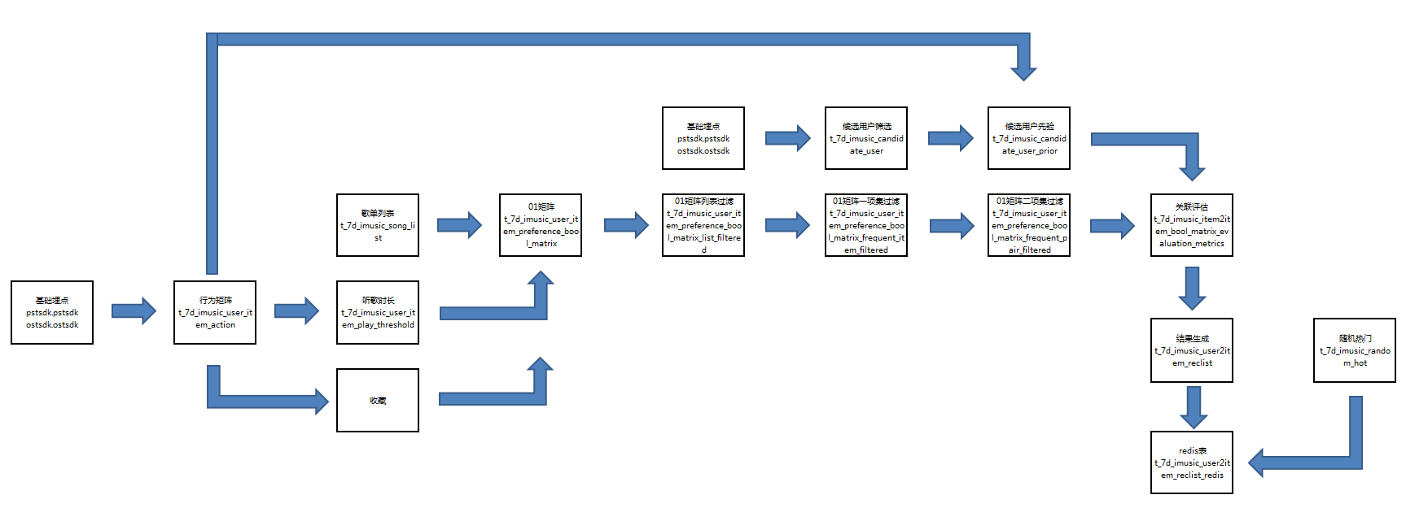
Data Flow

Slide 41
Prior Posterior Diff Set --1
Prior Set
I1
I2
I3
I4
Posterior Set
I1
I2
I3

Slide 42
Prior Posterior Diff Set --2
Transactions
Filtered Transactions
Filter
Before Model
Transactions
Model
Filter
After Model
(i1, i2)
(i1, i3)
(i2, i3)
(i2, i4)
(i4, i2)
Transactions
Filter
(i1, i2)
(i1, i3)
(i2, i3)
(i4, i2)
In Model

Slide 43
Online
Model
Feature
pCTR
pCTR 实时= Feature 实时 or Model 实时

Slide 44
Q&A

