Slide 1

Hakuna Matata Tech: Smart Solutions, No Worries
Project Name - Agent Noise
Problem Statement - Digital Privacy and Secure Communication (Employing AI to address
social challenges and enhances the accuracy of information.)
Our Solution - Developed a secure communication system using AI steganography
for encrypted voice, ensuring privacy with stealth mode and P2P communication.
Team Name - Simba
Team Member 1- Sampurna Yanda
(+91) 7501775752
sampurnayanda9287@gmail
Team Member 2 - Smrutymayee Rout
(+91) 9040639551
routsmruti03@gmail.com
College/University - ITER, SOA University (Bhubaneswar)

Slide 2

Problem (Issues, relevance)
~Issues
Communication is vulnerable to surveillance, interception, and censorship. Traditional encryption is detectable
It enables security, undetectable messaging with AI steganography, encryption, and P2P tech, ensuring privacy.
~Relevance

Slide 3

Solution (Approach, benefits)
AI-Powered
Steganography
End-to-End encryption
Sleath Mode
Real time and efficient
Increased privacy
High Security

Slide 4






Tech Approach (Stack & Architecture)
Backend
Frontend
AI &
Steganography
Flask API
(using render)
HTML
CSS
JavaScript
Encryption
Python
NumPy,
SciPy
Wave, Pydub
AES
JWT

Slide 5
Feasibility (Challenges, scalability)
Our model is viable with current AI-driven steganography, encryption, and P2P tech.
Feasibility
Security Risks, usability, Real time processing and Scalability
Challenges
Scalability
By optimizing AI models for real-time processing
Enhancing server capacity for high-volume traffic

Slide 6

Impact (Benefits, future scope)
Benefits
Future Scope
~ Maintains privacy & security.
~ Provides protection for
vulnerable groups.
~ Our model is scalable and
accessible.
~ our model reduces detection.
~ Voice Biometric Integration.
~ Cross-Platform Expansion
(both mobile phones & desktop)
~ Enhanced Threat Detection.
~ Integration with AI for privacy.

Slide 7
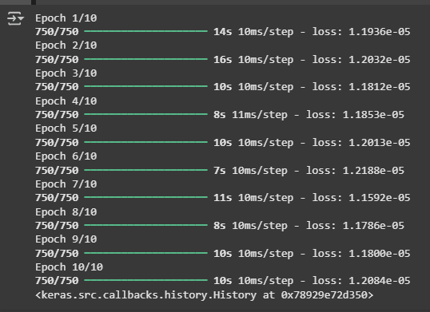
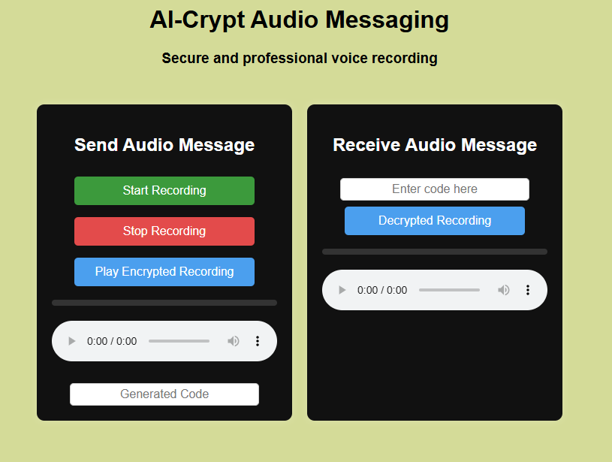
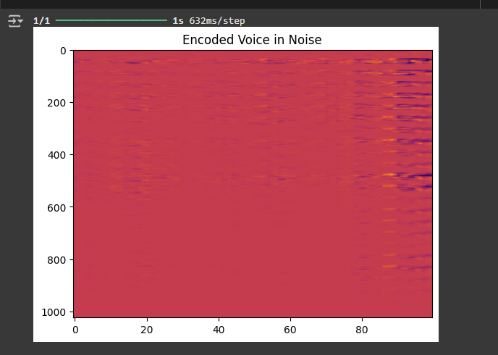
Prototype (Wireframes, mockups)
Github repository
Mock-up Page of our model
Training of model
Encrypted Audio

