Slide 1
AI Parking Assistant
Stage 2 — Human-in-the-Loop Approval
Connecting users to administrators for reservation approval

Slide 2
What's new in Stage 2?
Stage 1 built the chatbot. Stage 2 adds a human in the loop — no reservation goes through without admin approval.
Feature
Stage 1
Stage 2
Parking Q&A via RAG
✓
✓
Reservation collection
✓
✓
Guardrails
✓
✓
Admin notification
✗
✓
Approve / Reject flow
✗
✓
Reservation status check
✗
✓
Admin panel UI
✗
✓

Slide 3
Two agents, one system
Agent 1 — User Chatbot
Agent 2 — Admin Agent
→ Answers parking questions
→ Receives reservation from Agent 1
→ Collects reservation details
→ Sends request to administrator
⇄
→ Applies guardrails
→ Waits for Approve / Reject
→ Sends reservation to Agent 2
escalates
reservation
→ Updates reservation status in DB
→ Tells user: awaiting approval
→ Notifies user of outcome

Slide 4
End-to-end flow
1
User: "book parking"
↓
2
Agent 1 collects details
↓
3
Saved as PENDING in DB
↓
4
Agent 2 notifies admin
↓
5
Admin: Approve / Reject
↓
6
DB updated + user informed

Slide 5
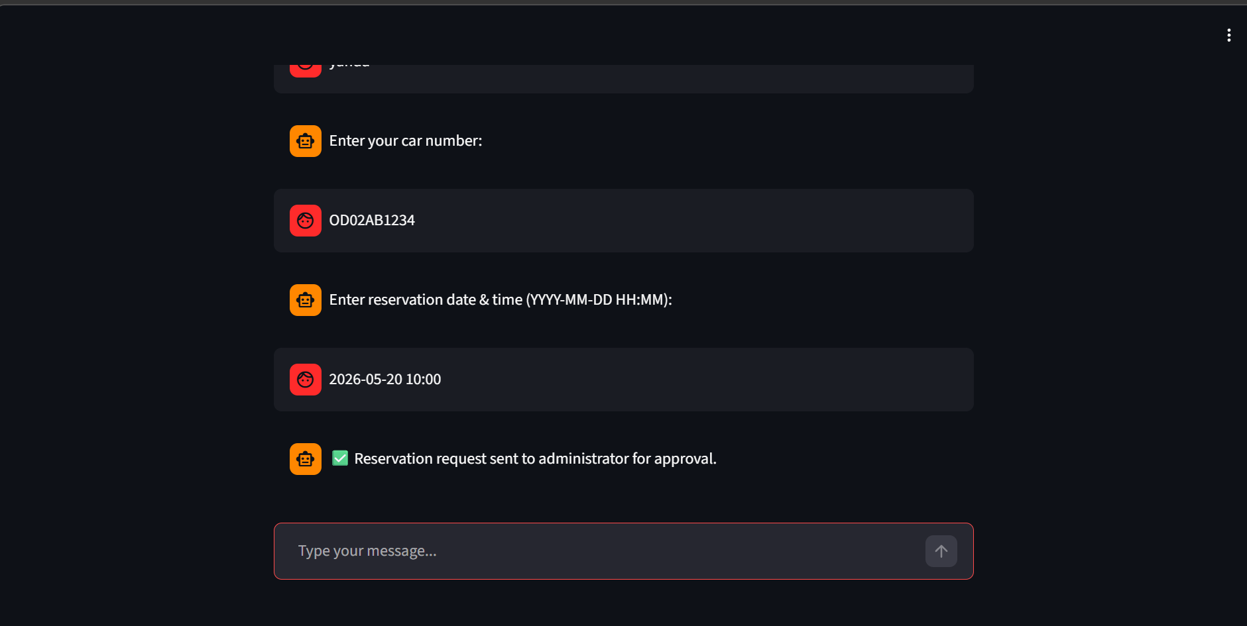
Reservation sent to admin
Once the user completes the booking, Agent 1 hands off to Agent 2 which immediately escalates to the admin.
[screenshot: reservation-escalated.png]
✅ The chatbot confirms: "Reservation request sent to administrator for approval."

Slide 6
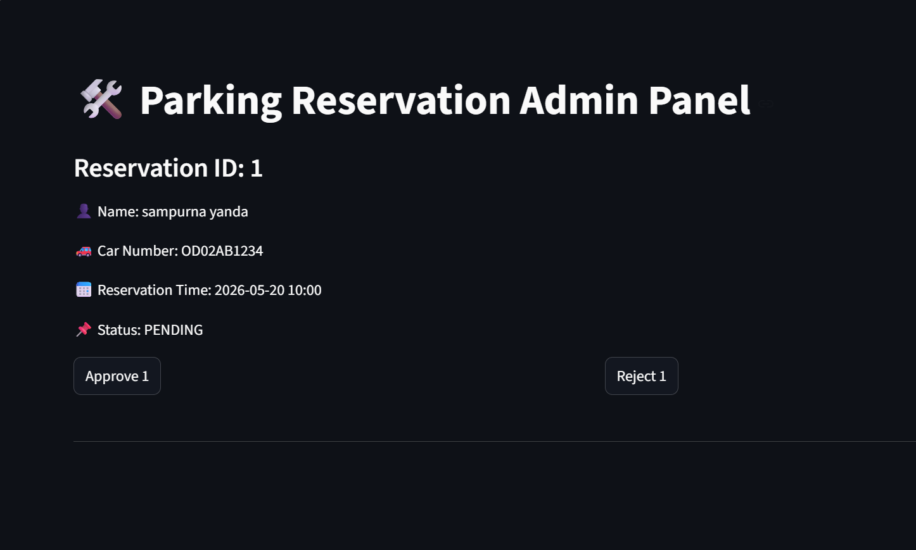
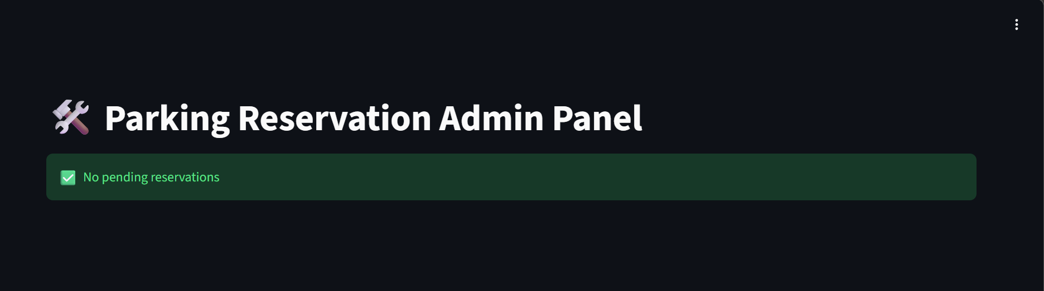
The admin panel
The administrator sees all pending reservations and can approve or reject each one with a single click.
[screenshot: admin-panel.png]
[screenshot: admin-panel-empty.png]
Pending reservation with Approve / Reject
After approval — no pending reservations
Admin panel shows: Reservation ID · Name · Car Number · Date & Time · Status

Slide 7
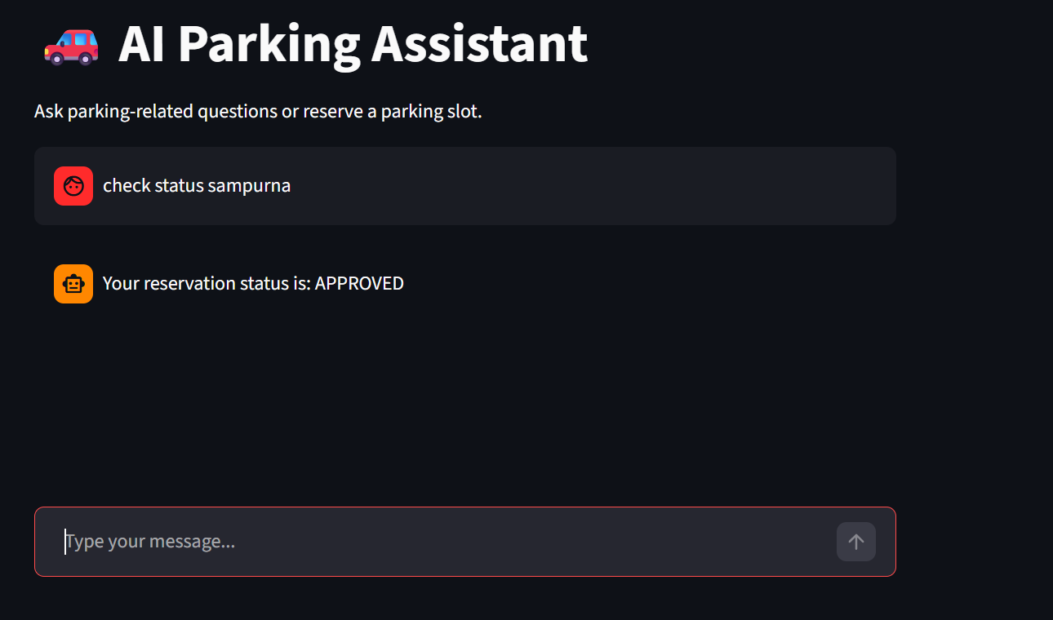
Users can check their status
At any point, users can type "check status <name>" to see if their reservation was approved or rejected.
[screenshot: status-check-approved.png]
PENDING
APPROVED
REJECTED
Possible reservation statuses

Slide 8
Testing
At least 2 tests per module. Run with "pytest -v"
test_chatbot.py
test_info_query · test_guardrail · test_status_query
Checks RAG responses, guardrail blocking, and reservation status queries.
test_reservation.py
test_reservation_start · test_reservation_flow · test_reservation_datetime
Validates the full booking conversation flow and DB write operations.
test_admin_agent.py
test_admin_notification_sent · test_approval_flow · test_rejection_flow
Tests admin notification delivery and approve / reject status updates.
[screenshot: pytest-results.png] → 6 passed ✓

