Slide 1

WATER QUALITY PREDICTION
Presented By:
[your name]

Slide 2
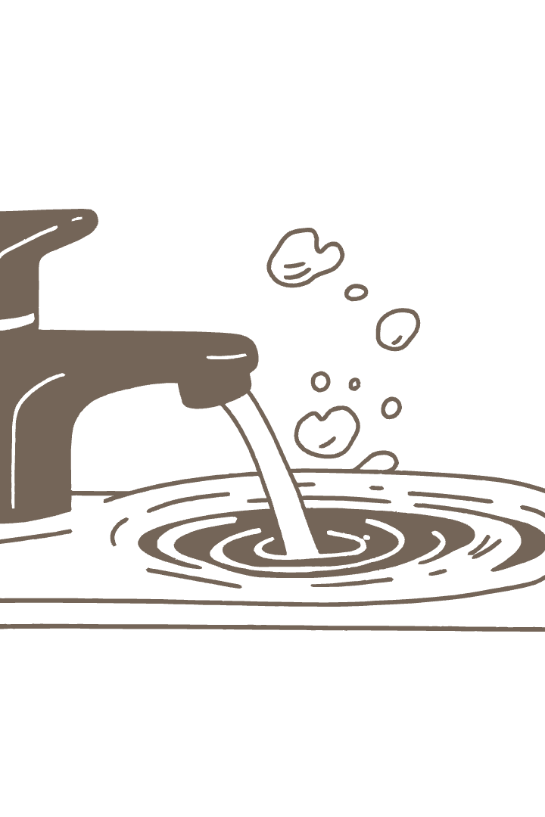
ABSTRACT:
This presentation explores using machine learning to predict water potability. By analyzing features like pH, hardness, and solids, the goal is to develop a system that aids in faster water quality assessment. This approach can help improve decision-making and reduce the time and resources required for manual testing. We will cover the data, methods, and results achieved through this project.

Slide 3

Introduction to Research
Access to safe drinking water is crucial for public health and well-being. Traditional manual testing methods are often time-consuming and resource-intensive. Machine learning offers a promising alternative by enabling the classification of water as potable or not potable based on chemical features such as pH, Hardness, Solids, Conductivity, and Turbidity. This project aims to build an automated and accurate prediction model that enhances water quality monitoring and decision-making processes.

Slide 4

Objective of Research Work
Develop an efficient Machine Learning model for water quality classification, enhancing the accuracy of identifying safe water sources.
Use supervised learning techniques on labeled water datasets, ensuring the model learns from verified data and makes reliable predictions.
Reduce time and effort in water testing by automating the process, allowing for faster results and more efficient resource allocation.
Improve decision-making in environmental monitoring by providing actionable insights into water quality, supporting informed policies and interventions.

Slide 5
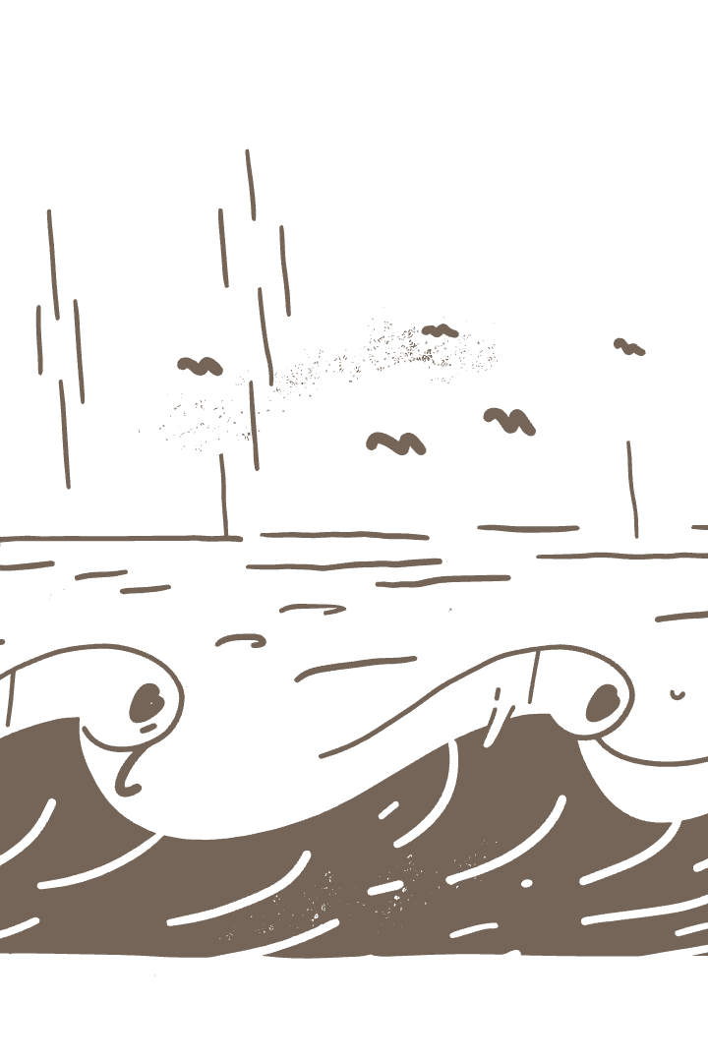
Introduction to Domain
This project combines environmental science and machine learning. Water quality is assessed using characteristics such as pH, Hardness, Solids, Sulfate, and Organic Carbon. The target feature is "Potability", indicating whether water is safe (1) or unsafe (0) for drinking. Data preprocessing, including handling missing values and normalizing features, is a critical step. ML algorithms like Random Forest, Decision Tree, and Logistic Regression are used to classify water quality, providing a comprehensive analysis.

Slide 6

Literature Survey
Previous studies have explored various models, including SVM, Decision Trees, and Naive Bayes, to predict water potability.
However, these studies often relied on smaller datasets and achieved only moderate accuracy levels. Furthermore, some models lacked the robustness needed for real-time data application.
This context motivated the use of ensemble methods in our project, aiming for improved performance and reliability in water quality prediction.

Slide 7

Existing Methodology
Current systems for water quality assessment often rely on manual tests or employ basic ML models with limited data preprocessing and feature selection.
This can lead to a high false-negative rate in predictions, where unsafe water is incorrectly identified as safe. Existing methodologies also lack adaptability to new datasets, hindering their effectiveness in diverse environmental conditions.
Our proposed approach aims to address these shortcomings through advanced techniques and comprehensive data analysis.

Slide 8

Proposed Methodology and Research Modules
The dataset includes key features like pH, Hardness, Solids, Chloramines, and Sulfate. Missing values were addressed using mean imputation to fill null entries in numeric columns, ensuring data completeness.
The dataset was split into 80% for training and 20% for testing using train_test_split(), providing a robust evaluation framework.
Three ML algorithms—Logistic Regression, Decision Tree, and Random Forest—were applied, and model performance was assessed using Accuracy, Precision, Recall, and F1-Score. The Random Forest model achieved the best performance with an accuracy of 67.38%.

Slide 9

Technologies Used
Python Programming Language – Core language used for data processing and model development.
Jupyter Notebook – Interactive environment for writing and running Python code.
Pandas & NumPy – Used for data manipulation, cleaning, and numerical operations.
Matplotlib & Seaborn – For data visualization (e.g., heatmaps, histograms).
Scikit-learn (sklearn) – Applied for machine learning models like:
Logistic Regression
Decision Tree
Random Forest
Train-test split and accuracy evaluation

Slide 10

Algorithms Used
Logistic Regression
A linear model used for binary classification (potable or not potable).
Useful for understanding the influence of features on predictions.
Decision Tree Classifier
Tree-based model that splits data based on feature values.
Easy to interpret and visualize decision-making paths.
Random Forest Classifier
An ensemble method combining multiple decision trees.
Improves accuracy and reduces overfitting.
Achieved the highest accuracy of 67.38% in this project.

Slide 11

Results and Discussions
Three models were tested: Logistic Regression, Decision Tree, and Random Forest.
All models were evaluated using Accuracy, Precision, Recall, and F1-Score.
Random Forest Classifier achieved the best accuracy of 67.38%, showing better generalization.
The confusion matrix revealed moderate prediction capability with some misclassifications.
Results indicate the importance of feature quality and data preprocessing in water quality prediction.

Slide 12

Conclusion
This project demonstrated that machine learning is effective for predicting water quality, offering a valuable tool for environmental monitoring and public health. The results highlight that thorough data preprocessing can significantly boost model accuracy. Among the tested models, Random Forest exhibited the best performance, making it a reliable choice for water potability prediction. This model can support more informed and timely decision-making in public health and environmental management.

Slide 13

Future Work
Incorporate More Features: Include additional parameters such as turbidity, temperature, and dissolved oxygen to improve prediction accuracy.
Enhance Model Robustness: Explore advanced ensemble methods or deep learning architectures for better generalization across different water bodies.
Real-time Monitoring: Integrate the model into IoT-based systems for real-time water quality monitoring and alerts.
Geographical Expansion: Apply the model to datasets from diverse regions to test adaptability and scalability.
User-Friendly Interface: Develop a mobile or web-based application for stakeholders to access predictions easily.

Slide 14
References
Pradeep, J., Natarajan, A., & Vivekanandan, P. (2012). Character Recognition using Artificial Neural Network. International Journal of Computer Applications, 39(9), 37–40.
Prabavathy, S., & Saranya, S. (2021). Water Quality Prediction Using Machine Learning. International Journal for Research in Applied Science and Engineering Technology (IJRASET), 9(4), 2456–2460. https://doi.org/10.22214/ijraset.2021.33630
Patel, K., & Jain, R. (2019). Water Quality Prediction using Machine Learning. International Journal of Engineering Research & Technology (IJERT), 8(7), 2278–0181.

Slide 15

Publications
Prabavathy, S. & Saranya, S. (2021) Water Quality Prediction Using Machine Learning IJRASET, 9(4), 2456–2460. [DOI: 10.22214/ijraset.2021.33630]
Patel, K. & Jain, R. (2019) Water Quality Prediction using Machine Learning IJERT, 8(7), 2278–0181.

